Slide 1
Two brothers were left alone in the kitchen. The older brother pulled the egg carton out of the refrigerator. He pulled the eggs out of the refrigerator and told his little brother, “I’ll give you five dollars if you let me break three of these eggs over your head.” The little brother said, “You promise?” And the older brother said, “I promise.”
Then he pulled out an egg and broke it over his brother’s head. It oozed down through his hair and ran down his face. Then he pulled out the second egg and broke it over his brother’s head. This one was really messy. It went all the way down the back of his neck and inside his shirt collar. After the second one, the little brother really braced himself. He knew the third egg was going to be really nasty. And he waited. And waited. He waited but the third egg never did come. Finally, he spoke up. “Hey, when’s the third egg coming?” Finally, the older boy told him, “It’s not—if I broke that one over your head, it would cost me five dollars.”

Slide 3

Entire World Has Been Put in Holding Pattern
World Locked Down by COVID-19…
…so we had to Wait
We just started to see a Little Break…
…Civil Unrest… so we Wait Again
Before the Unrest Sees Any Breaks…
...Election Season Starts…
…Nation Divided
Again…Wait Wait Wait

Slide 4

“Thank You For Holding”
Reasons to Thank God…
…For the Wait pt1
Psalm 27:14
“Wait for the Lord; be strong, and let your heart take courage; wait for the Lord!”
Edward Church
August 28, 2020

Slide 5

Ever Felt Like Your Life Was Put On Hold?
Your Expecting…
  Growth but …Feel Stagnant
  Joy but …Feel Pain
  Breakthrough but …Feel Broke Down
You Pray and Expect but All There is…
  …WAIT!
God Definitely …
  …Understands
  …Has a Plan

Slide 6
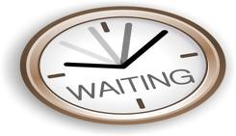
Waiting…
WHO Likes to Wait?
  Fallen Humans Do Not Like to Wait
  We Want Instant Gratification
  We Want Life’s Knottiest Problems Solved in a Half Hour
  Why is it So Hard for Sons of Adam to Wait?

Slide 7
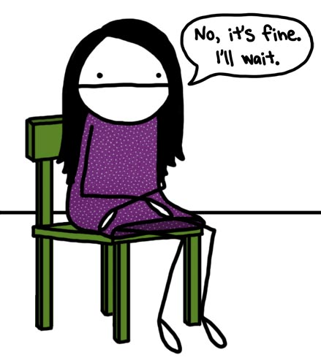
Waiting…
Waiting On the Lord Is..
…One of the Most Sanctifying (prep for service)
…Necessary Aspects of the Christian Life
“O Lord, your ways are higher than our ways, your thoughts higher than our thoughts.” -Isa 55:9
We Pray in Hope…
…Then We Wait on the Lord to Answer
The Puritans Developed the Doctrine of Waiting…
“God’s School of Waiting”
“Wait for the Lord; be strong, and let your heart take courage; wait for the Lord!” - Psalm 27:14

Slide 8
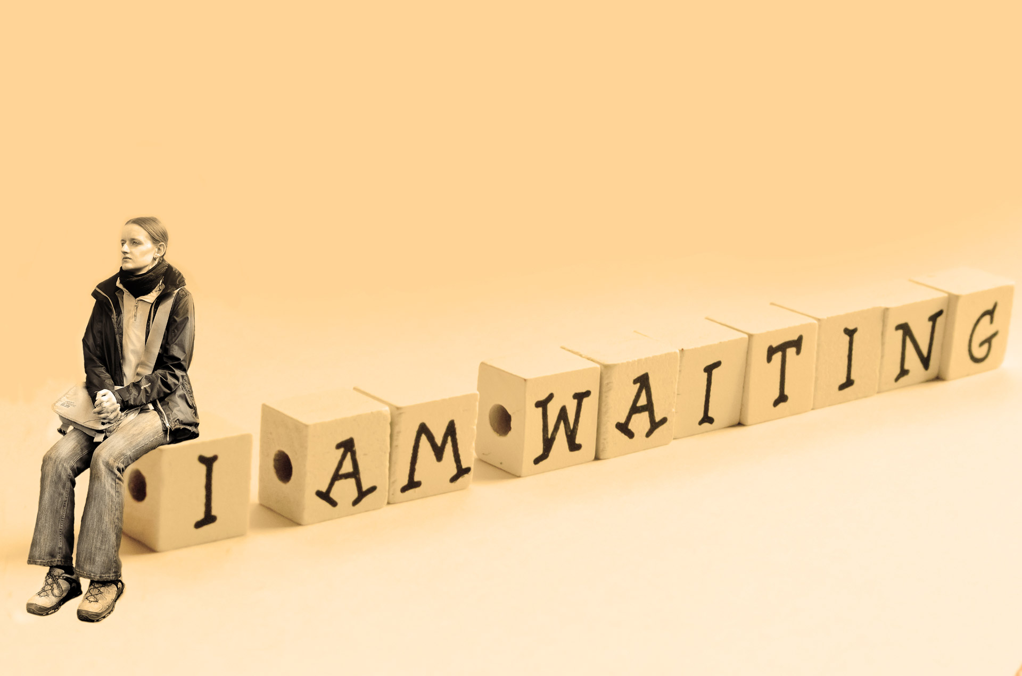
Waiting…
As Difficult As It Can Be…
Waiting Builds Spiritual Muscles In A Unique Manner
“But they who wait on the Lord shall renew their strength; they shall mount with wings as eagles, they shall run and not grow weary, they shall walk and not faint.” Isa 40:31
Wait= bind together, make strong
Renew= sprout again
    Waiting On the Lord Does Many Good Things for Us!

Slide 9
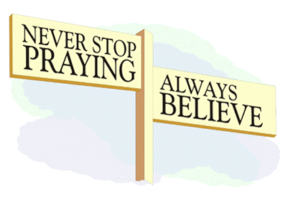
Causes Us To Pray Without Ceasing
We are Needy and He Owns the Cattle on a Thousand Hills
He is Always Faithful and…
…the Outcome of Our Waiting Proves Him True
1 Thessalonians 5:16-18 (MSG)
¹⁶ Be cheerful no matter what;¹⁷ pray all the time; ¹⁸ thank God no matter what happens. This is the way God wants you who belong to Christ Jesus to live.
Divine…
          Connection –He Desires It
          Communication –He is Listening
          Consolation –He will Respond

Slide 10
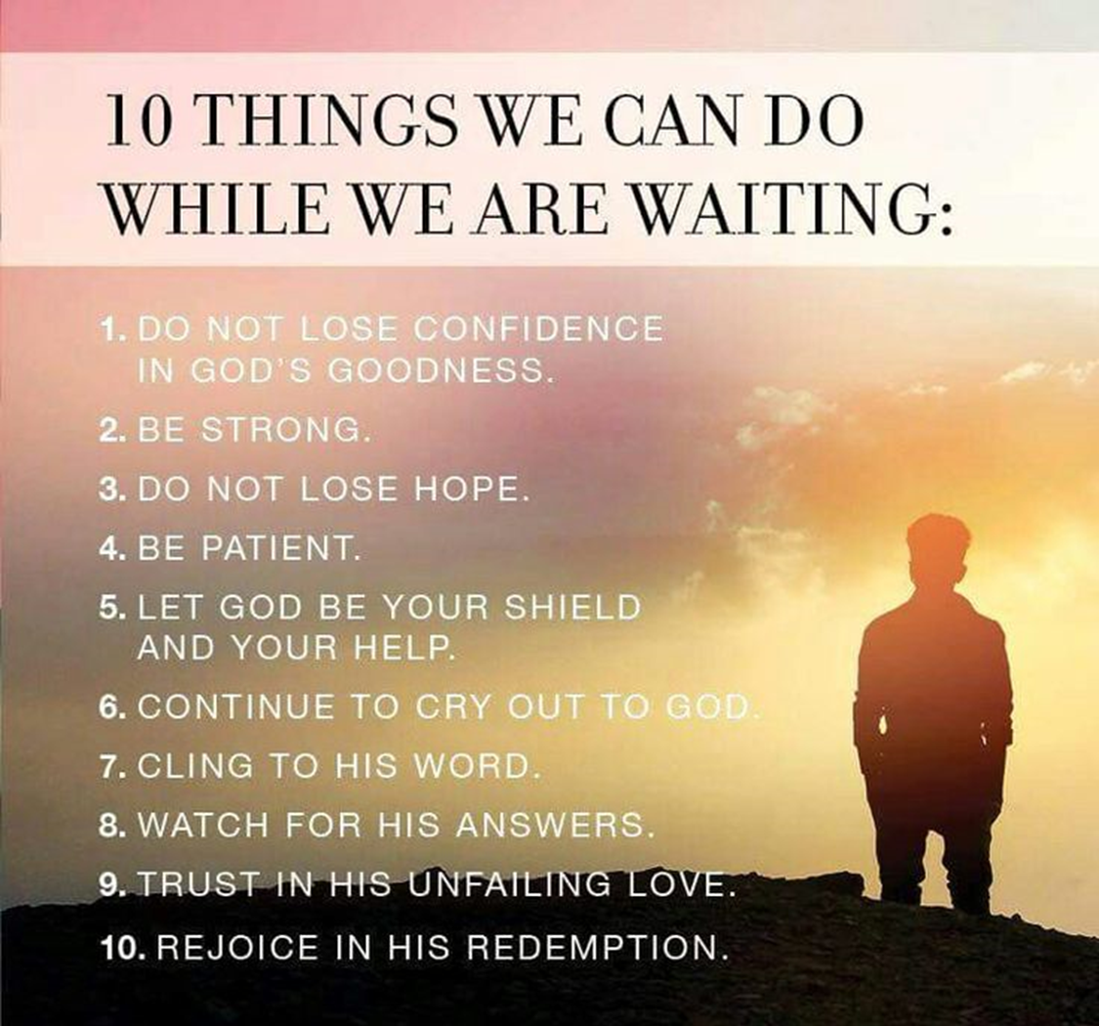
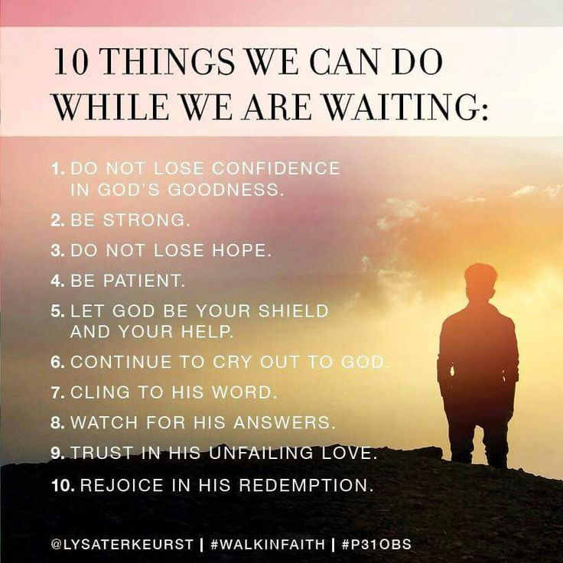

Slide 12
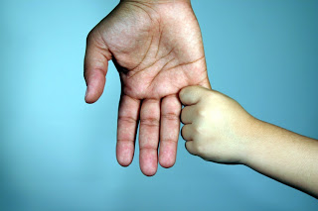
We Get a Greater Understanding
We Understand that We are Dependent Upon Our Creator
Though Our Hearts Crave Omniscience / Omnipotence,
…We Possess Neither
…Waiting Helps Us to Focus On that Reality
Hebrews 10:23 (AMP)
²³ So let us seize and hold fast and retain without wavering the hope we cherish and confess and our acknowledgement of it, for He Who promised is reliable (sure) and faithful to His word.
  Dependent – “seize and hold fast…”
  Dependable – “…is reliable and faithful to His Word”

Slide 13

Increases Our Faith
Hebrews Defines Faith as…
“the conviction of things hoped for…
…the evidence of things not seen?” -Heb. 11:1
We Wait…
…God Works
…We Get Results (His)
We Get Impatient…
…We Get Ahead of God
…We Get Results (ours)

Slide 14
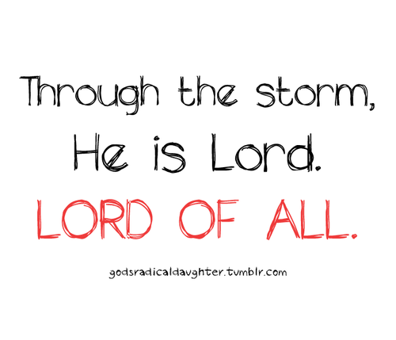
Helps us Lean on God’s Sovereignty
Waiting, We Experience God’s Lordship In an Intimate Way
Psalm 97:9 (NLT)
⁹ For you, O LORD, are supreme over all the earth; you are exalted far above all gods. -He Is Perfect (He IS God!)
Colossians 1:17 (AMP)
¹⁷ And He Himself existed before all things, and in Him all things consist (cohere, are held together) -He Is Power!
Psalm 9:9 The LORD also will be a stronghold for the oppressed,
A stronghold in times of trouble; -He Is Protection!

Slide 15

Gives Us Hope for Our Future
Ro 8:24–25, “Now hope that is seen is not hope. For who hopes for what he sees? But if we hope for what we do not see, we wait for it with patience.”
Waiting Instills a Glorious By-product “Patience” …
…a Lost Spiritual Virtue
Luke 21:19 (KJV) In your patience possess ye your souls.
Luke 21:19 (AMP) ¹⁹ By your steadfastness and patient endurance you shall win the true life of your souls.
Patience = Not Just Waiting But How We Act While We Wait

Slide 16
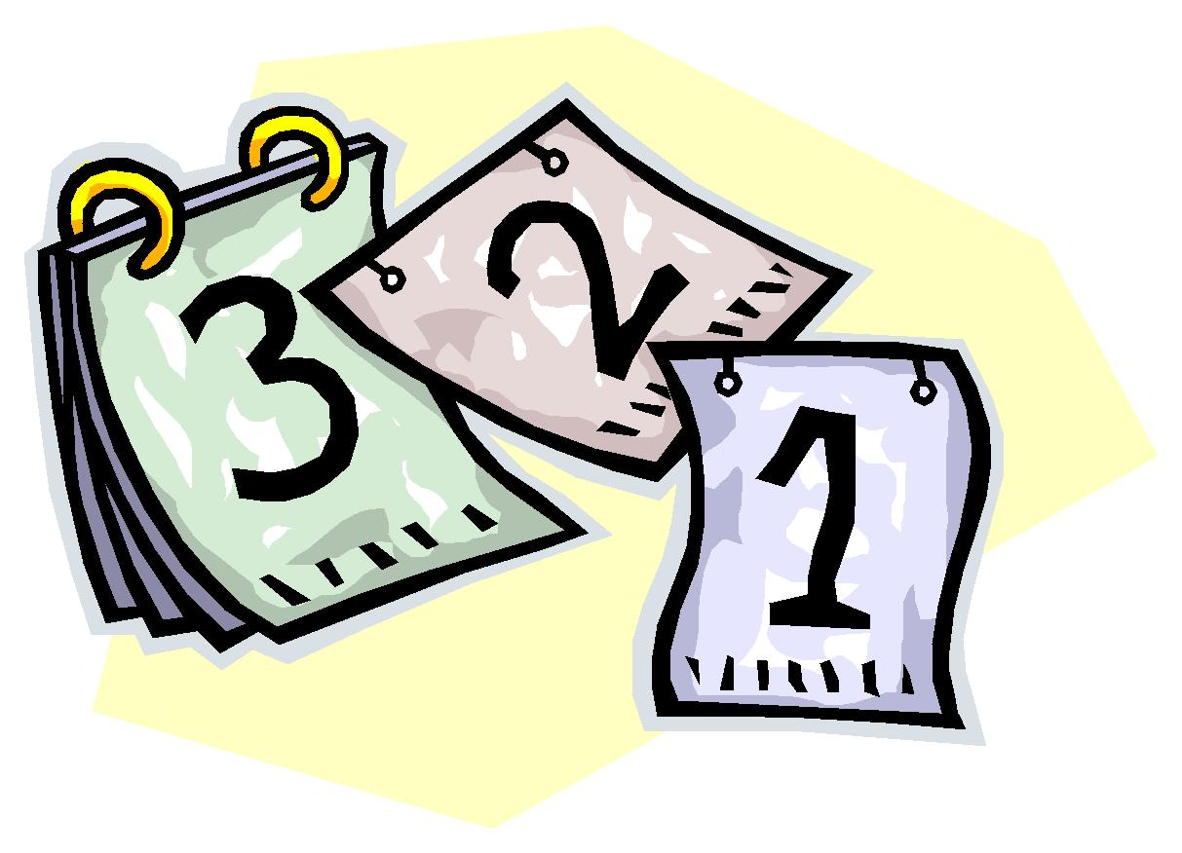
Reminds Us that We Live Between the Times
When Jesus Returns
  The “Not Yet” Will Collapse Into the “Already”
  No More Waiting for Answers
  Jesus Will Set Everything Right
Until Then, We Pray / Wait / Are Sanctified by God’s Wise Process
Hebrews 11:13 (MSG)
¹³ Each one of these people of faith died not yet having in hand what was promised, but still believing. How did they do it? They saw it way off in the distance, waved their greeting, and accepted the fact that they were transients in this world.

Slide 17
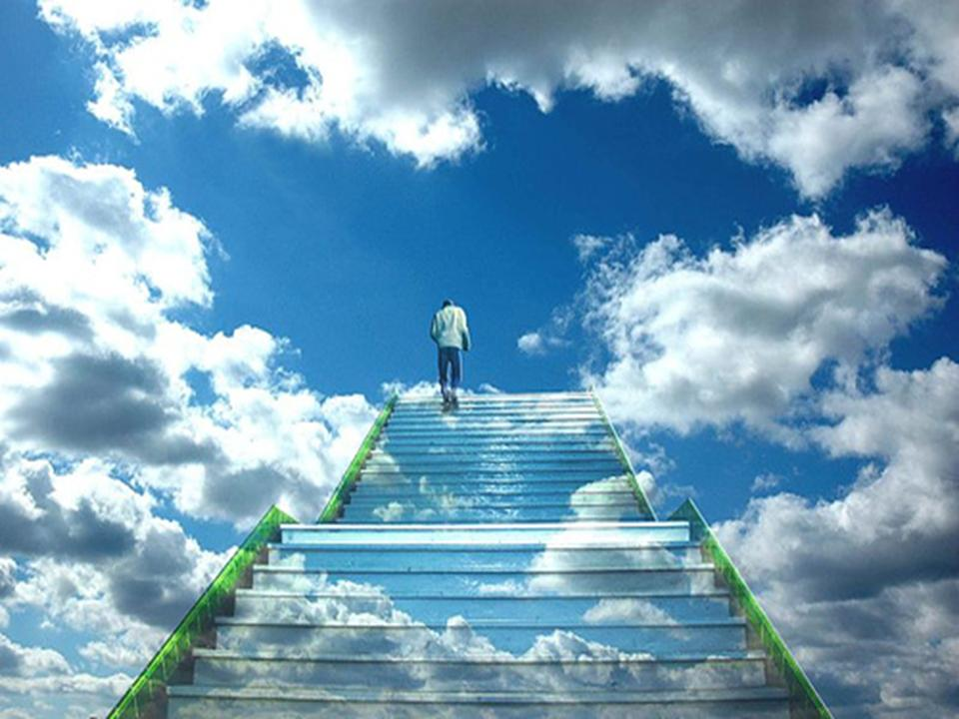
Gives Us an Eternal Viewpoint
When We Bring Urgent Petitions Before the Lord…
  We Wait With Expectancy
  We Move From Our Way To God’s Way
Jonathan Edwards Prayed, “O Lord, stamp eternity on my eyeballs.”
  Waiting Helps to Do That
  It Prioritizes the Eternal Over the Temporal
2 Corinthians 4:18 (KJV)
¹⁸ While we look not at the things which are seen, but at the things which are not seen: for the things which are seen are temporal; but the things which are not seen are eternal.

Slide 18
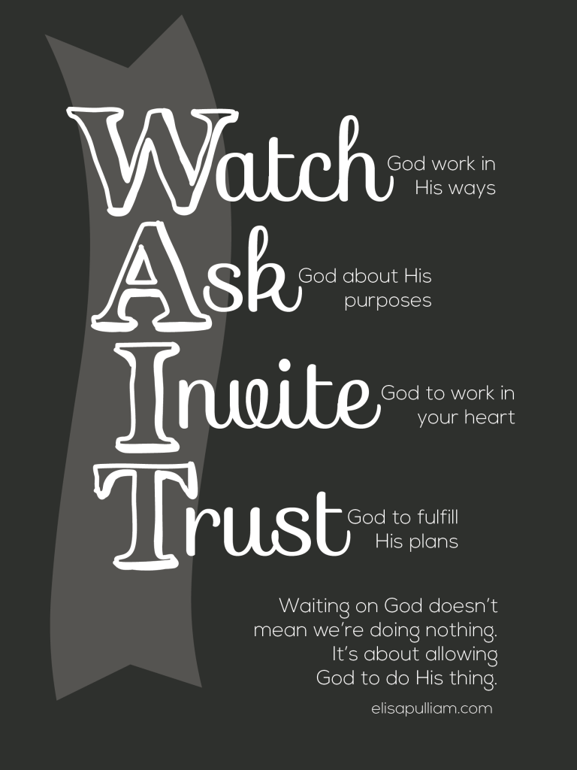

Slide 19
Psalm 27:14 (MSG)
¹⁴ Stay with GOD! Take heart. Don't quit. I'll say it again: Stay with GOD.
Psalm 27:14 (AMP)
¹⁴ Wait and hope for and expect the Lord; be brave and of good courage and let your heart be stout and enduring. Yes, wait for and hope for and expect the Lord.
Psalm 27:14 (KJV)
¹⁴ Wait- to bind together (by twisting), i.e. collect; to expect :- gather (together), look, patiently, tarry, wait
on the LORD:
be of good courage- to fasten upon; hence to seize, be strong (figurative courageous, causative strengthen, cure, help, repair, fortify),
he shall strengthen- to fasten upon; hence to seize, be strong (figurative courageous, causative strengthen, cure, help, repair, fortify), obstinate; to bind, restrain, conquer :- aid, amend, × calker, catch, cleave, confirm,
thine heart-
: wait,
I say, on the LORD.

Slide 20
COVID-19

Slide 21
7 Suggestions When God is Silent
Elijah had been used of God to hold back rain from the people for over three years, because of their sins. Obviously, he was not well liked as a preacher. I can imagine the stress he experienced during those years.
Something strikes me, however, that seems to further complicate Elijah’s situation.
Consider 1 Kings 18:1:
“After a long time, in the third year, the word of the LORD came to Elijah: “Go and present yourself to Ahab, and I will send rain on the land.”
According to a couple New Testament passages, this “After a long time” was actually three and a half years. The famine was three and a half years long. For three and a half years, the people apparently continued to sin, Elijah continued to hold on by faith, but God said nothing. God was apparently inactive… not speaking… even to His great servant Elijah during this time.
Have you ever been there? Has the silence of God in your life ever been eerily strong?
Imagine you had been faithfully serving… God is using you… you are in constant communication with Him… and then suddenly… everything is quiet. You have to wait.
The separation must have seemed unbearable. Elijah is not liked and unpopular. He’s an outcast from the people and the One he trusted most was seemingly absent.
God would soon do a miracle through Elijah… one he couldn’t even imagine… certainly not script, but during this period all Elijah could do was wait.
If you have been follower of Christ very long, you have had periods where it seems God is nowhere to be found. We often call them periods of spiritual dryness. Sometimes I refer to it as being in a spiritual funk.
What should we do during the times of silence, before the miracles of God come through for us?
If you are like me, you can figure out how to celebrate a miracle. You don’t need much help doing that. The tough part of life is figuring out what to do during the years of silence… during the years when miracles are seemingly nowhere to be found.
What do we do during the spiritually dry periods of life when we don’t hear clearly the voice of God?
Here are 7 suggestions for those times:
Don’t ignore the silence – Some of the biggest moves God has made in my life have come after a period of spiritual dryness… when it seemed like God was doing nothing in my life. Stay very close to God and watch for Him to eventually display His power. He will in the fullness of time.
Confront known sin in your life do a self check up – This wasn’t the problem of silence for Elijah, but the problem for the Israelites was that they were chasing after other gods and living lives in total disobedience to God. Sin may not be the reason you don’t sense closeness to God right now, but if you have known sin in your life it will affect your intimacy with God.
Go back to what you know – Get back to the basics of the faith that saved you. You’ll do it 100s of times in your life, but you must remind yourselves of the basis of faith… which is the very character and promises of God. God is in control. He really is… even when it doesn’t seem that He is anywhere to be found.
Make a decision… Choose sides – You can’t adequately serve God and the world. (Consider Joshua 24:15.) Something happens in life, often sin, busyness, boredom, or a tragedy… but if we are normal, we have periods where we grow away from our close relationship with God. God hasn’t moved, but if you’ve shifted in your obedience, get back securely on the right side.
Trust More… Not less – Times of silence may be filled with fear, but ironically, these times require more faith. Times come in our spiritual life when our enthusiasm isn’t as real as when we began our walk with God. That’s not an indication to quit… it may be that God is using that time for something bigger than you could have imagined… but whatever is next will most likely require a deeper level of trust.
Listen and Watch Closely – Some day God is going to make His plans known to you. Don’t miss them. He may come to your personally, through His Word, circumstances, or another person. You’ll need to be in a position to know that God is moving. (Read THIS POST if you need help discerning God’s will.)
Get ready to receive – God will break the silence some day… and when He does it WILL be good. If you mope around in your sorrows, you’ll be less prepared to receive the good things to come. Not because of your circumstances, but because of your faith, clothe yourself in joy as you wait for God to bless you after the period of silence.
Are you in one of those periods of silence today? How do you handle these periods of time?

Slide 22
Where is God When God is Not There?
Psalm 13
1 How long, O Lord? Will You forget me forever? How long will You hide Your face from me?
2 How long shall I take counsel in my soul, having sorrow in my heart daily? How long will my enemy be exalted over me?
3 Consider and hear me, O Lord my God; enlighten my eyes, lest I sleep the sleep of death;
4 Lest my enemy say, “I have prevailed against him”; lest those who trouble me rejoice when I am moved.
5 But I have trusted in Your mercy; My heart shall rejoice in Your salvation.
6 I will sing to the Lord, because He has dealt bountifully with me. (NKJV)
One of the most excruciating experiences of human existence is to have to face an overwhelming trial while having a strong feeling that God just isn’t there for you in that dark hour. Have you ever felt that way?
Have you ever had to walk through a valley of suffering feeling alone with no signs of God anywhere?
Do you know what it feels like to sense that God just doesn’t care what you are experiencing and how you are suffering?
Have you ever felt like God is there for everyone else except for you?
I have been a Christian now for over 35 years, and I have served in ministry for over 25 years. Through these many seasons of life I have learned a few things about these lonely valleys of suffering. Please allow me to share a few of them with you.
Important Realization #1:
Even when God is “not there,” He IS there.
I am discovering after having experienced many painful valleys that God truly is there even when I don’t sense His presence. He may not respond exactly the way I want him to, but that is always because His plan is much higher and more sophisticated than I could ever imagine.
He has an amazing way of working for my ultimate good through those dark moments, and relieving the pain momentarily would not allow Him to accomplish that bigger plan in my life. So the pain continues, and God is there, and His purposes are made perfect through those experiences.
Important Realization #2:
I almost never understand the reason for the suffering while I am in the middle of the storm.
God’s plans are so high and lofty that my small mind cannot even come close to comprehending them. If He was to try to sit down and explain why I am going through a particular experience, He would likely begin explaining to me some events that took place back in the 1500s. He would then trace it through the millions and millions of different lives that were all interrelated over the course of the next several centuries. And then that would bring Him to my life and the specific experience today which then also relates to the next century or two of time.
His plan is so complex that He would lose me on the second or third sentence. So there is no way we could ever truly grasp an explanation from the Creator and Sustainer of the universe.
Most of the time I never really “get” why I am suffering until a much later time in my life. Sometimes it can take months, sometimes years, and sometimes I never really have a full understanding. Some things will only make sense when I get to heaven and have a chance to ask God personally. But for now I must trust Him.
Important Realization #3:
God always has a purpose, and that purpose is always good.
There is no such thing as random pain without meaning. God uses pain to speak into our world and into our lives directly. He teaches us things through pain that we could never learn through a seminar or book or podcast. Some people reject God, because they can’t think of a reason why God would allow pain or suffering. But just because we can’t think of a reason for the pain does not mean that a good reason does not exist. (Sorry for the double negative there. I hope you get my point.)
God’s ways are perfect, and His love for us is without end. And every single millisecond of suffering is always for a good purpose in our lives. Always!
Important Realization #4:
It’s ok to doubt God, but never deny Him.
By reading the verses from Psalm 13 above, we can see that even David at times felt like God was nowhere to be found. But he never got to the point where he denied God’s existence. As a matter of fact, he goes on to say in the very first verse of the next Psalm that “the fool has said in his heart that there is no God.” (Psalm 14:1)
It’s ok to doubt, but don’t allow yourself to sink to the point where you actually deny God’s existence. That will only end in disaster for you. Instead, hang onto God’s hand as you ride out the storm.
In that dark night of suffering, just close your eyes and hold His hand. You will make it through if you hang on. If you let go, all bets are off. So hold tightly to the Rock.
The Bottom Line.
If you’re reading this blog post, it is not by random chance. God drew you here to receive these words. He wants you to trust Him. He wants you to know that He loves you, and He is there for you no matter how you may feel at this present moment.
Just close your eyes and hold onto His hand.
He will bring you through the darkness.
Run TO God and not AWAY from Him.
Never jump off the Rock in the midst of the storm.
The sun will shine tomorrow, and you will again experience the amazing blessings of the God who loves you.
Trust Him.

Slide 25
7 Astonishing Reasons to be Thankful When You're Waiting
I don’t like to wait. No, let’s be completely forthright: I despise waiting. There is a certain highway in the city where I live that is notorious for traffic that is snarled for several hours on both sides of rush hour: I avoid it like cream of broccoli soup. Every Sunday morning, there are certain members of my family who move at the speed of a glacier in getting ready for worship, and I’m convinced they make less haste on the days I have to preach. They make me wait, and I don’t like it.
I realize that I am not alone in this. Fallen humans categorically do not like to wait. We want instant gratification. We want life’s knottiest dilemmas solved in a half hour or so. Why is it so hard for sons of Adam to wait? Conventional wisdom says doing absolutely nothing should be easy for us, but it is not.
Over the years, I have learned that waiting on the Lord one of the most potentially sanctifying (and necessary) aspects of the Christian life. It is one of those glorious “gospel paradoxes” that makes us say with the prophet, “O Lord, your ways are higher than our ways, your thoughts higher than our thoughts.” We pray in hope, and then we wait on the Lord to answer. A Christian man prays for a job so that he can provide for his family as God has commanded, and then he waits. A mother prays that God will draw her wayward son to himself unto salvation, and then she waits. We pray that God will make our future path clear, and we wait. We read Matthew 6:34 for a thousandth time for comfort.
The Puritans understood this reality well and developed something of a doctrine of waiting; they referred to it as being in “God’s school of waiting.” William Carey understood it well. He spent many years on the mission field before seeing his first convert. Of greater import, the inspired writers understood it well: Psalm 27:14, “Wait for the Lord; be strong, and let your heart take courage; wait for the Lord!”
As difficult as it can be, waiting builds spiritual muscles in a unique manner. My sinful impatience notwithstanding, Isaiah makes this truth clear: “But they who wait on the Lord shall renew their strength; they shall mount with wings as eagles, they shall run and not grow weary, they shall walk and not faint.” What a glorious promise! And yet, our discontented hearts find it difficult to wait.
Yet waiting on the Lord many good things for us. It:
1. Causes us to pray without ceasing. We are needy and He owns the cattle on a thousand hills. He is always faithful and the outcome of our waiting proves Him wholly true.
2. Instills in us a clearer understanding that we are creatures who are absolutely dependent upon our Creator. Though our sinful hearts crave omniscience and omnipotence, we possess neither, and waiting helps us to focus on that reality.
3. Increases our faith. After all, does not the writer of Hebrews define faith as “the conviction of things hoped for, the evidence of things not seen?” (Heb. 11:1). We wait and God works.
4. Transfers the doctrine of God’s absolute sovereignty from the speculative realm to the practical. In waiting, we actually experience God’s Lordship in an intimate way.
5. Grounds our future in a certain hope. This is Paul’s point in Romans 8:24–25, “Now hope that is seen is not hope. For who hopes for what he sees? But if we hope for what we do not see, we wait for it with patience.” A glorious by-product of this is that it instills patience, that most elusive of spiritual virtues, in us.
6. Reminds us that we live between the times. When Jesus returns, the not yet will collapse into the already, and there will be no more waiting for an answer to desperate prayers. The Kingdom will be consummated, and Jesus will set everything right. Until then, we pray and wait and are sanctified by God’s wise process.
7. Stamps eternity on our eyeballs. When we bring urgent petitions before the Lord, we wait with expectancy, and the city of man in which we live fades in importance, and we begin to realize that the city of God is primary. As Jonathan Edwards prayed, “O Lord, stamp eternity on my eyeballs.” Waiting helps to do that. It prioritizes the eternal over the temporal in accord with 2 Corinthians 4:18 (KJV)
¹⁸ While we look not at the things which are seen, but at the things which are not seen: for the things which are seen are temporal; but the things which are not seen are eternal.

