Slide 1
After leaving the racetrack, Joe bumped into his old friend Jon on the bus.
"Say," Jon said, "How's it going?"
"Going? You want to hear one of the most amazing things that ever happened? Tell me, what's today's date?"
"July seventh."
"Right. The seventh day, of the seventh month. I go to the track at seven minutes past seven. My son is seven years old today, and we live at number seven, Seventh Avenue."
"Let me guess," Jon interrupted. "You put everything you had on the seventh horse in the seventh race."
"Right."
"And he won!" Jon sighed.
"No. He came in seventh."

Slide 3

The Model Prayer
“Lord Teach Us How to Call to You” –pt2
Matthew 6:9
Edward Christian Church
October 11, 2020

Slide 4
I Have Heard a So Many Times in these Last Few Days….
Pray for our World, Nation, Our President…
…Our Communities, Our Families
Have You Ever Wondered…
  How to Pray
  What to Say
  How to Say
  What We Say Seems at Times Powerless
James 4:3 (NASB)
You ask and do not receive, because you ask with wrong motives, so that you may spend it on your pleasures.

Slide 5
The Disciples…
Saw so many Powerful Works Thru Jesus
But….
They Didn’t Ask How to Do Those Things…
They Knew to Ask the Deeper Question…
  Knew How to Pray (little power) Religion
  Didn’t Know How to Pray (unlimited power) Relationship
Edward Christian Church

Slide 6
Christ Shows us a Good Example of Prayer
  It is Called the…
    Model Prayer
    "Lord's Prayer"
    “Disciples' Prayer”
"After this manner" We are to Pray (9)
  The One We Pray Through…
…Shows Us How to Pray
Edward Christian Church

Slide 7
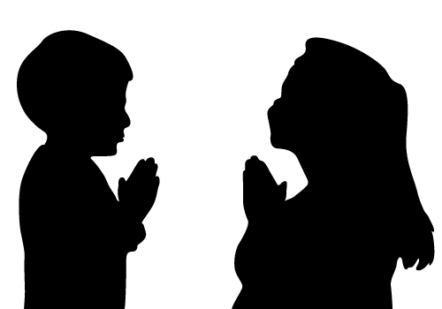
The Relationship to God "Our Father which art in heaven" (9)
Two Important Things About Prayer.
  We Pray to Our Father- It is God, not Mary or an angel.
  “Who Art in Heaven" Not Limited By Earthly Restraints
The Reverence for God "Hallowed be thy name" (9)
The Rule of God "Thy kingdom come. Thy will be done in earth, as it is in heaven" (10).
The First Part of the Prayer…
Places God in His Proper Position as…
“Our Heavenly Father Full of Glory, Power and Honor”
Edward Christian Church

Slide 8
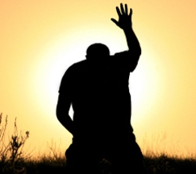

Edward Christian Church
Resources of God "Give us this day our daily bread" (11)
This is a Petition for our Earthly Needs
It involves Three Things.
  1st, Favor. "Give."
    The emphasis is on mercy not merit
  2nd, Faith. "This day... daily."
    This is looking to God everyday by faith
  3rd, Food. "Bread“
    We are to pray for our material needs as well as our spiritual

Slide 9
Repentance to God"Forgive us our debts, as we forgive…" (12)
  Luke has "sins" (Luke 11:4) instead of "debts"
The Work of Forgiveness -Matt 6:14,15
  The work of forgiveness is an important work for a person.
The Duty of Forgiveness. "Forgive" (14,15)
  Divine command not optional, but is a duty.
The Defining of Forgiveness. "Forgive" (14,15).
  Forgive = "to send away... to let go"
  Forgiveness is Not Probation…
…but a Complete Dismissal of All Charges.
The Doing of Forgiveness. "Forgive men their trespasses" (14)

Slide 10

Edward Christian Church
Righteousness from God"Lead us not into temptation, but deliver us from evil" -Matthew 6:13
First, Desire. "Lead us not into temptation"
    One's Desire to Walk a Holy Life.
Second, Deliverance. "Deliver us from evil."
    This is Not Seeking Exemption from Trial but…
…Escape from Transgression.

Slide 11
Edward Christian Church
The Respect for God "For thine is the kingdom, and the power, and the glory, forever. Amen" -Matthew 9:13
  It Acknowledges the...
    Sovereignty of God ("thine is the kingdom"),
    Power of God ("the power"),
    Magnificence of God ("the glory"), and
    Eternality of God ("forever").

Slide 12

The First 3 Petitions Direct Our Attention to God the Father
  Pray to the Father about His Name - Hallowed be your name
  Pray to the Father about His Kingdom - Your kingdom come
  Pray to the Father about His Will - Your will be done
The Next 3 Teaches Us to Pray for Ourselves and for Others
  Pray for Provision - Give us today our daily bread
  Pray for Pardon - Forgive us our debts
  Pray for Protection - Lead us not into temptation
These Last 3 Things, Take Care of All the Needs of Life:
  Provision takes care of your Present
  Pardon takes care of your Past
  Protection takes care of your Future

Slide 13
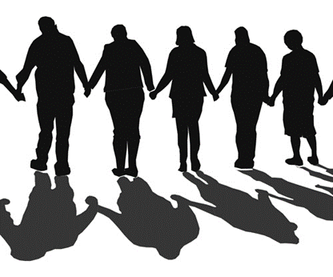
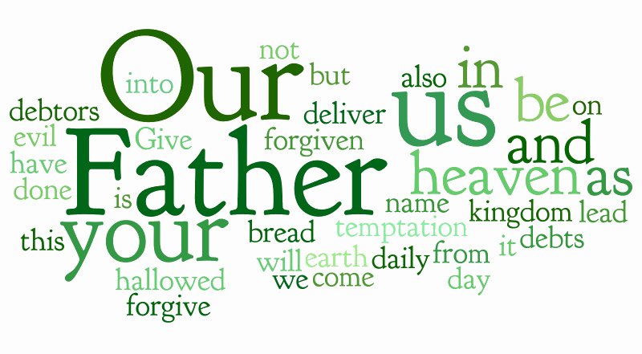

Slide 14
Model Prayer (Matthew 6:9-13)
The fourth form of prayer, of which Christ speaks in this part about prayer in the Sermon on the Mount, is the second good example of prayer. It is the great model prayer. This prayer is often called the "Lord's Prayer" but would better be called the "Disciples' Prayer," for the Lord could not pray some parts of this prayer such as "forgive us our debts" (Matthew 6:12; which is forgive us our sins" in Luke 11:4) for Christ had no sins. The best title for the prayer is the "Model Prayer" or "Paragon Prayer," for the opening statement about the prayer says, "After this manner" (Matthew 6:9) we are to pray. The parts of this prayer show us how to pray.
• The relationship to God. "Our Father which art in heaven" (Matthew 6:9). The opening words tell us two important things about prayer. First, the Person prayed to. It is God, not Mary or an angel. We pray to God in heaven. Second, the person praying. "Our" speaks of the redeemed. It is the privilege of the redeemed to pray.
• The reverence for God. "Hallowed be thy name" (Matthew 6:9). The first petition in the prayer is for the glory and honor of God. It ought to be the first and foremost aim of our life to glorify God (1 Corinthians 10:31). Our praying should be more than "give me" but should include a prominent desire for God to be honored.
• The rule of God. "Thy kingdom come. Thy will be done in earth, as it is in heaven" (Matthew 6:10). This petition, has two parts. First, the Sovereign of man. "Thy kingdom come" speaks of the Divine rule of man. Praying for "Thy kingdom" to come, is praying for God to rule man. Second, the submission of man. "Thy will be done in earth, as it is in heaven." This second part prays that man will submit to God's rule and that this submission will be done with excellence—"as it is in heaven."
• The resources of God. "Give us this day our daily bread" (Matthew 6:11). This is a petition for our earthly needs. It involves three things. First, favor. "Give." The emphasis is on mercy not merit. Second, faith. "This day... daily." This is looking to God everyday by faith. It is not for a year's supply but for a day's supply. That requires faith. Third, food. "Bread." This indicates our needs as opposed to our wants. Bread is common, not a luxury. "Bread" also says we are to pray for our material needs as well as our spiritual needs.
• The repentance to God. "Forgive us our debts, as we forgive our debtors" (Matthew 6:12). To understand this petition better we need to note that Luke has "sins" (Luke 11:4) instead of "debts." The petition here is for Divine forgiveness of our sins. There are three important lessons in this partition. First, the importance of the petition. Forgiveness by God of our sins is our most important need. Second, the ignominy from the petition. Confessing our need of forgiveness acknowledges we are sinful and that is humbling. Few want to admit they are sinful. But until you humble yourself about your sin, you will never obtain forgiveness of your sins from God. Third, the imperative in the petition. "As we forgive our debtors." This is not works for salvation, but language to show the sincerity of our petition. We must come in true repentance. True repentance will not harbor unforgiveness of others.
• The righteousness from God. "Lead us not into temptation, but deliver us from evil" (Matthew 6:13). There are two important parts to this petition. First, desire. "Lead us not into temptation." This does not mean God will lead us to evil and the petition is a request for Him not to do that—rather it is a negative way of expressing one's desire to walk a holy life. Second, deliverance. "Deliver us from evil." This is not seeking exemption from trial but escape from transgression. It is not a petition to be exempt from suffering but to escape from sin. In total the two parts ask God to lead the petitioner in holiness and to remove any unholiness in the petitioner.
• The respect for God. "For thine is the kingdom, and the power, and the glory, forever. Amen" (Matthew 9:13). The prayer closes with great respect for God. The first petition was for the glory of God; the last words are acknowledgement of the glory of God. Our prayers have too many petitions for ourselves and not enough praise for God. Cut the petitions if you have to but do not cut the praise part of your prayers. The praise here is excellent. It acknowledges. The Sovereignty of God ("thine is the kingdom"), the power of God ("the power"), the magnificence of God ("the glory"), and the eternality of God ("forever"). There is a lot of good theology in this last part of the prayer. Our prayers should reflect good doctrine or they are not good prayers.
Analytical Bible Expositor - Analytical Bible Expositor – Matthew.

Slide 15
Instructions About Pardon -Matthew 6:14,15
  The subject of pardon (forgiveness for others) first came up in the paragon prayer. Here Christ amplifies on the subject.
1. The Work of Forgiveness (Matthew 6:14,15)
  The work of forgiveness is an important work for a person.
The duty of forgiveness. "Forgive" (Matthew 6:14,15). it a Divine command. Thus forgiveness is not optional, but is a duty.
The defining of forgiveness. "Forgive" (Matthew 6:14,15). "forgive" means "to send away... to let go" (Thayer).. Forgiveness is not probation, but a complete dismissal of all charges.
The doing of forgiveness. "Forgive men their trespasses" (Matthew 6:14). The doing of forgiveness has two important guidelines.
  First, what to forgive. We cannot forgive wrongs done to others. The wrong must be done to us. Furthermore, we cannot forgive a wrong done to us if it involves a breaking of a law of the land, for that means the transgression involves more than just us, but it also involves society. We do not have authority to forgive such transgressions. Courts decide those matters.
  Second, when to forgive. This is a point that is often overlooked in the matter of forgiveness. Jesus said, "If thy brother trespass against thee, rebuke him; and if he repent, forgive him" (Luke 17:3). We are to forgive when there is repentance. If God forgave without repentance, it would fill heaven with unrepenting sinners and make heaven a corrupt and cruel place. We are to forgive as God forgives. We are to have a forgiving spirit that is ready at all times to forgive when the transgressor repents. But we are not to forgive until there is repentance by the evil-doer.
The dividend of forgiveness. "Your heavenly Father will also forgive you" (Matthew 6:14). This is a great reward, for our greatest need is forgiveness of our sins by God. The carnal mind does not appreciate this dividend—the only dividends it is interested in are those in this world especially those that have to do with money and possessions. But forgiveness of our sins by God is the greatest dividend of all. This forgiveness does not mean, as we noted earlier in the paragon prayer, that salvation is based on works. Rather, the willingness to forgive others simply confirms the genuineness of our own repentance.
2. The Warning About Forgiveness (Matthew 6:15)
"If ye forgive not men their trespasses, neither will your Father forgive your trespasses" (Matthew 6:15). Failure to forgive brings the retribution of not being forgiven by God.
  A fair promise. The promise of retribution is fair because it only reflects the attitude of the unforgiving person. If we are not of a forgiving spirit, we will find out that God will not be of a forgiving spirit to us—and we cannot complain, it is only fair.
  A firm promise. "Neither will." The promise of retribution is not stated in uncertain terms. God will not forgive the unforgiving person. It is a firm, absolute Divine promise.
  A fearful promise. To have God so against you that He will not forgive you is to come under the condemnation of heaven. That is a most fearful consequence. It makes the spirit of retaliation, which is the opposite of the spirit of forgiveness, a most perilous spirit. To meet God as an unforgiving God is the worst experience you can ever have!

Slide 16
Matthew 6:9-15
I. As Children, when we say, "Our Father."
II. As Worshippers, when we say, "Hallowed be Thy Name."
III. As Subjects, when we say, "Thy kingdom come."
IV. As Servants, when we say, "Thy will be done."
V. As Suppliants, when we say, "Give us this day…"
VI. As Confessors, when we say, "Forgive us," etc.
VII. As Dependents, when we say, "Deliver us," etc.
Or, as some one has put it:
I. Our Position, a son adopted, "Our Father."
II. Our Fitness, a worshipper sanctified, "Hallowed."
III. Our Allegiance, a citizen, "Thy kingdom."
IV. Our Usefulness, a servant employed, "Thy will be done."
V. Our Provision, a beggar fed, "Give us this day."
VI. Our Pardon, a sinner absolved, "Forgive us our debts."
VII. Our Safety, a pilgrim guided, "Lead us not into temptation."
VIII. Our Victory, a soldier succoured, "Deliver us from all evil."

Slide 17
The Disciple’s Prayer in Brief
The first 3 petitions direct our attention to God the Father.
  Pray to the Father about His Name - Hallowed be your name
  Pray to the Father about His Kingdom - Your kingdom come.
  Pray to the Father about His Will - Your will be done
The second 3 teaches us to pray for ourselves and for others.
  Pray for Provision - Give us today our daily bread.
  Pray for Pardon - Forgive us our debts.
  Pray for Protection - Lead us not into temptation.
These Last 3 things, take care of all the needs of life:
  Provision takes care of your present.
  Pardon takes care of your past.
  Protection takes care of your future.

Slide 18
Instructions About Pardon -Matthew 6:14,15
The subject of pardon (forgiveness for others) first came up in the paragon prayer. Here Christ amplifies on the subject.
1. The Work of Forgiveness (Matthew 6:14,15)
The work of forgiveness is an important work for a person. So many things are made important in this world that are not important, but forgiveness is important, though the world does not give it much importance.
• The duty of forgiveness. "Forgive" (Matthew 6:14,15). This instruction about forgiveness is an instruction in duty. In fact in Mark 11:25, a text similar to this one, the Greek word translated "forgive" is in the imperative mood grammatically which makes it a Divine command. Thus forgiveness is not optional, but is a duty.
• The defining of forgiveness. "Forgive" (Matthew 6:14,15). The word translated "forgive" in these two verses means "to send away... to let go" (Thayer). Applied to its use in our text, it means the dismissal of a punishment or of a debt. It means you no longer hold against someone a wrong that was done to you. Forgiveness is not probation, but a complete dismissal of all charges.
• The doing of forgiveness. "Forgive men their trespasses" (Matthew 6:14). The doing of forgiveness has two important guidelines. First, what to forgive. We cannot forgive wrongs done to others. The wrong must be done to us. Furthermore, we cannot forgive a wrong done to us if it involves a breaking of a law of the land, for that means the transgression involves more than just us, but it also involves society. We do not have authority to forgive such transgressions. Courts decide those matters. Second, when to forgive. This is a point that is often overlooked in the matter of forgiveness. Jesus said, "If thy brother trespass against thee, rebuke him; and if he repent, forgive him" (Luke 17:3). We are to forgive when there is repentance. If God forgave without repentance, it would fill heaven with unrepenting sinners and make heaven a corrupt and cruel place. We are to forgive as God forgives. We are to have a forgiving spirit that is ready at all times to forgive when the transgressor repents. But we are not to forgive until there is repentance by the evil-doer.
• The dividend of forgiveness. "Your heavenly Father will also forgive you" (Matthew 6:14). This is a great reward, for our greatest need is forgiveness of our sins by God. The carnal mind does not appreciate this dividend—the only dividends it is interested in are those in this world especially those that have to do with money and possessions. But forgiveness of our sins by God is the greatest dividend of all. This forgiveness does not mean, as we noted earlier in the paragon prayer, that salvation is based on works. Rather, the willingness to forgive others simply confirms the genuineness of our own repentance.
2. The Warning About Forgiveness (Matthew 6:15)
"If ye forgive not men their trespasses, neither will your Father forgive your trespasses" (Matthew 6:15). Failure to forgive brings the retribution of not being forgiven by God.
• A fair promise. The promise of retribution is fair because it only reflects the attitude of the unforgiving person. If we are not of a forgiving spirit, we will find out that God will not be of a forgiving spirit to us—and we cannot complain, it is only fair.
• A firm promise. "Neither will." The promise of retribution is not stated in uncertain terms. God will not forgive the unforgiving person. It is a firm, absolute Divine promise.
• A fearful promise. To have God so against you that He will not forgive you is to come under the condemnation of heaven. That is a most fearful consequence. It makes the spirit of retaliation, which is the opposite of the spirit of forgiveness, a most perilous spirit. To meet God as an unforgiving God is the worst experience you can ever have!
Analytical Bible Expositor - Analytical Bible Expositor – Matthew..

Slide 19

Edward Christian Church

Slide 20
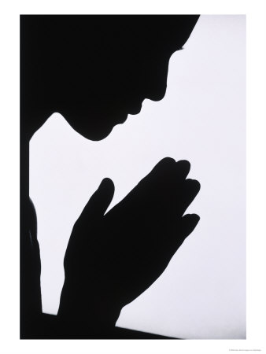
Edward Christian Church

Slide 21
The Righteousness from God. "Lead us not into temptation, but deliver us from evil" (Matthew 6:13). There are two important parts to this petition. First, desire. "Lead us not into temptation." This does not mean God will lead us to evil and the petition is a request for Him not to do that—rather it is a negative way of expressing one's desire to walk a holy life. Second, deliverance. "Deliver us from evil." This is not seeking exemption from trial but escape from transgression. It is not a petition to be exempt from suffering but to escape from sin. In total the two parts ask God to lead the petitioner in holiness and to remove any unholiness in the petitioner.
The Respect for God. "For thine is the kingdom, and the power, and the glory, forever. Amen" (Matthew 9:13). The prayer closes with great respect for God. The first petition was for the glory of God; the last words are acknowledgement of the glory of God. Our prayers have too many petitions for ourselves and not enough praise for God. Cut the petitions if you have to but do not cut the praise part of your prayers. The praise here is excellent. It acknowledges. The Sovereignty of God ("thine is the kingdom"), the power of God ("the power"), the magnificence of God ("the glory"), and the eternality of God ("forever"). There is a lot of good theology in this last part of the prayer. Our prayers should reflect good doctrine or they are not good prayers.
Analytical Bible Expositor - Analytical Bible Expositor – Matthew.

Slide 22
1. "Our Father" - Our focus in prayer is on our Father. It is an intimate time of developing our relationship with our loving heavenly Father. Prayer is best done in concert with other believers. Prayer is not an exercise in isolation. We must regard other Christians as our sisters and brothers that also call God their Father. Together we acknowledge He is our creator, sustainer, guide, provider, protector and authority. Without good communications to our Father we are without hope. One’s prayer life is dependent on the quality of our individual and corporate relationship with the Father.
2. "Who art in heaven" - Our Father is not limited by earthly restraints. We communicate directly with the everlasting God who controls all things. We do not need to wait or rely on any mediator. God is not limited by human restraints. Earth has no sorrow that heaven cannot heal. God’s thoughts are greater than human ideas. The Lord is in the heavens - He does whatever He pleases. Prayer is a bridge from our earth bound limits to heaven’s infinite resources.
3. "Hallowed be your name" - We come to God with a holy reverence. Only God deserves to be regarded as "Holy, Holy, Holy. Lord, God Almighty." He is the God the Father, God the Son, and God the Holy Spirit. His name is above every other name in heaven and earth. We worship Him with thanksgiving and come into His courts with praise. We are to exalt Him with all of His attributes not forgetting one aspect of His love. We forget not one of His benefits!

Slide 23
Before we begin: Name three things you pray about most often. Why does God want us to ask him to provide “daily” bread?
With this petition we turn a corner in our journey through the Lord’s Prayer. The first three petitions direct our attention to God the Father. We are instructed to . . .
Pray to the Father about His Name - Hallowed be your name.
Pray to the Father about His Kingdom - Your kingdom come.
Pray to the Father about His Will - Your will be done
The second half of the Lord’s Prayer teaches us to pray for ourselves and for others. We are to . . .
Pray for Provision - Give us today our daily bread.
Pray for Pardon - Forgive us our debts.
Pray for Protection - Lead us not into temptation.
A brief glance at the Lord’s Prayer reveals that there is one word that characterizes the first half of the prayer and another word that characterizes the second half of the prayer. The word for the first half is “your"-Your name, Your kingdom, Your will. The word for the second half of the prayer is “us"-Give us, forgive us, lead us. By arranging things this way Jesus is teaching us that we are to begin with God’s concerns. We are to pray to God about the things he is most concerned about. When we have done that, we are to pray for our own concerns-Our daily bread, our forgiveness, and our protection in the moment of temptation. We start in heaven and then come down to earth, which is the pattern of all divine revelation.
We start in heaven and then come down to earth, which is the pattern of all divine revelation.
God And Your Problems
In the second half of this prayer God is brought directly into the very tiniest details of our everyday lives. If the first half of the prayer seems too esoteric, if the first half seems too theoretical, if it seems too theological-it shouldn’t-but if for some reason it does, you will certainly understand and draw near to the second half of the Lord’s Prayer because it is meant for you and the problems you are facing in your daily life.
Let’s take a look at the second half of the prayer and analyze it a little bit more. It contains three petitions- “Our daily bread”, “forgive us our debts”, and “lead us not into temptation.” That covers provision, pardon and protection. If you think about those three things, they take care of all the needs of life:
Provision takes care of your present.
Pardon takes care of your past.
Protection takes care of your future.

Slide 24
4. "Your kingdom come, your will be done" - We are asking for His kingdom to come in all of its spiritual qualities of love, joy, peace, patience, kindness, goodness, gentleness, faithfulness and self-control. We ask God to extend His kingdom in quantity by bringing Christ’s salvation to every nation and every person. His kingdom breaks down all barriers that disallow God’s will from controlling each person, society and situation. His kingdom helps us put our priorities on to participating as workers in the spiritual harvest field rather than being merely maintenance minded.
5. "Give us this day our daily bread" - We must trust God for our physical as well as spiritual provisions in our daily prayers. He alone gives blessings without any regrets. We look to God alone for our blessings and remain content with what He provides. All work done without His provisions is done in vain. To those who fear God there is no want. He even prepares provisions for us in face of opposition.

Slide 25
6. "Forgive our trespasses as we forgive those who trespass against us." - We all need forgiveness, but we also need to forgive others. Holding grudges saps us of creative energies to love, lift and serve. By asking God for forgiveness we are willing to admit our sins, weaknesses and areas where we have done less than our best. Refusing to forgive others hinders our relationship with God. Our debt to God is far greater than what we could repay. Our only hope is found in God’s forgiveness through Christ’s substitutionary death for the sins of world. Our prayer should be: "God help us to give what has been given to us.
7. "Lead us not into temptation" - Each of us has a tendency in our flesh to sin. Without God’s help we will self-destruct through the passions of our sinful nature. We must watch and pray that we enter not into temptation. The spirit is willing but the flesh is weak.
8. "Deliver us from evil" - We battle not against flesh and blood, but against the forces of darkness. Without God’s intervention we are all vulnerable to destruction by the devil, demons and wicked people. Look to God for protection from indiscrete words, gossip, backbiting, anger, jealousy, discontent, rage, revenge, lust, envy, lying, deceiving, and apathy. We need to take the evil from within and without seriously. Ask God to conquer the forces of evil as He fights our battles for us.

Slide 26
9. "For You Alone Own the Kingdom and the Power and the Glory For ever." - All things are from God. For the Lord all things exist and were created. To God belongs all the praise, honor and glory. We are His people and the sheep of His pasture. All the means for accomplishing His will are done through His power, His kingdom and His glorious purposes. The rule of God is the goal of our prayer. We will not worry over what individual God uses for His purposes. Instead, we will look to Christ and His kingdom despite the stormy seas around us. Our ultimate reward comes from God not from any office, position or human award.
Just as an iceberg shows only 10% of its substance above the waterline, so people only reveal 10% of their real self in their actions. Actions are determined by attitudes that are influenced by one’s perception of the attributes of God. Like the apostle Paul, our goal should be, "I consider everything a loss compared to the surpassing greatness of knowing Christ Jesus my Lord." (Philippians 3:8) The following figure can help all of us remember that our view of God’s attributes effect our attitudes which in turn determines our actions. A person’s real identity is comprised of the
following:
10% - ACTIONS
20%- ATTITUDES
70%-VIEW OF GOD’S ATTRIBUTES

Slide 27
The Resources of God. "Give us this day our daily bread" (11).
This is a petition for our earthly needs. It involves three things.
  First, favor. "Give." The emphasis is on mercy not merit.
  Second, faith. "This day... daily." This is looking to God everyday by faith. It is not for a year's supply but for a day's supply. That requires faith.
  Third, food. "Bread." This indicates our needs as opposed to our wants. Bread is common, not a luxury. "Bread" also says we are to pray for our material needs as well as our spiritual needs.
The Repentance to God. "Forgive us our debts, as we forgive our debtors" (12).
  To understand this petition better we need to note that Luke has "sins" (Luke 11:4) instead of "debts." The petition here is for Divine forgiveness of our sins. There are three important lessons in this partition.
  First, the importance of the petition. Forgiveness by God of our sins is our most important need.
  Second, the ignominy from the petition. Confessing our need of forgiveness acknowledges we are sinful and that is humbling. Few want to admit they are sinful. But until you humble yourself about your sin, you will never obtain forgiveness of your sins from God.
  Third, the imperative in the petition. "As we forgive our debtors." This is not works for salvation, but language to show the sincerity of our petition. We must come in true repentance. True repentance will not harbor unforgiveness of others.

Slide 28
Petition with Promise
You Don’t Need a Quarter to call someone who cares
Matt 6 Luke 11
Model Prayer
Getting to the point bringing out the big guns
follow the yellow brick road call home

Slide 29
Revival

Slide 30
Have You Ever Wondered…
  How to pray
  What to Say
  How to Say
  What We Say is Powerless
James 4:3 (NASB)
³ You ask and do not receive, because you ask with wrong motives, so that you may spend it on your pleasures.

Slide 31
The Relationship to God "Our Father which art in heaven" (9)
  "Our Father" - Our focus in prayer is on our Father.
  "Who Art in Heaven"
    Our Father is Not Limited By…
      Earthly Restraints
      Man’s Abilities
He is the Everlasting God Who Controls All Things.
  Earth Has No Sorrow that Heaven Cannot Heal.
  Prayer is a Bridge from Our Earth Bound Limits…
  …to Heaven’s Infinite Resources.
Edward Christian Church

Slide 32
The Relationship to God "Our Father which art in heaven" (9)
The Reverence for God "Hallowed be thy name" (9)
  The First Petition in the Prayer is for the…
  … Glory and Honor of God
  It Ought to Be the First and Foremost Aim of Our Life to…
  … Glorify God (1 Cor 10:31).
  Our Praying Should Be More than "Give Me“…
  It Should Include a Prominent Desire For…
  …God To Be Honored.
Edward Christian Church

Slide 33
The Relationship to God "Our Father which art in heaven" (9)
The Reverence for God "Hallowed be thy name" (9)
The Rule of God "Thy kingdom come. Thy will be done in earth, as it is in heaven" (10).
Two Parts
  1st, As Subjects, We Say, "Thy kingdom come."
    Praying for God to Rule Man.
  2nd, As Servants, We Say,
  "Thy will be done in earth, as it is in heaven"
    Prays that Man Will Submit to God's Rule and…
    This Submission Will Be Done with Excellence—
    "as it is in heaven”
Edward Christian Church

Slide 34
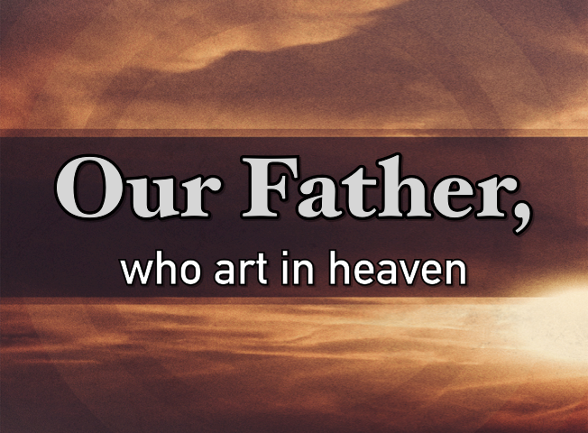
The First Part of the Prayer is…
Places God in His Proper Position as…
“Our Heavenly Father Full of Glory, Power and Honor”
This Part Alone Should Bring Stability…
…in these Unstable Times
But He Doesn’t Stop There….

Slide 35
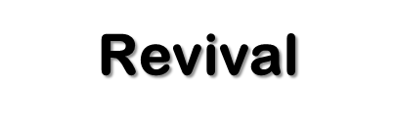
We Live in Unprecedented Times…
Just When You Think It Cannot Get More Complicated…
…BAM!!!!!!
Leading Up to 2020…
  Talk of Last Day Revival
  Based on Prosperity
  Limited
  Causes Discord
Now That We Are in 2020…
  Talk of Last Day Revival
  Based on Tribulation
  No Limits
  Causes Peace

