Slide 1
Three men were trying to get in a crowded restaurant on Christmas day. They forgot to make reservations days before. The matradee met them and said, "Because it's Christmas day we have a special deal to get you in to get the last three tables. If you have something on you that has to do with Christmas, I’ll let you in."
The first man reached into a shirt pocket and took out a lighter, flicked it, held it up and said, "A Christmas candle?"
The matradee chuckled and said, "OK, you can come in."
The next man reached into a pants pocket, took out a set of keys, shook them in the air, and stated, "Jingle Bells?"
The matradee paused, groaned and said, "Get in before I change my mind."
The last man rummaged through his pants pockets; nothing. Next, he checked his shirt pockets: nothing again.
Finally, he searched his coat pockets, paused, thought for a moment and then took out a pair of women's eyeglasses.
He looked at matradee and said, "They're Carol's?"

Slide 3
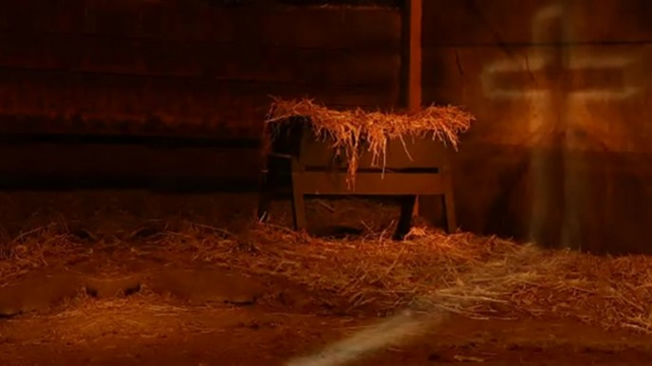
The Manger…
…a Picture of Things to Come
Christmas 2020
Edward Church

Slide 4

Now Let’s Look Back 2020 Years
Life For Mary And Joseph Was Turned…
Upside Down
Inside Out
Right Is Wrong
Wrong Is Right
2020 Has Been A Very ________ Year
Life As We Know It Has Been Turned…
Upside Down
Inside Out
Right Is Wrong
Wrong Is Right

Slide 5
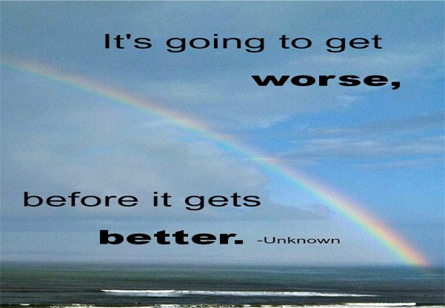
I Believe that 2020
Beginning
Set Up
Prophetic
Bigger Things to Come
2020 Years Ago
Beginning
Set Up
Prophetic
Bigger Things to Come

Slide 6
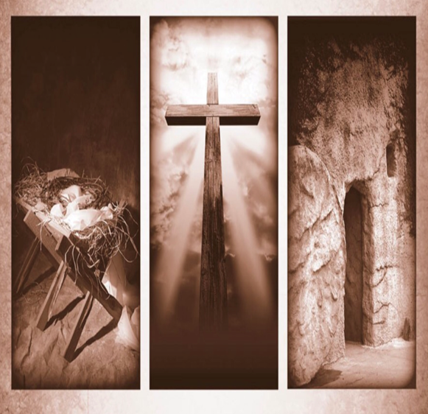
More Than the Manger
When You Think of Christmas…
…How Often Do You
…Connect It with Easter?
It’s a 6 mile journey between the manger and the cross. This journey, is the story of Jesus’ Incarnation. From His birth, His life always pointed to His death.
The Manger Was the Set-Up for More to Come

Slide 7
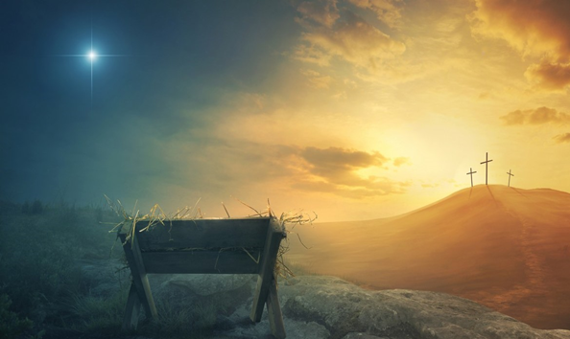
Luke 2
And it came to pass in those days, that there went out a decree from Caesar Augustus, that all the world should be taxed. 2 (And this taxing was first made when Cyrenius was governor of Syria.) 3 And all went to be taxed, every one into his own city. 4 And Joseph also went up from Galilee, out of the city of Nazareth, into Judaea, unto the city of David, which is called Bethlehem; (because he was of the house and lineage of David:) 5 To be taxed with Mary his espoused wife, being great with child. 6 And so it was, that, while they were there, the days were accomplished that she should be delivered. 7 And she brought forth her firstborn son, and wrapped him in swaddling clothes, and laid him in a manger; because there was no room for them in the inn.

Slide 8
Manger
Cross
No Room (3-4)
Crowd There (Taxed)
Dreaded
Still God was in Control
No Room (Luke 22)
Crowd There (Passover)
Celebration
Still God was in Control

Slide 9
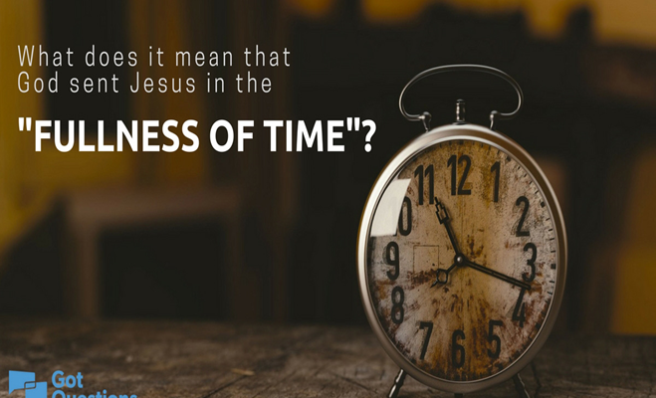
Cross
Manger
Accomplished (6)
Fulness of Time Gal
Galatians 4:4-5 (KJV)
⁴ But when the fulness of the time was come, God sent forth his Son, made of a woman, made under the law,
6 And so it was, that, while they were there, the days were accomplished that she should be delivered.
Accomplished (John 19:28-30)
Fulness of Time
Galatians 4:4-5 (KJV)
⁵ To redeem them that were under the law, that we might receive the adoption of sons.
28 After this, knowing that everything had now been accomplished, and to fulfill the Scripture, Jesus said, “I am thirsty.” 29 A jar of sour wine was sitting there. So they soaked a sponge in the wine, put it on a stalk of hyssop, and lifted it to His mouth. 30 When Jesus had received the sour wine, He said, “It is finished.” And bowing His head, He yielded up His spirit.

Slide 10
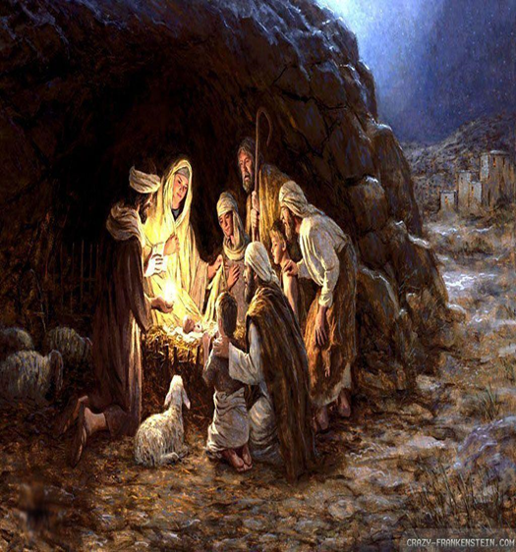
Manger
Cross
Cave (7)
Borrowed Stable
They Had No Way
God Made a Way…
…Where There Was No Way
Cave (Matt 27:57-60 )
Borrowed Tomb
They Had No Way
God Made a Way…
…Where There Was No Way

Slide 11
Manger
Cross
Manger (7)
Broken Wood
Carry Out Common Task
Dispense Broken Food
Helpless
In Hands of Others
Back Upon the Wood
Precious Gift
Cross (John 19:17)
Broken Wood
Carry Out Common Task
Dispense Broken Body
Helpless
In Hands of Others
Back Upon the Wood
Precious Gift

Slide 12
Manger
Cross
Swaddling Clothes
Linen Strips
Brought Comfort
Temporary
One-Time Use
Soon Empty
Grave Clothes ( )
Linen Strips
Brought Comfort
Temporary
One-Time Use
Soon Empty

Slide 13
Manger
Cross
Dependable Guide
“Star”
High / Lifted Up
Pointed to God
Darkness Could Not Hide It
Only Made It Brighter
Gave Hope
Dependable Guide
“Cross”
High / Lifted Up
Pointed to God
Darkness Could Not Hide It
Only Made It Brighter
Gave Hope

Slide 14
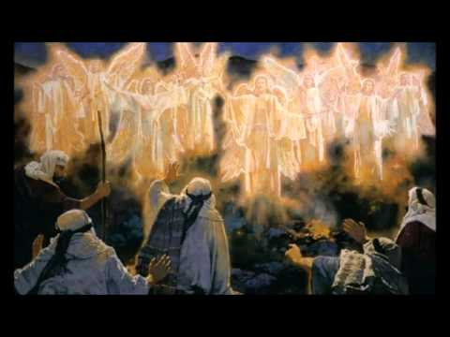
Manger
Cross
Angels Announced
Common People
Uncommon Message
Brought Fear
Became Joy
He is Here
Common People…
…Spread Uncommon Message
Angels Announced
Common People
Uncommon Message
Brought Fear
Became Joy
He is Not Here
Common People…
…Spread Uncommon Message

Slide 15
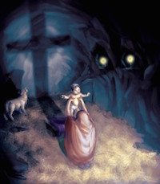
Manger
Cross
Became a Symbol of Hope
…and Life
Became a Symbol of Hope
…and Life
From Your Beginning …
…To Your End
God’s Got This!!!

Slide 16
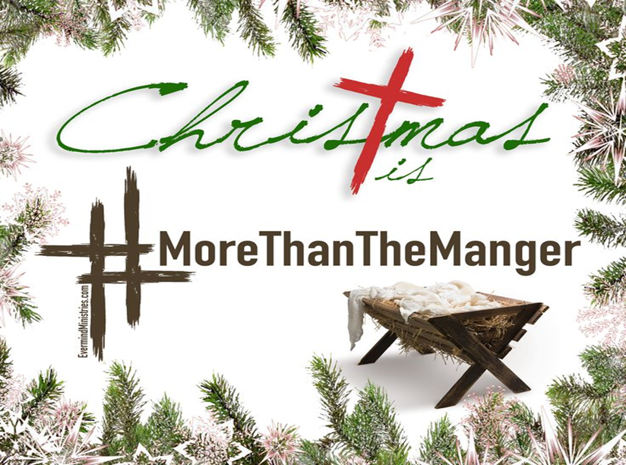
He Did Not Come to Take Away the Pain.
…He Came to Share the Pain,
…To Show Us How and Help Us
…Bear the Cross that Would Face In Our Own Lives
Just as 2020 was a picture of Things to Come…
…2020 was Likewise a Picture of Things that Are Coming!

Slide 18
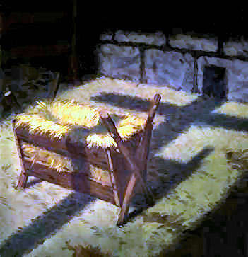
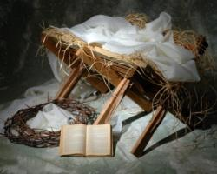


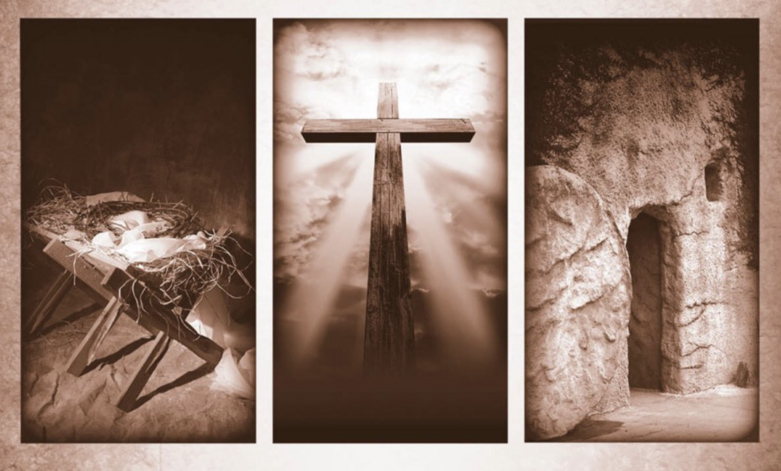

Slide 19

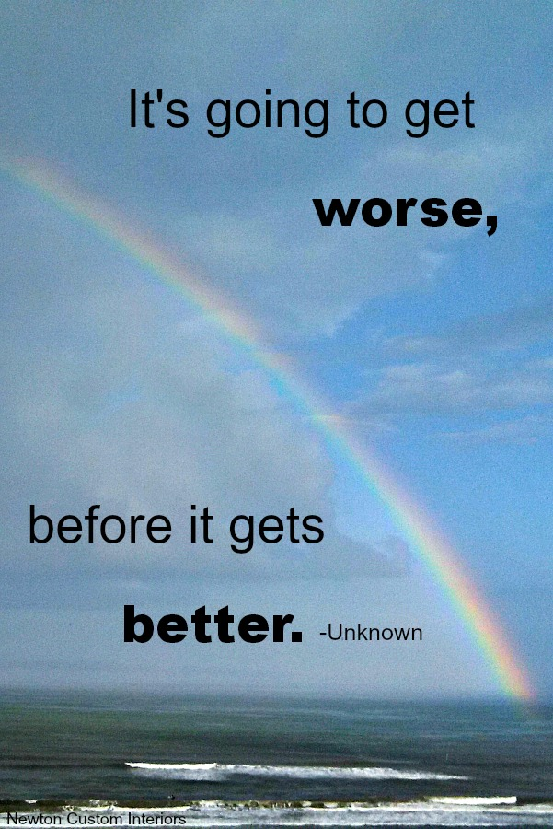


Slide 20
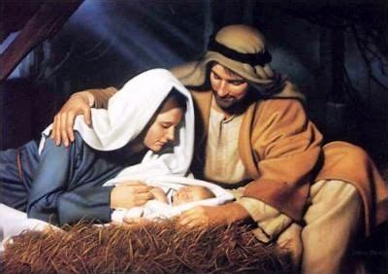
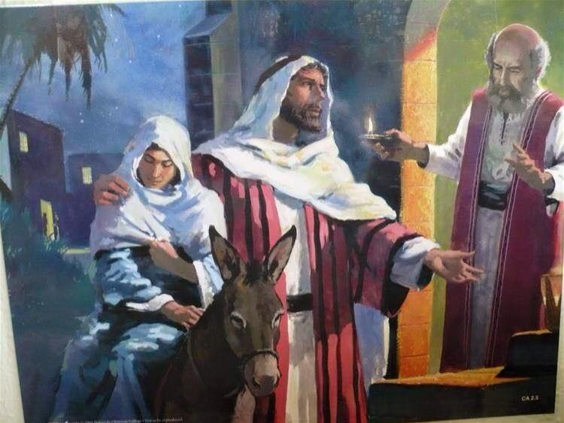
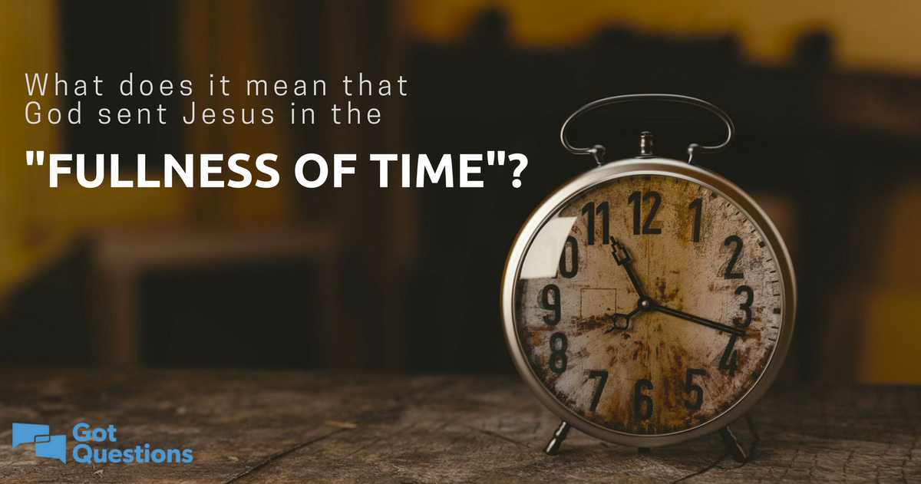


Slide 21
And the course wood of the manger and its placement outside, points to Jesus’ death on a wooden cross, which takes place outside where he was naked and exposed to the elements.
At the manger, Jesus is pictured with Joseph and Mary on each side. At the cross, Jesus is also flanked by two people, but they’re thieves. In both scenes, Mary looks upon Jesus.
At the manger, baby Jesus is swaddled in a cloth, perhaps by Joseph. After Jesus’ death on the cross, his body is wrapped in a linen burial cloth by Joseph of Arimathea.

Slide 22
No Room (place) - Cave
No Place- Borrowed Tomb

Slide 25
Dark when He was Born
Dark when He Died
he did not come to take away the pain. Rather, he came to share the pain, and to show us how and help us bear the cross that would face in our own lives.

Slide 26
The Manger Reflects the Cross
It’s a 6 mile journey between the manger and the cross. This journey, is the story of Jesus’ Incarnation. The journey brings salvation to all.
The Time and Place
And all went to be taxed, every one into his own city
Jerusalem was crowded -Passover

Slide 27
The humiliation of our Lord on Calvary was already preceded by the infinite condescension and humiliation of the Lord in becoming man and being born in a dark dank cave only fit for animals and laid in a feeding trough of the beasts that occupied that same space.
we see glimpses of his passion:
the rejection by the towns people would prefigure his rejection by the religious authorities and the masses;
the wood of the manger prepares this child for the wood of the cross, as this trough also prepares him for burial in a coffin;
the swaddling clothes that wraps his fragile newly born flesh would one day encase his mortal corpse;
the cave where he was born already points to the tomb where his body was laid and from here to he would proclaim the good news of the resurrection to the world.

