Slide 1
Fear Hath Torment
A man has been visiting a therapist because he has had a fear of monsters living under his bed. The man has been seeing this doctor for months. Every time he would come in the doctor would ask “have you made any progress?”. Every time the man would say “no”. The man decided to go and see another doctor. When he went back to his other doctor and he asked “have you made any progress?” he said “yes, I am feeling all better now” The doctor asked “what happened”. The man said “I went to another doctor and he cured me in one session”. The doctor asked “What did he tell you?” The man said “he just told me to cut the legs off of my bed”.
Today I want us to cut some legs off of the bed

Slide 3
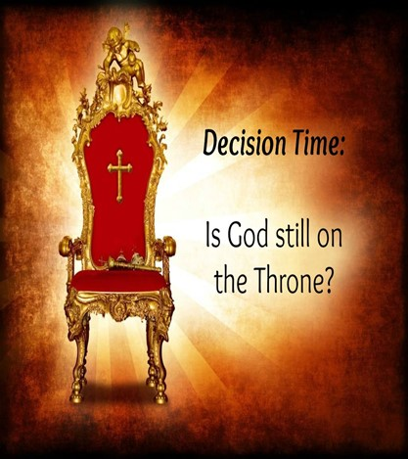
Who’s Really in Charge?
Calling the Shots?
Isaiah 6

Slide 4


We Just Came Through a…
…Tumultuous Election
Both Sides Have…
…Blood on Their Hands
Between COVID and this Election…
…Our Nations Values and Faith
…Have Been Shaken to the Core!

Slide 5

This Week Marked Beginning of a New Administration
Listen Carefully…
NO Matter Which Party Had Won…
For Some this is a Great Day
…Others a Bad Day
Remember 4 yrs. Ago?
School Classes Shutting Down…
Folks Going in All Types of Emotional Crisis
We Don’t Have to Go There….

Slide 6
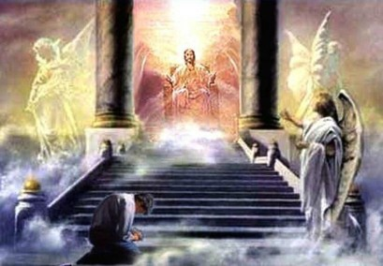
In the year that king Uzziah died
  End - Known
  Begin - Unknown
  End - Cycle Never Stops
¹ In the year that king Uzziah died I saw also the Lord sitting upon a throne, high and lifted up, and his train filled the temple.
² Above it stood the seraphim's: each one had six wings; with twain he covered his face, and with twain he covered his feet, and with twain he did fly.
³ And one cried unto another, and said, Holy, holy, holy, is the LORD of hosts: the whole earth is full of his glory.
⁴ And the posts of the door moved at the voice of him that cried, and the house was filled with smoke.
⁵ Then said I, Woe is me! for I am undone; because I am a man of unclean lips, and I dwell in the midst of a people of unclean lips: for mine eyes have seen the King, the LORD of hosts.
⁶ Then flew one of the seraphim's unto me, having a live coal in his hand, which he had taken with the tongs from off the altar:
⁷ And he laid it upon my mouth, and said, Lo, this hath touched thy lips; and thine iniquity is taken away, and thy sin purged.
⁸ Also I heard the voice of the Lord, saying, Whom shall I send, and who will go for us? Then said I, Here am I; send me. Isaiah 6:1-8 (KJV)
I saw also the Lord…
Isaiah Desperately…
…Needed a Re-Focus
I saw also the Lord sitting upon a throne,
High and lifted up, and his train filled the temple…

Slide 7
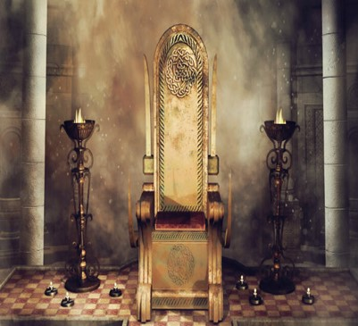
All Leaders of the World
Great God Jehovah
Hold Office
Elected or Battled
Limited Seat
Limited Power
Limited Ability
Sits on Throne
Always Been
Will Always Be
Unlimited Power
Unlimited Ability…
All Seeing…
…All Knowing
…All Powerful

Slide 8

God Is Still On The Throne.
God is not pacing in the throne room wondering what to do next.
He is Sovereign Over All Things.
⁹ Remember the former things of old: for I am God, and there is none else;
I am God, and there is none like me,
¹⁰ Declaring the end from the beginning, and from ancient times the things that are not yet done, saying, My counsel shall stand, and I will do all my pleasure: Isaiah 46:9-10 (KJV)
⁹ Remember your history, your long and rich history. I am GOD, the only God you've had or ever will have— incomparable, irreplaceable—
¹⁰ From the very beginning telling you what the ending will be, All along letting you in on what is going to happen, Assuring you, 'I'm in this for the long haul, I'll do exactly what I set out to do,' Isaiah 46:9-10 (MSG)

Slide 9
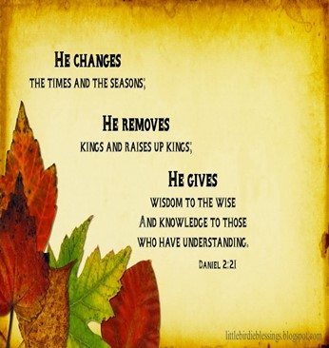
God Raises Up and Puts Down Leaders
²¹ And he changeth the times and the seasons:
he removeth kings, and setteth up kings:
he giveth wisdom unto the wise,
and knowledge to them that know understanding:
His ways are high above our ways and everything God allows
moves history along to its prophesied end. Daniel 2:21 (KJV)
Daniel 2:20-22 (MSG)
²⁰ "Blessed be the name of God, forever and ever. He knows all, does all:
²¹ He changes the seasons and guides history, He raises up kings and also brings them down, he provides both intelligence and discernment,
²² He opens up the depths, tells secrets, sees in the dark—light spills out of him!

Slide 10
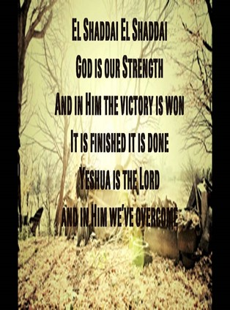
Perhaps God Wants Us American Christians To Put Our
…Trust Solely In God, Rather Than Our Comfort/ Security.
It’s Time For Us To Realize That…
He Is Enough. Actually, God Is MORE Than Enough.
When Abram was ninety-nine years old, the LORD appeared to him and said, "I am God Almighty; walk before me and be blameless. 2 I will confirm my covenant between me and you and will greatly increase your numbers." Genesis 17:1-2 NIV
The Hebrew word for God Almighty is El Shaddai – the God who is more than enough – more than sufficient. It means that He has the power to complete promises of blessings and prosperity. Everything God does is over the top, more than enough, a surplus, super-abundant, overflowing, good measure, pressed down, shaken together, and running over!

Slide 11
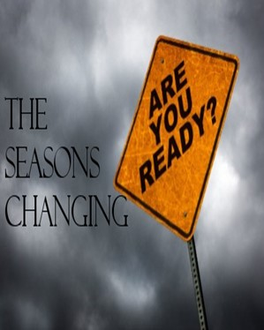
Whatever We Might Face In The Coming Years, God Is Allowing It.
Perhaps We’ll Face Strong Persecution.
Perhaps the World Will Get Worse…
…Our Light Will Shine Brighter.
Perhaps the Lord will come to take his Bride home…
…we’ll finally be raptured out of this corrupt world!
Whatever Lies Ahead…
…We Must Trust In Christ Alone Like Never Before.
He Is Our Only Real Security and He Is All We Need
His Children, Sit Quietly in His Presence…
…Be At Peace No Matter What Happens
The Great “I AM” Is In Control Rest In That

Slide 12




Who’s Really in Charge?
Calling the Shots?

Slide 14


