Slide 2
Repeat
These are the 2 Most Important Hours of My Week – Help Me to Cherish Them
I Am Here Today to Worship
Not to Be Entertained
I Am Singing to An Audience of One
Accept My Worship Oh Lord!

Slide 3
Praise Time!!

Slide 4
Repeat
I Lift My Offering to You
Let It Please You Oh Lord
This is My Seed
Although It Leaves My Hand
It will Never Leave My Life
You Will Multiply It!
Accept My Seed Oh Lord!

Slide 5
A man, down on his luck, went into a church which catered to the "uppity". Spotting the man's dirty clothes a deacon, worried about the churches image, went to the man and asked him if he needed help. The man said, "I was praying / the Lord told me to come to this church."
The deacon suggested that the man go pray some more and possibly he might get a different answer. The next Sunday the man returned. The deacon asked, "Did you get a different answer?"
The man replied, "Yes I did. I told the Lord that they don't want me in that church and the Lord said, 'Don't worry about it son; I've been trying to get into that church for years and haven't made it yet either."

Slide 7


April 11, 2021
Edward Church
7 Churches pt. 11
Laodicea (3:14-21)
“ Disappointing Church”

Slide 8
The Lord Comes to His Churches…
…to Speak to Them About
  Where They Are…
  Where He Wants Them to Be…
  He Comes to Them w-…
…a Message Of Comfort

Slide 9

¹⁴ And unto the angel of the church of the Laodiceans write; These things saith the Amen, the faithful and true witness, the beginning of the creation of God; ¹⁵ I know thy works, that thou art neither cold nor hot: I would thou wert cold or hot. ¹⁶ So then because thou art lukewarm, and neither cold nor hot, I will spue thee out of my mouth. ¹⁷ Because thou sayest, I am rich, and increased with goods, and have need of nothing; and knowest not that thou art wretched, and miserable, and poor, and blind, and naked: ¹⁸ I counsel thee to buy of me gold tried in the fire, that thou mayest be rich; and white raiment, that thou mayest be clothed, and that the shame of thy nakedness do not appear; and anoint thine eyes with eyesalve, that thou mayest see. ¹⁹ As many as I love, I rebuke and chasten: be zealous therefore, and repent. ²⁰ Behold, I stand at the door, and knock: if any man hear my voice, and open the door, I will come in to him, and will sup with him, and he with me. ²¹ To him that overcometh will I grant to sit with me in my throne, even as I also overcame, and am set down with my Father in his throne.

Slide 10

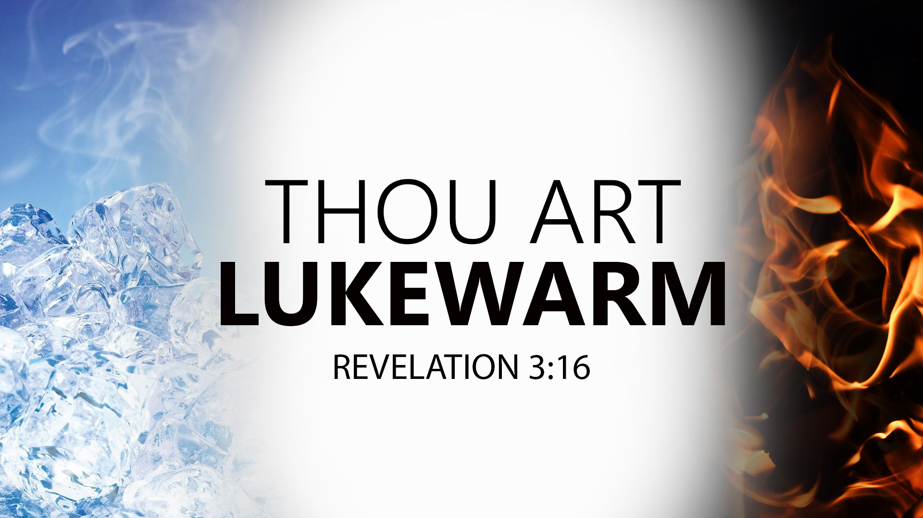


Jesus Eyes Laodicea…
…I Think I’m Going to Puke!

Slide 11

All the Churches Had a Mixed Message of
Good – Bad – Ugly…
With 2 Exceptions…
Philadelphia –Only Good
Laodicea –Only Ugly
It Was in Most Dangerous of Conditions
Maintaining a Church
Without Key Ingredient…
Jesus!
Laodicea = the People Rule

Slide 12
Dangerous Problems
There Was a Problem w- Control (14)
“the church OF the Laodiceans”
There Was a Problem w- Passion (15)
Indifferent and Apathetic.
Going Through the Motions
There Was a Problem W- Perception (17)
Looked At Position, Possessions, Power
Jesus Saw Indifference, Apathy, Ignorance

Slide 13

Laodicea Inside Out
Indifferent-“Lukewarm” (15-16)
  Hard to Deal With
  Would Rather…
  Cold= Lack of Heat (Spt/ Mind)…
  …(Rigorm)
  Hot= Boiling (Spt/ Mind)…
  …(On Fire)
Invoking-“Displeasing to God” (16)
  All About Them
  Nauseating

Slide 14
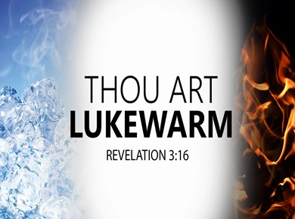
Irrational-“Satisfied” (17)
“..rich, increased w/ goods….”
Complacency is a like Virus…
  Saps Energy
  Dulls Attitude
  Brain Drain (No Challenge)
if what did yesterday still looks big…

Slide 15
Laodicean = the people rule
Independent of God (17b)
“have need of nothing....”
Insensitive Spiritually (17-18)
“..not know naked.....blind..”

Slide 16
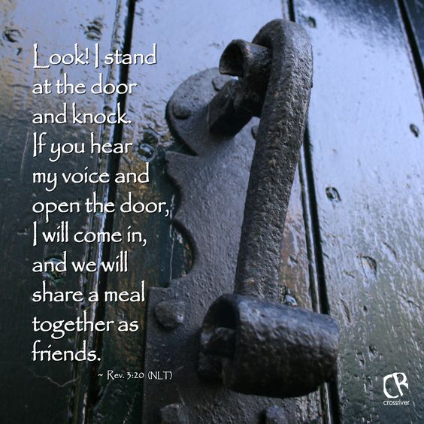
Laodicean = the people rule
Impoverished Spiritually (17)
  Excuses vs Exercise
Isolated (20) “I stand at door/ knock”
  Sad- Jesus Nowhere in Church
  Sadder- They were Unaware

Slide 17
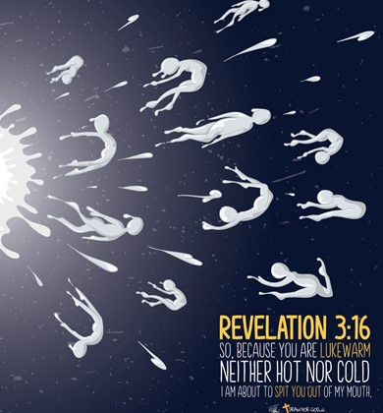
Jesus Gives the Greatest Warning
Because You Are Lukewarm…
Taste/ Test= Spew Out of His Mouth
Timing= Into Tribulation

Slide 18
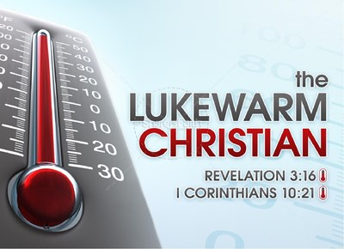
Remedy: (18)
  “Rely on me/ Comeback to me..”
True Treasure
“buy of me gold tried in fire..mayest be rich”
True Salvation
“white raiment..be clothed..shame…nakedness”
True Discernment
“anoint eyes with eyesalve, that thou mayest see”

Slide 19

Signs of a Lukewarm Christian
God is No Longer First in Their Life.
Give Leftover Time, Talent/ Treasure
Decreased Interest In Things Of God
Only Go to Church For Social Reasons…
…If They Go It All.
(Spiritual Show And Tell)
They Make Excuses For Their Chill…
…Blame Becomes Their Game

Slide 20

Signs of a Lukewarm Repentance
Put God First Again
No More Leftover Time, Talent/ Treasure
Increased Interest In Things of God
Go to Church for Spiritual Reasons…
(No More Spiritual Show And Tell)
Refuse Excuses For Their Chill…
…Responsibility instead of Blame

Slide 21

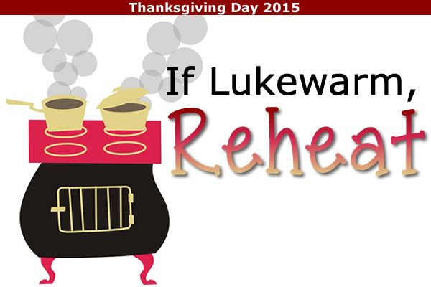

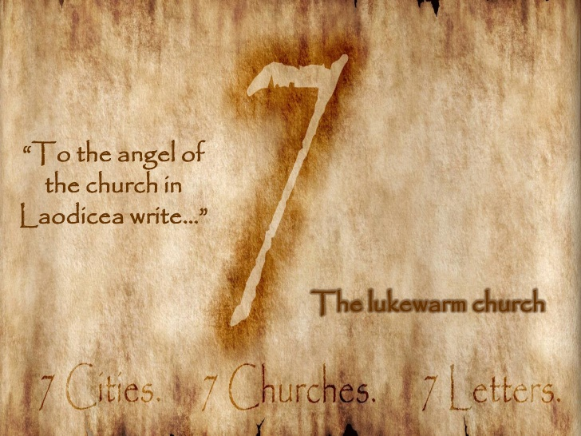
Time to Step in…
…Out of the Cold

Slide 23

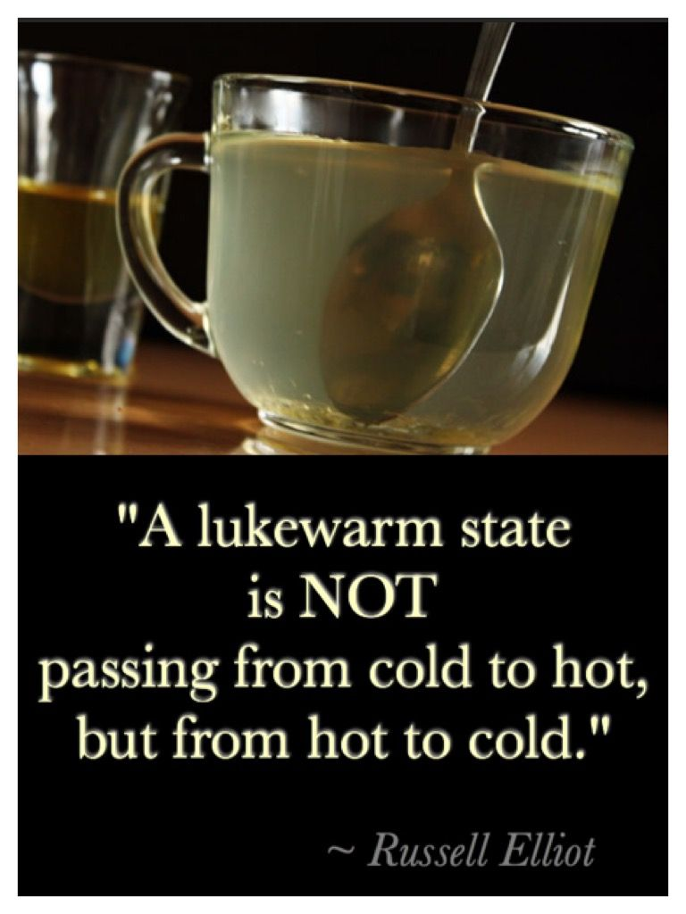
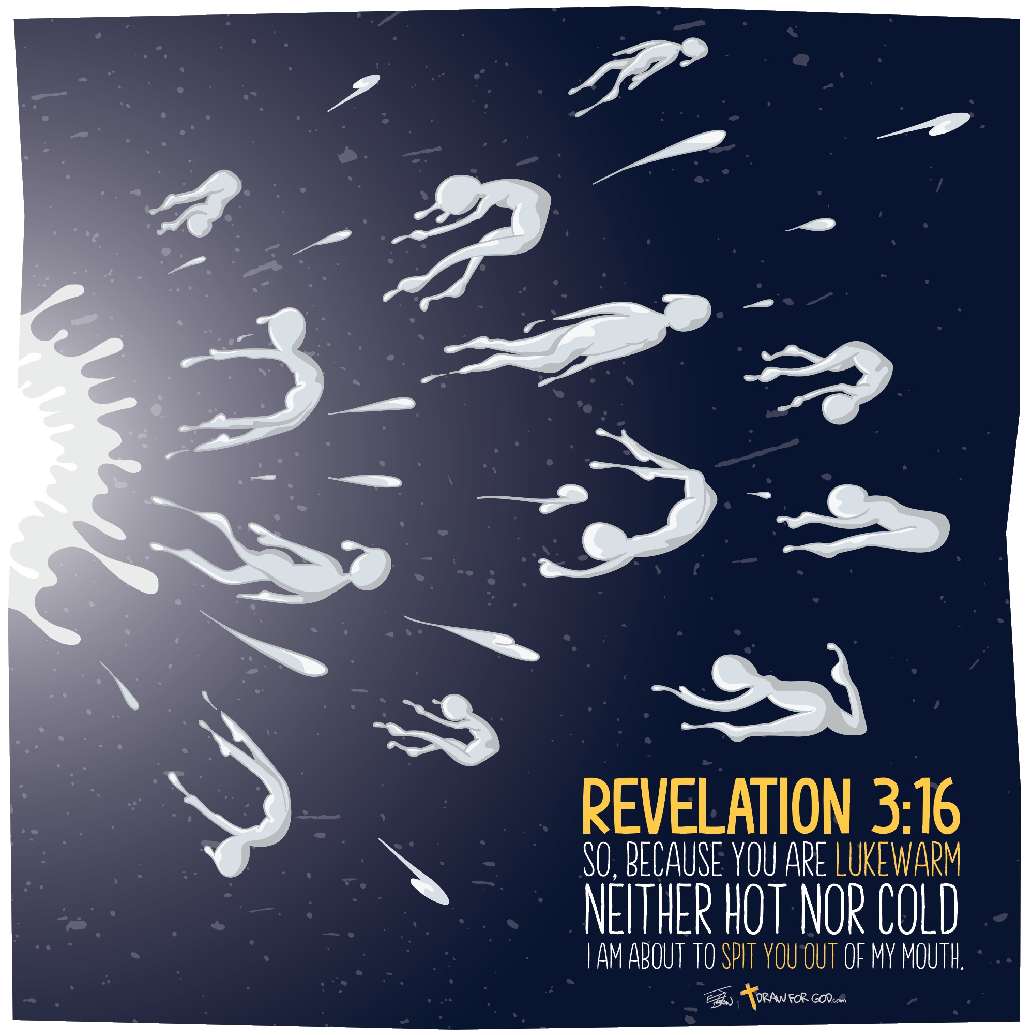
The first lesson to learn from Laodicea is – the Church only functions with supernatural energy – the wisdom, the knowledge, and the life of the Holy Spirit of God. Nothing else will bring a lifeless, sleeping church to life. My ideas, your ideas, nor any of man’s schemes will suffice.
Only you can open the door
The final lesson of Laodicea is – it is personal. Jesus is at the door but only you can open it – your friends can’t, your parents can’t, just you. That is why the message of Scripture is “you are the living stones that make up the Church.” – 1 Pet. 2:5.

Slide 26
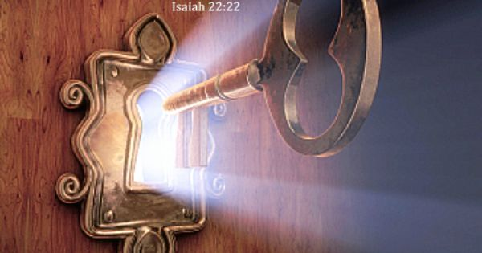

Slide 27
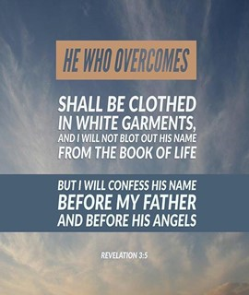
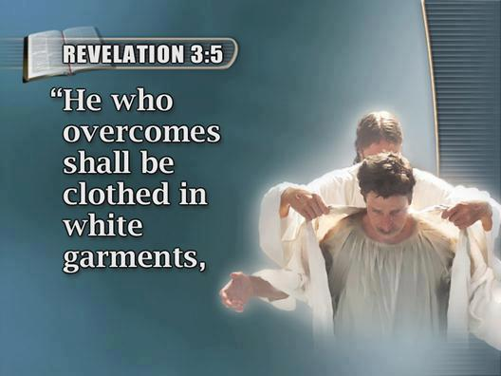
REWARDS for REAL FAITH
White CLOTHES
God Will Clean the Slate- Count Us Blameless
Place in HEAVEN
Not Blotting Our Names Out of the Book Of Life…
…Means We Gain Entry to Heaven
This Doesn’t Mean Eternal Security
He Says We Must Be Faithful to the End
Confession Before GOD
Christ Will Confess Our Name Before God.
Confession Means “Agreement.”
He Will Agree That We Are His.

Slide 28
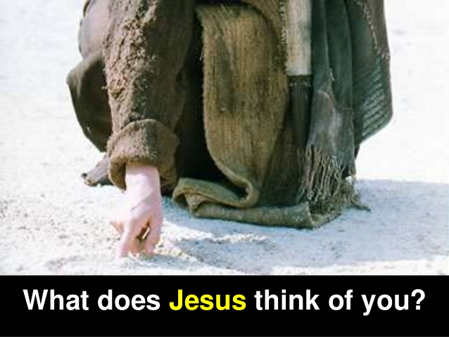

Slide 29
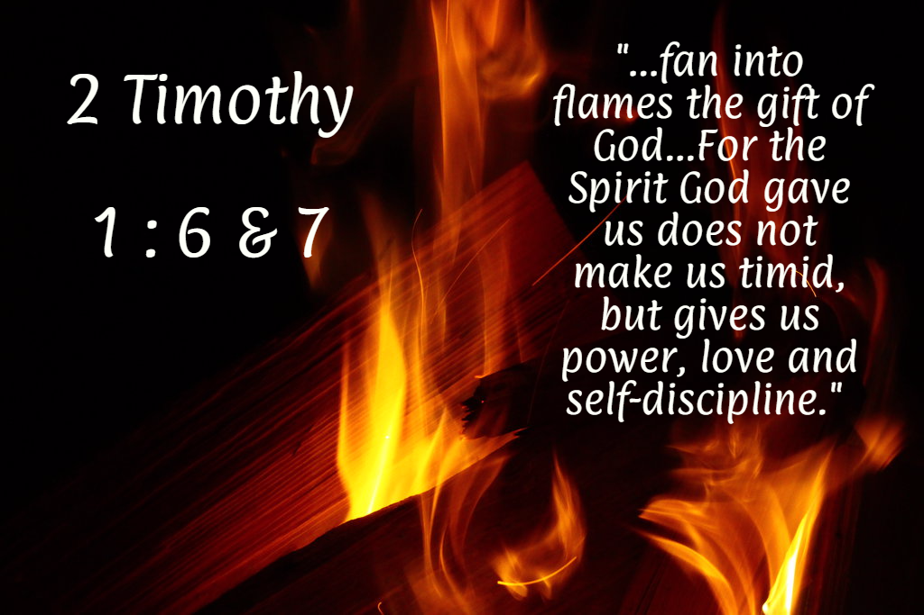

Slide 30
Jesus Eyes Laodicea…
…I Think I’m Going to Puke!

Slide 31
Time to…
Wake Up
Get Up!
Shape Up!
Show Up!

Slide 32

