Slide 2
Repeat
These are the 2 Most Important Hours of My Week – Help Me to Cherish Them
I Am Here Today to Worship
Not to Be Entertained
I Am Singing to An Audience of One
Accept My Worship Oh Lord!

Slide 3
Praise Time!!

Slide 4
Repeat
I Lift My Offering to You
Let It Please You Oh Lord
This is My Seed
Although It Leaves My Hand
It will Never Leave My Life
You Will Multiply It!
Accept My Seed Oh Lord!

Slide 5
A middle aged woman had a heart attack and was taken to the hospital. While on the operating table she had a near death experience. Seeing God, she asked "Is my time up?"
God said, "No, you have another 43 years, 2 months and 8 days to live."
Upon recovery, the woman decided to stay in the hospital and have a facelift, liposuction and a tummy tuck. She even had someone come in and change her hair color. Since she had so much more time to live, she figured she might as well make the most of it.
After her last operation, she was released from the hospital. While crossing the street on her way home, she was killed by an ambulance.
Arriving in front of God, she demanded, "I though you said I had another 40 years?"
God replied, "I didn’t recognize you."

Slide 7
John the Revelator and the Rapture
March 25, 2021
Rapture 3D –pt. 3
Revelation 4
Edward Christian Church

Slide 8
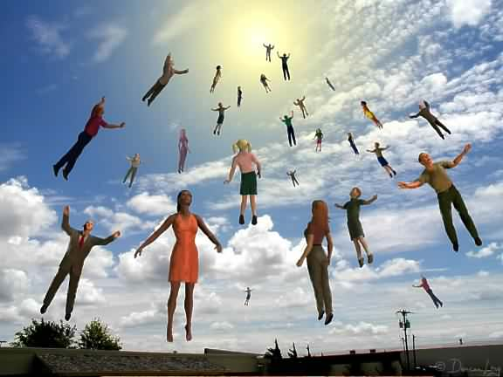
Rapture
We are About to Experience One of the
Greatest Events in Human History!
Something Dramatic Will Take Place…
It Summons the End of the Church Age…
…the Age of Grace
…the Age of the Spirit

Slide 9
Pictures and Types
God Always Leaves a Trail of Prophetic Bread-Crumbs in the Form of Pictures and Types that Lead Up to the Actual Prophetic Event
  Years BEFORE It Happens
It Shows that God is Always…
  Control
  Calling History

Slide 10
Rapture Types…
Enoch –Gen 5:24
Elijah –II Kings 2:9-12
Philip –Acts 8:39
Paul –II Cor 12:2
Jesus –Acts 1:9

Slide 11
John’s Rapture…
The Rapture is…
  Not Clearly Called
  Clearly Indicated

Slide 12
John’s Rapture
Arrangement of Events (1:19)
Completed First 2 Segments …
Things You Have Seen
“Glorified Christ”
Things Which Are
“Seven Churches”
Things Which Take Place After
“The Lord’s Day”

Slide 13
John’s Rapture
Absence of the Church!
Not One Time is the Church Mentioned after Chap 3
Chap 2/3= “He that hath ear…Spirit says to churches”
After= if anyone hath an ear, let him hear”
Chap 4-19= God is Not Referred to Father but…
…God, Lord, Almighty/ non-personal names

Slide 14
John’s Rapture
Ascension of the Holy Spirit (5)
Revelation 2 and 3
Holy Spirit is in Midst of Churches
Revelation 4
Holy Spirit Before Throne
II Thes 2:6-8
Restraining Force…
…..Taken Out of the Way

Slide 15
John’s Rapture
Affirmation of Scriptures
Voice
Rev 4:1, I Thes 4:16
Trumpet
Rev 4:1, I Thes 4:16, I Cor 15:52
Change
Rev 4:2, I Cor 15:52-53

Slide 16
John’s Rapture
Attendance of John!
(4:1) John is Called to Heaven
“Come Up Hither”
John is a Type of the Church
The Church is His Bride…
Come Up Hither= Raptured
…into His Ultimate Presence
…to Prepare for the Wedding

Slide 17
What On Earth Am I Here For?
God has a purpose for your life!
Am I ready to meet Jesus? BE PREPARED!
Am I living life fully? BE EXPECTANT!
Am I concerned for others? BE SHARING!

Slide 18
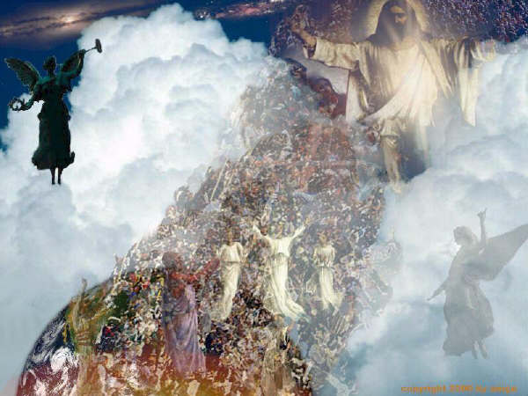
Reaching One more for Jesus...
This could be the Day!!!!

Slide 19
arcj

Slide 21
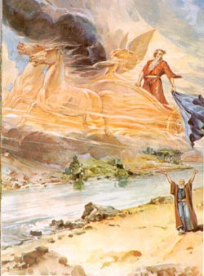
Reaching One more for Jesus...
Be inviting people you know to our
Church

Slide 22
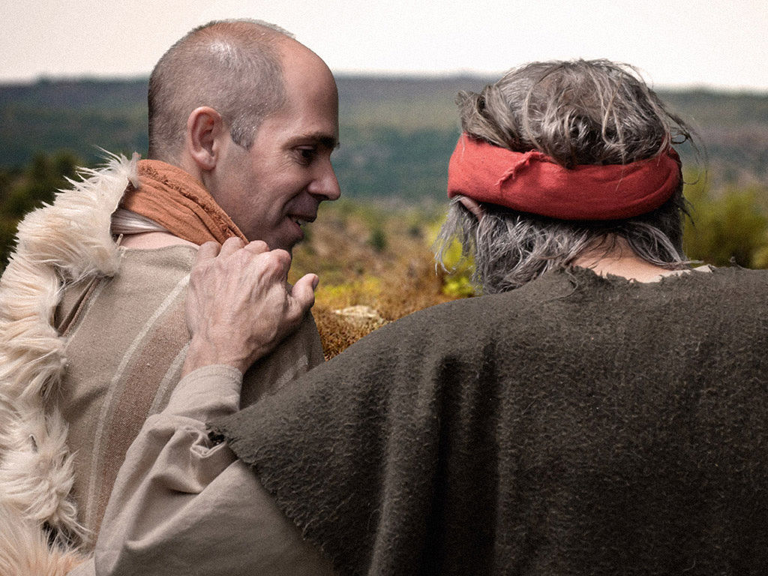
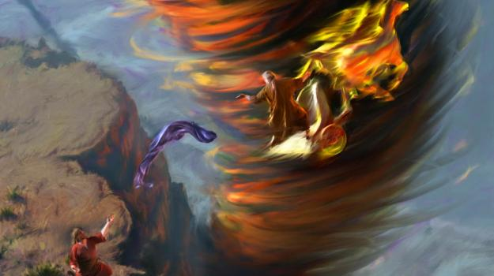

Slide 23
Elijah’s Journey of Destiny Review:
Experience a new personal relationship with Christ!
Blessings are often followed by testing - be guarding your minds!
Hear and obey the Lord as He quietly speaks to you!
Be ready to evacuate the earth at any moment!
Pack your bags with Jesus and
don’t buy any green banana’s!

Slide 24
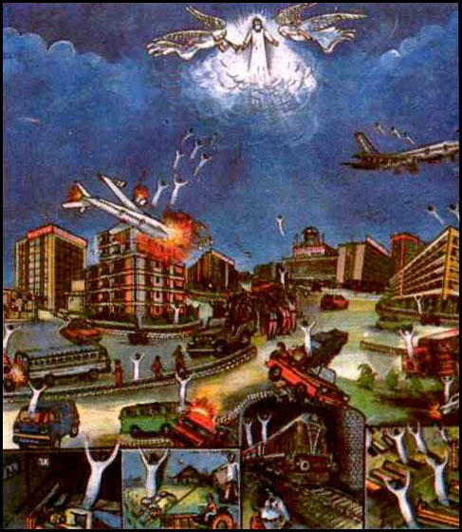
Elijah’s Rapture
CONFUSION “Cried out... tore his clothes...” Rapture Shocks the Minds of Those Left Behind!
1 Thessalonians 5:2-3
For yourselves know perfectly that the day of the Lord so cometh as a thief in the night. For when they shall say, Peace and safety; then sudden destruction cometh upon them, as travail upon a woman with child; and they shall not escape.

Slide 25
Elijah’s RAPTURE
2 Kings 2:11-12 As they were walking along and talking together, suddenly a chariot of fire and horses of fire appeared and separated the two of them, and Elijah went up to heaven in a whirlwind. Elisha saw this and cried out, "My father! My father! The chariots and horsemen of Israel!" And Elisha saw him no more. Then he took hold of his own clothes and tore them apart.

Slide 26
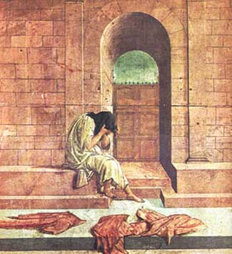
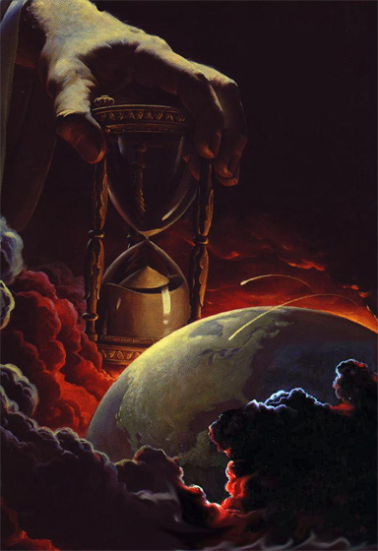
Part 4 of 4
2Kings 2:11-12 and Selected
Pew Bible page 260

Slide 27
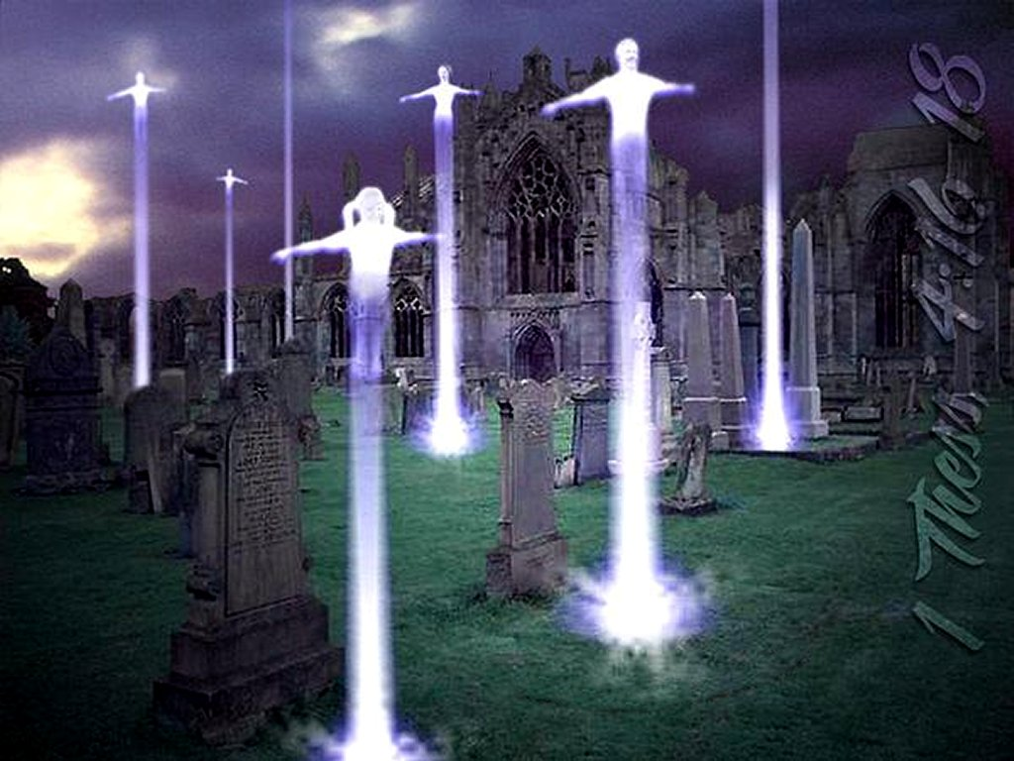
2Kings 2:11-12 and Selected

Slide 29
Reasons for Rapture
Brings His Bride Home to Heaven
Brings Believer into Eternal Fellowship
Completion of Salvation by Grace
Brings Believer into His Rewards
Removal of Restraining Ministry of
Holy Spirit
Sets Stage for the Seven Year Tribulation
Sets Stage for Anti-Christ’s
Rise to Power

Slide 30
Genesis 5:21-24 (KJV)
²¹ And Enoch lived sixty and five years, and begat Methuselah: ²² And Enoch walked with God after he begat Methuselah three hundred years, and begat sons and daughters: ³ And all the days of Enoch were three hundred sixty and five years: ²⁴ And Enoch walked with God: and he was not; for God took him.
2 Kings 2:9-12 (KJV)
⁹ And it came to pass, when they were gone over, that Elijah said unto Elisha, Ask what I shall do for thee, before I be taken away from thee. And Elisha said, I pray thee, let a double portion of thy spirit be upon me. ¹⁰ And he said, Thou hast asked a hard thing: nevertheless, if thou see me when I am taken from thee, it shall be so unto thee; but if not, it shall not be so. ¹¹ And it came to pass, as they still went on, and talked, that, behold, there appeared a chariot of fire, and horses of fire, and parted them both asunder; and Elijah went up by a whirlwind into heaven. ¹² And Elisha saw it, and he cried, My father, my father, the chariot of Israel, and the horsemen thereof. And he saw him no more: and he took hold of his own clothes, and rent them in two pieces.
Acts 8:37-40 (KJV)
³⁷ And Philip said, If thou believest with all thine heart, thou mayest. And he answered and said, I believe that Jesus Christ is the Son of God. ³⁸ And he commanded the chariot to stand still: and they went down both into the water, both Philip and the eunuch; and he baptized him. ³⁹ And when they were come up out of the water, the Spirit of the Lord caught away Philip, that the eunuch saw him no more: and he went on his way rejoicing.
⁴⁰ But Philip was found at Azotus: and passing through he preached in all the cities, till he came to Caesarea.
2 Corinthians 12:1-2 (KJV)
¹ It is not expedient for me doubtless to glory. I will come to visions and revelations of the Lord.
² I knew a man in Christ above fourteen years ago, (whether in the body, I cannot tell; or whether out of the body, I cannot tell: God knoweth;) such an one caught up to the third heaven.
Acts 1:9-10 (KJV)
⁹ And when he had spoken these things, while they beheld, he was taken up; and a cloud received him out of their sight. ¹⁰ And while they looked stedfastly toward heaven as he went up, behold, two men stood by them in white apparel;

Slide 31
Rapture Types…
Enoch
Brought into God’s Presence
Elijah
Brought Completion
Philip
A Sign -for All involved
Paul
Receive Deeper Revelation
Jesus
All of the Above

