Slide 2
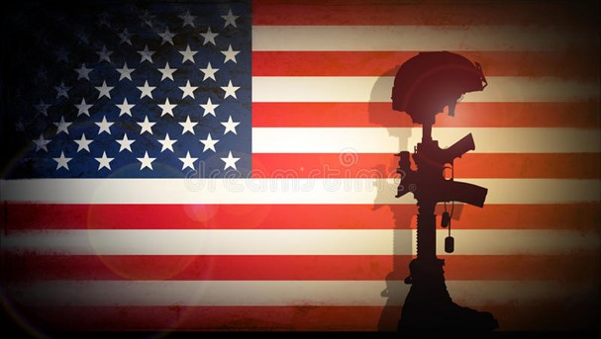
Memorial Day 2021
Revelation 13:8
Psalm 139
Edward Church
May 30, 2021

Slide 3
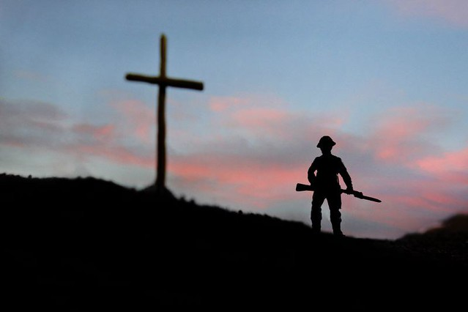
The Sacrifice
Civil War:
~625,000
World War I:
116,516
World War II:
405,399
Total Killed 35 Mill.

Slide 4
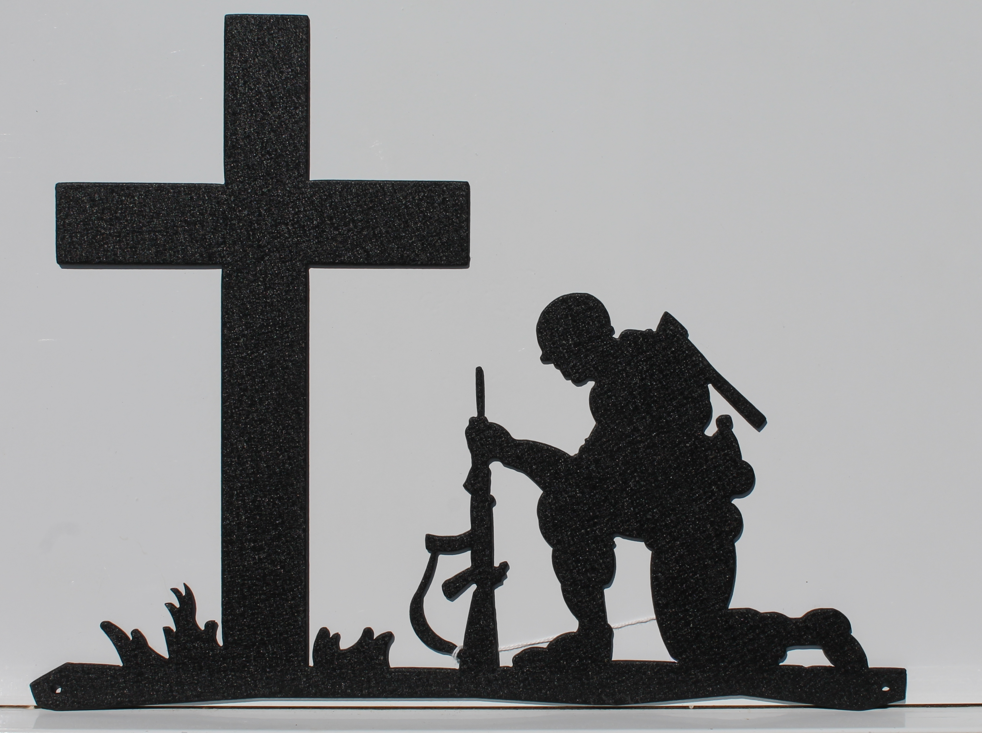
The Sacrifice
Korea:
36,516
Vietnam:
58,209
Total Killed 3,435,000

Slide 5
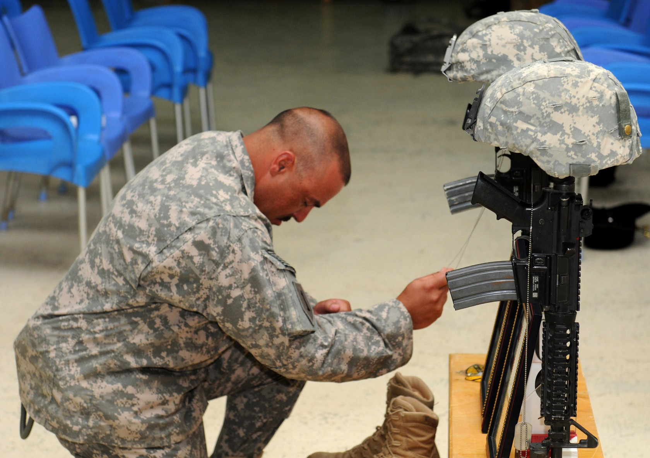
The Sacrifice
Desert Storm:
293
Afghanistan
2,216 +
Iraq:
4,497 +

Slide 6
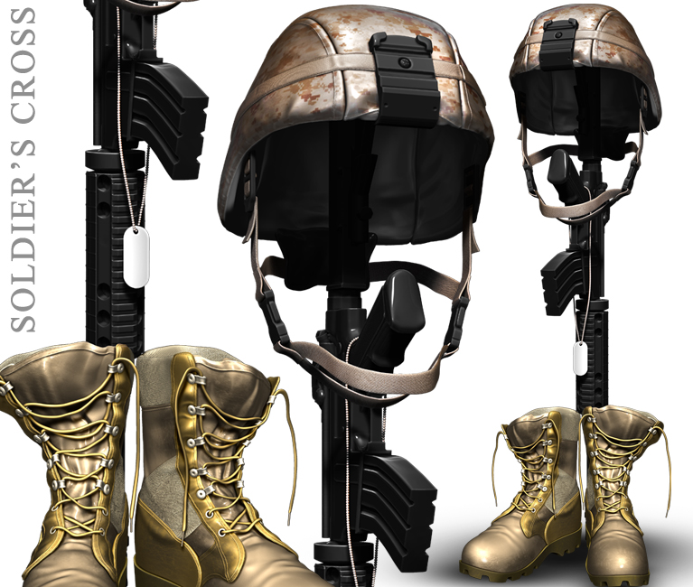
The Sacrifice
The sacrifice of one’s life for one's country is a truly awesome act.
As our Marines remind us:
“all gave some, but some gave all.”
Today honors those who set a great example of faith for us to follow.

Slide 7
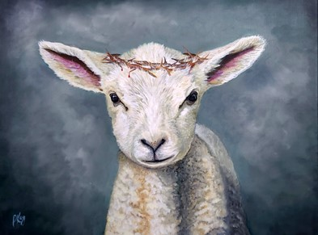
Today We Want to Remember Another
Great Sacrifice for Our Freedom
Jesus Christ and the Cross
The Difference is…
Those Memorials Are For Those Who Answered the Call
Jesus Answered Before the Call

Slide 8
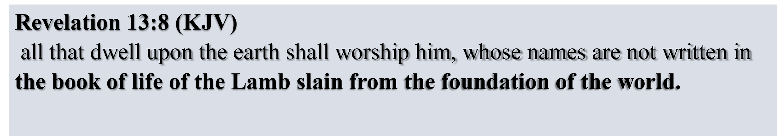

Slide 9

God Created the Heaven and Earth
Sin Came the Cure was Already Secure
Satan Fell and Take One Third of the Angels
God Made Man and Said It was Very Good
First Bite of the Forbidden Fruit…
…the Cure was Already Taken Care Of
Abraham was Given the Promise that His Seed Would Be Mighty
Judah was Given Promise that the Scepter Would be Given to His Seed

Slide 10
Gabriel Appeared to Mary and Joseph and the Shepherds
They Saw Him Set His Face Like a Flint…It Was Set
Garden
Trial
Beatings
Mocking
Cross
He Cried “It IS Finished?”
The Empty Tomb
Resurrection

Slide 11

Let’s Take This to the Next Level
Psalm 139

Slide 12
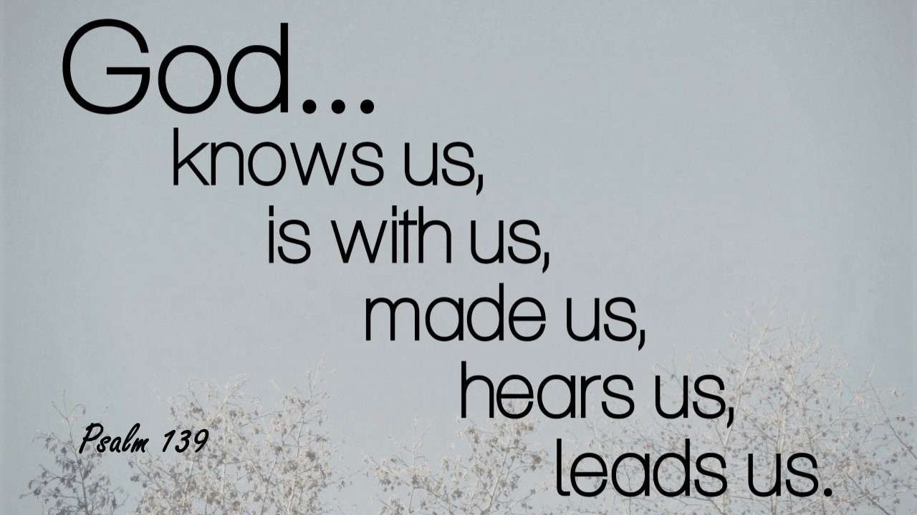
Psalm 139:13-18 (KJV)
¹³ For thou hast possessed my reins: thou hast covered me in my mother's womb.
¹⁴ I will praise thee; for I am fearfully and wonderfully made: marvellous are thy works; and that my soul knoweth right well.
¹⁵ My substance was not hid from thee, when I was made in secret, and curiously wrought in the lowest parts of the earth.
¹⁶ Thine eyes did see my substance, yet being unperfect; and in thy book all my members were written, which in continuance were fashioned, when as yet there was none of them.
¹⁷ How precious also are thy thoughts unto me, O God! how great is the sum of them!
¹⁸ If I should count them, they are more in number than the sand: when I awake, I am still with thee.
Psalm 139:13-18 (NLT2)
¹³ You made all the delicate, inner parts of my body and knit me together in my mother’s womb.
¹⁴ Thank you for making me so wonderfully complex! Your workmanship is marvelous—how well I know it.
¹⁵ You watched me as I was being formed in utter seclusion, as I was woven together in the dark of the womb.
¹⁶ You saw me before I was born. Every day of my life was recorded in your book. Every moment was laid out before a single day had passed.
¹⁷ How precious are your thoughts about me, O God. They cannot be numbered!
¹⁸ I can’t even count them; they outnumber the grains of sand! And when I wake up, you are still with me!

Slide 13
He Knows Me Inside Out
¹³ You made all the delicate, inner parts of my body /knit me together in my mother’s womb.
He Knows How Complicated I Can Be
¹⁴ Thank you for making me so wonderfully complex! Your workmanship is marvelous—how well I know it.
¹⁵ You watched me as I was being formed in utter seclusion, as I was woven together in the dark of the womb.
He Knows My Beginning from the End
¹⁶ You saw me before I was born. Every day of my life was recorded in your book. Every moment was laid out before a single day had passed.
He Loves Me Anyway
¹⁷ How precious are your thoughts about me, O God. They cannot be numbered!
¹⁸ I can’t even count them; they outnumber the grains of sand! And when I wake up, you are still with me!

Slide 14
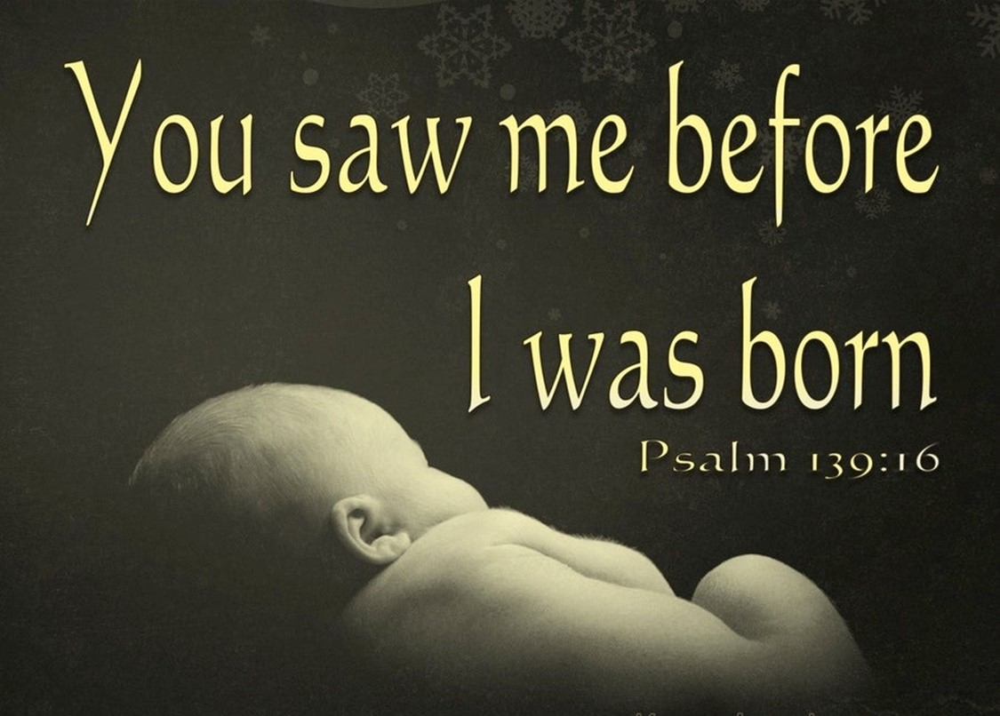
Jesus…
Died for Me
Designed a Plan for Me
All Before I was Born!
Ephesians 1:4 (NLT2)
⁴ Even before he made the world, God loved us and chose us in Christ to be holy and without fault in his eyes.
Ephesians 1:4 (MSG)
⁴ Long before he laid down earth's foundations, he had us in mind, had settled on us as the focus of his love, to be made whole and holy by his love.

Slide 15
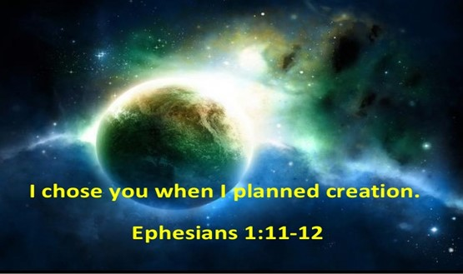

Never Forget the Ones
and the
ONE Who Died for Us

