Slide 1
Two children ordered their mother to stay in bed one Mother's Day morning. As she lay there looking forward to breakfast in bed, the smell of bacon floated up from the kitchen.
But after a good long wait she finally went downstairs to investigate. She found them both sitting at the table eating bacon and eggs.
"It's a surprise for Mother's Day," one explained, "we decided to cook our own breakfast."
============================
If evolution really works, how come Mothers only have two hands?

Slide 4
Mother’s Day 2021
Edward Church
May 9, 2016
Genesis 24

Slide 5
Mother’s Day
It’s Mothers Day…
…Again!
…Time to Feel
Below Standard
Far From Perfect
Never Ever Able to Reach
Not Today!!!

Slide 6
Rebekah
Rebekah Was ..
Far From Perfect
Dysfunctional Family
Showed Favoritism
Could Be Deceitful
But God Chose to Use Her Anyway
It was Her Attitude Before She Had Ever Seen Isaac that…
…Makes Her Stand Out !
It was the Reason God Used a Less than Perfect Woman…
…to Help Give Birth to a Great Nation

Slide 7
Genesis 24:17-19
“Then the servant ran to meet her, and said, “Please let me drink a little water from your jar.” She said, “Drink, my lord”; and she quickly lowered her jar to her hand, and gave him a drink. Now when she had finished giving him a drink, she said, “I will draw also for your camels until they have finished drinking.””
Opportunity was Coming Her Way…

Slide 8
Opportunity from God is Made Up of Three Things
Growth
Service
Promotion
One of the Stars of this Story is Rebecca –
another star often overlooked…..
Camels
Camels are Awkward, Big, Ugly…
No Manners
They Bite
Step On You
Spit On You

Slide 9
Camels are Awkward, Big, Ugly…
No Manners
They Bite
Step On You
Spit On You
Guess What?
God is Sending Camels into Your Life…
Persons
Places
Things
They are Always Associated with…
Growth
Service
Promotion

Slide 10
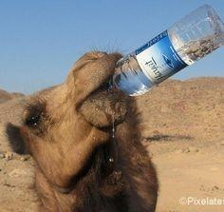
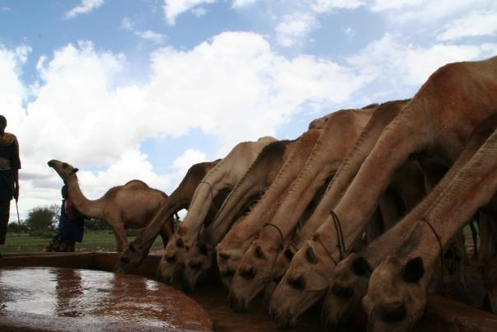
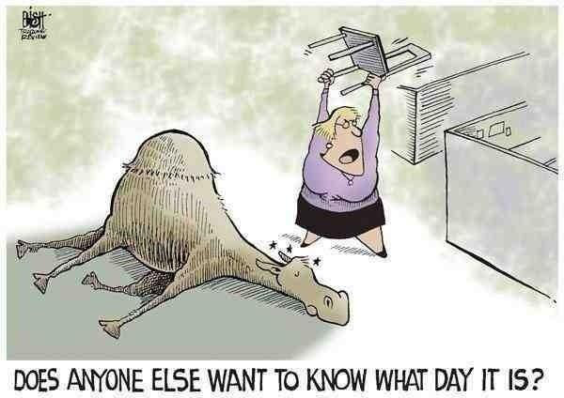
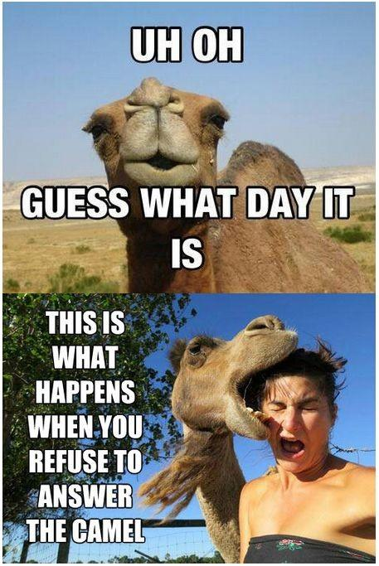
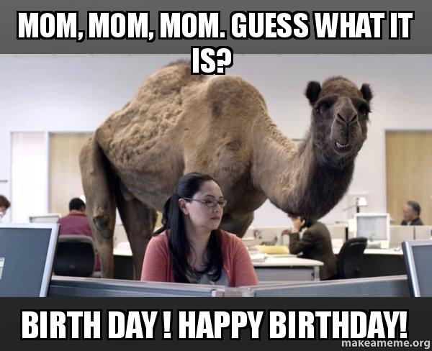

Slide 11
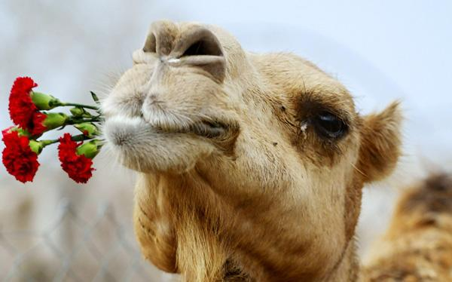
Camels Camels Everywhere!
Genesis 24
Happy Mother’s Day !!

Slide 12
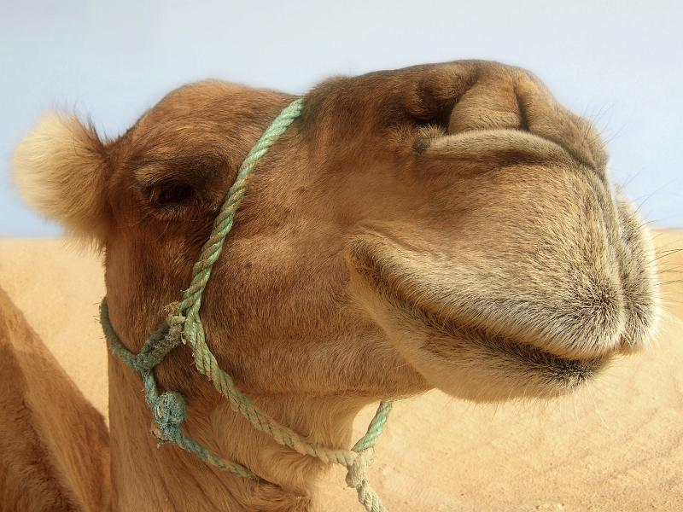
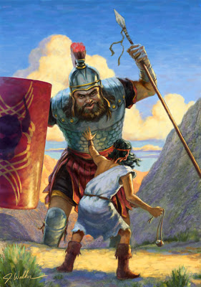
God Used the Camel to Bring Opportunity for …
#1- Growth
Sometimes God Sends a Giant (David)
Sometimes He Sends a Camel (Reb)
Always For Growth
All We Can See If Not Looking
…Big Giants
…Stinky Camels

Slide 13
God Used the Camel to Bring Opportunity for …
#1- Growth
#2- Service
Flexing our Servant Muscles is the Quickest Way to…
…Please God and Grow in Him
Average (we live in a world were average is normal)
Jesus was Against Average
Go Second Mile= Matt 5:41
Rebekah (capture by beauty)=beautiful inside/ out
Dan 6:3, “..excellent spirit..”

Slide 14
The Camel Brings….. Opportunity for … #1- Growth #2- Service
Goes Beyond
…Normal Stopping Points
Crowded (13)
Call -distance -ran (20)
Climb -History says well on hill
Goes Beyond
…Abnormal Stopping Points
10 Camels
20/30 Gals Each
5 Gal Pitcher
Stand Line
Far Away –Ran
Up Hill
40/60 Trips
Time -2-3 Hrs.

Slide 15
The Camel Brings….. Opportunity for …
#1- Growth-
#2- Service-
#3- Promotion-
She Took Time for Service for Camels-
Soon She Would Own Those Camels + a Whole Lot More
Watering of the Camels = a Sign to the Servant
Shows Him that Rebekah Had…
…the Characteristics of Abraham’s Family
Do You Have the Family Trait?
Step Beyond Average!!!

Slide 16
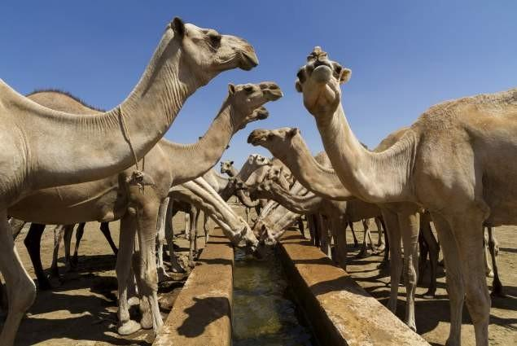
The Camels are Waiting!
God’s Waiting Too!

Slide 17
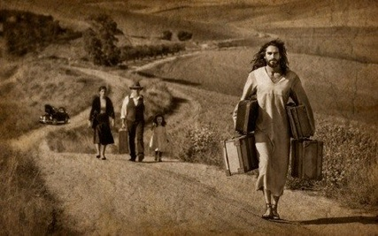
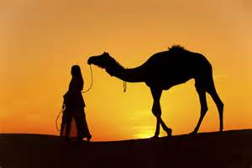
God is Looking
For a
Second Mile
Mom!!

Slide 18
Happy Mother’s Day !!
I am Much Cuter than a Camel

Slide 25
The Camel Brings….. Opportunity for …
#1- Growth-
#2- Service-
Flexing our servant muscles is the quickest way to please God and Grow in Him
Average (we live in a world were average is normal)
Jesus was against Avgas –Go Second Mile= Matt 5:41
Rebekah (capture by beauty)=beautiful inside/ out Dan 6:3, “..excellent spirit..”
1- Goes beyond Normal Stopping Points
a- crowded (13)
b- call -distance -ran (20)
c- climb -History tells us well on hill
2- Goes beyond Abnormal Stopping Points
10 camels
20/30 gals each
5 gal pitcher
stand line
far away –ran
Up hill
40/60 trips
poss. time -2-3 hrs.

