Slide 2

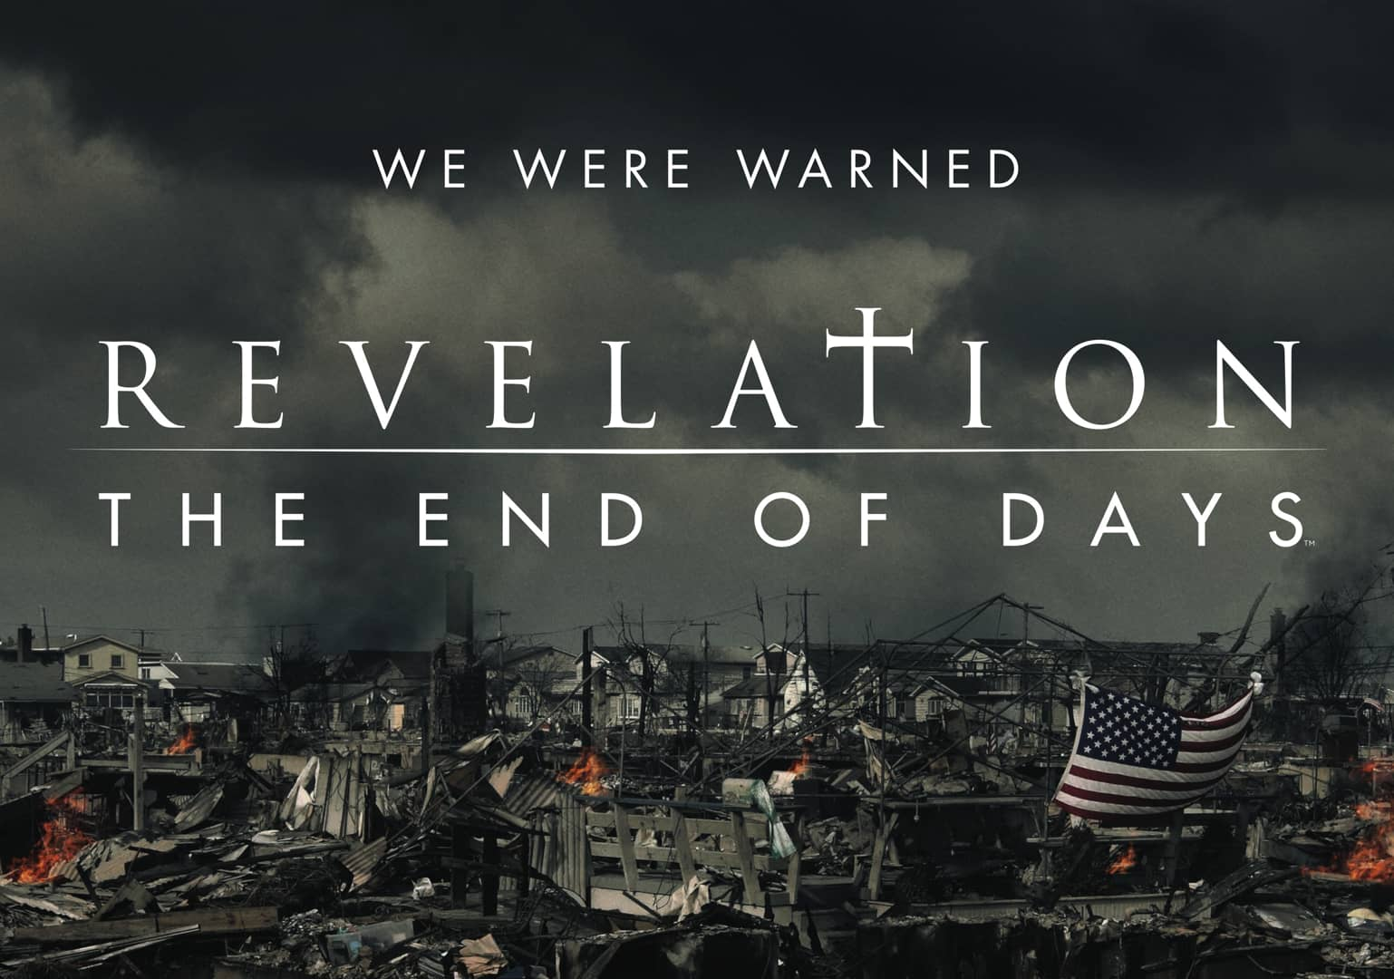
August 29, 2021
Edward Church
Revelation (6:1-4) pt.4
“ Black Horse”

Slide 3
Revelation 6:5-7 (KJV)
⁵ And when he had opened the third seal, I heard the third beast say, Come and see. And I beheld, and lo a black horse; and he that sat on him had a pair of balances in his hand.
⁶ And I heard a voice in the midst of the four beasts say, A measure of wheat for a penny, and three measures of barley for a penny; and see thou hurt not the oil and the wine.
⁷ And when he had opened the fourth seal, I heard the voice of the fourth beast say, Come and see.

Slide 4
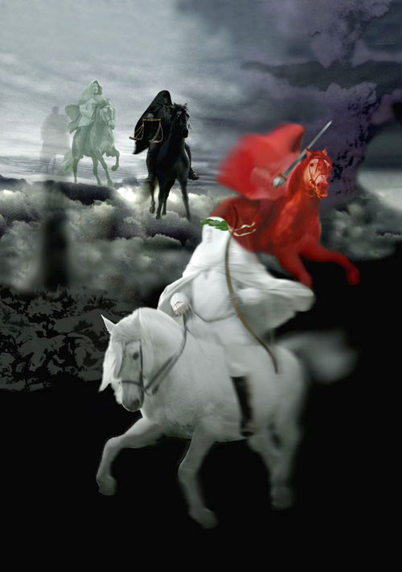
Jesus breaks the seven seals on the book one by one.
As the seals are opened, a series of Divine Judgments are poured out upon the earth and those who dwell on the earth.
The four seals describe events that will take place during the…
…First 21 months of Tribulation.

Slide 5
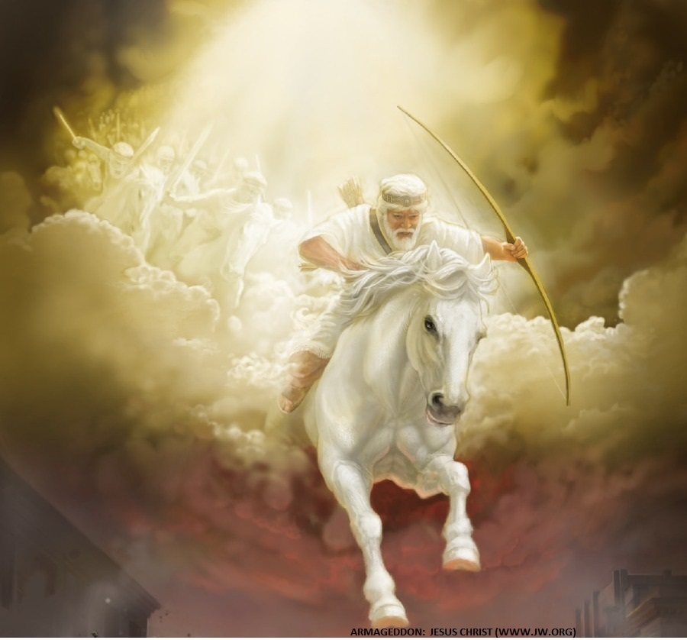
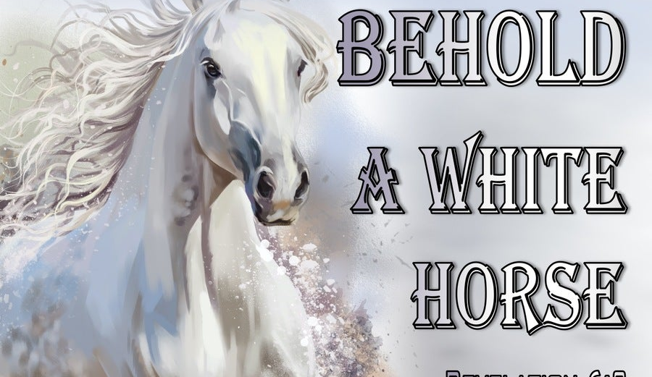
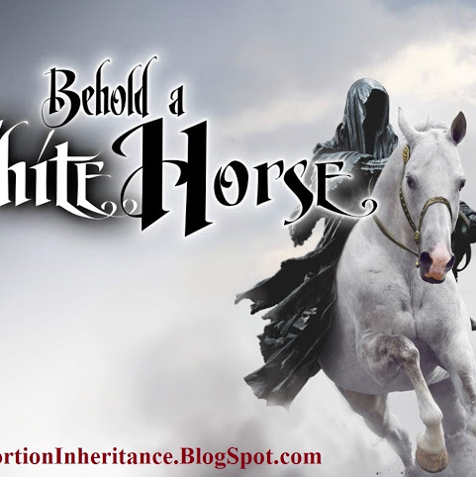
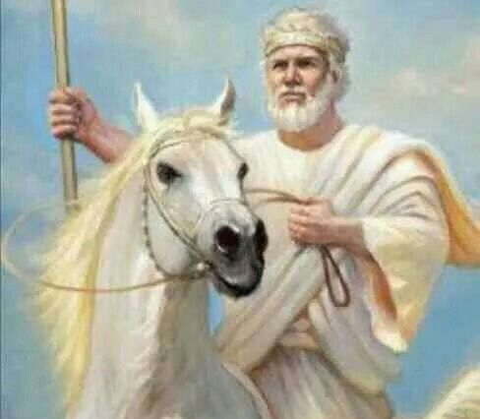
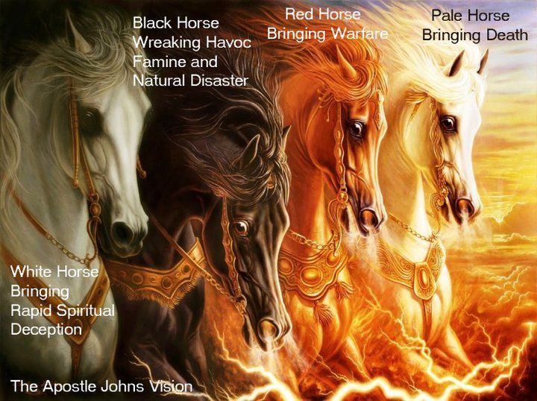
When The Lamb Opens First Seal,
…“The Noise Of Thunder” in Heaven
Signals the Approach of a Storm
What Is About To Be Unleashed…
…On This World Is
…Beyond Description.

Slide 6
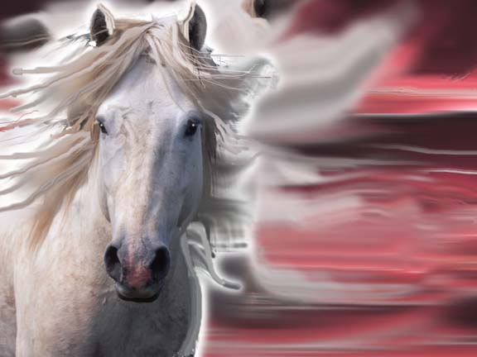
The White Horse of Deception
He’s the…
“Great Counterfeiter”
Does all to Imitate Christ…
…to Deceive the Masses
Jews will Believe He is
…the True Messiah
…Until
Satan Inhabits Him Midway
..of the
…Tribulation Period

Slide 7
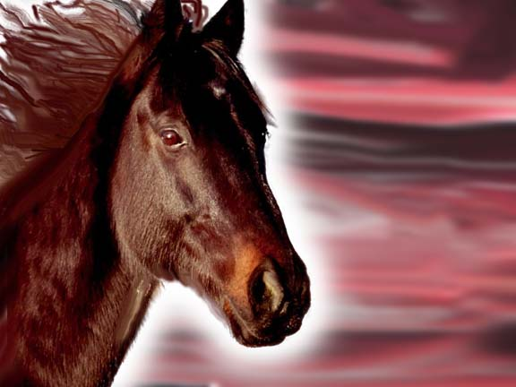
Revelation 6:3-4
2nd Seal
Red Horse
of Destruction
“War”
Notes:
2. Think of the word Division—red horse

Slide 8
Red Horse Of Destruction
The Planet Is Brutalized
    “Great”
    –refers to the extent
    In every aspect that we can comprehend
    “Sword”
    –refers to short sword
…used in
Assassinations
    The World is…
    …Ripe for War
Notes:
2. Think of the word Division—red horse

Slide 9
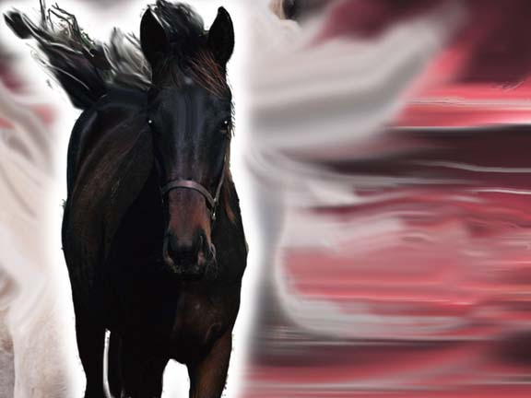
Revelation 6:5-6
3rd Seal
Black Horse Of Destitution
War and Famine
are
Evil Companions
Notes:
3. Depravation…as the black horse rides by. Then click again at “Balances” to add scales pic.

Slide 10
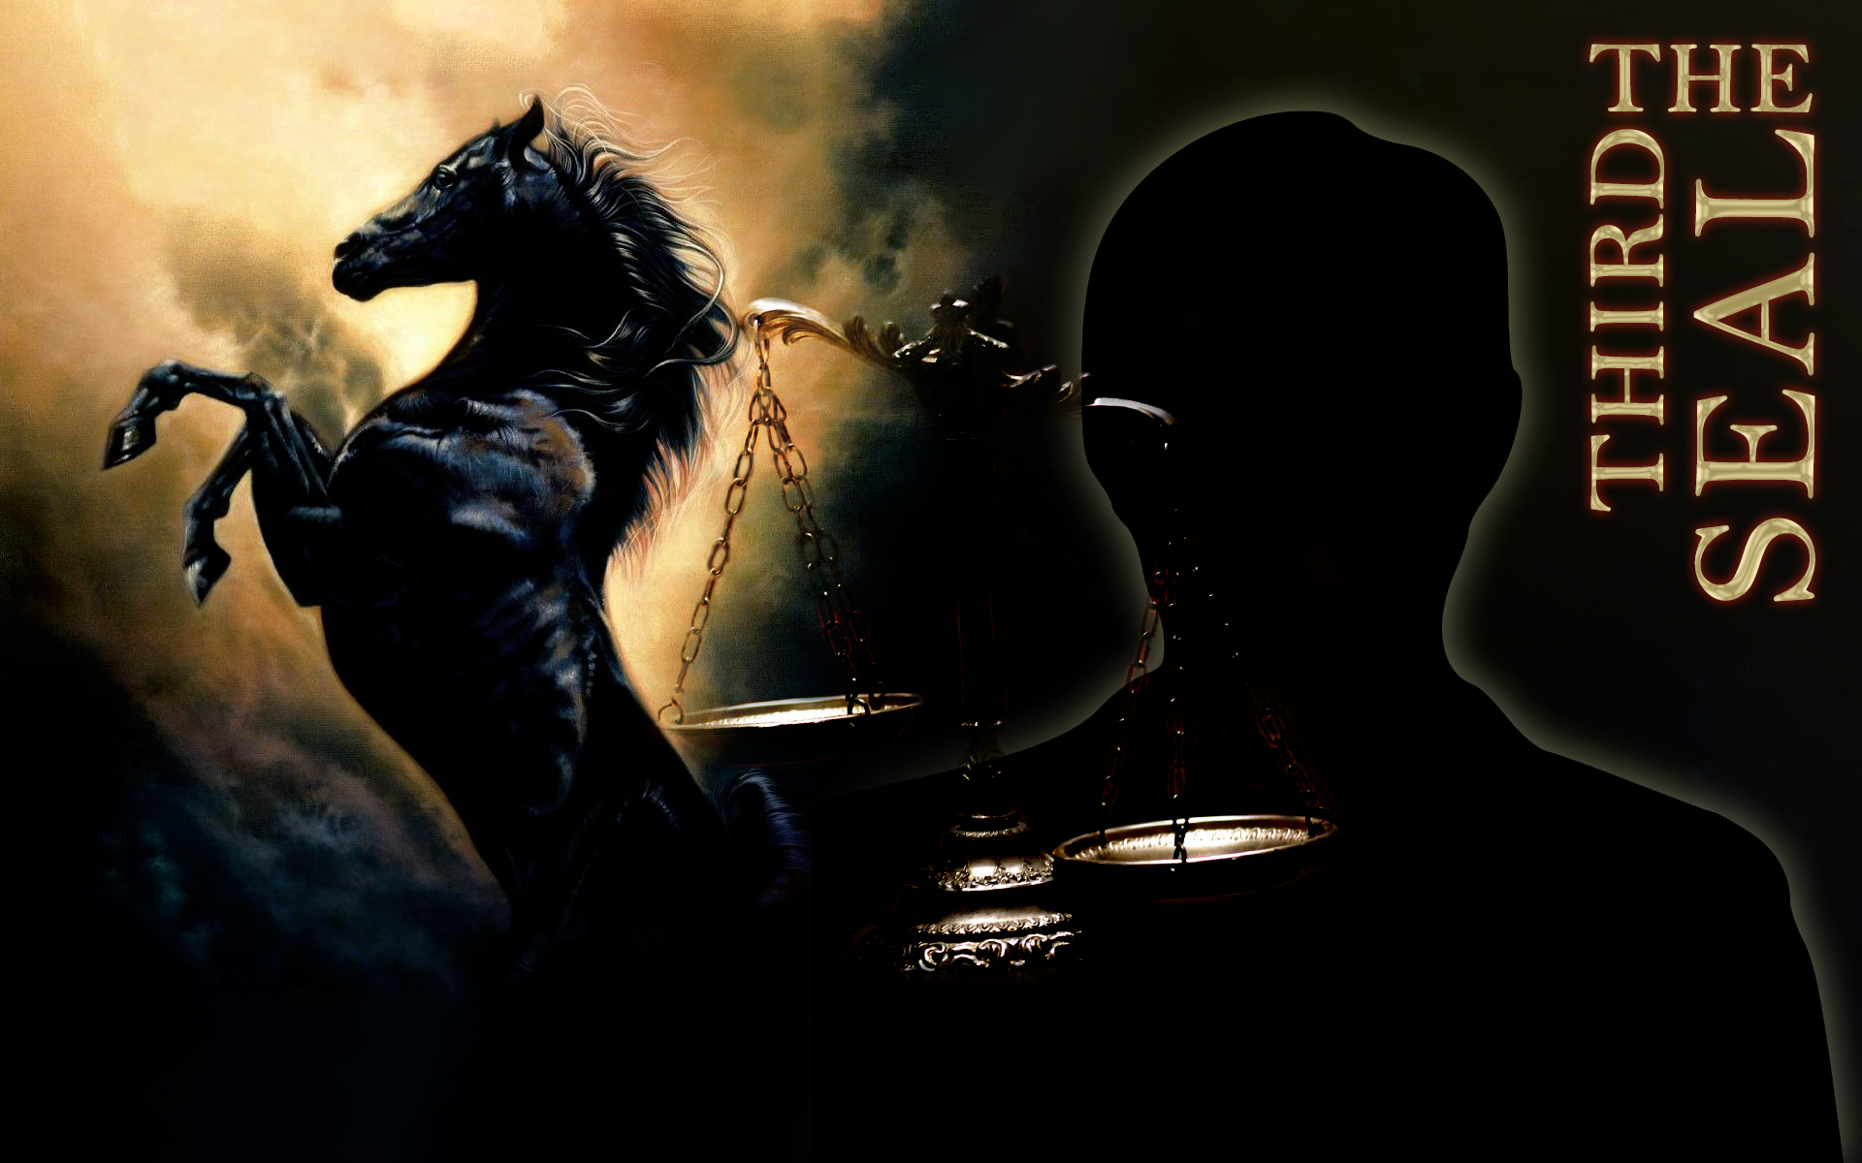
Notes:
3. Depravation…as the black horse rides by. Then click again at “Balances” to add scales pic.

Slide 11
Black Horse Of Destitution
Marked by Shortages
      Set of Scales = Rations
      Indicates Tribulation marked by…
      …Severe Shortages
      So Severe…
      …Basic Necessities
      …are Rationed
Notes:
3. Depravation…as the black horse rides by. Then click again at “Balances” to add scales pic.

Slide 12
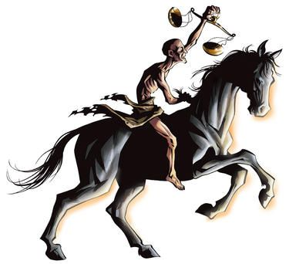
Black Horse Of Destitution
Marked by Starvation
    Measure (enough food to feed grown working man for one day)
    Barley
    (cheap…
    -used for livestock…
…poor man's food)
    Penny
    (denarii =
    days wage)
Notes:
3. Depravation…as the black horse rides by. Then click again at “Balances” to add scales pic.

Slide 13
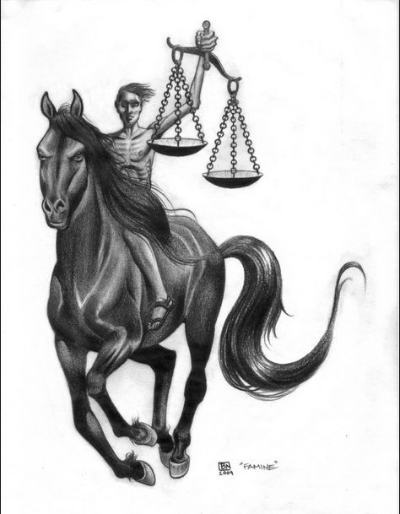
Black Horse Of Destitution
Marked by Separation
      “hurt not the…
      Oil and Wine...”
      Luxury Items Not Effected
      Classes Will Grow Farther Apart
Notes:
3. Depravation…as the black horse rides by. Then click again at “Balances” to add scales pic.

Slide 14
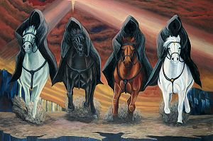
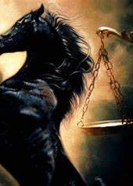
All Hell IS Breaking Loose!
You Don’t Have to…
…Experience What’s Coming
“Today is the Day of Salvation”

