Slide 1
Try Not to Mess it Up!!!
This is the Day that the Lord Hath Made
We Will Rejoice and Be Glad in It!!
Glory

Slide 2
Repeat
These are the 2 Most Important Hours of My Week – Help Me to Cherish Them
I Am Here Today to Worship
Not to Be Entertained
I Am Singing to An Audience of One
Accept My Worship Oh Lord!

Slide 3
Repeat
I Lift My Offering to You
Let It Please You Oh Lord
This is My Seed
Although It Leaves My Hand
It will Never Leave My Life
You Will Multiply It!
Accept My Seed Oh Lord!

Slide 4
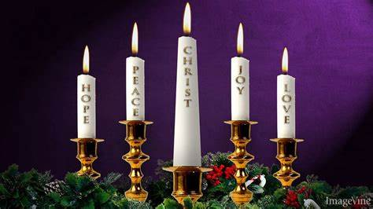

Slide 6
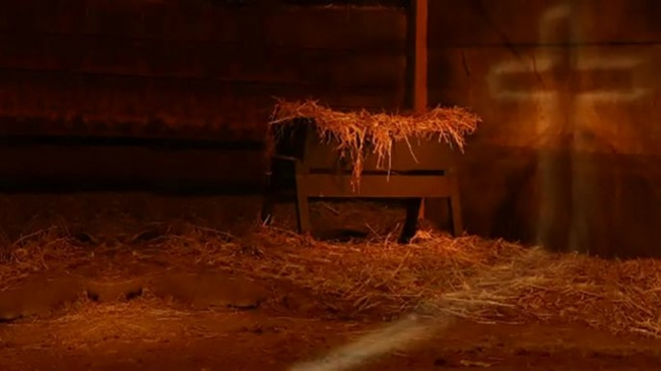
More Than a Manger…
…Redemption Journey
…Beginning and the End
Back to Basics
The Power of the Manger
Pt1
Christmas 2021
Edward Church

Slide 7


Now Let’s Look Back 2021 Years
Life For Mary And Joseph Was Turned…
Upside Down
Inside Out
Right Is Wrong
Wrong Is Right
2021 Has Been A Very ________ Year
Life As We Know It Has Been Turned…
Upside Down
Inside Out
Right Is Wrong
Wrong Is Right

Slide 8

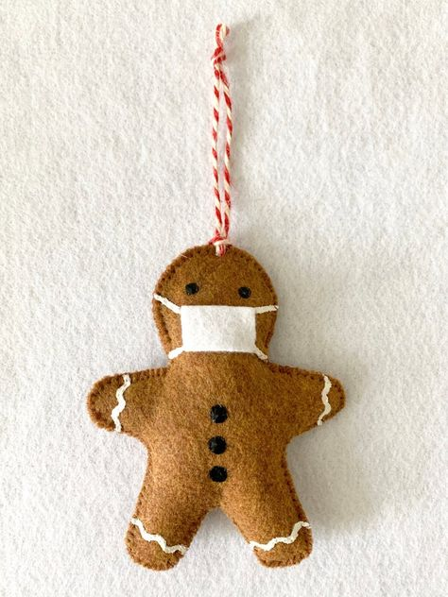
The 14 Day Shut Down
  Turned Into 2 years
  NO STOPPING in Sight
COVID SEEMS to Be in CONTROL

Slide 9
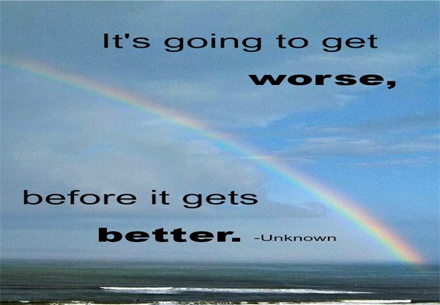
I Believe that 2021
Beginning
Set Up
Prophetic
Bigger Things to Come
2021 Years Ago
Beginning
Set Up
Prophetic
Bigger Things to Come

Slide 10
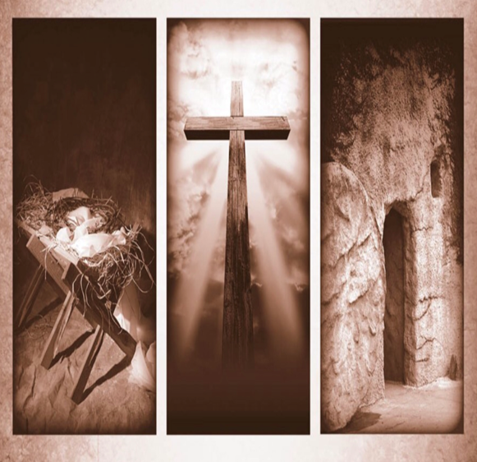
More Than the Manger
When You Think of Christmas…
…How Often Do You
…Connect It with Easter?
It’s a 6 Mile Journey Between the Manger and the Cross.
  This Journey, is the Story of Jesus’ Incarnation.
  From His Birth, His Life Always Pointed to His Death.
The Manger Was the Set-up For More to Come

Slide 11
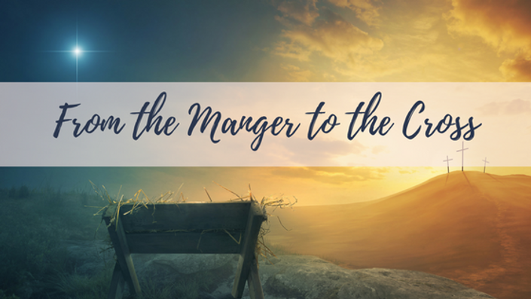
Luke 2
And it came to pass in those days, that there went out a decree from Caesar Augustus, that all the world should be taxed. 2 (And this taxing was first made when Cyrenius was governor of Syria.) 3 And all went to be taxed, every one into his own city. 4 And Joseph also went up from Galilee, out of the city of Nazareth, into Judaea, unto the city of David, which is called Bethlehem; (because he was of the house and lineage of David:) 5 To be taxed with Mary his espoused wife, being great with child. 6 And so it was, that, while they were there, the days were accomplished that she should be delivered. 7 And she brought forth her firstborn son, and wrapped him in swaddling clothes, and laid him in a manger; because there was no room for them in the inn.

Slide 12

Manger
Cross
No Room (3-4)
Crowd There (Taxed)
Dreaded
Still God was in Control
No Room (Luke 22)
Crowd There (Passover)
Celebration
Still God was in Control

Slide 13

Cross
Manger
Accomplished (6)
Fulness of Time
Galatians 4:4-5 (KJV)
⁴ But when the fulness of the time was come, God sent forth his Son, made of a woman, made under the law,
6 And so it was, that, while they were there, the days were accomplished that she should be delivered.
Accomplished (John 19:28-30)
Fulness of Time
Galatians 4:4-5 (KJV)
⁵ To redeem them that were under the law, that we might receive the adoption of sons.
28 After this, knowing that everything had now been accomplished, and to fulfill the Scripture, Jesus said, “I am thirsty.” 29 A jar of sour wine was sitting there. So they soaked a sponge in the wine, put it on a stalk of hyssop, and lifted it to His mouth. 30 When Jesus had received the sour wine, He said, “It is finished.” And bowing His head, He yielded up His spirit.

Slide 14
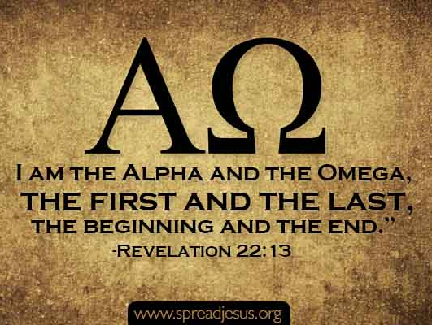

Covid is…
Powerful But Not All Powerful
Has a Beginning and an End
But…
Jesus is…
All Powerful
He is The Beginning…
…The End

Slide 15
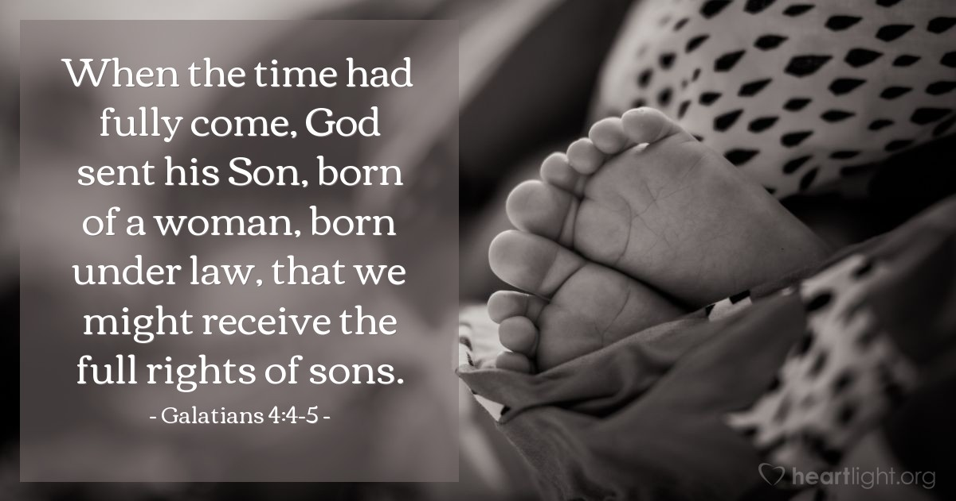
Just as with…
        Manger
        Cross
Your Time is Coming Too!

Slide 16
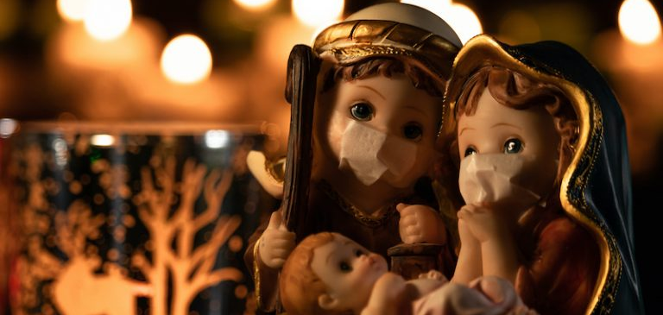
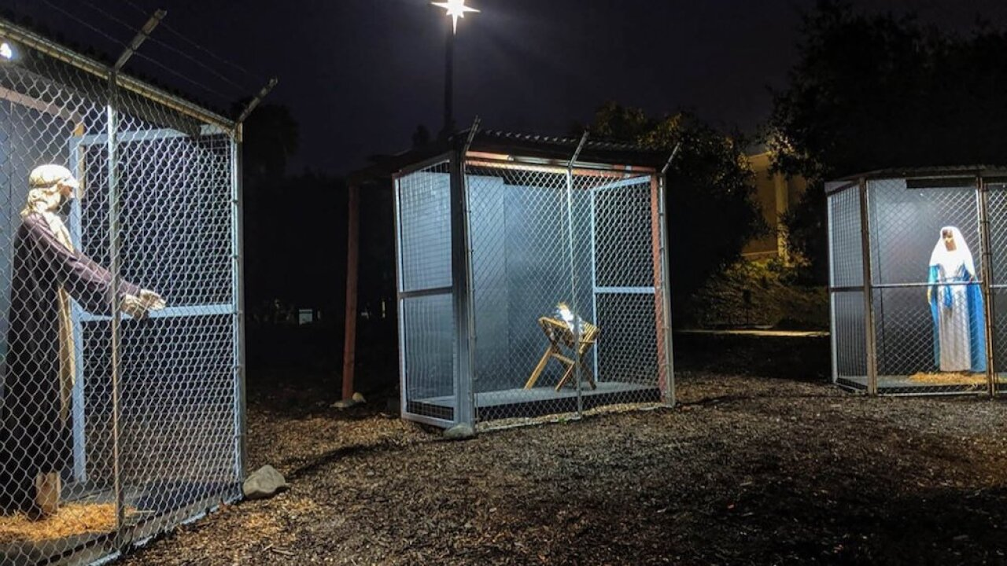
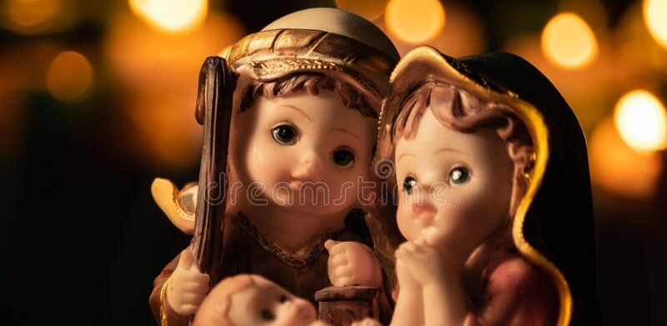
Remember
COVID Will Not Win
Your Problems Will Not Win
The Alpha and Omega
Beginning and End
The Great I Am
Will Lead You to Victory!!!

