Slide 1
Try Not to Mess it Up!!!
This is the Day that the Lord Hath Made
We Will Rejoice and Be Glad in It!!
Glory

Slide 2
Announcements
Please Prayer for the Storm Victims

Slide 3
Repeat
These are the 2 Most Important Hours of My Week – Help Me to Cherish Them
I Am Here Today to Worship
Not to Be Entertained
I Am Singing to An Audience of One
Accept My Worship Oh Lord!

Slide 4
Praise Time

Slide 5
I keep falling in love with Him
Over and over and over and over again
I keep falling in love with Him
Over and over and over and over again
.
[Chorus]
He gets sweeter and sweeter
as the days go by
Oh what a love between my Lord and I
I keep falling in love with Him

Slide 6
Verse 1
O come let us adore Him, O come let us adore Him
O come let us adore Him, Christ the Lord.
Verse 2
For You alone are worthy, For You alone are worthy
For You alone are wor-thy, Christ the Lord.
Verse 3
We'll give You all the glory, We'll give You all the glory,
We'll give You all the glo - ry, Christ the Lord.

Slide 7
Repeat
I Lift My Offering to You
Let It Please You Oh Lord
This is My Seed
Although It Leaves My Hand
It will Never Leave My Life
You Will Multiply It!
Accept My Seed Oh Lord!

Slide 8


Slide 9
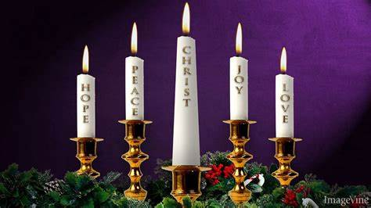

Slide 10
Two snowmen are standing in a field. One says to the other: "Can you smell carrots?"
A woman goes to the post office to buy stamps for her Christmas cards. She says to the clerk, "May I have 50 Christmas stamps?"
The clerk says, "What denomination?"
The woman says, "God help us. Has it come to this? Okay, give me 6 Catholic, 12 Presbyterian, 10 Lutheran and 22 Baptists."

Slide 12
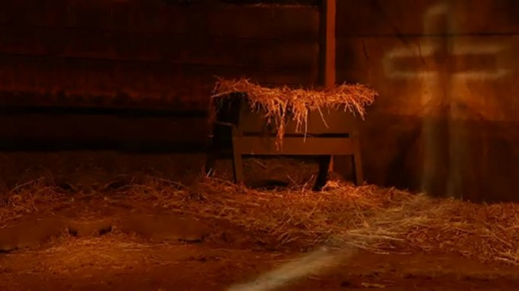
More Than a Manger…
…Redemption Journey
…Beginning and the End
Back to Basics
The Power of the Manger
Pt2
Christmas 2021
Edward Church

Slide 13

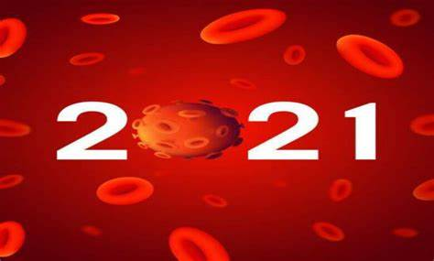
Now Let’s Look Back 2021 Years
Life For Mary And Joseph Was Turned…
Upside Down
Inside Out
Right Is Wrong
Wrong Is Right
2021 Has Been A Very ________ Year
Life As We Know It Has Been Turned…
Upside Down
Inside Out
Right Is Wrong
Wrong Is Right

Slide 14
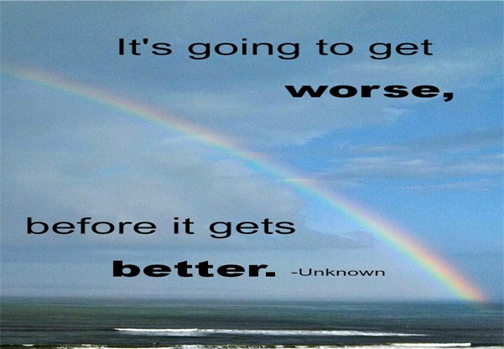
I Believe that 2021
Beginning
Set Up
Prophetic
Bigger Things to Come
2021 Years Ago
Beginning
Set Up
Prophetic
Bigger Things to Come

Slide 15
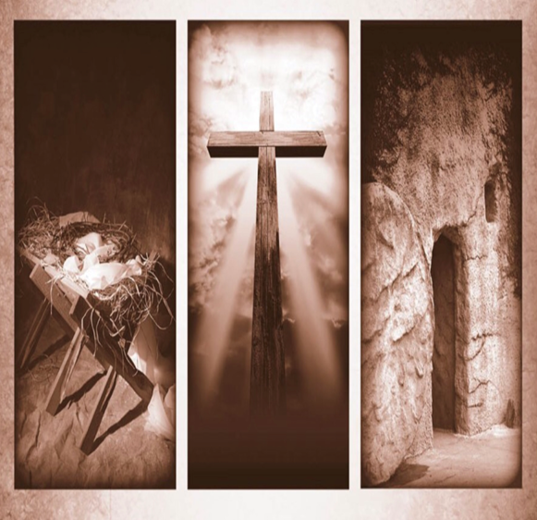
More Than the Manger
When You Think of Christmas…
…How Often Do You
…Connect It with Easter?
It’s a 6 Mile Journey Between the Manger and the Cross.
  This Journey, is the Story of Jesus’ Incarnation.
  From His Birth, His Life Always Pointed to His Death.
The Manger Was the Set-up For More to Come

Slide 16

Manger
Cross
No Room (3-4)
Crowd There (Taxed)
Dreaded
Still God was in Control
No Room (Luke 22)
Crowd There (Passover)
Celebration
Still God was in Control

Slide 17
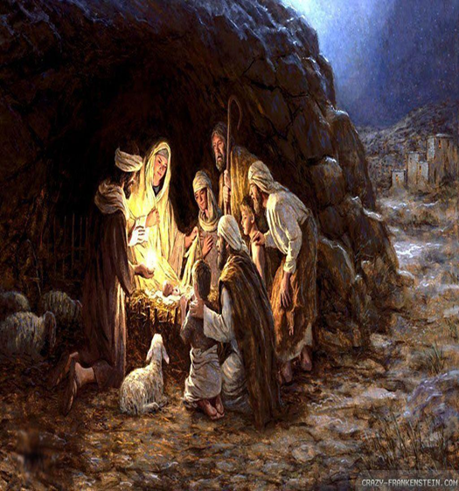
Manger
Cross
Cave (7)
Borrowed Stable
They Had No Way
God Made a Way…
…Where There Was No Way
Cave (Matt 27:57-60 )
Borrowed Tomb
They Had No Way
God Made a Way…
…Where There Was No Way

Slide 18
Manger
Cross
Manger (7)
Broken Wood
Carry Out Common Task
Dispense Broken Food
Helpless
In Hands of Others
Back Upon the Wood
Precious Gift
Cross (John 19:17)
Broken Wood
Carry Out Common Task
Dispense Broken Body
Helpless
In Hands of Others
Back Upon the Wood
Precious Gift

Slide 19
Manger
Cross
Swaddling Clothes
Linen Strips
Brought Comfort
Temporary
One-Time Use
Soon Empty
Grave Clothes ( )
Linen Strips
Brought Comfort
Temporary
One-Time Use
Soon Empty

Slide 20
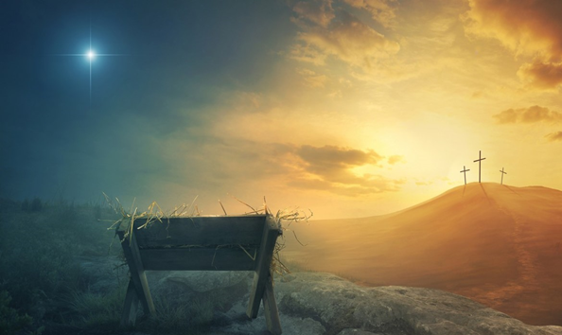
Manger
Cross
Dependable Guide
“Star”
High / Lifted Up
Pointed to God
Darkness Could Not Hide It
Only Made It Brighter
Gave Hope
Dependable Guide
“Cross”
High / Lifted Up
Pointed to God
Darkness Could Not Hide It
Only Made It Brighter
Gave Hope

Slide 21
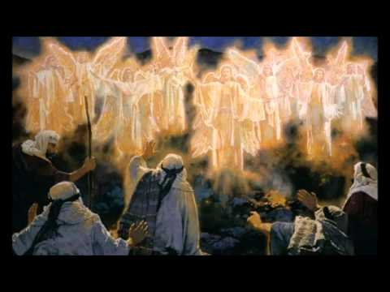
Manger
Cross
Angels Announced
Common People
Uncommon Message
Brought Fear
Became Joy
He is Here
Common People…
…Spread Uncommon Message
Angels Announced
Common People
Uncommon Message
Brought Fear
Became Joy
He is Not Here
Common People…
…Spread Uncommon Message

Slide 22

He Did Not Come to Take Away the Pain.
…He Came to Share the Pain,
…To Show Us How and Help Us
…Bear the Cross that Would Face In Our Own Lives
Just as 2021 years ago was a Picture of Things to Come…
…2021 was Likewise a Picture of Things that Are Coming!

Slide 23
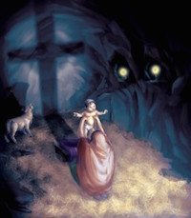
Manger
Cross
Became a Symbol of Hope
…and Life
Became a Symbol of Hope
…and Life
From Your Beginning …
…To Your End
God’s Got This!!!

Slide 24
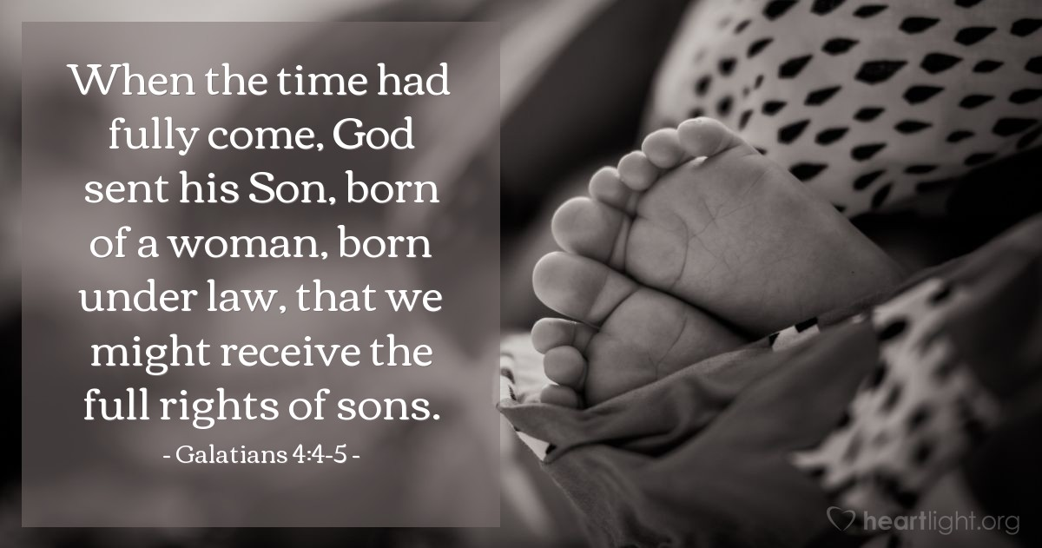
Just as with…
        Manger
        Cross
Your Time is Coming Too!

Slide 26
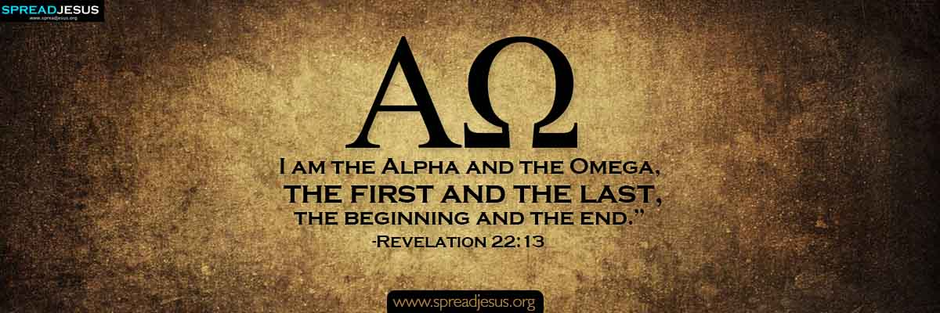

Covid is…
Powerful But Not All Powerful
Has a Beginning and an End
But…
Jesus is…
All Powerful
He is The Beginning…
…The End

Slide 27
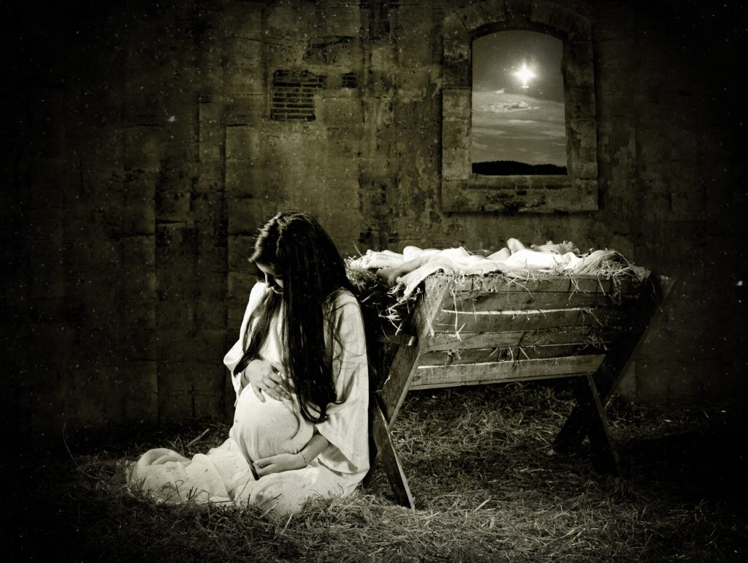


Slide 28
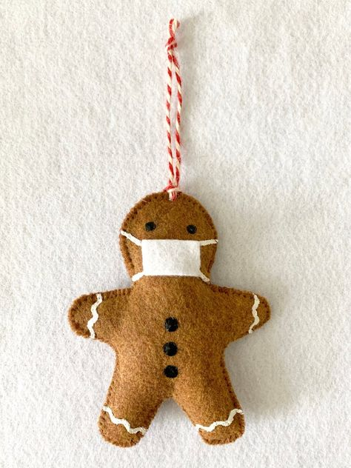
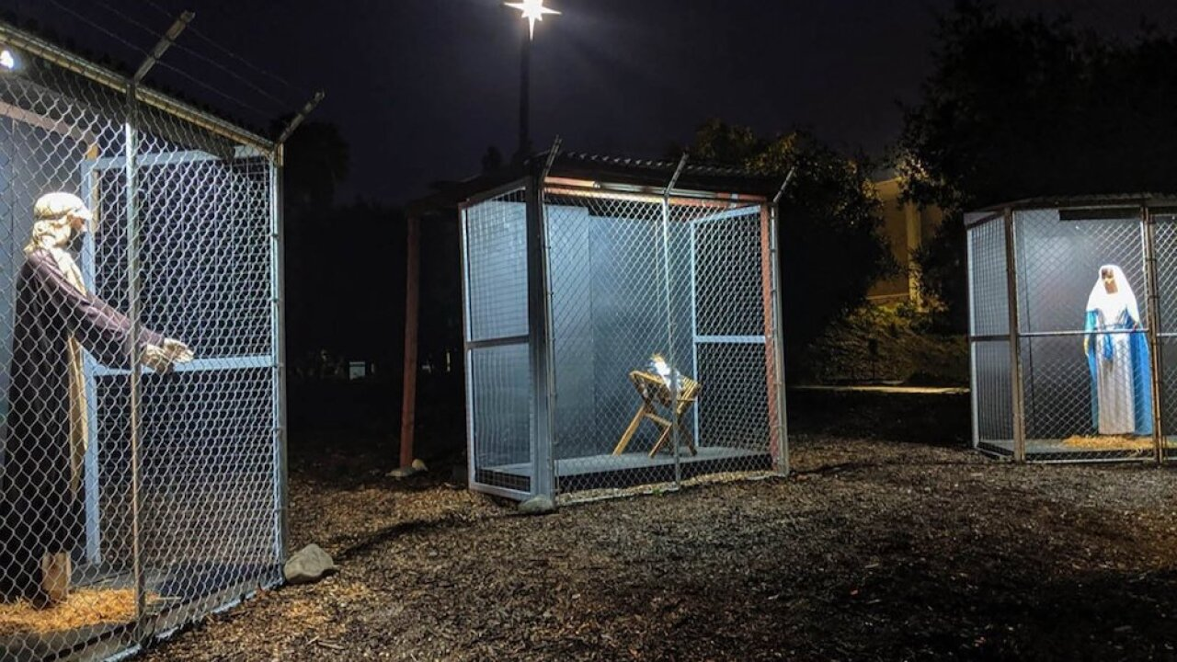
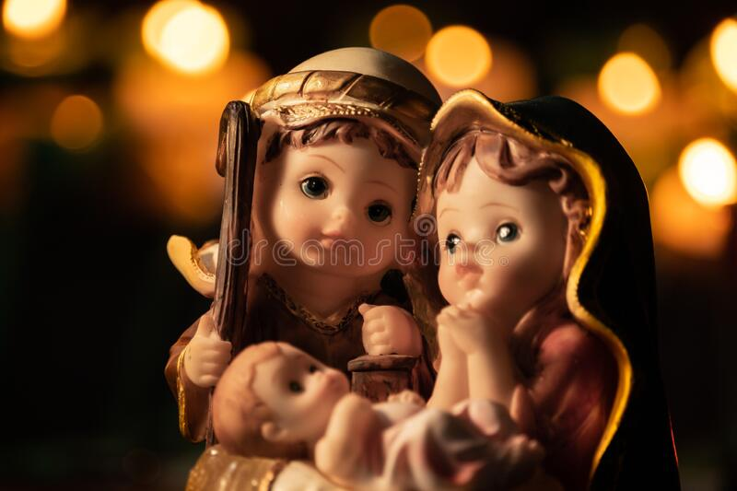

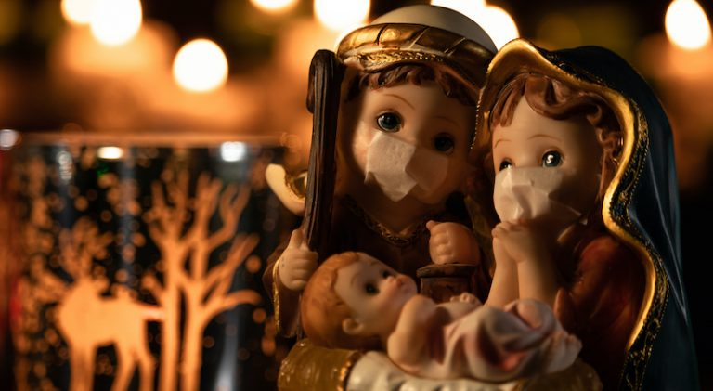

Slide 29
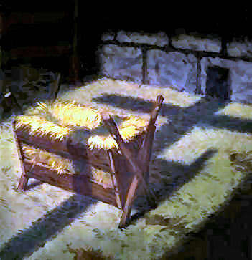
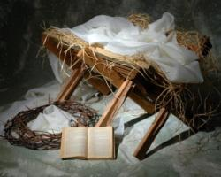


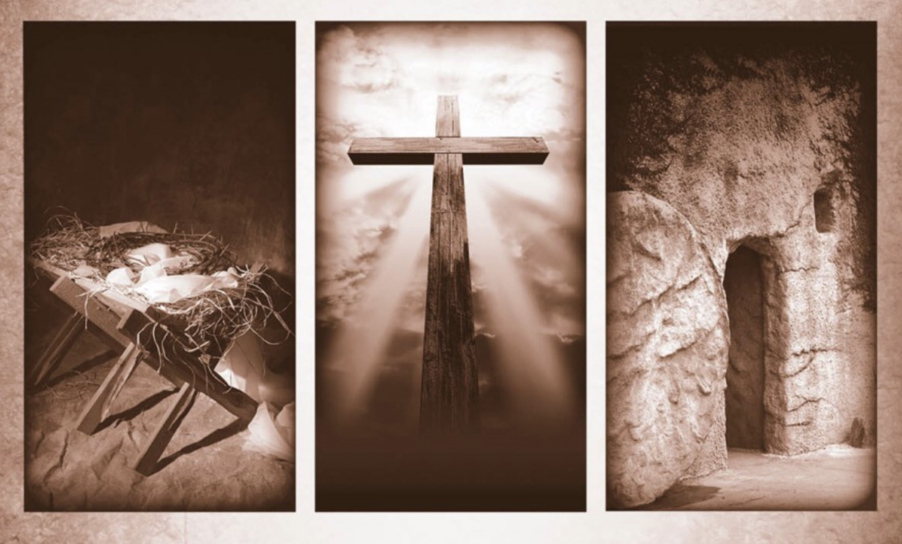

Slide 30

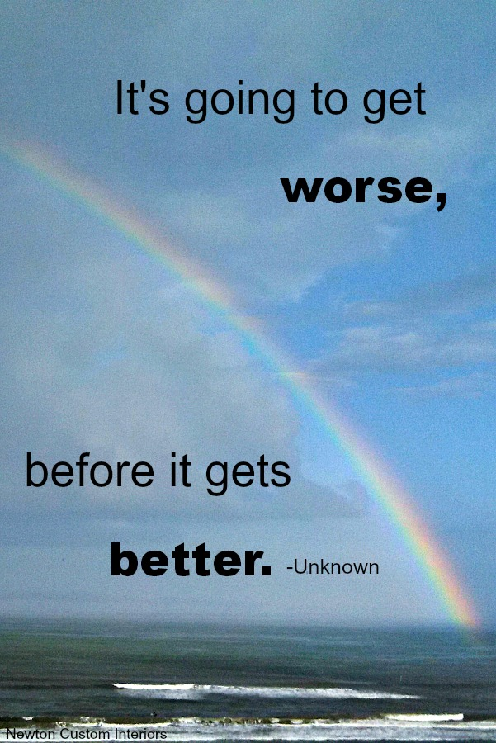


Slide 31
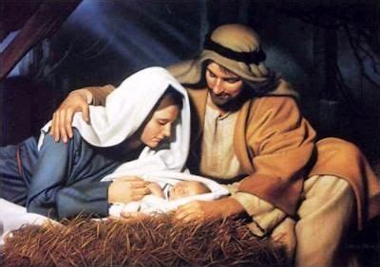
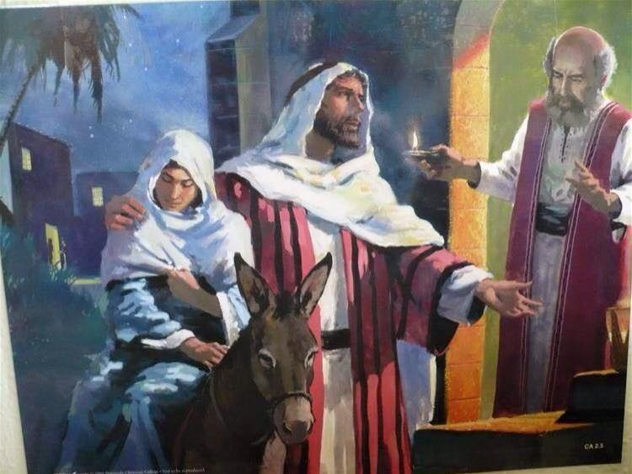
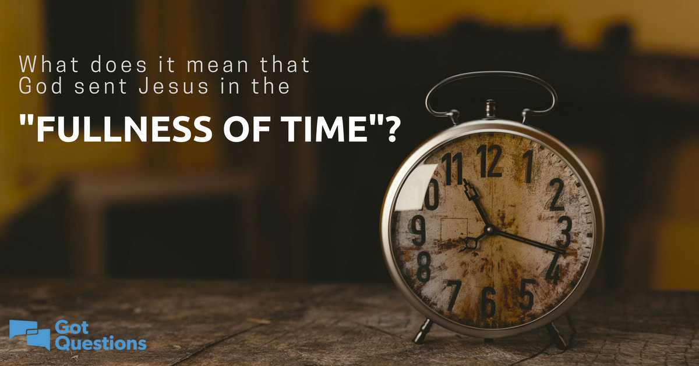


Slide 32
And the course wood of the manger and its placement outside, points to Jesus’ death on a wooden cross, which takes place outside where he was naked and exposed to the elements.
At the manger, Jesus is pictured with Joseph and Mary on each side. At the cross, Jesus is also flanked by two people, but they’re thieves. In both scenes, Mary looks upon Jesus.
At the manger, baby Jesus is swaddled in a cloth, perhaps by Joseph. After Jesus’ death on the cross, his body is wrapped in a linen burial cloth by Joseph of Arimathea.

Slide 33
No Room (place) - Cave
No Place- Borrowed Tomb

Slide 35
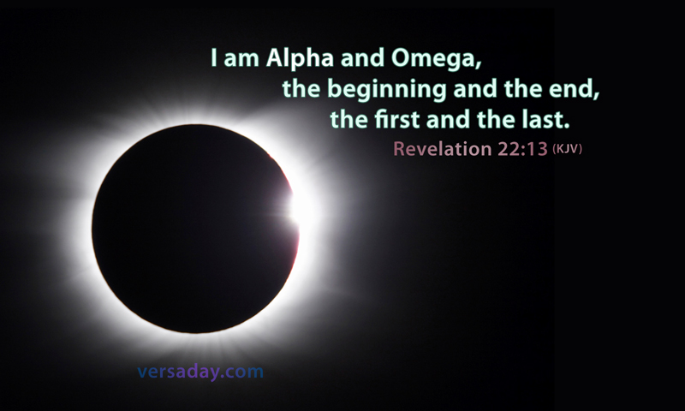
Covid is…
Powerful But Not All Powerful
Has a Beginning and an End
But…
Jesus is…
All Powerful
He is the Beginning…
…and an End

Slide 36
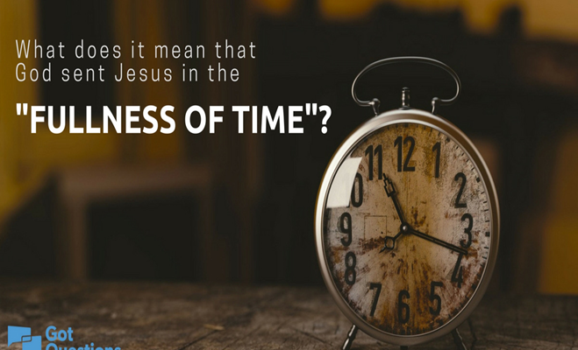
Cross
Manger
Accomplished (6)
Fulness of Time
Galatians 4:4-5 (KJV)
⁴ But when the fulness of the time was come, God sent forth his Son, made of a woman, made under the law,
6 And so it was, that, while they were there, the days were accomplished that she should be delivered.
Accomplished (John 19:28-30)
Fulness of Time
Galatians 4:4-5 (KJV)
⁵ To redeem them that were under the law, that we might receive the adoption of sons.
28 After this, knowing that everything had now been accomplished, and to fulfill the Scripture, Jesus said, “I am thirsty.” 29 A jar of sour wine was sitting there. So they soaked a sponge in the wine, put it on a stalk of hyssop, and lifted it to His mouth. 30 When Jesus had received the sour wine, He said, “It is finished.” And bowing His head, He yielded up His spirit.

Slide 37
The 14 Day Shut Down
  Turned Into 2 years
  NO STOPPING in Sight
COVID SEEMS to Be in CONTROL

Slide 38
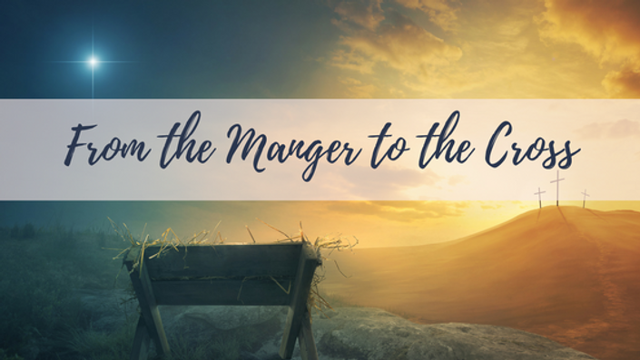
Luke 2
And it came to pass in those days, that there went out a decree from Caesar Augustus, that all the world should be taxed. 2 (And this taxing was first made when Cyrenius was governor of Syria.) 3 And all went to be taxed, every one into his own city. 4 And Joseph also went up from Galilee, out of the city of Nazareth, into Judaea, unto the city of David, which is called Bethlehem; (because he was of the house and lineage of David:) 5 To be taxed with Mary his espoused wife, being great with child. 6 And so it was, that, while they were there, the days were accomplished that she should be delivered. 7 And she brought forth her firstborn son, and wrapped him in swaddling clothes, and laid him in a manger; because there was no room for them in the inn.

Slide 39
Remember
COVID Will Not Win
Your Problems Will Not Win
The Alpha and Omega
Beginning and End
The Great I Am
Will Lead You to Victory!!!

