Slide 2
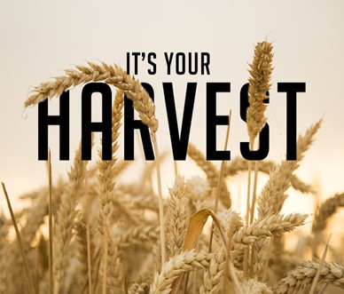
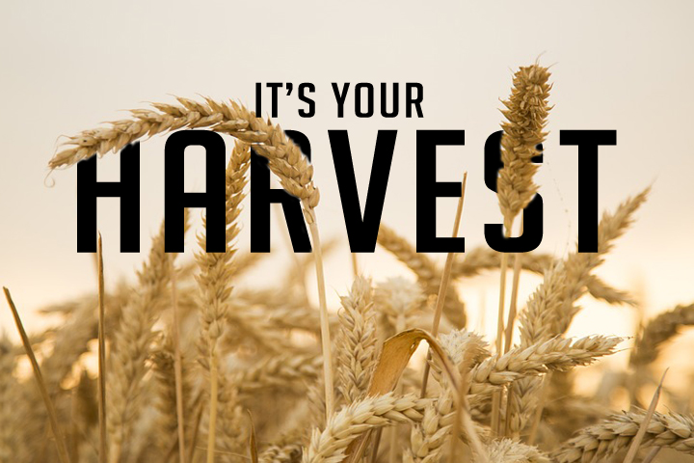
Plain Talk About Our Harvest pt1
Galatians 6:7-8
Edward Church
January 9, 2022

Slide 3
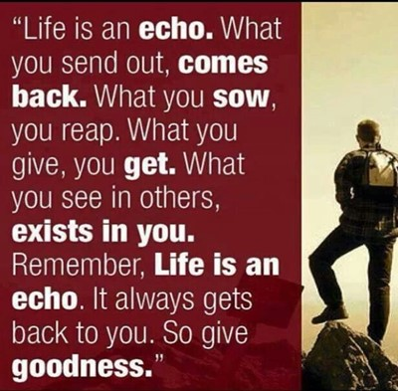
Last Week We Talked About Things Out of Our Control…
ie… Covid, World Events, Other People
Things in our Control
  Attitude Toward These
  Response to These
Let’s Add Another Item to Our List of What we can Control
  What and How We Sow

Slide 4
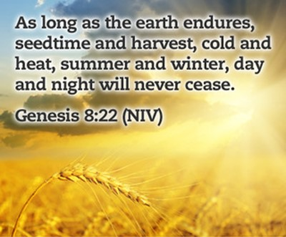
Principle
Promise
Provision
But
If Your God’s Child…
You Are Never
Hopeless / Helpless
2020 / 2021
Left Many Feeling Hopeless / Helpless

Slide 5
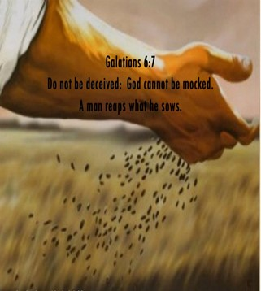
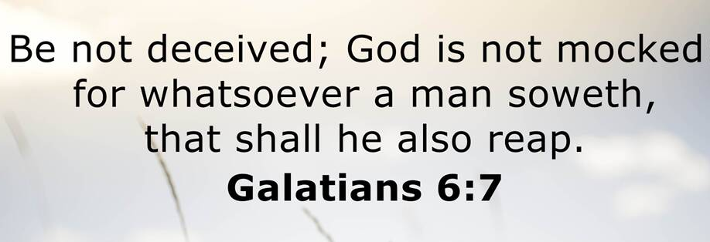
Whatsoever- Word, Deed, Action / Inaction
Soweth- scatter, invest
Shall- it will happen
Reap- Harvest, receive the same

Slide 6
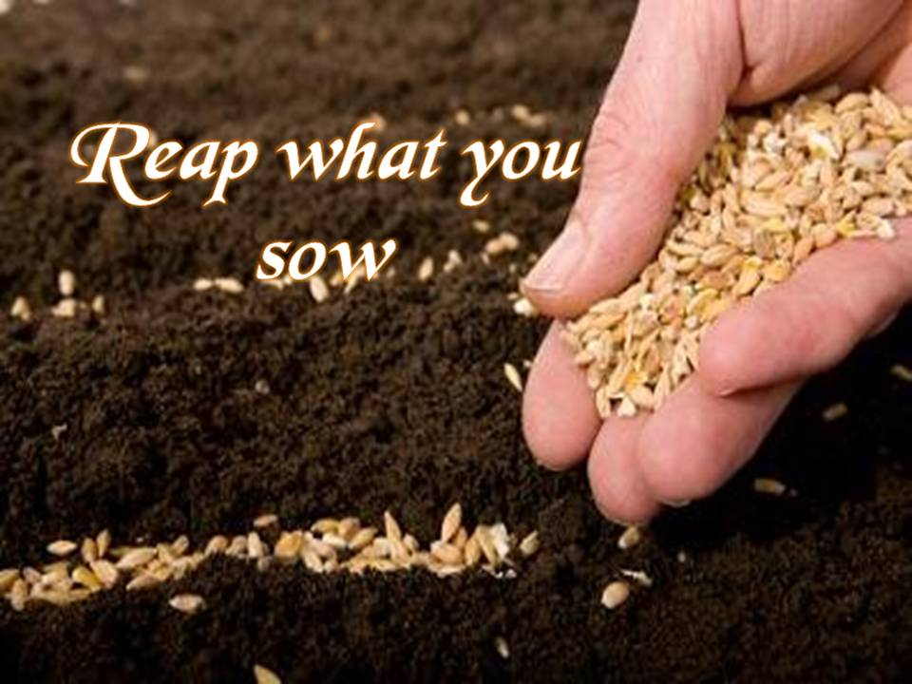
We Reap Only What Has Been Sown
Reaping From What We Sow
Reaping From What Others Sow
  Sowing Always Involves Seeds
  Seeds = Potential
  Seeds Always Produces a Harvest
  Harvest = Results
        Some are Positive
        Some are Negative

Slide 7
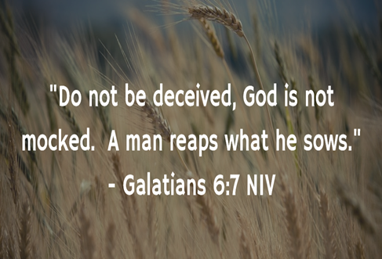
  Reaping From What We Sow
Negative…
"He that soweth iniquity shall reap vanity" -Prov 22:8
"For they have sown the wind, and they shall reap the whirlwind" -Hosea 8:7
James 4:17 (KJV)
¹⁷ Therefore to him that knoweth to do good, and doeth it not, to him it is sin.

Slide 8
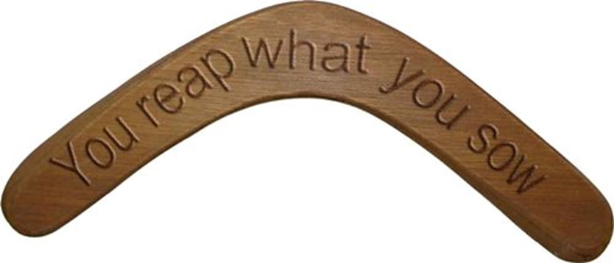
  Reaping From What We Sow
Positive…
Psalms 126:5-6
^{5 “}They that sow in tears shall reap in joy. ⁶ He that goeth forth and weepeth, bearing precious seed, shall doubtless come again with rejoicing, bringing his sheaves with him.”
Galatians 6:9-10 (KJV)
⁹ And let us not be weary in well doing: for in due season we shall reap, if we faint not. ¹⁰ As we have therefore opportunity, let us do good unto all men, especially unto them who are of the household of faith.

Slide 9
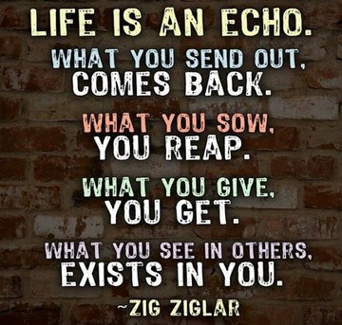
  Reaping From What We Sow
What are You Sowing?
Positive?
Negative?

