Slide 2
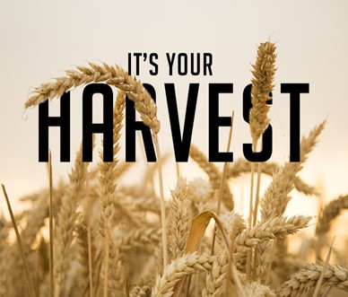
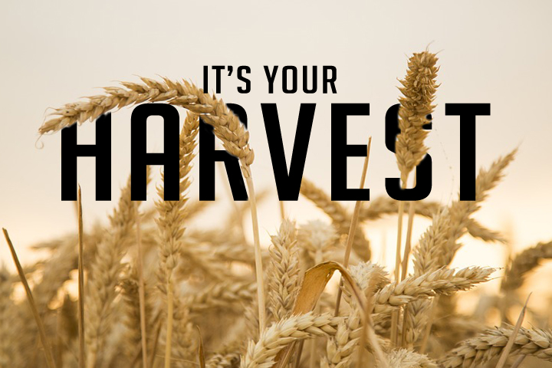
Plain Talk About Our Harvest pt2
Galatians 6:7-8
Edward Church
January 16, 2022

Slide 3
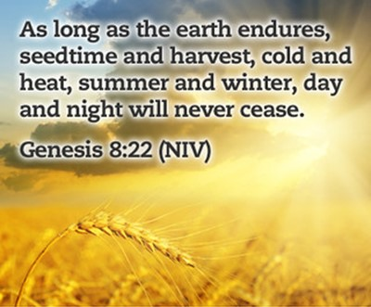
Principle
Promise
Provision
But
If Your God’s Child…
You Are Never
Hopeless / Helpless
2020 / 2021
Left Many Feeling Hopeless / Helpless

Slide 4
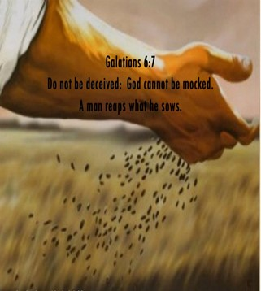
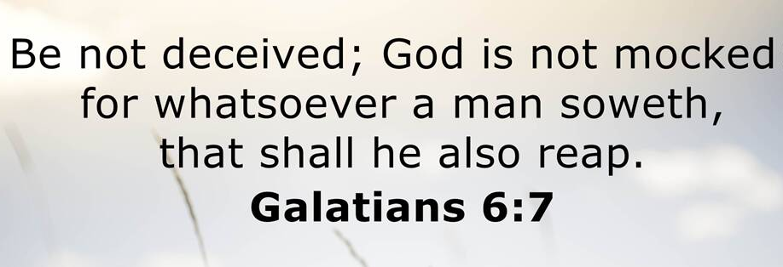
Whatsoever- Word, Deed, Action / Inaction
Soweth- scatter, invest
Shall- it will happen
Reap- Harvest, receive the same

Slide 5
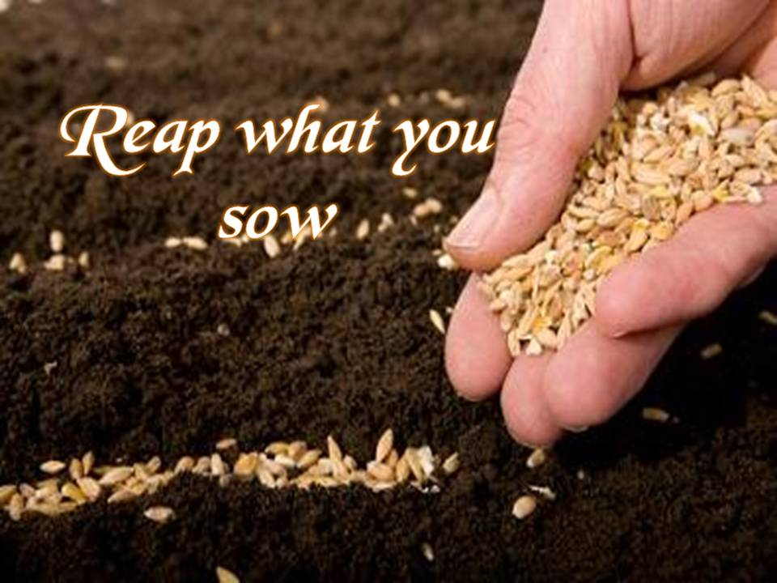
We Reap Only What Has Been Sown
Reaping From What We Sow
Reaping From What Others Sow
  Sowing Always Involves Seeds
  Seeds = Potential
  Seeds Always Produces a Harvest
  Harvest = Results
        Some are Positive
        Some are Negative

Slide 6
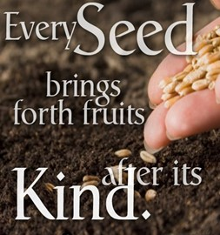
We Reap the Same In Kind As We Sow
Whatsoever
Seed Always Surrenders to the…
…Law of Reproduction
Not Just Natural Seeds…
…But
Seeds of…
          Attitudes
          Actions
This Involves Spiritual, Mental, Emotional Seeds

Slide 7
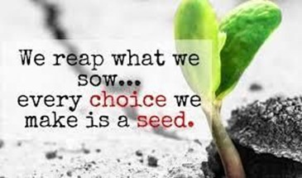
We Reap the Same In Kind As We Sow
Job 4:8 (AMP)
As I myself have seen, those who plow iniquity
And sow trouble and mischief reap the same.
Proverbs 11:18 (NASB)
The wicked earns deceptive wages, But he who sows
righteousness gets a true reward.
Matthew 7:12 (KJV)
Therefore all things whatsoever ye would that men
should do to you, do ye even so to them: for this is
the law and the prophets.

Slide 8
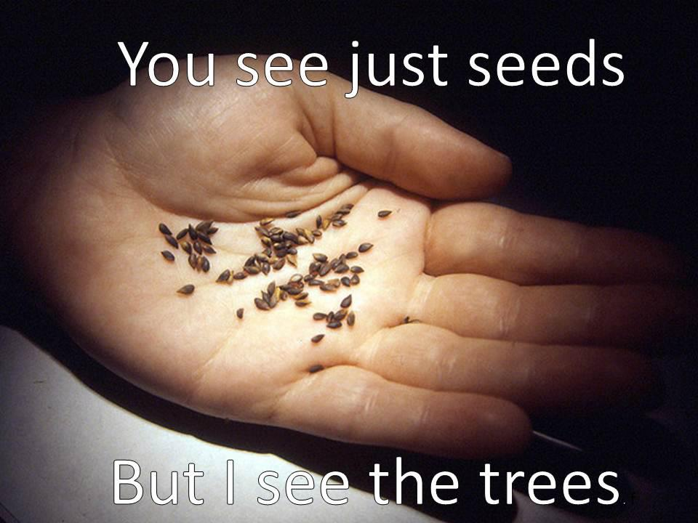
We Reap More Than We Sow
The Power of Reproduction
1 Kernel of Corn Will Produce 1 Corn Stalk.
On The Average, Each Stalk will Produce 3 Ears.
The Average Ear of Corn has 250 Kernels
So that a Single Kernel of Corn …
…will Yield a 75000% Increase.
What Do You Need?

Slide 9
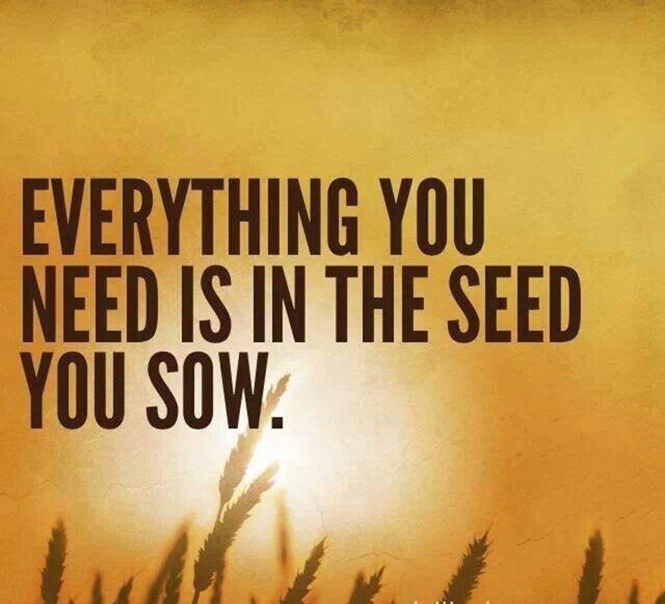
We Reap More Than We Sow
If You Want to Reap…
Better Marriage
…Sow into Your Marriage
Better Work Relationships
…Sow into Work Relationships
Better Personal Relationships
…Sow into Personal Relationships
Better Spiritual Life
…Sow into Spiritual Things

Slide 10
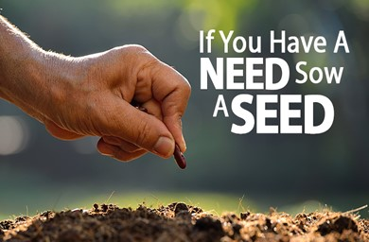
We Reap More Than We Sow
What Do You Need?
  Love
  Joy
  Peace
  Help
    Physical
    Mental
    Financial
    Spiritual
Quit Placing Blame and…
Start Planting Seed!!!

Slide 11
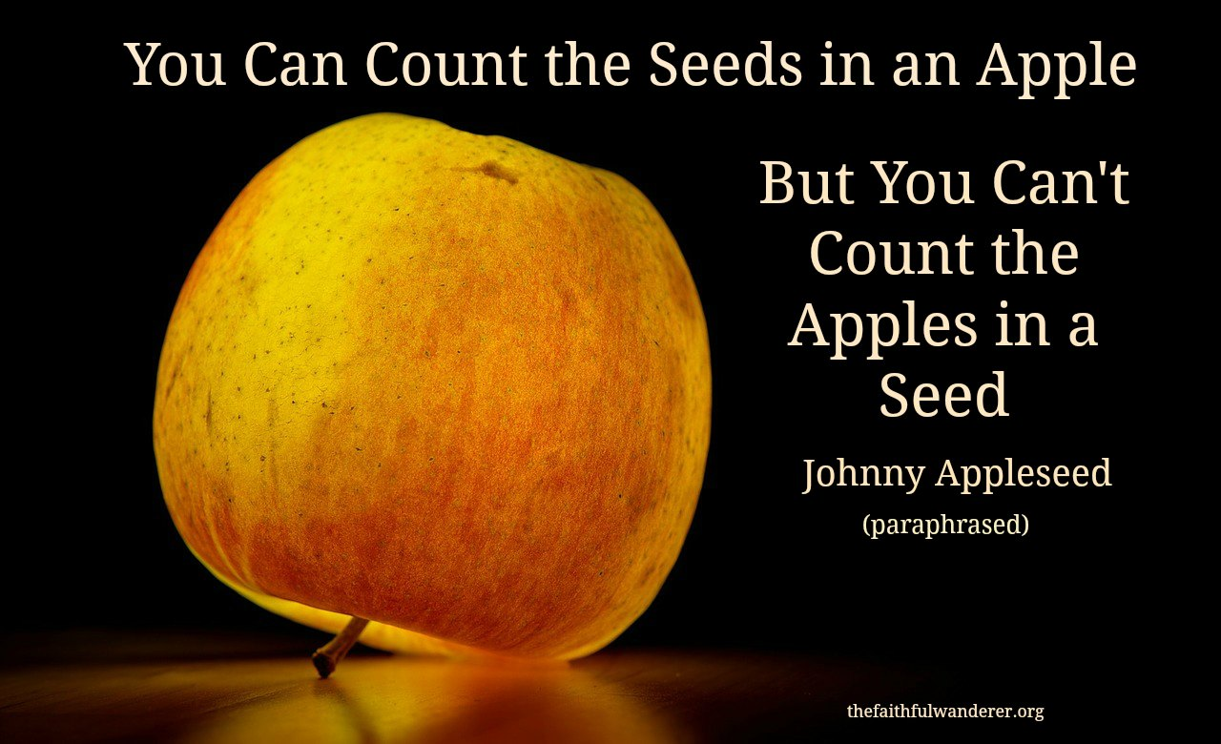
We Reap More Than We Sow
You Can Count the Number of Seeds…
…in an Apple
You Cannot Count the Number of Apples…
…in a Seed
Only God Can!!!

Slide 12
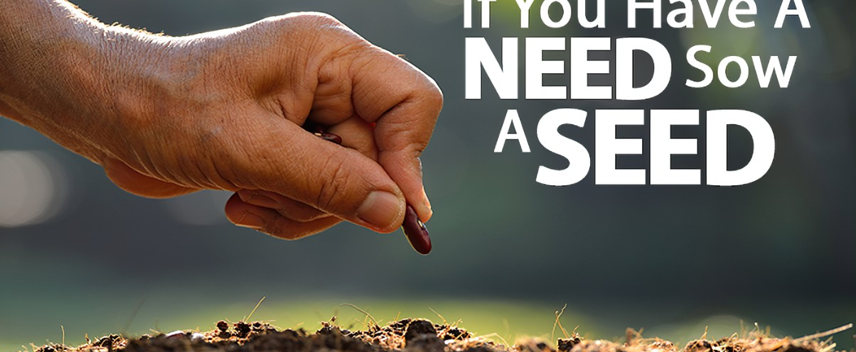
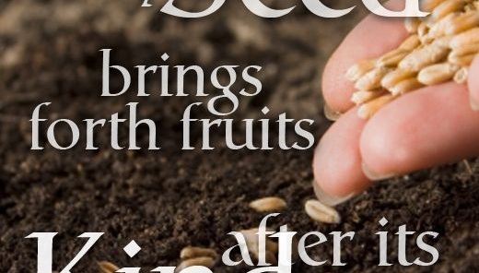

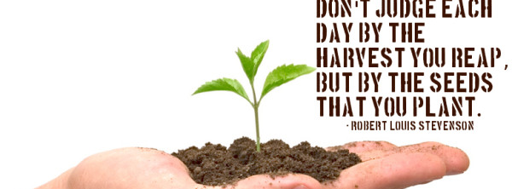
Harvest is a Consequence
“You Will Always Reap What You Sow”
Harvest is a Process
“It Takes Time and Steps”
Harvest is a Season
“There is an Appropriate Time or Due Season”

