Slide 2
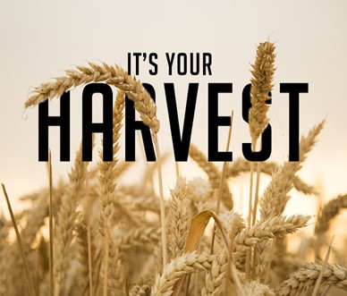
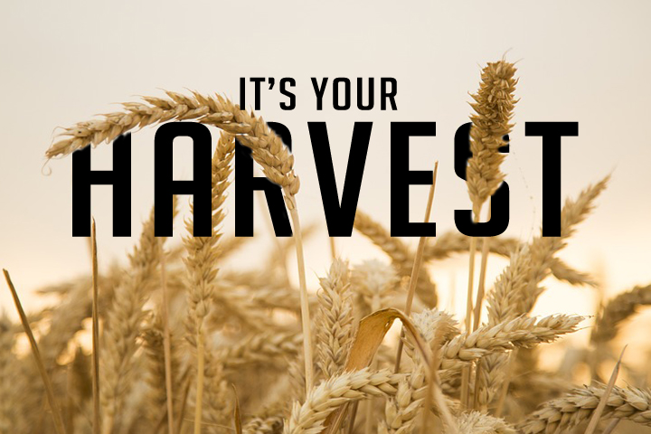
Plain Talk About Our Harvest pt3
Galatians 6:7-8
Edward Church
January 29, 2022

Slide 3
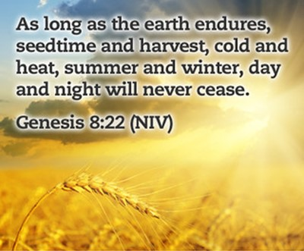
Principle
Promise
Provision
But
If Your God’s Child…
You Are Never
Hopeless / Helpless
2020 / 2021
Left Many Feeling Hopeless / Helpless

Slide 4
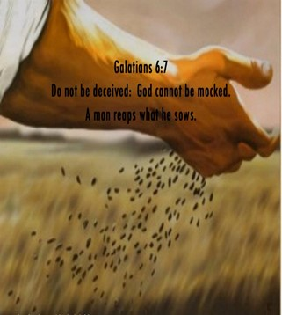
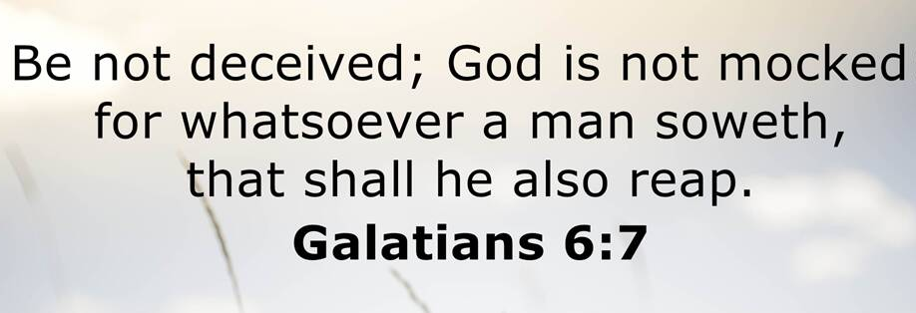
Whatsoever- Word, Deed, Action / Inaction
Soweth- scatter, invest
Shall- it will happen
Reap- Harvest, receive the same

Slide 5
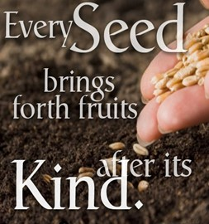
We Reap the Same In Kind As We Sow
We Reap Only What Has Been Sown
We Reap More Than We Sow

Slide 6
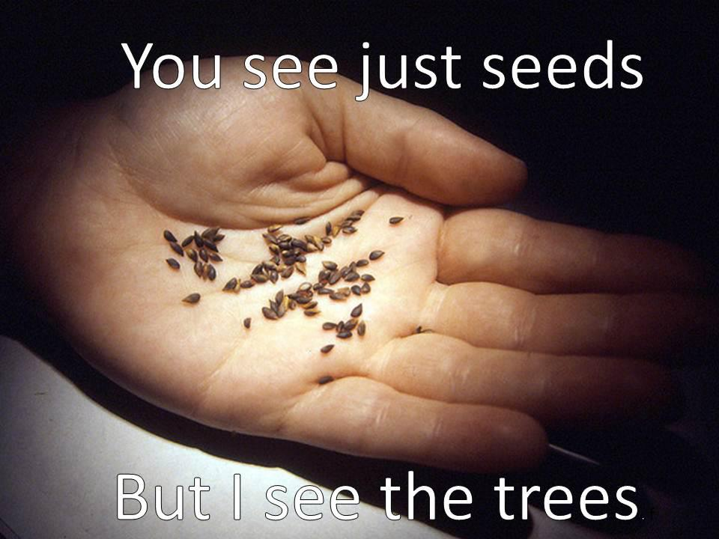
We Reap More Than We Sow
The Power of Reproduction
1 Kernel of Corn Will Produce 1 Corn Stalk.
On The Average, Each Stalk will Produce 3 Ears.
The Average Ear of Corn has 250 Kernels
So that a Single Kernel of Corn …
…will Yield a 750 Kernals
… 75,000 % Increase.
What Do You Need?

Slide 7
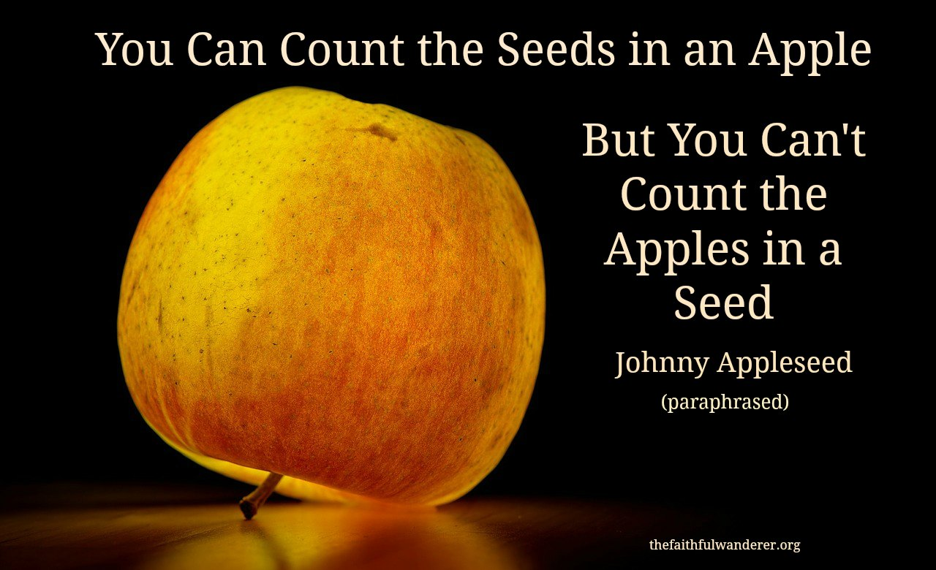
We Reap More Than We Sow
You Can Count the Number of Seeds…
…in an Apple
You Cannot Count the Number of Apples…
…in a Seed
Only God Can!!!

Slide 8
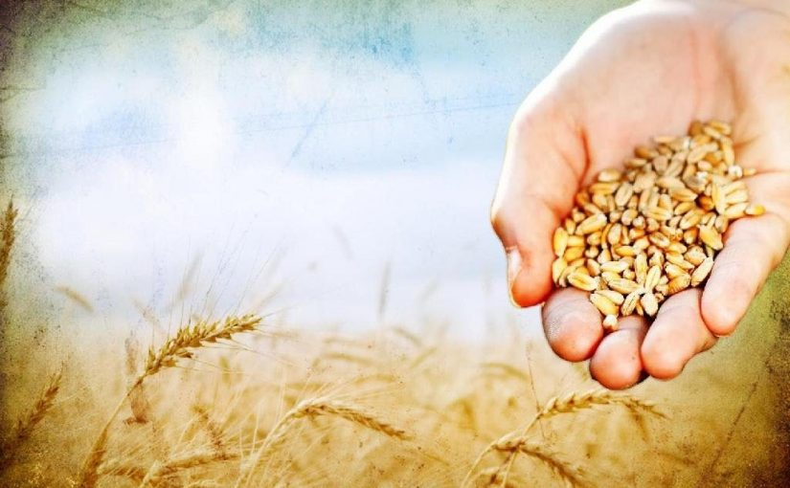
We Reap In Proportion to What We Sow
2 Cor. 9:6, “Now this I say, he who sows sparingly
shall also reap sparingly; and he who sows bountifully
Shall also reap bountifully”
This Deals With Personal:
  Responsibility –quit looking to blame
  Faithfulness –start planting –quit talking
  Faith –it is possible to limit our harvest

Slide 9
We Reap In Proportion to What We Sow
Luke 6:38, “Give, and it will be given to you; good
measure, pressed down, shaken together, running over, they will pour into your lap. For by your standard of measure it will be measured to you in return”
Ephesians 3:20, “Now to Him who is able to do
exceeding abundantly beyond all that we ask or think,
according to the power that works within us”

Slide 10
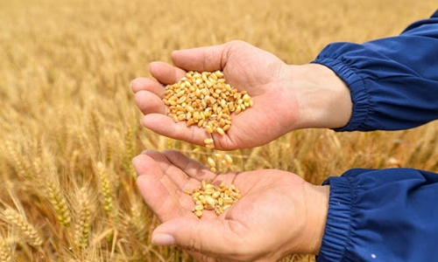
We Reap In Proportion to What We Sow
If You Want to Have…
…More than Enough … Give!
…Less than Enough … Grasp!
  If You Want Abundance … Scatter!
  If You Want To Be Needy ... Hoard!
This Includes Every Area of Your Life !

Slide 11

We Reap in a Different Season than” “”
“...for in due season"
refers to an occasion, set or proper time:
(convenient, due) season, (due, short) time
  This is God's Appointed Time,
  It Cannot Be Changed by Us
Genesis 8:22 , “While the earth remains, Seedtime
and harvest, And cold and heat, And summer and
winter, And day and night Shall not cease”

Slide 12
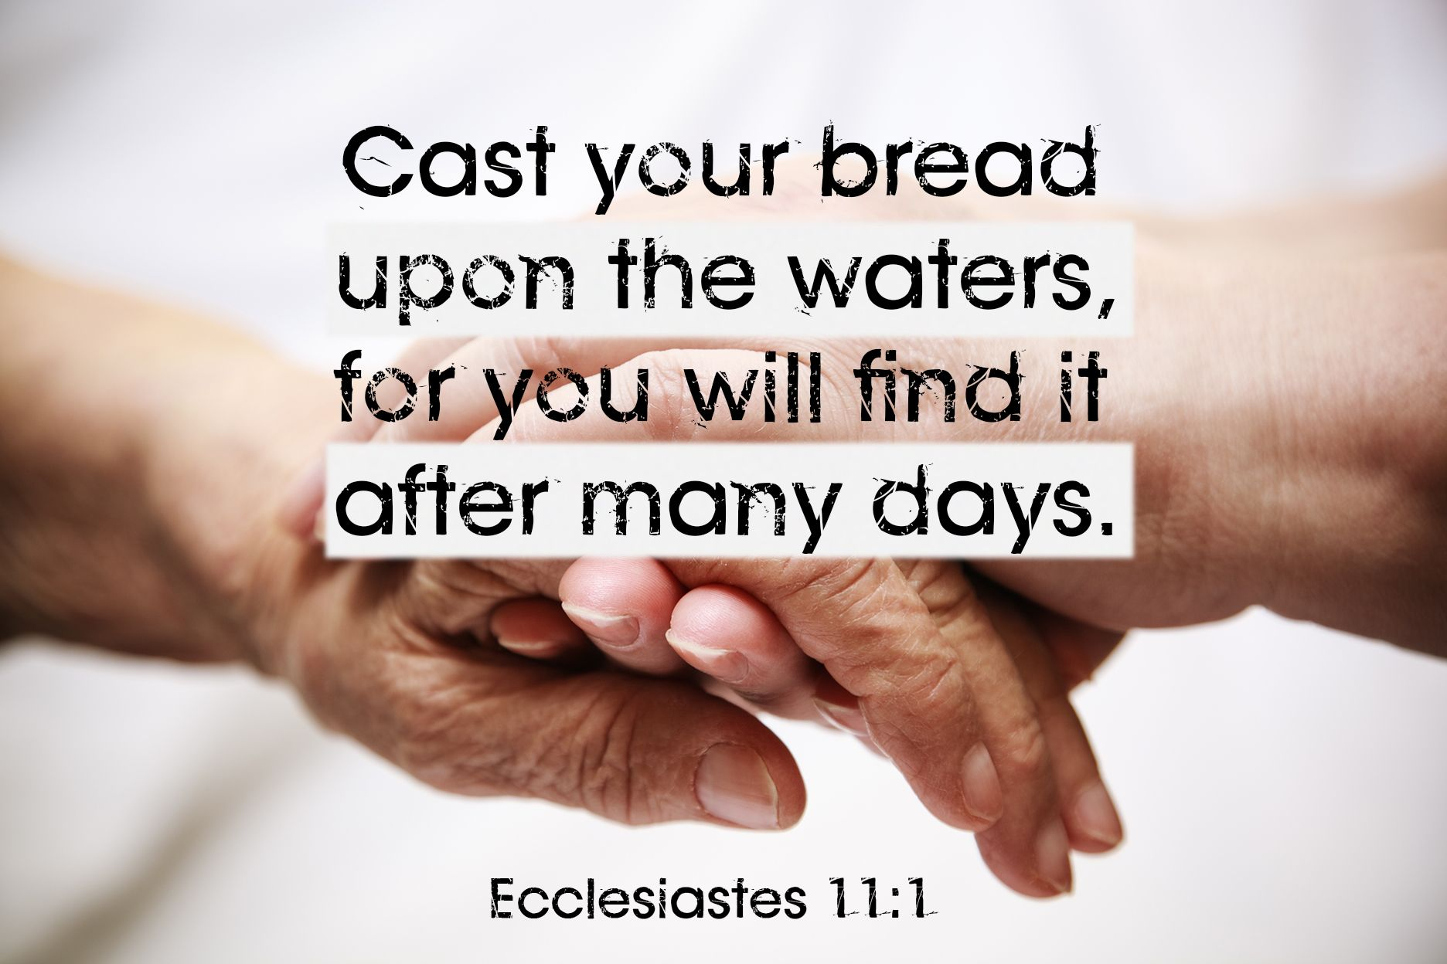
We Reap in a Different Season than” “”
Ecclesiastes 11:1-6, “Cast your bread on the surface
of the waters, for you will find it after many days.
    Process
    Problem
    Promise
Ecclesiastes 3:1-2, “To every thing there is a season,
and a time to every purpose under the heaven: ² A
time to be born, and a time to die; a time to plant, and
a time to pluck up that which is planted;

Slide 13
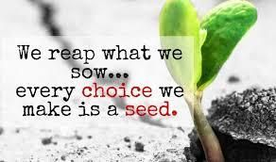
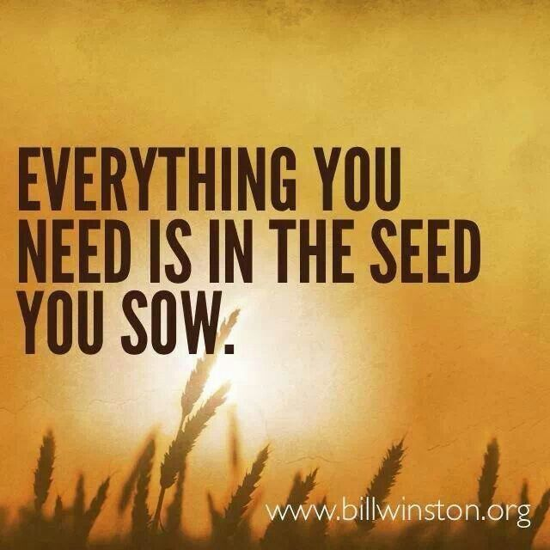
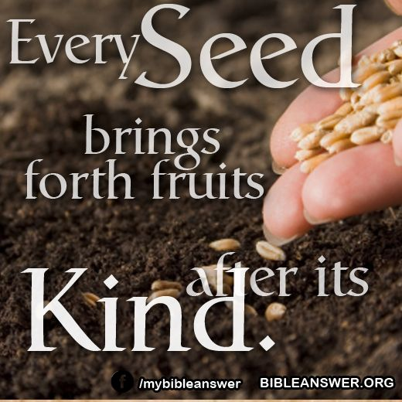
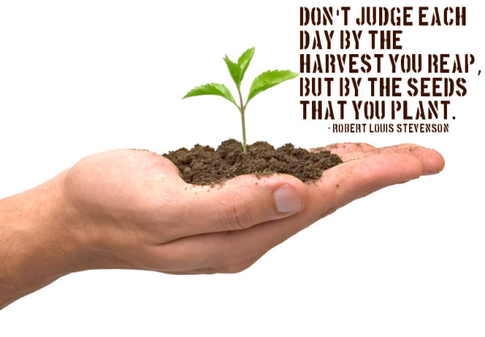
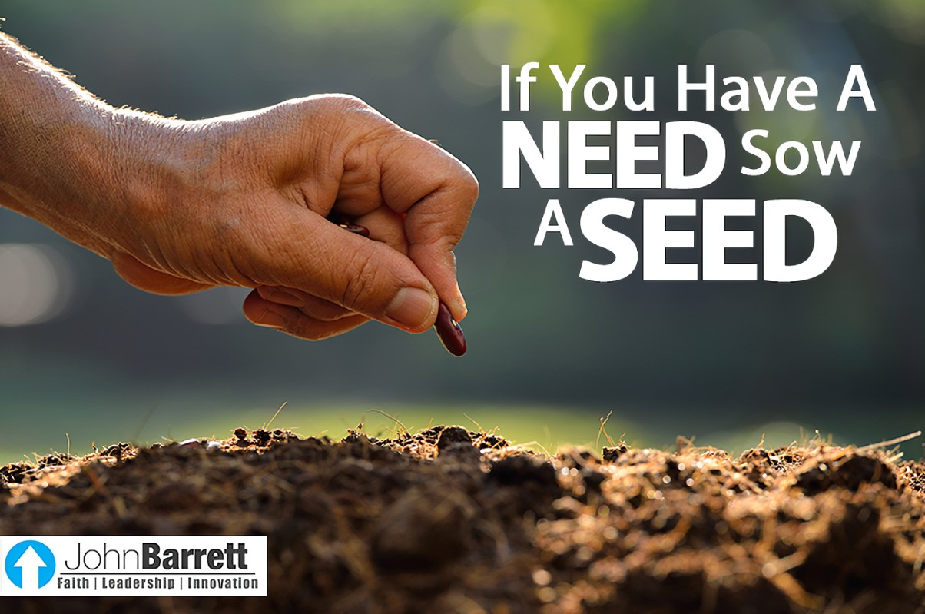
God Is Faithful to His…
Word
  Principles
  Promise
Don’t Eat Your Seed

