Slide 2
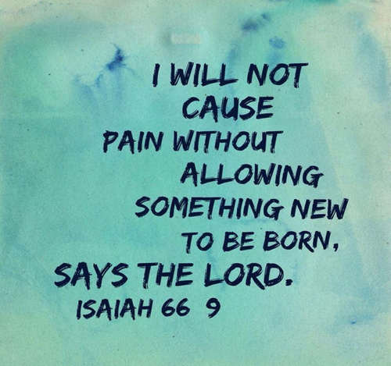
Turning Our Pains into Praises –p2
Edward Church
II Cor 12:7-10
March 13, 2022

Slide 3
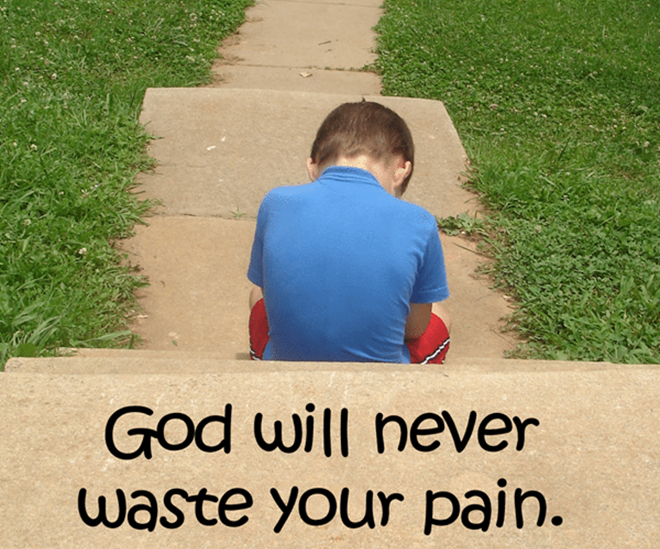
God Never Allows
PAIN
Without a…
Plan
Path
Promise
Romans 8:28 (NLT2)
²⁸ And we know that God causes everything to work together for the good of those who love God and are called according to his purpose for them.

Slide 4
God Promises an Exchange

Slide 5

Paul’s “thorn in the flesh” has had a Lot of Interpretations
“Skolop” = a Pointed Thing.
Something
  of a Bodily Annoyance/ Disability.
  Pain that Bothers us….
  …Physically, Mentally, Emotionally, Spiritually
Paul Prayed that His “Thorn” Be Taken Out.
But God Responded…
“Let the Pain Remain, Paul, it’s Good for You”.

Slide 6

Raise a
Barrier
Shield
Defend
Make More than Enough

Slide 7
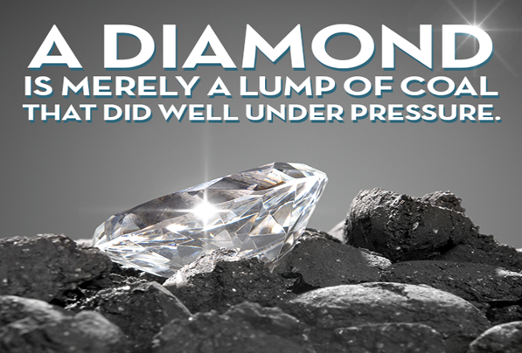
Accept the Presence of your Pains! (7)
Pain Keeps Our Feet on the Ground.
“To keep me from becoming conceited”… (7)
  Above Measure= “to exalt self above measure”
    Prevents Conceit …Improper View -Focus Lost
    Protects Us from Us …Implosion
        Pain Becomes
          Eye-Opener
          God’s Tool to Protect Us

Slide 8
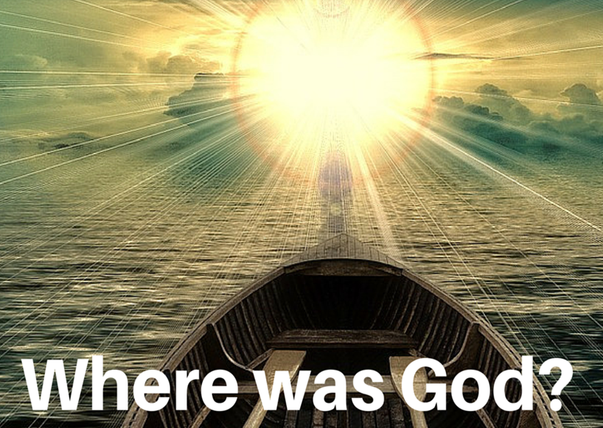
Accept the Presence of Your Pains! (7)
..To keep me from becoming conceited, there was given me a thorn in my flesh, a messenger of Satan, to torment me.
Paul’s Pain was Not an Offer
  It was Given
  God Gave It
  If God Gave It, It Must Be Good for Paul
We View the Presence of Pain / Problems to Be…
…Unwanted, Ingredients of Life

Slide 9
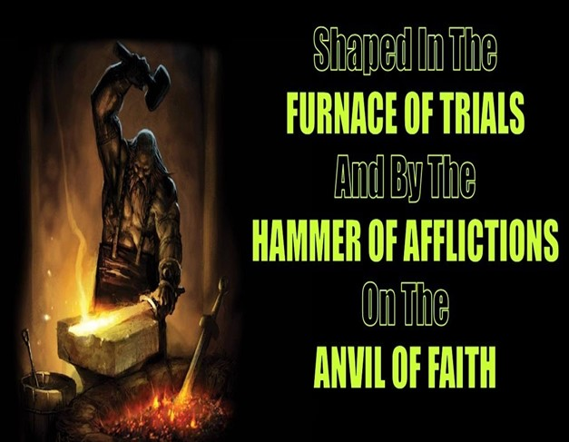
Accept the Presence of your Pains! (7)
Pain Keeps Our Faith On the Grind!
“A Messenger of Satan to Torment Me…”
Buffet= “torment” “strike with a fist”
It Was Meant to Put Paul On the Anvil Of God
One Good Reason to Simply Accept Our Pains
…They Sharpen Our Faith
…Pain Is God’s Tool to Perfect Us

Slide 10
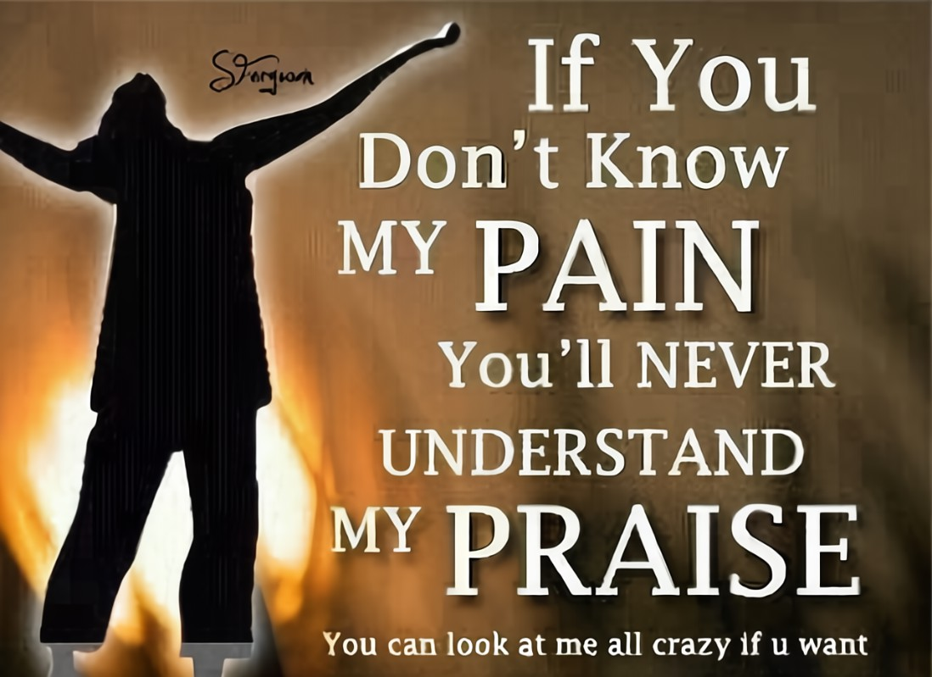
Appreciate the Essence of your Pains! (9)
… I will boast all the more gladly about my weaknesses,
so that Christ's power may rest on me.
How Could a Sane Person Appreciate Pain?
But Paul was saying,
“boast all the more gladly about our weaknesses”
  Infirmities= weakness-corruption- pain
    Focus Changed

Slide 11

Four Things You Can Take Pleasure In - No Matter What
Take Pleasure In Your Weakness’ - God’s Not Finished
Paul pled to the Lord, “Take this weakness!”
2 Cor12:9 NLT Each time he said, “No. But I am with you; that is all you need. My power shows up best in weak people.” Now I am glad to boast about how weak I am; I am glad to be a living demonstration of Christ’s power, instead of showing off my own power and abilities.
Take Pleasure in the Fact that Grace Comes to the Rescue
Grace Works Best During the Frail Moments of Time.
When I am Weak – Can’t Handle the Situation…
…Jesus is the Strong One, Steps Up and He Rescues!

Slide 12
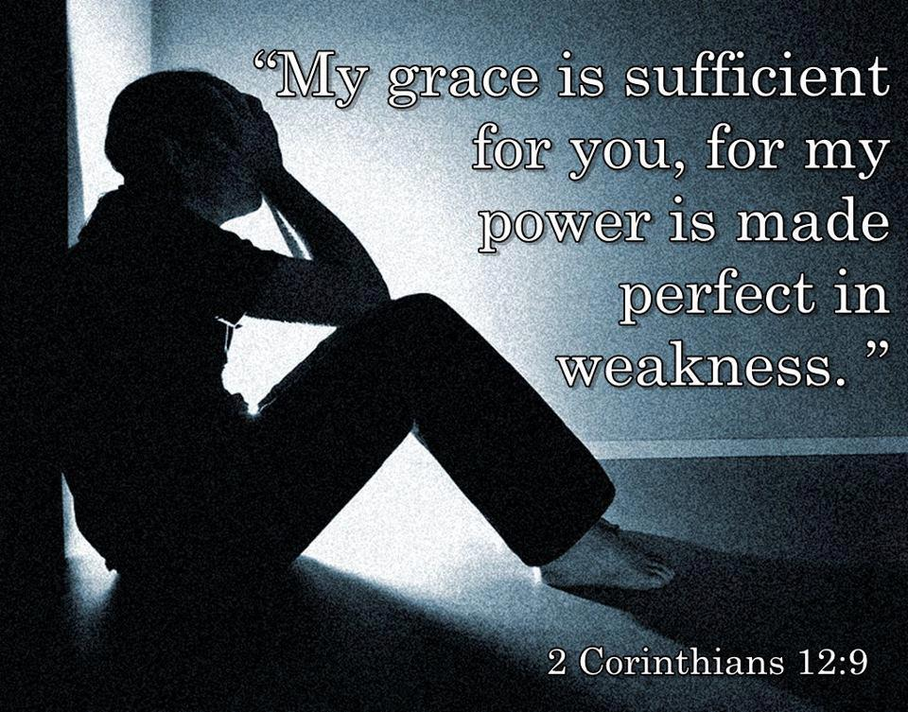
Four Things You Can Take Pleasure In—No Matter What
Take Pleasure that Grace Brings the Supernatural
Grace is defined as—God’s supernatural touching our natural.
“…Christ’s power may rest on me…”
Rest= build a tent- working within- giving help
Take Pleasure in the Fact that God Called You to Believe
Believe that God’s Grace is Enough….

Slide 13
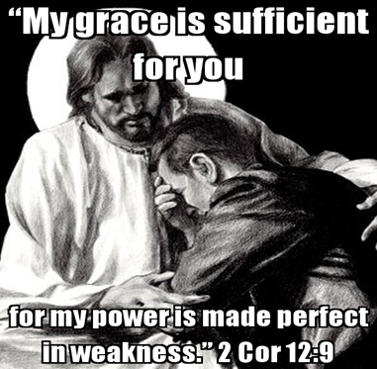
… for Christ's sake, I delight in weaknesses, ..insults, in hardships, in persecutions, difficulties. For when I am weak, then I am strong.
The Best Result of Pain is a Refined Character
Life Is 10% What Happens to You and 90% How We Respond
Our Pain Enhances our Contentment!
“I delight in weaknesses…”
  Delight=“to be willing and to take pleasure”.
  Weak= “impotency or unable to do anything”
  Strong=“able to do everything”.
God Uses Pain as a Measure of Our Faith
When Stripped of Human Strength that We Can Be …
…Useful and Mighty in His Strength

Slide 14
