Slide 2
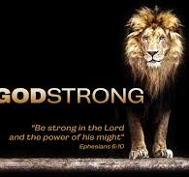

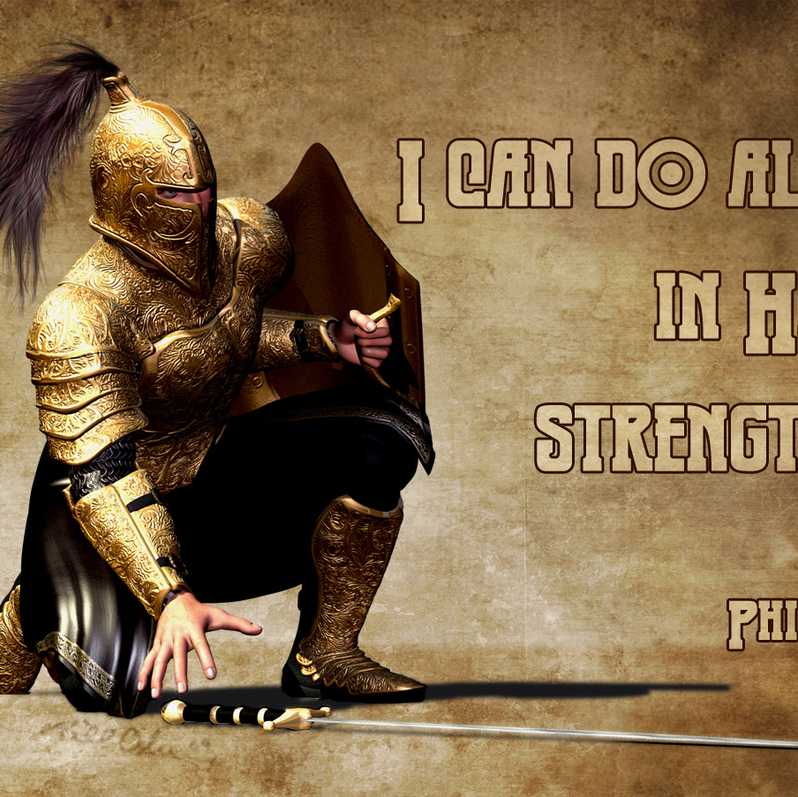

March 27, 2020
Positive
Spiritual
Attitude
Pt2
Joshua 1
Edward Church

Slide 3

Luke 21:26 (AMP)
²⁶ Men swooning away or expiring with fear and dread and apprehension and expectation of the things that are coming on the world; for the [very] powers of the heavens will be shaken and caused to totter.
Luke 21:26 (MSG)
²⁶ in an uproar and everyone all over the world in a panic, the wind knocked out of them by the threat of doom, the powers-that-be quaking.
languish :- cover (over), fail, faint, feebler,
hide self, be overwhelmed, swoon

Slide 4
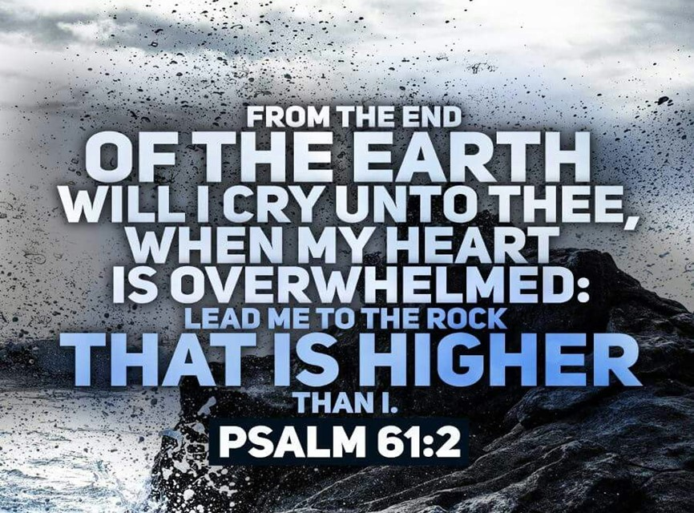
Overwhelmed
Psalm 61:2 (KJV)
From the end of the earth will I cry unto thee, when my heart is overwhelmed: lead me to the rock that is higher than I.
  Heart – mind, will, emotions
  Overwhelmed – faint, fail, swoon, cover
  Lead – to transport, bring, lead
  Rock – Solid, Refuge
  Higher - to rise above

Slide 5
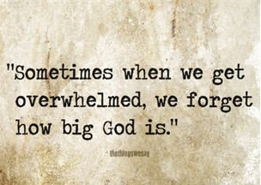
Joshua
If Ever a Person Was Overwhelmed…
He was Called to…
  Take Mose’s Place
  …Big Shoes to Fill
  Take the Land
  …Big Job to Complete
  Both Seemed Impossible
  …Too Big Without God

Slide 6
This Big Job Would Require
a Big Attitude

Slide 7

As Long as I Can Remember…
…Life has Been Full of Challenges
…But Since 2020
…Life Itself is a Challenge
How Do We Meet These?

Slide 8

Romans 12:2, says that we should be “transformed by the renewing of [our] mind.”
Ephesians 4:23 says, “let the Spirit renew your thoughts and attitudes.”
Ephesians 4:23 (AMP)
²³ And be constantly renewed in the spirit of your mind [having a fresh mental and spiritual attitude]

Slide 9

Discovering What…
  Drives Your Positive Attitude
  Determines the Power of Your Attitude
    PMA – self strong
    PSA – God Strong

Slide 10

Positive Mental Attitude (PMA)
Good But Weak
Depends on Me
Positive Spiritual Attitude (PSA)
Great and Strong
Depends on God
God’s Word is the Fuel
Our Attitude is the Throttle

Slide 11

Perfect Model for a Perfect Attitude
"This book of the law shall not depart out of thy mouth; but thou shalt meditate therein day and night, that thou mayest observe to do according to all that is written therein: for then thou shalt make thy way prosperous, and then thou shalt have good success." -Josh 1:8
A Positive Spiritual Attitude (State of Mind)…
…Leads to Positive Spiritual Perspective (Point of View)
Three Parts of Joshua 1:8 Stand Out:

Slide 12

Positive Thinking
"But thou shalt meditate therein day and night..."
What You Think Matters
never read where God says, “Whatever! It is what it is!”
God Knows
Who He IS.
What He Wants How to Express It
God Wants Us to Do the Same
Proverbs 23:7 that as a man thinks in his heart, so is he.
If you want to Stay Positive, you are going to have to Think Positive.
You Need to Think on the Word!
The Bible is the Most Positive, Absolute Thing Out There.

Slide 13

Positive Thinking
"But thou shalt meditate therein day and night..."
What You Think Does Matter
"Finally, brethren, whatsoever things are true, whatsoever things are honest, whatsoever things are just, whatsoever things are pure, whatsoever things are lovely, whatsoever things are of good report; if there be any virtue, and if there be any praise, think on these things." Philippians 4:8
Continually Think about the Goodness of God vs…
…Dwell on negative thoughts that get you discouraged.
What you think about yourself is also significant.
You are Who God Says You Are, Have / Do What He says You Can Have / Do
When you are in Christ, there is no limit to the good things that are in you.
Ps 77:12, "I will meditate also of all thy work, and talk of thy doings."

Slide 14

Positive Speaking
"This book of the law shall not depart out of thy mouth..."
What Comes Out of Our Mouth is So Important
Proverbs 12:14, "A man shall be satisfied with good by the fruit of his mouth."
We Need to Keep the Word Continually In Our Mouths to Remind Us of Who We Are In Christ And What We Have In Christ.
Find the scriptures in the Bible that have the phrase "In Him", "In Whom", and "In Christ".
When you find these Scriptures, Mark them, Meditate on them, and Start Confessing them Over Your Life.
  You’ll Be Amazed at the Positive Changes that Happen In Your Life.

Slide 15

Positive Action
"That thou mayest observe to do according to all. Is written therein..:
James 1:22 (Amplified)
"But --obey the message; be doers of the Word and not merely listeners to it,
betraying yourselves [into deception by reasoning contrary to the truth]."
God’s Word is Full of Positive Confession…
…We Need to Act Upon that Positive Confession.
Just as Faith Without Works Is Dead, so is a Positive Attitude Without Action.
If the Word Says You Are…
  the light of the world, how are you going to act?
  the righteousness of God in Christ, how are you going to act?
  the healed, how you going to act?
When we act upon God’s word, we authenticate our confession. And when our actions are authentic, our positive actions will encourage others to do the same.

Slide 16
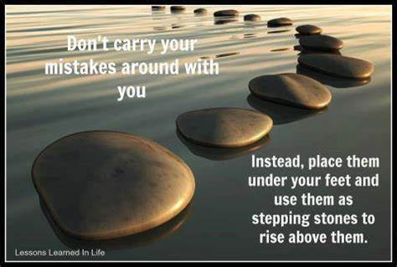
Positive Action
"That thou mayest observe to do according to all. Is written therein..:
Deut 28:1-2, "And it shall come to pass, if thou shalt hearken diligently unto the voice of the LORD thy God, to observe/ to do all his commandments which I command thee this day, that the LORD thy God will set thee on high above all nations of the earth:/ all these blessings shall come on thee, / overtake thee..."
Keeping a Positive Attitude Is Crucial to Your Success in Life.
Isaiah 1:19, if you are willing and obedient, you shall eat the good of the land.
Willing is a Condition of the Heart that Reflects Your Attitude.
The Only Difference Between a Stumbling Block and a Steppingstone…
…Is Your Attitude.

Slide 17








We Have a…
…Powerful Task Ahead of Us
It Does Not Compare with…
…The Positive Power …Behind Us

Slide 18
In Order to Connect
With this Positive Power
We Have to…
  Think the Word
  Speak the Word
  Walk the Word

