Slide 2

Edward Church
July 17, 2022
Genesis 41:50-54

Slide 3

Genesis 41:50-54 (KJV)
⁵⁰ And unto Joseph were born two sons before the years of famine came, which Asenath the daughter of Potipherah priest of On bare unto him.
⁵¹ And Joseph called the name of the firstborn Manasseh: For God, said he, hath made me forget all my toil, and all my father's house.
⁵² And the name of the second called he Ephraim: For God hath caused me to be fruitful in the land of my affliction.
⁵³ And the seven years of plenteousness, that was in the land of Egypt, were ended.
⁵⁴ And the seven years of dearth began to come, according as Joseph had said: and the dearth was in all lands; but in all the land of Egypt there was bread.

Slide 4
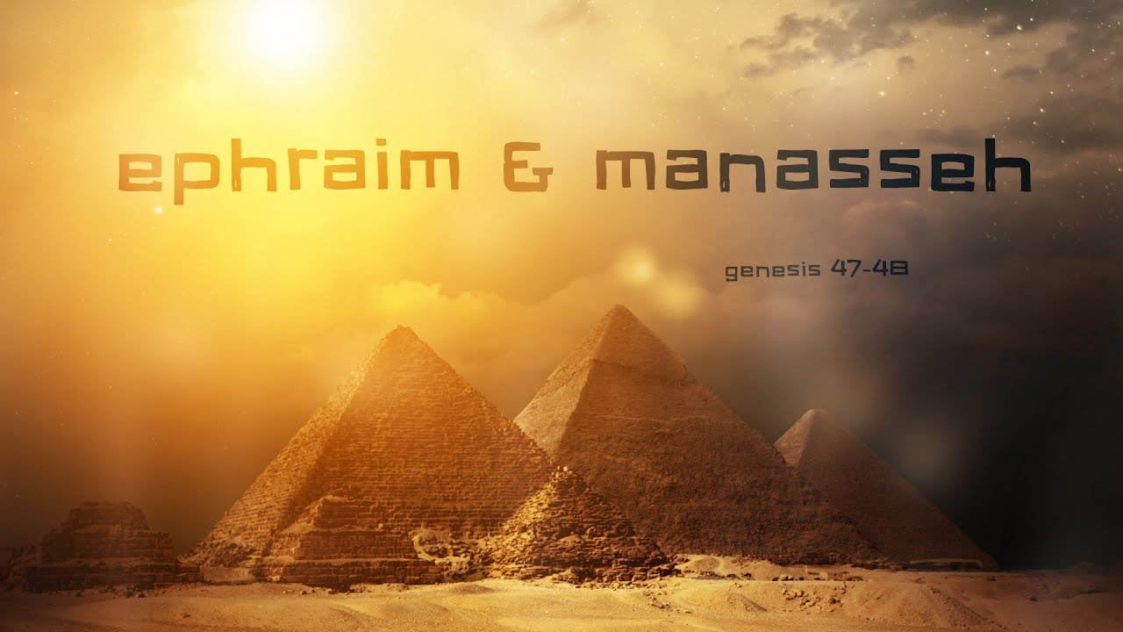
Manasseh (causing to forget)
Ephraim (double fruit)
Notice 2 Things About Names
Their …
Power
Position

Slide 5
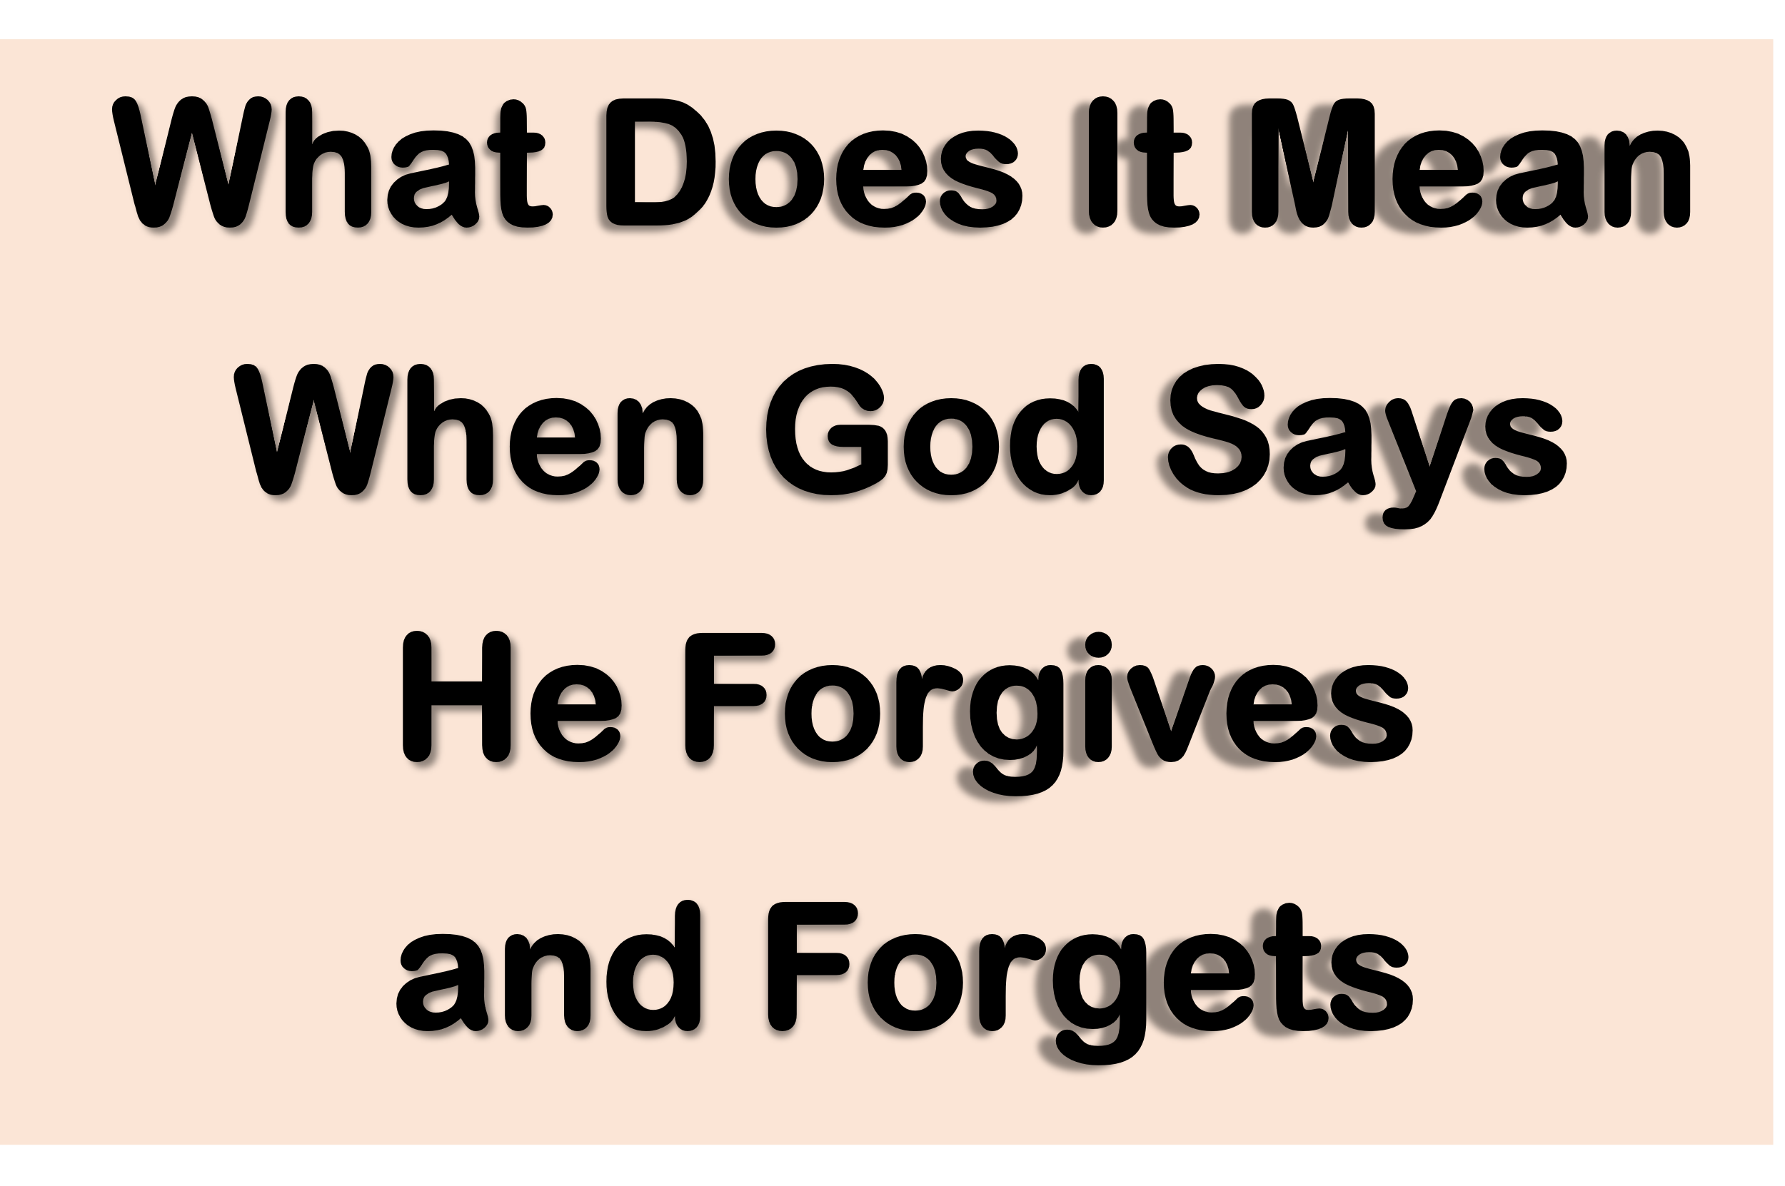
“To forget" does not mean "to fail to remember." Apart from senility, hypnosis, or a brain malfunction, no mature person can forget what has happened in the past.
We may wish that we could erase certain bad memories, but we cannot.
"To forget" in the Bible= "no longer to be influenced by or affected by."
"And their sins and iniquities will I remember no more" -Heb. 10:17
He is not suggesting that He will conveniently have a bad memory!
This is impossible with God.
God is saying, "I will no longer hold their sins against them.
Their sins can no longer affect their standing with Me…
…or influence My attitude toward them."

Slide 6
Isaiah 43:25, ESV
I am he who blots out your transgressions for my own sake, and I will not remember your sins.
2 Corinthians 5:19, NLT
For God was in Christ, reconciling the world to himself, no longer counting people’s sins against them. And he gave us this wonderful message of reconciliation.
Hebrews 10:17, NLT
Then he says, “I will never again remember their sins and lawless deeds.
Psalm 103:11 -12, ESV
For as high as the heavens are above the earth, so great is his steadfast love toward those who fear him; as far as the east is from the west, so far does he remove our transgressions from us.
Hebrews 8:12, NLT
And I will forgive their wickedness, and I will never again
remember their sins.

Slide 7

It is Taking Forgiveness
to the “Next Level”
It is the “Most Like God”
It Requires “God to Enable You to Do This”

Slide 8
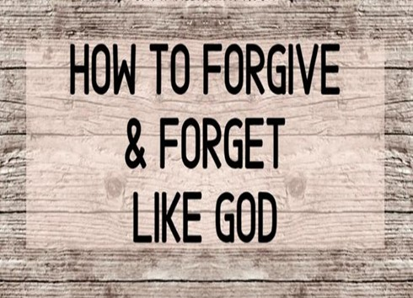
There are Many Examples in the Bible
I Think One of the Greatest is Joseph
He Truly Modeled this Godly Principle
Look at His Life Journey

Slide 9
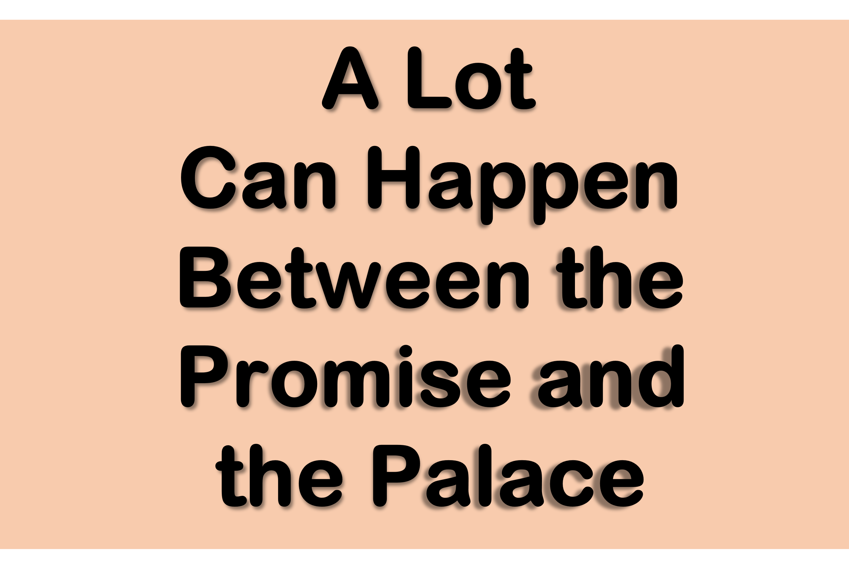
Genesis 37-50
Promise -dream -started
Pit -stalled -became nightmare
Potiphar -stalled
Prison -stalled
Palace -dream – started again
Proof -stretched

Slide 10

It is Taking Forgiveness
to the “Next Level”
It is the “Most Like God”
It Requires “God to Enable You to Do This”
Instead of Focusing on the Hand that Brought the Problems
…He Focused on the Hand that Brought the Promise
He Realized that God Used His Problems
As a Vehicle to Bring Him Into the Promise

Slide 11
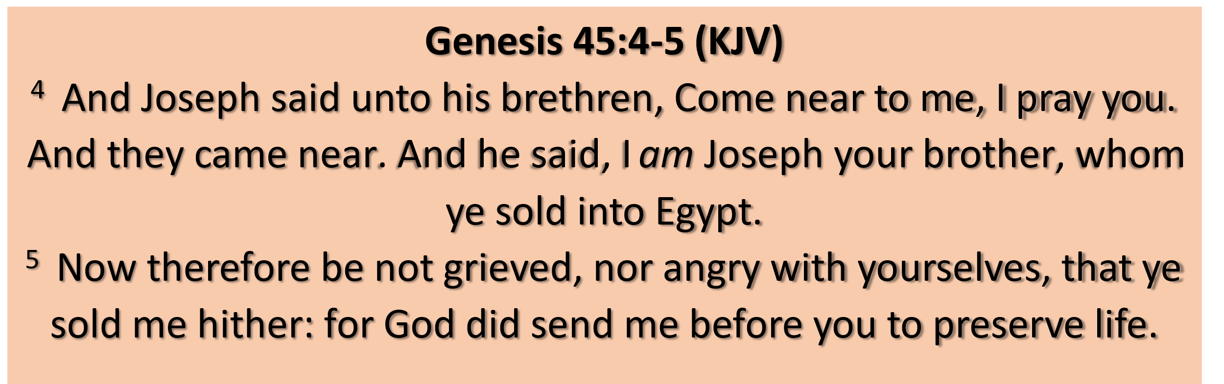
He Acknowledged the…
    Pain of Man
    Plan of God
    Product of It All
Romans 8:28 (AMP)
²⁸ We are assured and know that [God being a partner in their labor] all things work together and are [fitting into a plan] for good to and for those who love God and are called according to [His] design and purpose.

Slide 12

Manasseh (causing to forget)
Ephraim (double fruit)
Notice 2 Things About Names
Their …
Power -brought me to a place of…
  Peace -no longer destroying me
  Power -I can give it to God
Position -brought me to a place of…
  Productive -Again
  Plenty –More Productive than before the Offense

Slide 13
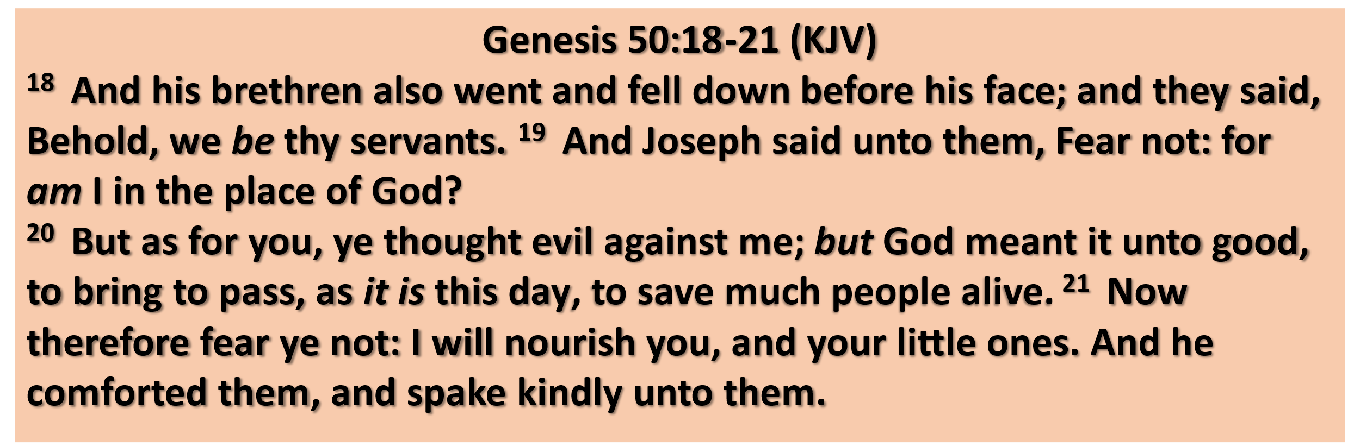

Slide 14





Forgive and Forget
It is…
Never
  Easy
Always
  Powerful
  Productive
  Pleasing to God

