Slide 2
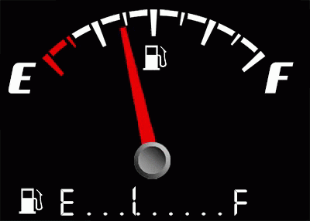

Edward Church
Aug 21-2022
Edward Christian Church
7- 26-2020
Running On Empty
1 Kings 19

Slide 3
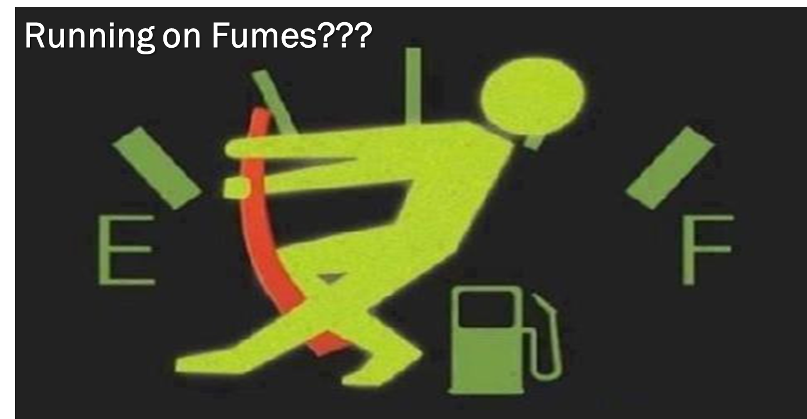
Running on Empty
Have You…
  Gone as Far as You Can Go
  Taken All You Can Take
  Given All You Can Give
Welcome to…
…Running on Empty!

Slide 4
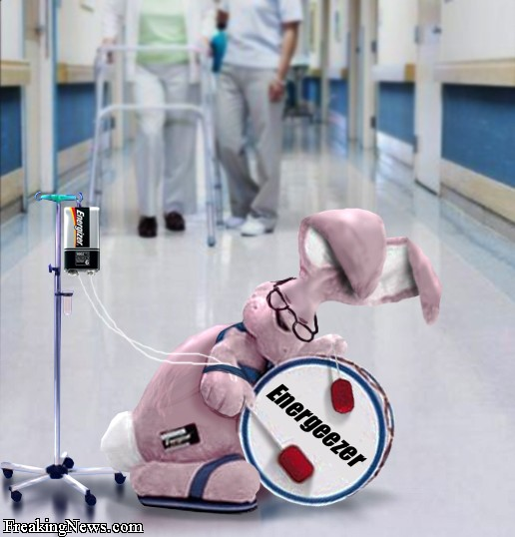
Running on Empty
  Mentally
  Physically
  Spiritually
Exhausted

Slide 5
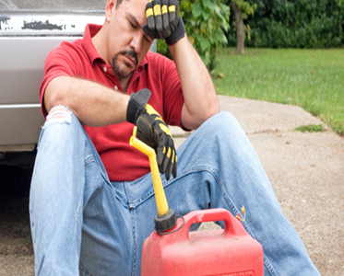
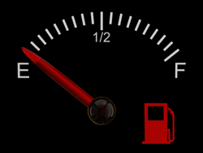
The Danger of
Running on Empty…
Empty Leads to Burnout
Burnout Creates Brokenness
Brokenness Drives Depression

Slide 6
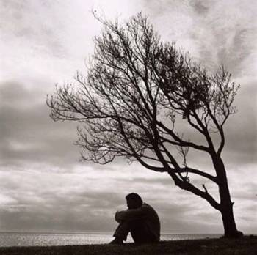

The Bible is Full of God’s People
Facing Empty Tanks
But Had to Keep Going
Moses – Numbers 11:1-15
David – Psalms 31:9-13
Job – Job 7:2-3
Jeremiah – 20:14-18
Elijah – I Kings 19

Slide 7
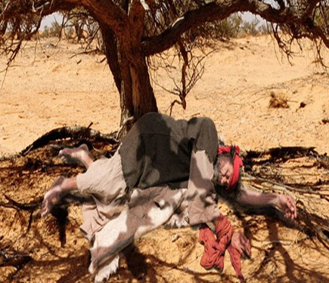
Running on Feeling (Spt High)
  1 Kings 18:46
    One of the Greatest MOVES of God
    Elijah was Running On Emotions
Running on Fear (Spt Low)
  1 Kings 19:1-3
    One of the Greatest Threats of Satan
    This Time, Elijah Is Running On Fear
Running on Empty (Spt Exhaustion)
  1 Kings 19:4-5
    One of the Greatest Moves of Fear
    Elijah Has Run Out Of Gas.

Slide 8
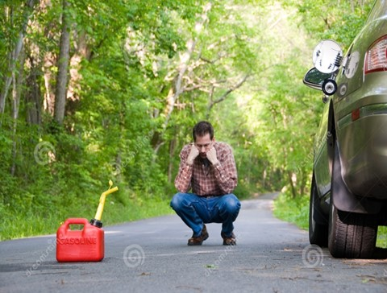

Does this Describe You?
Has Your Life of Faith…
Become a
Life of Fear?
Life of Fumes?
Empty?
Remember
God Sees You!
He Has Never Left You!

Slide 10
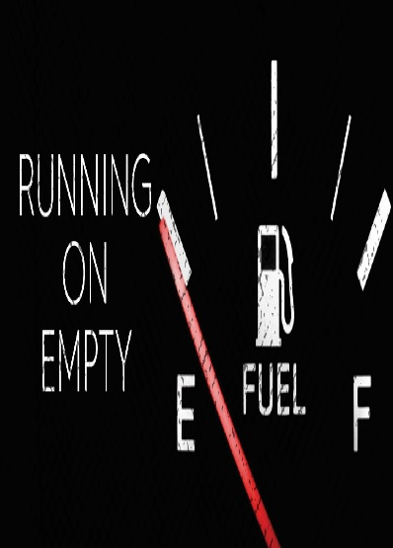
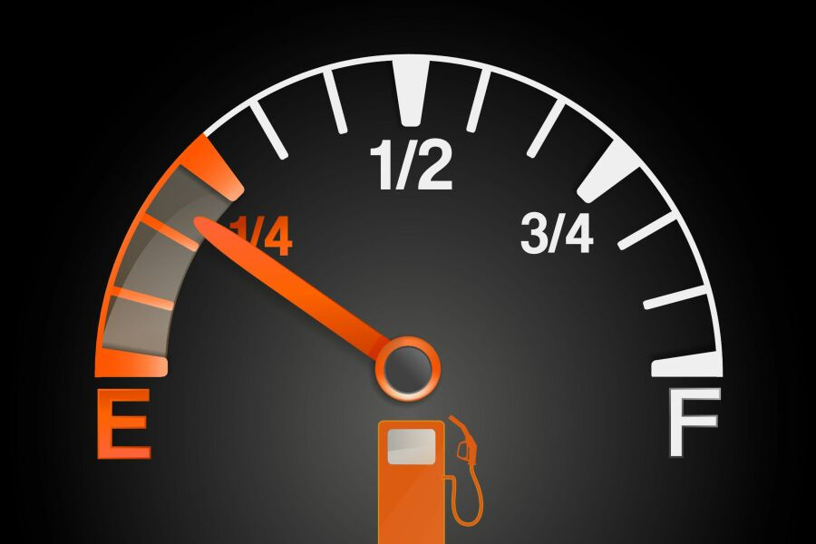
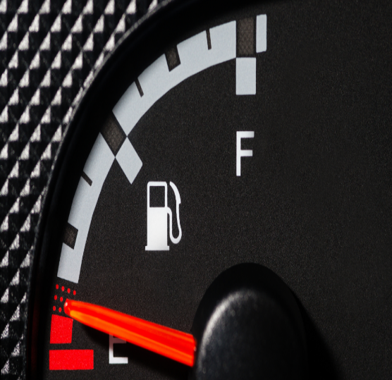
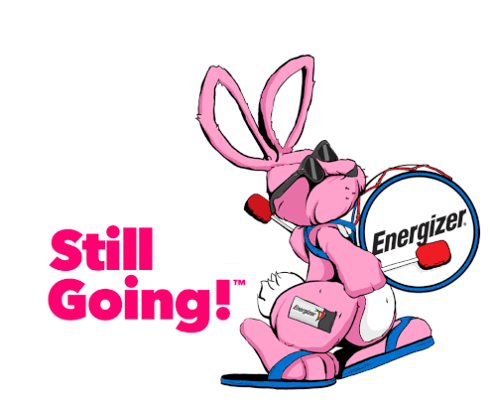
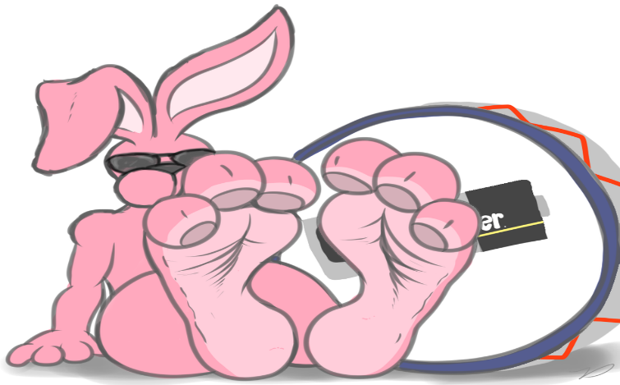
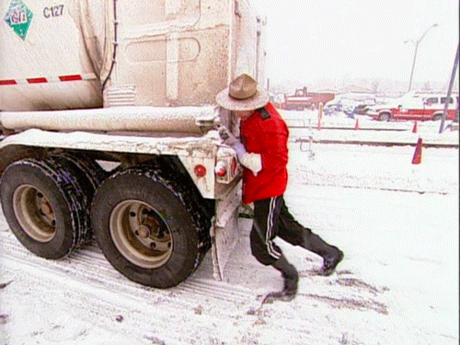

Slide 11
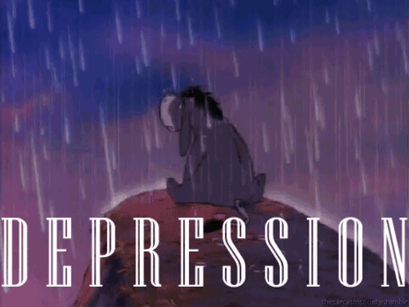

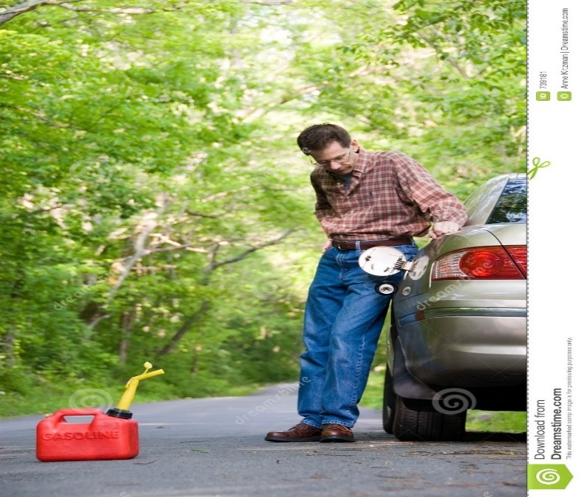
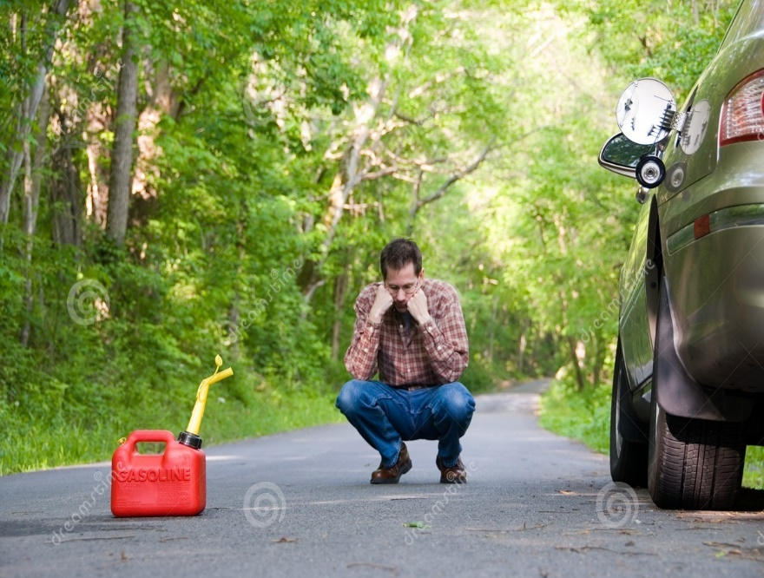

Slide 12
1. Running on Feeling.
(1 Ki 18:46 KJV) And the hand of the LORD was on Elijah; and he girded up his loins, and ran before Ahab to the entrance of Jezreel.
After the seventh prayer, the rain came in the shape of a man’s hand. Suddenly the sky was black, and the thundering rains came.
In our text, Elijah is running in the rain. What is his motivation? He was sure that revival had indeed come to Israel. He outran the chariot of King Ahab. He came to the entrance of the palace. No doubt, he must of thought, I will be an invited honored guest? After all, his God had won the contest of fire!
Elijah was running on the emotion of hope. He was running on feelings. He felt good about his victory. Have you ever had your hopes suddenly dashed? Elijah was about to!
2. Running on Fear.
(1 Ki 19:1 KJV) And Ahab told Jezebel all that Elijah had done, and withal how he had slain all the prophets with the sword.
(1 Ki 19:2 KJV) Then Jezebel sent a messenger unto Elijah, saying, So let the gods do to me, and more also, if I make not thy life as the life of one of them by to morrow about this time.
(1 Ki 19:3 KJV) And when he saw that, he arose, and went for his life, and came to Beersheba, which belongeth to Judah, and left his servant there.
Queen Jezebel was not about to repent. She wanted the life of Elijah, and meant to do it by days end!
Elijah is up and running again. This time, Elijah is running on fear.
Fear will motivate a man. Fear sells. Everyone wants to be safe. Some people only to come to Church, because, they feel safe there.
Unfortunately, for those who seek only safe harbors, God has called us to minister into the world of Jezebels!
We are to take up a cross and the message of the gospel and launch out into the deep. And Jezebel wants to take your life from you!
3. Running on Fumes.
(1 Ki 19:4 KJV) But he himself went a day’s journey into the wilderness, and came and sat down under a juniper tree: and he requested for himself that he might die; and said, It is enough; now, O LORD, take away my life; for I am not better than my fathers.
(1 Ki 19:5 KJV) And as he lay and slept under a juniper tree, behold, then an angel touched him, and said unto him, Arise and eat.
In this text, Elijah has run out of gas. He is fully immersed in depression.
And so will you be, if you do not find the proper fuel source of the Christian life!
A Christian is not to live by feelings. A Christian is not to live by fear. A Christian is to live by…
4. Running on Faith!
(1 Ki 19:8 KJV) And he arose, and did eat and drink, and went in the strength of that meat forty days and forty nights unto Horeb the mount of God.

Slide 13
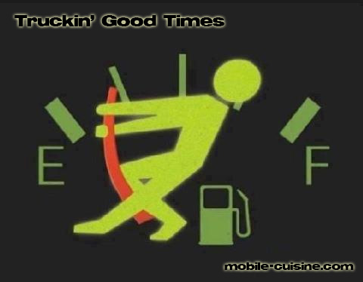

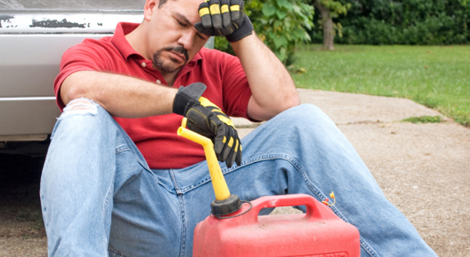
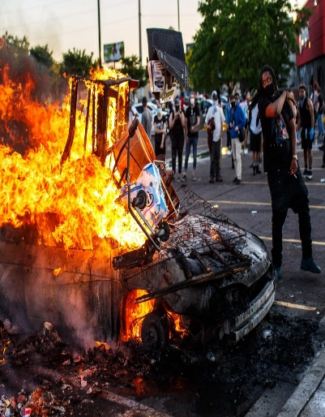
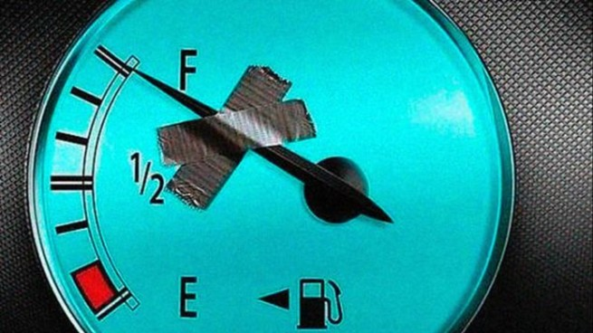
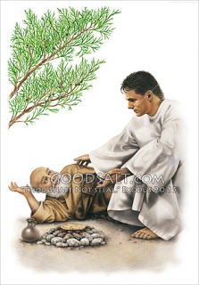
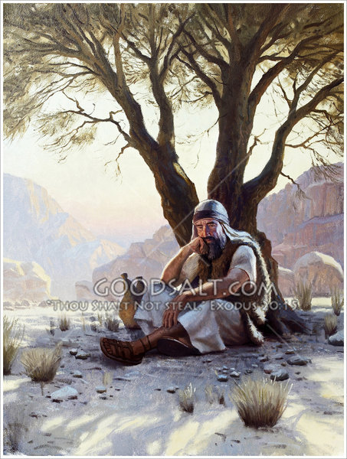

Slide 14
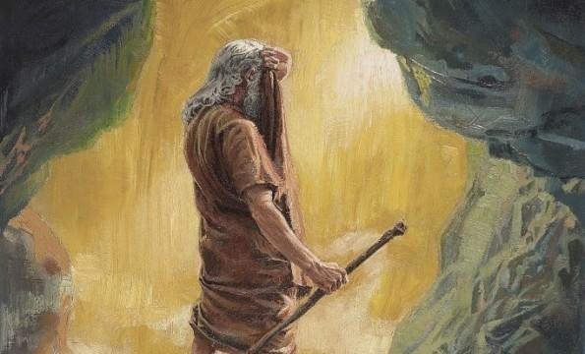
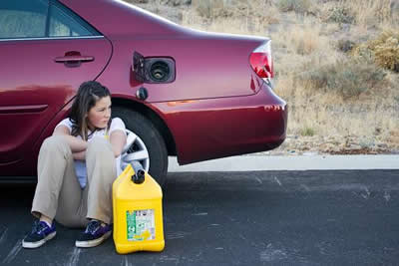

Slide 15
Why Does God Allow Us to…
…Get to this Point?
  Points to Power of the Cross…
      We All Need His Help
  Brings Message of Grace/ Mercy to Life
      Now It’s Personal
  Prompts Reliance upon Him/ Others
      We Can’t Do It Alone
  Show Us/ Others We Can Still Be Used…
      Even in the Worst of Situations
  Move Beyond Guilt to Usefulness Again!

Slide 16
Symptoms of emotional exhaustion can manifest in emotional, physical and behavioral ways
Feeling a sense of failure and self-doubt
Feeling helpless, trapped and defeated
Feeling detached and alone in the world
Feeling unmotivated
Feeling negative, cynical and dissatisfied
Feeling tired and drained most of the time
Feeling sick a lot, and having a lowered immunity to illness
Frequent headaches and other aches and pains
Changes in sleep or appetite
Withdrawing from responsibilities
Isolating yourself from others
Procrastinating or taking longer than usual to get things done
Using food, drugs, alcohol, shopping to cope with feelings, or avoid feelings
Irritability, or taking frustrations out on others
Missing work, or coming in late and leaving early

Slide 17
The madness on a grand scale is manifest with countless crazies on the more local scale – drug dealers – snipers – cereal killers – even school bullies (if you want to become really local).
There is no shortage of craziness out there and the temptation for godly people is to disengage and head for the hills – literally or figuratively.

Slide 18
An oak tree is the perfection of an acorn. And somebody has written these words:
When you’re discouraged and feeling a little blue, take a look at a mighty oak and see what a nut can do (Laughter).
That oak tree is the perfection of an acorn. It is, it means maturity. We grow under stress.

Slide 19



Have You Been Hurt?
Hurt People
…Hurt People
There’s a Big Difference Between:
Pain that’s Been…
    Dealt With
    Pushed Down
One Leads to…
    Development (fresh)
    Depression (stagnant)

Slide 20
Burnout
Our Society is…
…Burned Out
Our Families are…
…Burned Out
Our Churches are…
…Burned Out
It is the mark of…
…Our Generation

Slide 21
Three Things About Depression
It is…
Ancient Problem
Universal Problem
No Respecter of Persons

Slide 22
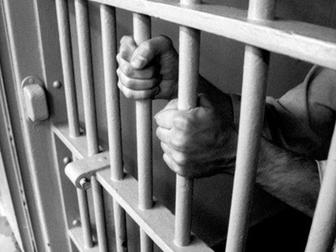
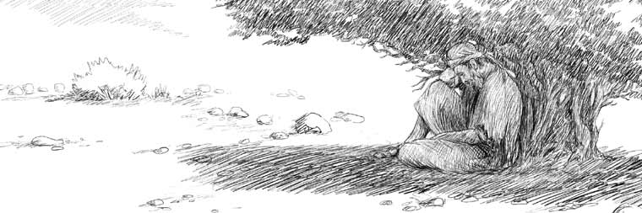
Symptoms of Depression
Weight Loss or Weight Gain
Loss of Sleep and Energy
Lose Interest in Most or All…
…Pleasurable Activities
Reduced Ability to Concentrate
Overcome w/ Feelings of…
    Hopelessness
    Uselessness

Slide 23

Five Factors of Elijah’s Depression
Elijah Faced…
Physical Exhaustion (5)
  Intense Activity-chap 18
    Rebuilt Altar - Showdown
    Killed 850 False Prophets
    Prayed Intensely for Rain
    Ran for Over 20 Miles
Emotional Exhaustion (3a, 4)
  He’s on Emotional Roller Coaster
    Arose and Ran for His Life (3)
    Take My Life -Kill Me! (4)

Slide 24
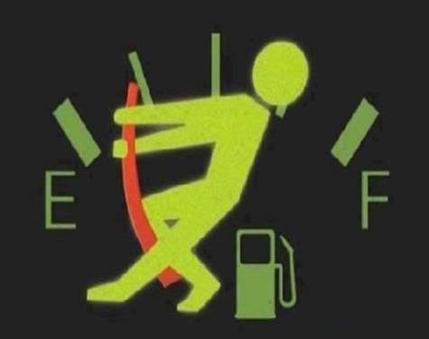
Running on Fumes???

Slide 25
Depression and the Bible
Moses – Numbers 11:1-15
David – Psalms 31:9-13
Job – Job 7:2-3
Jeremiah – 20:14-18
Elijah –I Kings 19

