Slide 1
A young newly wed was sitting at his desk paying bills when he happened upon the credit card bill. As he scanned through the charges he noticed one particular charge to a department store for $250. He called for his wife to join him. When she entered the room he asked her, “How could you do this? What on earth did you buy for $250?” “Well,” she said.. “I was standing in the department store looking for a dress. Then, I found myself trying it on. It was like the Devil was whispering to me, “Gee, you look great in this dress. You should buy it.” “Well,” the young husband answered. “You should know how to deal with the Devil! Just tell him, ‘Get behind me, Satan!” “I did,” retorted the wife. “But then he said it looked great from the back too!”

Slide 3
Just When You Thought it was Over
Edward Church
Oct. 2, 2022
Giants Still Fall
Part 3
II Samuel 21:15-21

Slide 4
Giants
A Giant is Anything that…
…intimidates with it’s Size
…threatens with it’s Power
…seeks to Take Away
stands between You and Victory

Slide 5
David is Near the End of His Ministry
David Fought Goliath at the Beginning
He discovered what One Man + God could do
He also discovered that God desired to do…
…a deeper work
The deeper work would bring uncomfortable times, hurts, pains in the midnight hour

Slide 6
David is near the End of His Ministry
Yet He Still…
…Served God Faithfully For 40 Years
He Also Discovered in that Time…
…The Giants Kept On Coming

Slide 7
We Know that Christ Cried “It Is Finished”
…Satan was Defeated
Didn’t Mean That Satan Was…
…Going to Accept It

Slide 8
David Realized that…
Goliath was Not his Only Giant
David was Responsible for Four More
Each One Describes Satan’s Tactics…
in
Progressive Spiritual Warfare

Slide 9
He Fought an Opponent that… …Refused to Quit
Life Lessons in Spiritual Warfare
As Long as there is Life In You…
…there will be a Fight For You
Satan Won’t Quit
But…

Slide 10
He Fought an Opponent that… …Refused to Quit
Luke 4:13 (KJV) ¹³ And when the devil had ended all the temptation, he departed from him for a season.
Luke 4:13 (MSG) ¹³ That completed the testing. The Devil retreated temporarily, lying in wait for another opportunity.
Luke 4:13 (AMP) ¹³ And when the devil had ended every [the complete cycle of] temptation, he [temporarily] left Him [that is, stood off from Him] until another more opportune and favorable time

Slide 11
Convenient Season
Matthew 26:41 (AMP) All of you must keep awake (give strict attention, be cautious and active) and watch and pray, that you may not come into temptation. The spirit indeed is willing, but the flesh is weak.

Slide 12
He Fought an Opponent that… …Refused to Quit
Goliath (beheader)
“Distort Thinking”
He Keeps Coming and Telling You …
…You Cannot Win
Always Rem. You’ve Survived Everything You Thought You Wouldn’t

Slide 15
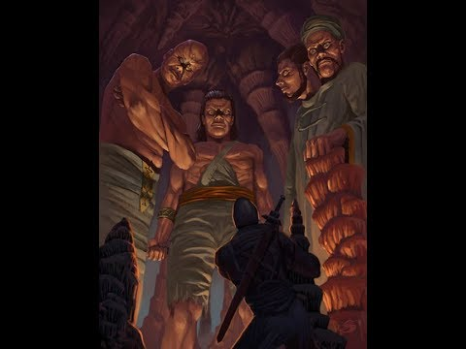
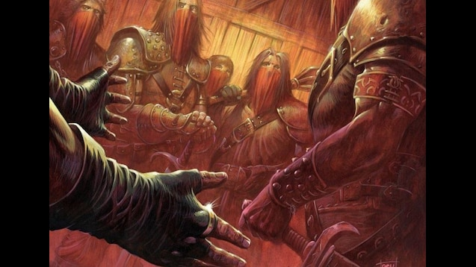
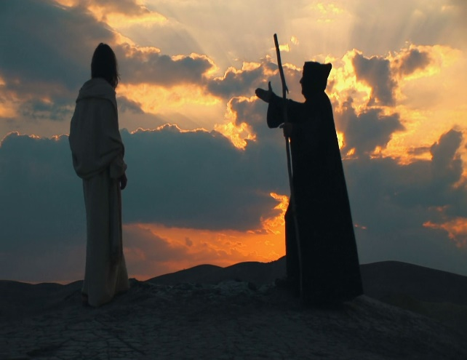
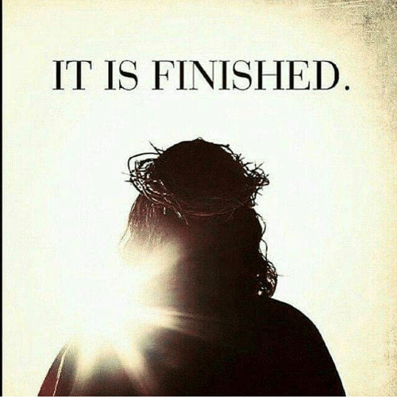
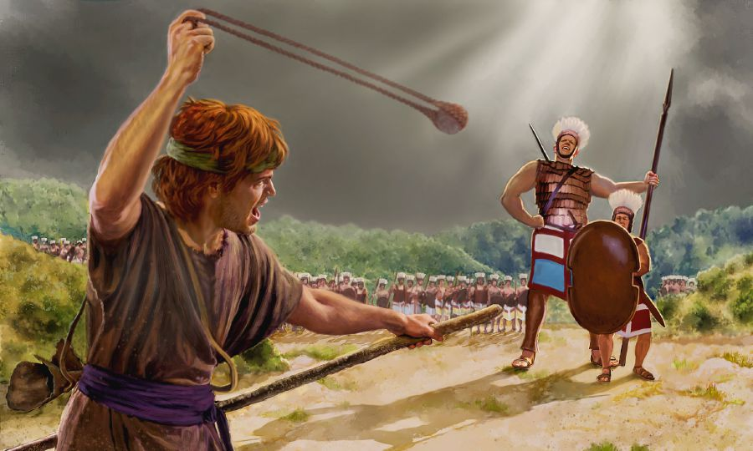

Slide 16
Three Things about Trials
They Come
They are a part of life
There will never be a time when…
…you are beyond being tried
They Go
Won’t last forever
God is Faithful
He will always provide a way of escape

Slide 17
He Fought an Opponent that… …Refused to Quit
Goliath (beheader)
“Distort Thinking”
Ishbibenob (to dwell + on high) -Isaiah 14
“Pride”
Genesis 3 - Adam & Eve Garden
Man had the position Satan wanted
Luke 4:5-8,“...High mountain… show kingdoms of the world at one time; all yours if you worship me...”

Slide 18
He Fought an Opponent that… …Refused to Quit
Goliath (beheader)
“Distort Thinking”
Ishbibenob (to dwell + on high)
“Pride”
3. Saph (contain, limit; snatch away, terminate)
“Trials”

Slide 19
He Fought an Opponent that… …Refused to Quit
Lahmi (to feed on, consume, devour, overcome, make war)
“Strongholds”
Powerful Presence -magnify
No name but physical description
“Confident Boast”
Isaiah 59:19 - comes in like a flood (stream/flow)…
…the Spirit will raise up a standard

Slide 20
He Fought an Opponent that… …Refused to Quit
Saph (contain, limit; snatch away, terminate)
“Trials”
Zec 3:1,“Satan stood (ready for action)
by R. Hand (power, fellowship) to Resist (satan)

Slide 21
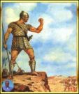
He Fought an Opponent that… …Refused to Quit
Lahmi (to feed on, consume, devour, overcome, make war)
“Strongholds”
I Peter 5:8,“devil as roaring lion walketh about... devour (consume, gulp entire)...”

Slide 22
He Fought an Opponent that… …Refused to Quit
Powerful Presence -magnify
No name but physical description
“Confident Boast”
Isaiah 59:19 - comes in like a flood (stream/flow)
The Spirit will raise up a standard

Slide 23
Luke 4:13 (KJV) ¹³ And when the devil had ended all the temptation, he departed from him for a season.
Luke 4:13 (MSG) ¹³ That completed the testing. The Devil retreated temporarily, lying in wait for another opportunity.
Luke 4:13 (AMP) ¹³ And when the devil had ended every [the complete cycle of] temptation, he [temporarily] left Him [that is, stood off from Him] until another more opportune and favorable time.

Slide 24
Luke 4:13 (KJV) ¹³ And when the devil had ended all the temptation, he departed from him for a season.
Luke 4:13 (MSG) ¹³ That completed the testing. The Devil retreated temporarily, lying in wait for another opportunity.
Luke 4:13 (AMP) ¹³ And when the devil had ended every [the complete cycle of] temptation, he [temporarily] left Him [that is, stood off from Him] until another more opportune and favorable time.

Slide 25
II. He Could not Trust in the… …Arm of the Flesh (15-16)
His State “...he grew weak…”
Neh 4:10 – strength (ability to reproduce)
Burden bearers decayed (weak knees)
Devil thought good time to destroy David
Sad many Christians wait for same thing

Slide 26
II. He Could not Trust in the… …Arm of the Flesh (15-16)
His Situation “...new sword...”
Just when you think you’ve seen it all
Psalm 34:19, “many (cast together)
Affliction (broken pieces; harm )
Righteous… Lord Delivereth (defend without fail )...”

Slide 27
III. We Need Each Other… …Can’t Go It Alone (17)
1st He Secured His Friend
-Succoured (surround, protect, aid)
Romans 15: 1,“…stronger bear infirmity… weak...”
Ecc 4:10,“When one falls they lift...”
Amos 3:3,“How can 2 walk…agreed?”

Slide 28
III. We Need Each Other… …Can’t Go It Alone (17)
2nd He Secured His Enemy
-Smote (go forward/ attack)
Exodus 17:12, -Aaron/ Hur held up Moses hands
Neh.4:16 -1/2 worked, 1/2 held sword

Slide 29
IV. When One Falls in Battle… …Keep in the Fight (17)
Great Example left by David
Is there not a cause?
Great Example left Built Upon
(v 17) the Light can’t go out!!!

Slide 30
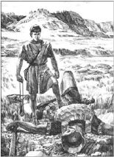
V. Giants Still Fall
Each Giant showed…
…a different side of devil’s tactics
Each person who defeated him shows…
…how to handle them
Counter-Spiritual Warfare

Slide 31
V. Giants Still Fall
David (burning, fervent love)…
…from Judah (praise)
“Celebrate the Cross”
Abisha (Grace) …
…son of Zeruiah (wounded; to leak/flow)
“look to the Cross”
Isaiah 53:1-12
Nothing I do can I do on my own!!

Slide 32
V. Giants Still Fall
Elhanan (stoop down) son of
Jaare Oregim (mighty + fruitful)
“apply the Cross”
Psalm 91:1,7
Isaiah 55:11,“..shall My Word go forth... not return void... shall acc. I please... prosper thing I sent…”

Slide 33
V. Giants Still Fall
Sibbechai (to entwine)
The Hushathite (to cover; bury)
“hide in the Cross”
Galatians 2:20,“I...crucified with Christ... I live... in flesh live by faith”
5. Jonathan (to build up as mountain)
Son of Shammah (he is there)
“trust the Cross”
I Peter 5:6, “Humble selves under M. Hand God... exalt (elevate) in due time”

Slide 34
Giants Still Fall !
Your Giants Still Fall !

Slide 35
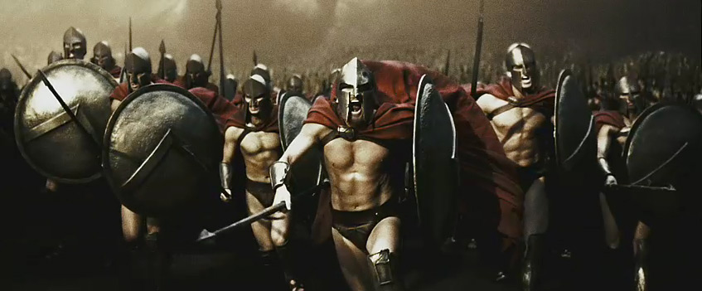
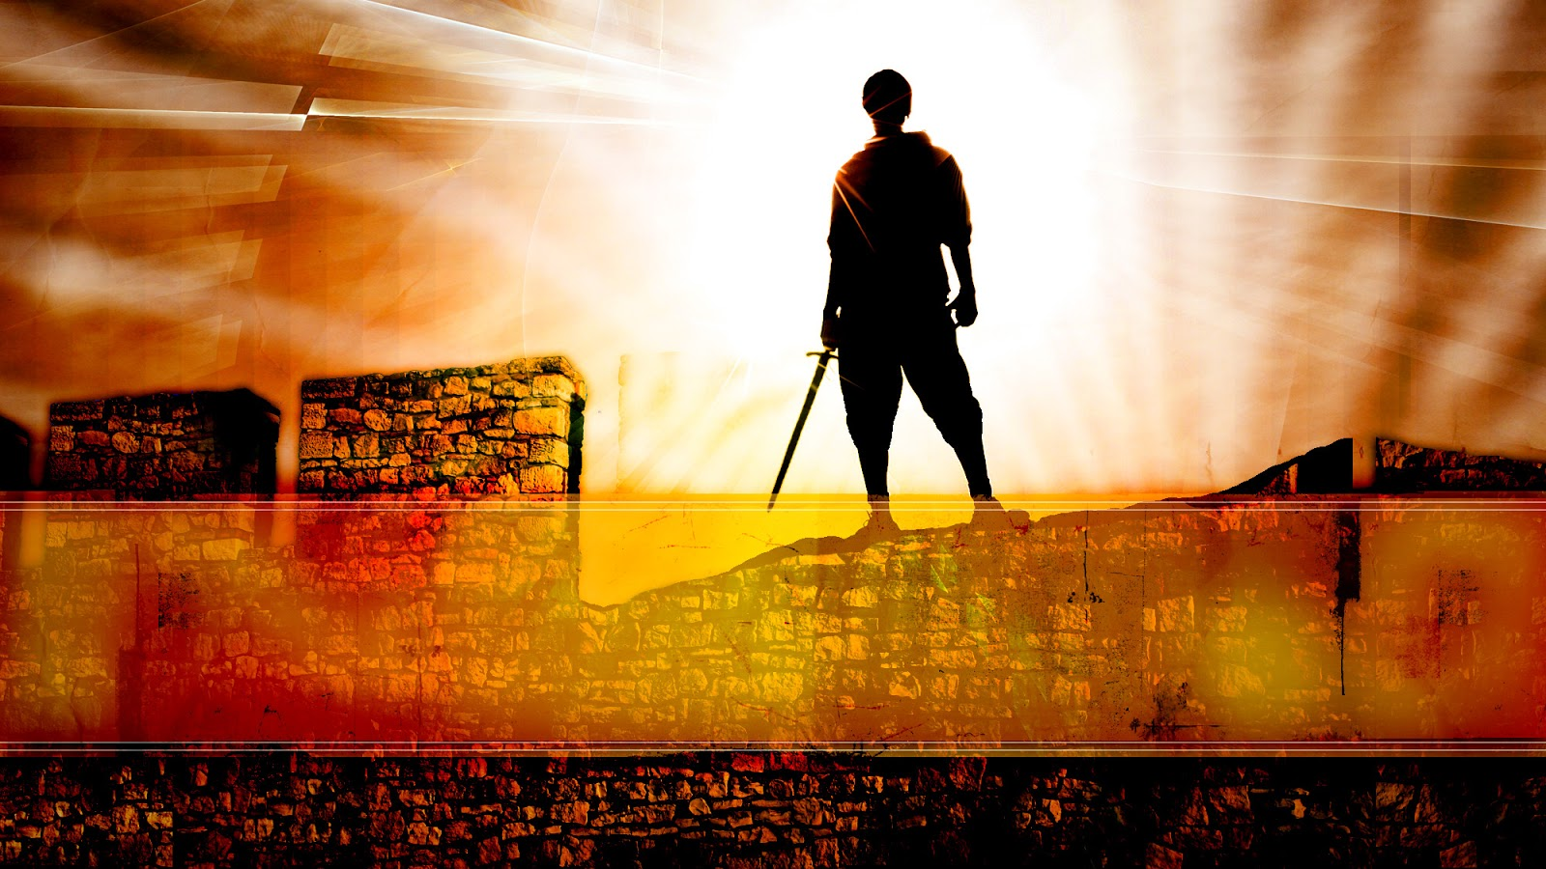

Slide 36
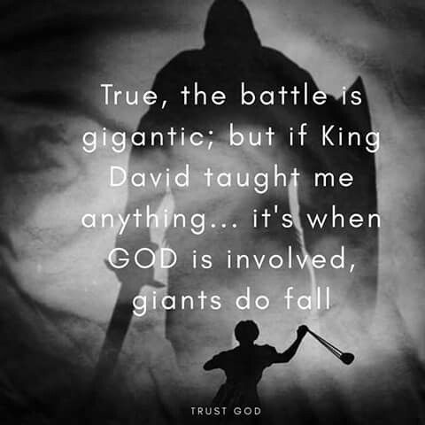
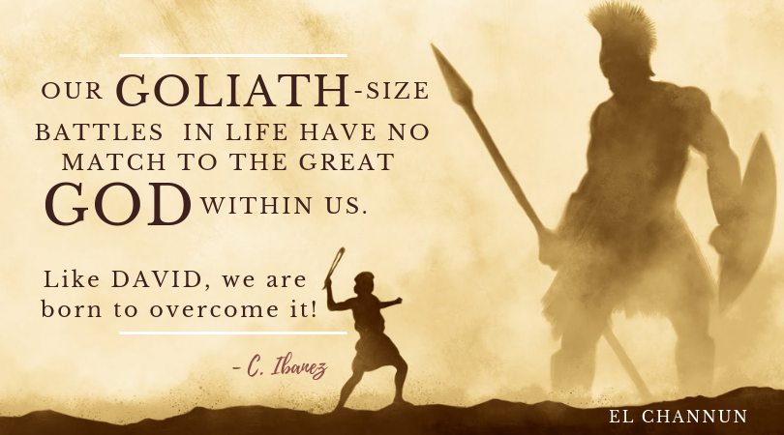
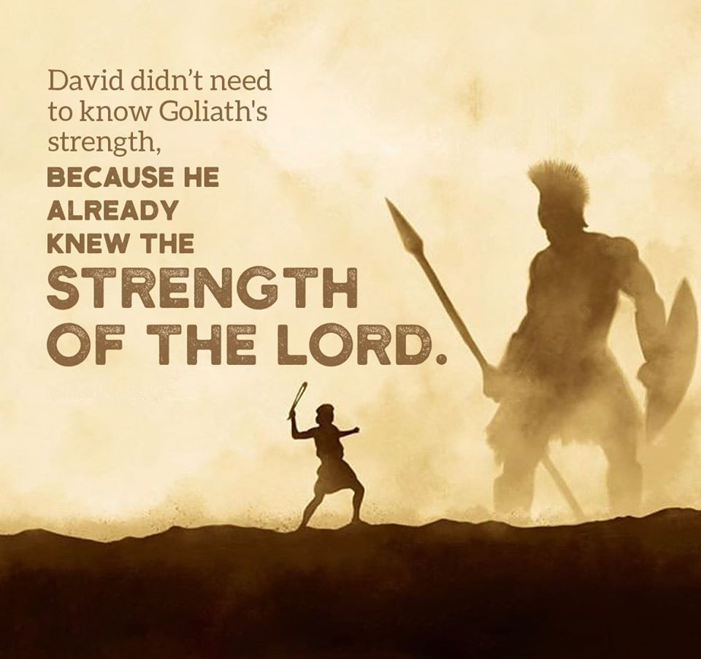
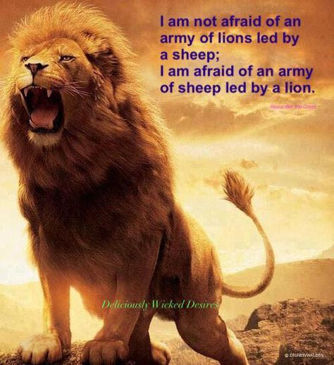

Slide 37
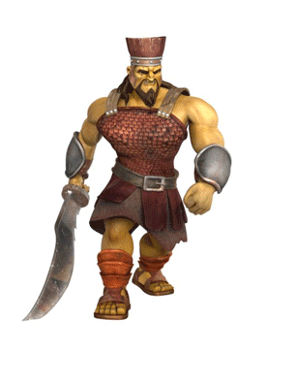
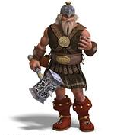
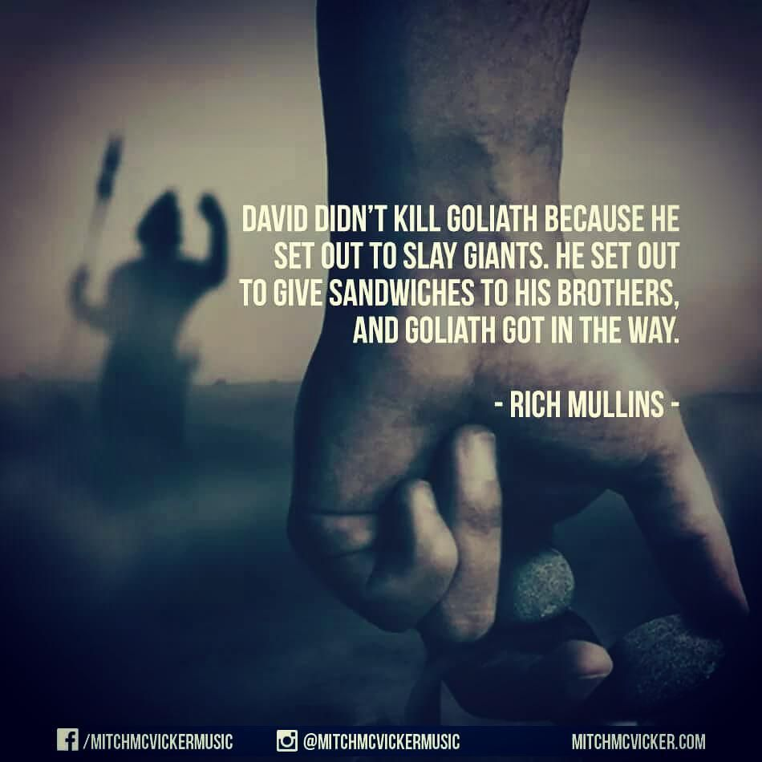
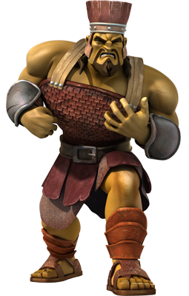
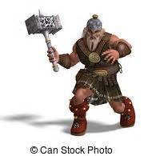

Slide 38
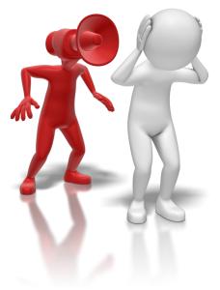
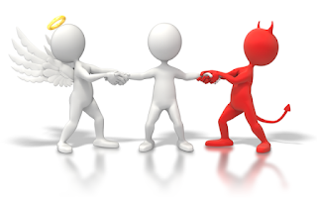
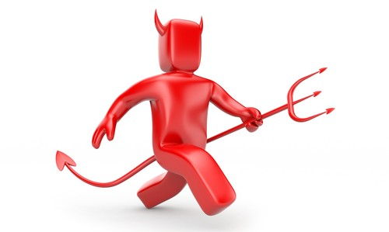
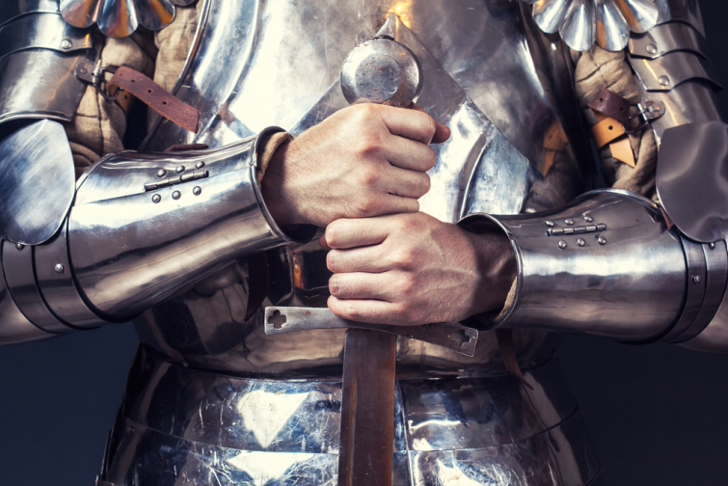
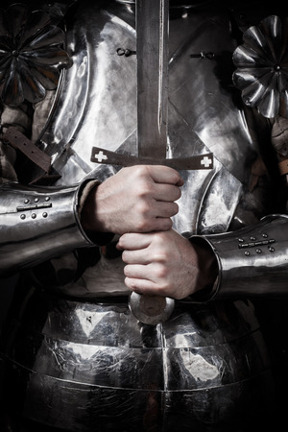
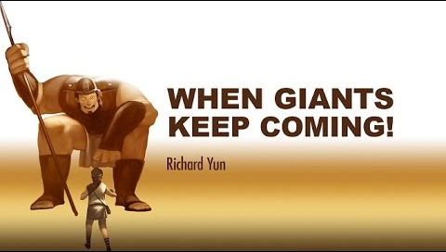
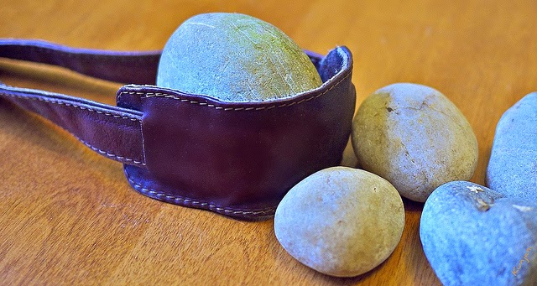

Slide 39
David is near the End of his ministry
David fought Goliath at the beginning
He discovered what One Man + God could do
He also discovered that God desired to do…
…a deeper work
The deeper work would bring uncomfortable times, hurts, pains in the midnight hour
He had seen many battles, been chased by Saul and Absalom, been a laughing stock

