Slide 2

Dealing With
Difficult People
Pt 2
November 6, 2022
Edward Church
The “Don’ts”
Philippians 2:3-4

Slide 3

How Many Know People Who…
…Remind You of This?
We All Have Them…
…in Our
  Past
  Present
  Future
Can’t Always Avoid…
..but Can Learn How to Handle

Slide 4

All of Us Can Be Grumpy & Difficult to Deal With
From Time to Time We Will…
…Encounter Folks Who Behave in the Same Way, or Worse
When You to Deal With Difficult People (And You Will)…
…The Following Tips Should Help:

Slide 5
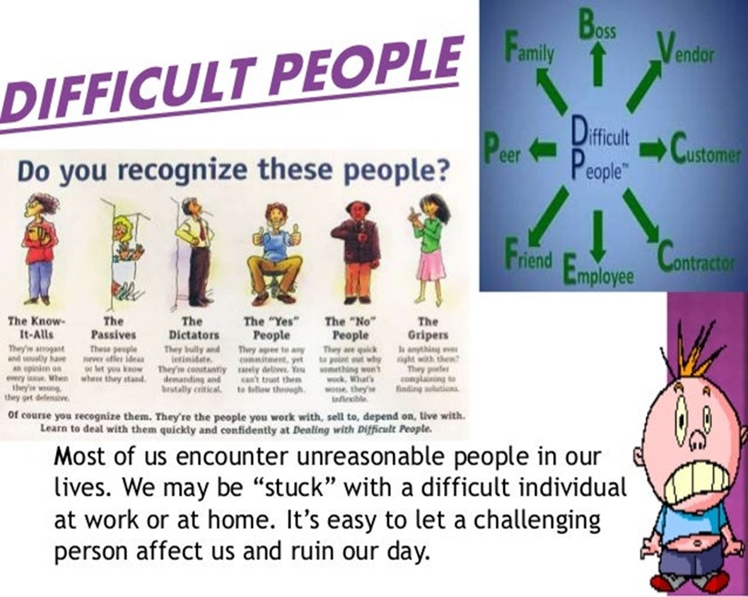
Realize
Difficult People Are a Part of Life
You Can’t Always Avoid them
If You Don’t Deal w- Them Correctly
They Will Sap Your Energy
Weigh You Down
But Dealt With Correctly
Both Will Be Bettered

Slide 6


Check Self - Don’t Be the One Being Difficult
Don’t Try to Change the Other Person
That's why we can be so sure that every detail in our lives of love for God is worked into something good. -Romans 8:28 (MSG)

Slide 7


Jeremiah 29:11 (MSG)
¹¹ I know what I'm doing. I have it all planned out—plans to take care of you, not abandon you, plans to give you the future you hope for.

Slide 8

Don’t Lecture
Lectures Can Turn Into Nagging; Building Walls Instead of Bridges
Since Nagging Usually Creates More Problems Than It Solves…
…Save Your Breath.
Prov 15:1, A soft answer turns away wrath, But a harsh word stirs up anger.
Prov 21:9, Better to dwell in a corner of a housetop, Than in a house shared with a contentious woman (or man)

Slide 9
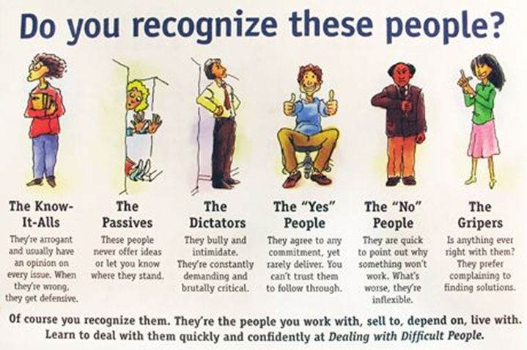
Do Not Protect Them from Consequences
When You Protect Other People From Their Consequences…
  You’re Doing Them A Disservice
  You’re Becoming An Enabler.
Most People Don’t Learn New Behaviors Until…
…The Old Behaviors Stop Working,
Hebrews 12:5-6
5 And you have forgotten the exhortation which speaks to you as to sons: “My son, do not despise the chastening of the LORD, Nor be discouraged when you are rebuked by Him; 6 For whom the LORD loves He chastens, And scourges every son whom He receives.”

Slide 10

Don’t Allow Yourself to Become Caught Up in the Other Person’s Emotional Outbursts
If Someone is Ranting, or Worse, You Have the Right to Get Up/ Leave.
Remember:
Emotions are Highly Contagious, You Could Become Angry, Too.
Make the Conscious Effort to Remain Calm (Proverbs 22:24, 25)
24Make no friendship with an angry man, And with a furious man do not go, 25Lest you learn his ways And set a snare for your soul.

Slide 11

