Slide 1
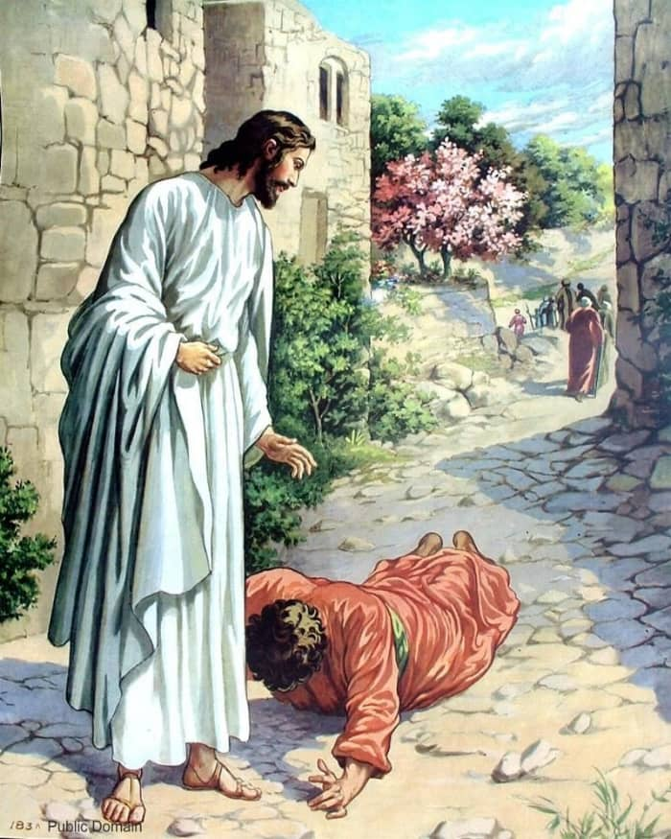
The Power of Thanksgiving
Luke 17:11-19

Slide 2
Power of Trouble (11-13)
Power of His Word (14)“go show yourselves to priest.”
Power of Faith in His Word (14)“as they went cleansed..”
Power of Thanksgiving (15-19)
(17)“..where are the nine?” -too many caught up in Gift –vs- Giver
(15)“..turned back”
Use the Same Intensity w- Thanksgiving as w- Asking

