Slide 1
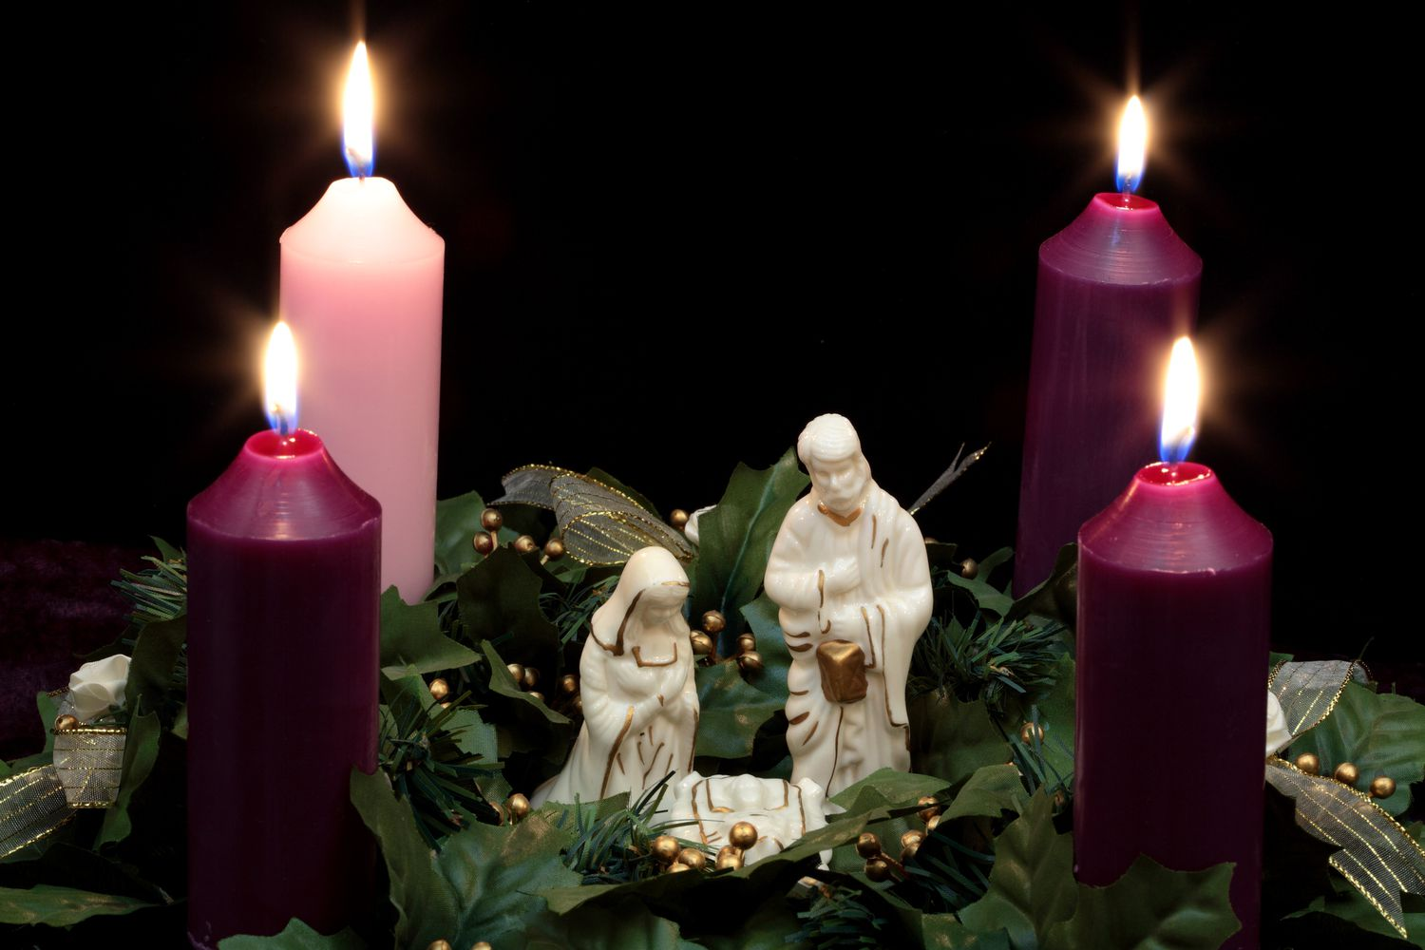
Jesus is Born
Praise God!

Slide 3
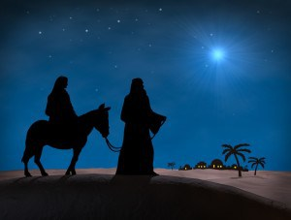
The Miserable Blessing
Luke 1
Part 2
December 11, 2022
Edward Church

Slide 4

Soft Gospel has Crept into the Church
We Want to Be An Overcomer…
..With Out the Challenge of Overcoming
We Want the Spoils of Victory …
…Without the Scars of the Battle
That Has Never Been God’s Plan

Slide 5

That Has Never Been God’s Plan
He is Raising Up a Mighty Army…
…Not Afraid to Face the Challenge
…Not Afraid to Collect Scars
…to Stand in this Last Generation
…and Declare…
We Will Not Go Silently in the Night!

Slide 6

Easy to Lose Sight of REAL BLESSINGS
Real Blessings Don’t Always Come…
    without Struggle
    without Pain
    with Answers
Often Leaves You Asking..
Lord…
If I Am SO BLESSED…
…Then Why Am I So Miserable?

Slide 7


Slide 8

Zacharias and Elisabeth
  Zacharias Doubts Message -Miserable
  Zacharias Stricken Dumb -Miserable
  Elisabeth Happy but Hiding -Miserable
  Baby Not Moved til Mary Arrives - -Miserable
  Zacharias Mouth Opens When Delivers Name

Slide 9
Luke 1:26-31 (KJV)
²⁶ And in the sixth month the angel Gabriel was sent from God unto a city of Galilee, named Nazareth, ²⁷ To a virgin espoused to a man whose name was Joseph, of the house of David; and the virgin's name was Mary. ²⁸ And the angel came in unto her, and said, Hail, thou that art highly favoured, the Lord is with thee: blessed art thou among women. ²⁹ And when she saw him, she was troubled at his saying, and cast in her mind what manner of salutation this should be.
³⁰ And the angel said unto her, Fear not, Mary: for thou hast found favour with God. ³¹ And, behold, thou shalt conceive in thy womb, and bring forth a son, and shalt call his name JESUS.

Slide 10
The Miserable Blessing
Story Continues…
Angel Appears to Mary and Says…
…You Are
    Highly Favored
    Blessed
  …And He Could Have Added
…Stressed!

Slide 11

1st- Mary Has Trouble Believing Angel -Miserable
2nd- Joseph Has Trouble Believing Mary –Miserable
3rd- Trip To Bethlehem(90-100 mi =10 mi / day) –Miserable
4^{th-} Upon Arrival “No Room” but a Cave- Miserable
5th- Shepherds Maneuvered in Night–Miserable
6th- Wise Men-Travelled 2 years –at Night –Miserable
7th- Uprooted Middle Of Night Trip to Egypt – Miserable
8th- Herod Kills All Male Children 2 / under -Miserable

Slide 12

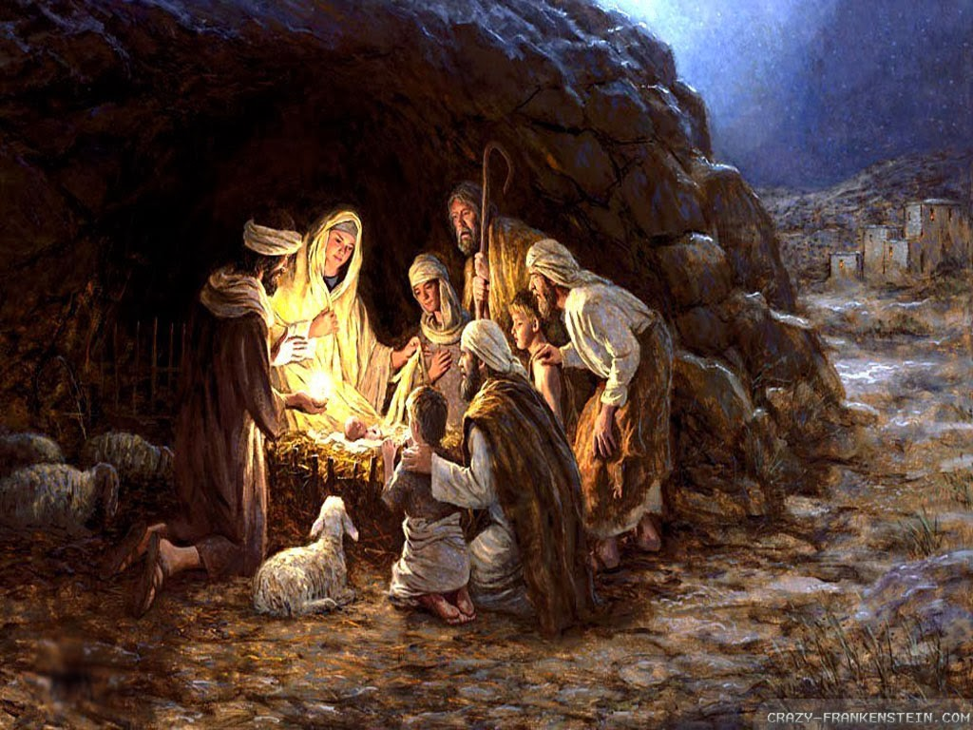
You Never Judge Your Blessing
  During the Process
  But By the End Product

Slide 13

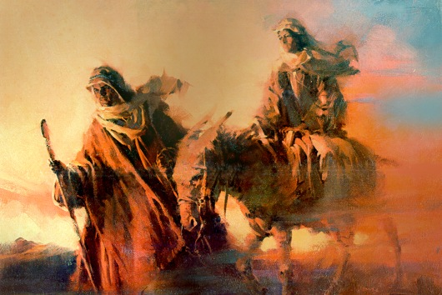
Process Makes You Tough
Wilderness is There to Purge Your…
  Motives
  Faith
  Fear
Isaiah 43:1-3 (KJV)
¹ But now thus saith the LORD that created thee, O Jacob, and he that formed thee, O Israel, Fear not: for I have redeemed thee, I have called thee by thy name; thou art mine. ² When thou passest through the waters, I will be with thee; and through the rivers, they shall not overflow thee: when thou walkest through the fire, thou shalt not be burned; neither shall the flame kindle upon thee. ³ For I am the LORD thy God, the Holy One of Israel, thy Saviour

Slide 14

Isaiah 43:1-3 (NLT)
¹ But now, O Jacob, listen to the LORD who created you. O Israel, the one who formed you says, “Do not be afraid, for I have ransomed you. I have called you by name; you are mine. ² When you go through deep waters, I will be with you. When you go through rivers of difficulty, you will not drown. When you walk through the fire of oppression, you will not be burned up; the flames will not consume you. ³ For I am the LORD, your God, the Holy One of Israel, your Savior.
Isaiah 43:1-3 (MSG)
¹ But now, GOD's Message, the God who made you in the first place, Jacob, the One who got you started, Israel: "Don't be afraid, I've redeemed you. I've called your name. You're mine. ² When you're in over your head, I'll be there with you. When you're in rough waters, you will not go down. When you're between a rock and a hard place, it won't be a dead end— ³ Because I am GOD, your personal God, The Holy of Israel, your Savior. I paid a huge price for you: all of Egypt, with rich Cush and Seba thrown in!

Slide 15

Isaiah 43:1 (KJV)
But now thus saith the LORD
created thee, O Jacob, (Produce)
formed thee, O Israel, (Re-Produce)
Fear not: for I have (Power)
redeemed thee, (Purpose)
called thee by thy name
thou art mine. (Possession)
² When thou passest through the waters, I will be with thee; and through the rivers, they shall not overflow thee: when thou walkest through the fire, thou shalt not be burned; neither shall the flame kindle upon thee.

Slide 16

Seasons of Misery
Realize
  Help Us Realize Our Limitations
Reach
  Force Us to Reach Out to God for Help
Reveal
  Reveal God and His Saving Grace / Strength
Adjust
  Help Us Adjust Our Attitudes

Slide 17

Know …
  He is Still IN Charge
  He Has Your Best Interest at Heart
  His Timing is Always Perfect
When You Don’t Know His Plan
When You Can’t See His Hand
You Can Trust His Heart!

Slide 18
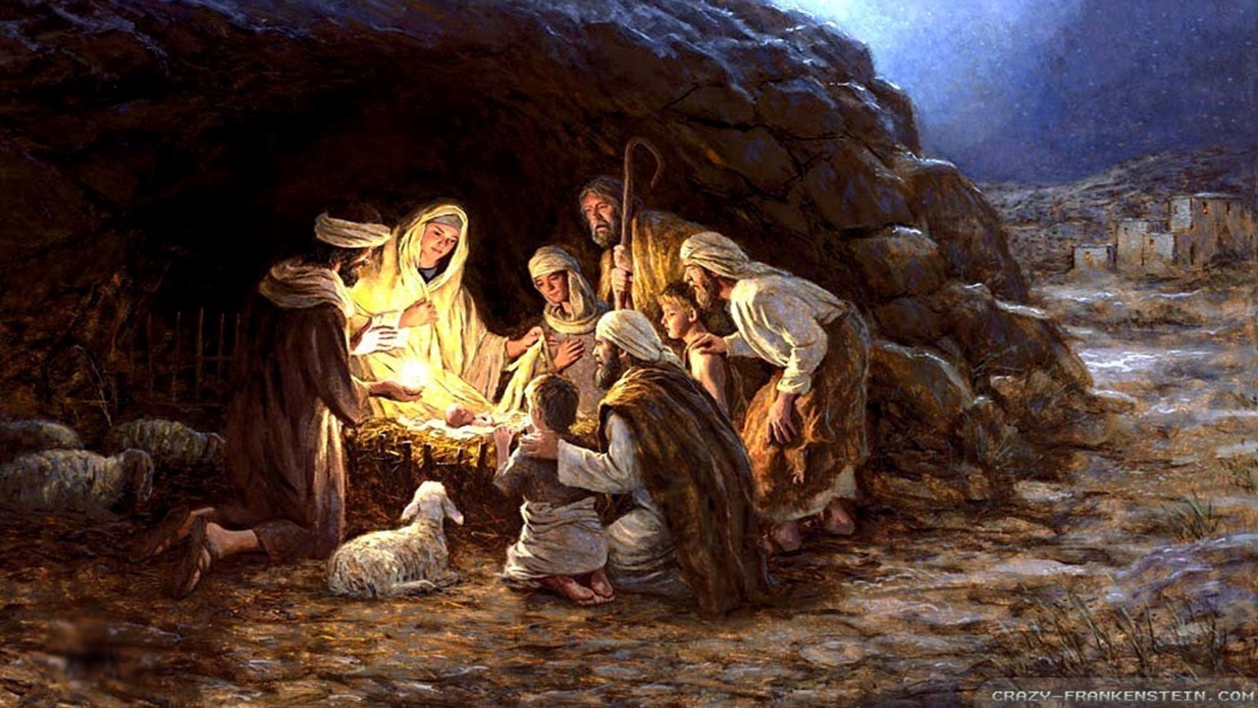
Thank God for…
…Our Miserable Blessings
They Often Lead to a Time of…
Hope
Second Chances
Redemption
Promises Fulfilled

