Slide 1
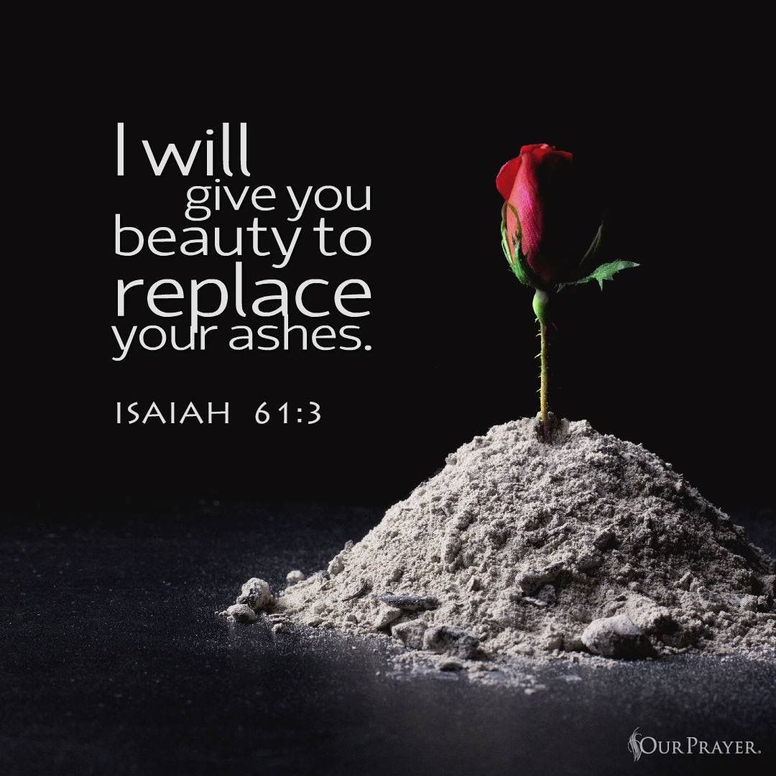

Slide 2

Spiritual Warfare
10% Satan’s Tactics
90% How We Respond
Remember…
With God We Are Not
Helpless
Hopeless
We Are Powerful!!

Slide 3

Repeat
These are the 2 Most Important Hours of My Week – Help Me to Cherish Them
I Am Here Today to Worship
Not to Be Entertained
I Am Singing to An Audience of One
Accept My Worship Oh Lord!

Slide 4
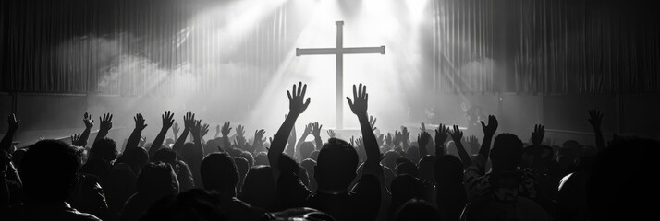
Edward Christian Church
5/17/2026

Slide 5
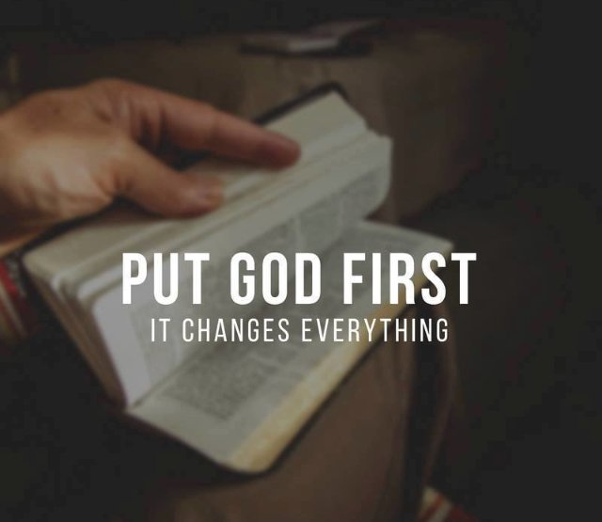
Repeat
I Lift My Offering to You
Let It Please You Oh Lord
This is My Seed
Although It Leaves My Hand
It will Never Leave My Life
You Will Multiply It!
Accept My Seed Oh Lord!

Slide 6

“He gives them beauty instead of ashes.” — Isaiah 61:3
THE EXCHANGE
Beauty for Ashes
When God Trades In What Broke You
Isaiah 61:1–3

Slide 7
At Sunday School they were teaching how God created everything, including human beings. Little Johnny seemed especially intent when they told him how Eve was created out of one of Adam’s ribs.
Later in the week, his mother noticed him lying down as though he were ill, and she said, ‘Johnny, what is the matter, young boy?’
Little Johnny responded, “I have pain in my side. I think I’m going to have a wife.”

Slide 8
“He gives them beauty instead of ashes.” — Isaiah 61:3
THE EXCHANGE
Beauty for Ashes
When God Trades In What Broke You
Isaiah 61:1–3

Slide 9
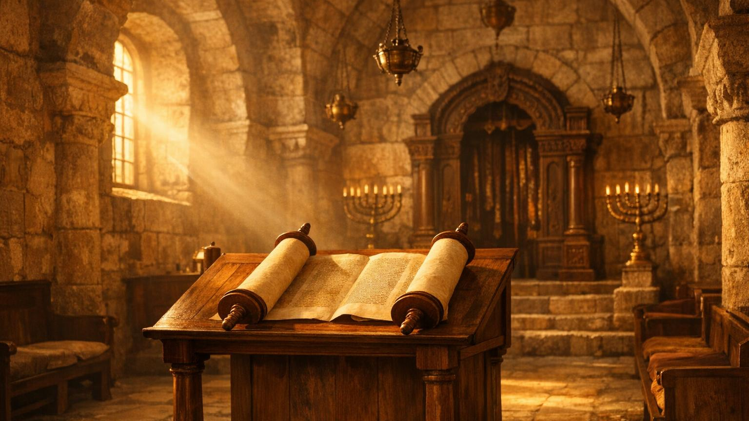
'Today this scripture is fulfilled in your hearing.' — Luke 4:21
A Scroll in a Synagogue
“He was not reading ancient history. He was declaring your present‑tense promise.
Luke 4:16–21
Jesus enters the synagogue.
He unrolls the scroll of Isaiah.
He reads Isaiah 61:1 aloud.
He sits. Every eye is fixed on Him.

Slide 10
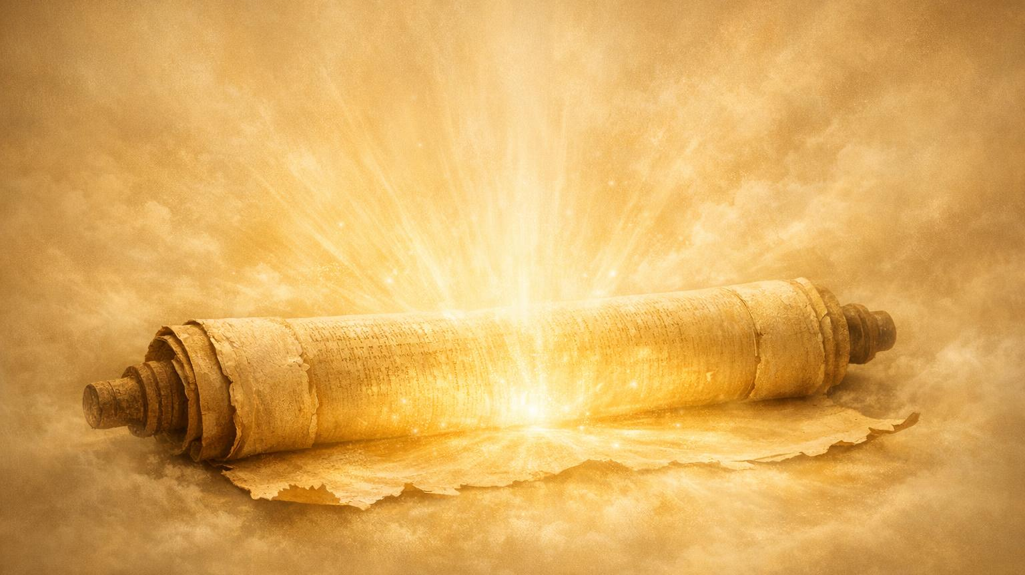
“The Spirit of the Lord God is upon me…” — Isaiah 61:1
Isaiah 61:1–3
“The Spirit of the Lord God is upon me… to give them a garland instead of ashes,
the oil of gladness instead of mourning,
the garment of praise instead of a faint spirit;
that they may be called oaks of righteousness, the planting of the Lord,
that he may be glorified.”
THIS TEXT STILL HAS YOUR NAME ON IT.

Slide 11
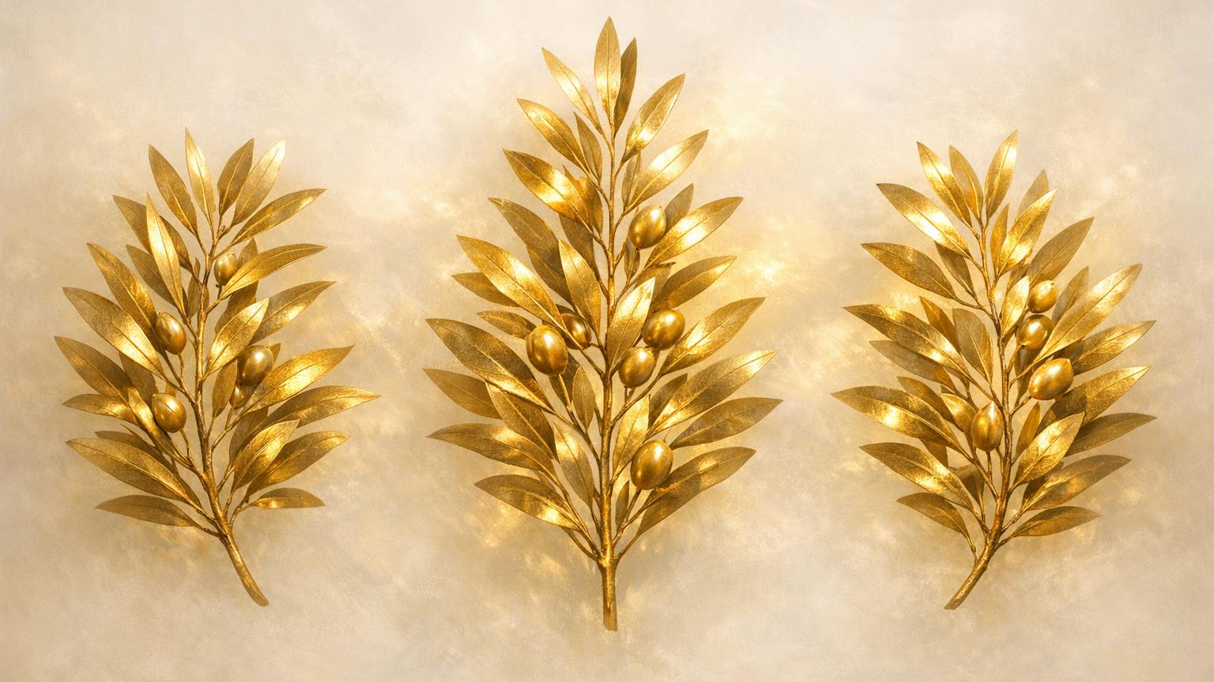
'I will restore to you the years the locust has eaten.' — Joel 2:25
Three Divine Trades
FOR in Heb = IN PLACE OF
1.
A Crown for Ashes
2.
Oil of Joy for Mourning
3.
Praise for a Dimming Spirit
God does not patch your old life. He substitutes it entirely.

Slide 12

'He will give you beauty instead of ashes.' — Isaiah 61:3
Beauty in Place of Ashes
ASH = the residue left when everything you loved has been burned.
CROWN = an ornament of glory placed on your head by God Himself.
God will not leave you in the rubble.
He will crown the place that once held your deepest grief.

Slide 13
'He will give you beauty instead of ashes.' — Isaiah 61:3
“Where did disappointment train you to…
…stop expecting beauty?”

Slide 14
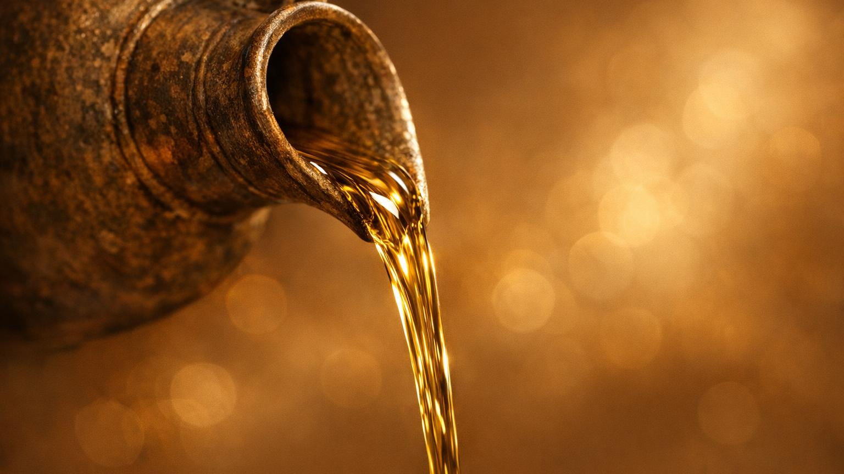
'He restores my soul.' — Psalm 23:3
Oil of Joy Instead of Mourning
Mourning is the Hebrew word for deep, inconsolable mourning
— grief so heavy it bends you.
Oil of Joy = oil of gladness, an anointing of exuberant joy.
God pours His joy directly into the place of your deepest grief.
Your mourning is not PERMANENT. It is the address where God Delivers your JOY.

Slide 15

'You have turned my mourning into dancing.' — Psalm 30:11
Garment of Praise Instead of a Dimming Spirit
Dimming Spirit— a spirit growing faint, smoldering, nearly extinguished.
God answers with Garment of Praise —
a garment of praise wrapped around you
Praise does not wait until you feel better.
Praise is what restores the fire.
"Put on the garment. The feeling will follow the act of worship."

Slide 16
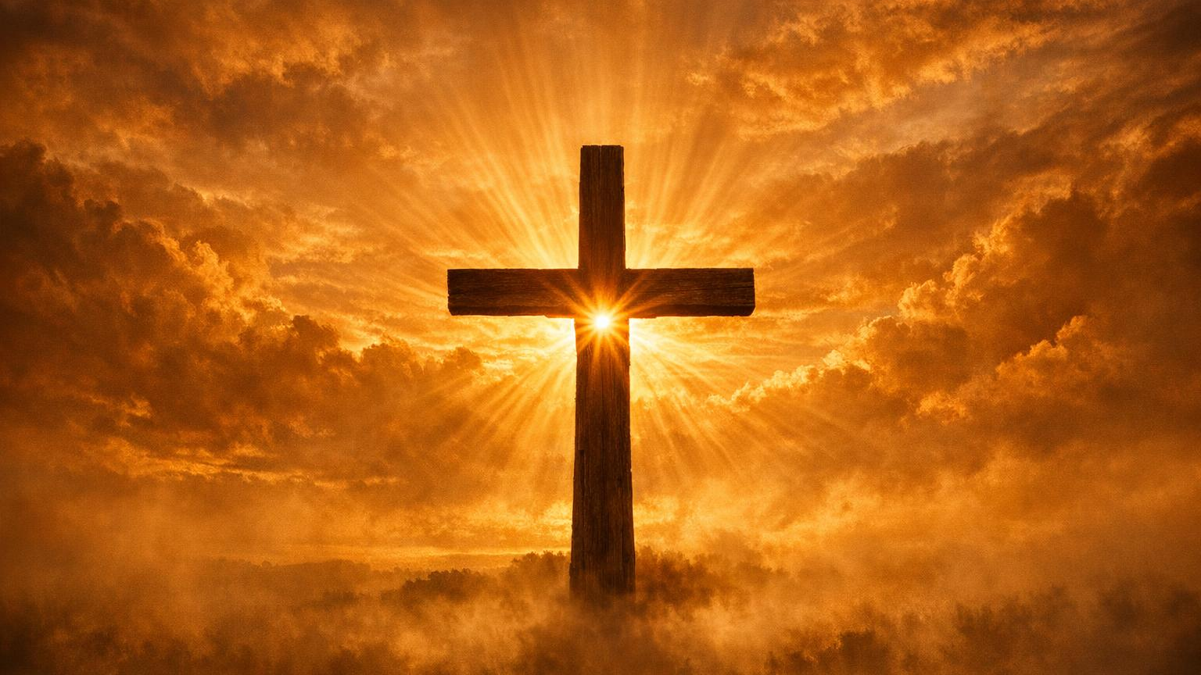
✦ "God made him who had no sin to be sin for us." — 2 Corinthians 5:21 ✦
The Ultimate Exchange
Where Every Trade Was Finalized
Jesus became ASHES — ashes, devastation, grief — so that you could receive CROWN
He took your mourning so you could have the oil of joy.
He wore the spirit of heaviness so you could wear the garment of praise.
"Calvary is the greatest exchange in history. And it still has your name on it."

Slide 17

'Cast your burden upon the Lord and He will sustain you.' — Psalm 55:22
Bring Your Ashes
The Exchange Requires a Transaction
You cannot receive the beauty if you are STILL CLUTCHING THE ASHES.
God is not asking you to pretend the pain was not real.
He is asking you to bring it all — your brokenness, your grief, your burned-down dreams — and lay it at His feet.
None of it disqualifies you. All of it qualifies you for the exchange.
The altar is not for perfect people.
It is for people carrying ashes who are ready to trade.

Slide 18
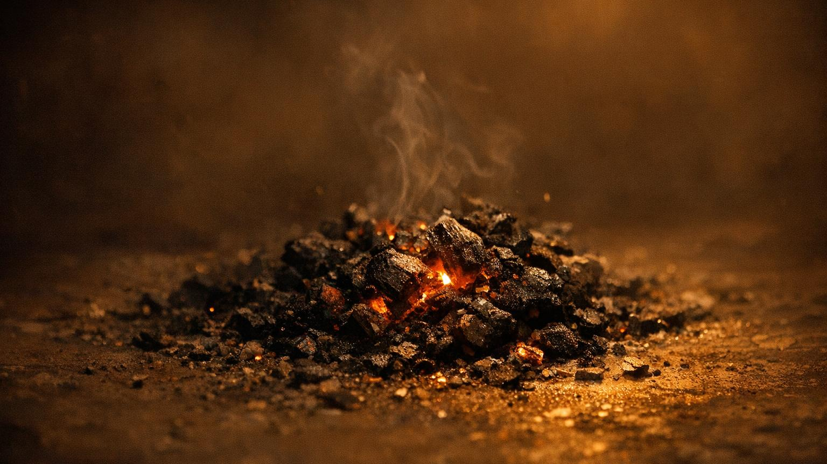
'Come to me, all you who are weary and burdened.' — Matthew 11:28
When the Ashes Feel Familiar
The Pain You Know vs. the Promise You Don't
Sometimes we hold onto our ashes not because we love the pain, but because the pain is all we know.
Grief can become an identity.
Brokenness can become a home.
When suffering has been your companion for so long, the thought of letting go feels less like freedom and more like losing the last piece of who you are.
But God is not asking you to forget.
He is asking you to stop building your life around what burned down.
Familiarity is not the same as safety. The ashes cannot keep you warm.

Slide 19
'Come to me, all you who are weary and burdened.' — Matthew 11:28
“Are you still wearing mourning clothes God never asked you to keep?”
Scripture: “You turned my mourning into dancing…” — Psalm 30:11

Slide 20
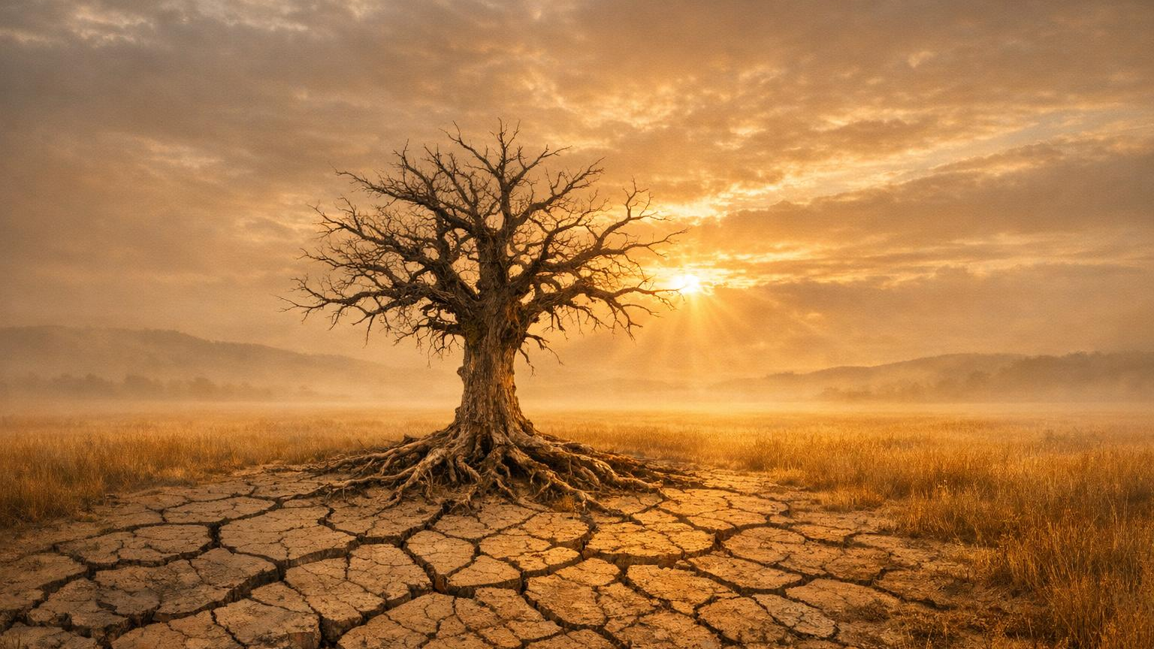
'For I know the plans I have for you,' declares the Lord. — Jeremiah 29:11
The Fear of What Comes Next
When Trust Feels Like a Risk You Cannot Afford
Letting go is terrifying when life has already taken so much from you.
The last time you trusted= disappointed. Last time you hoped, the door closed.
So now you hold the ashes tighter — not because you want to, but because you are afraid that if you open your hands, there will be nothing left.
But faith does not require you to see what is coming. It only requires you to believe the One who is calling you forward is worth following into the unknown.
God does not ask you to understand the plan.
He asks you to trust the Planner.

Slide 21

'Unless a grain of wheat falls to the ground and dies, it remains alone.' — John 12:24
The Moment of Release
When Letting Go Becomes an Act of Faith
There comes a moment when you must decide: will I keep holding what is already gone, or will I open my hands for what God is bringing?
Release is not a single act of courage — it is a daily choosing.
Some days you will feel the ashes slipping through your fingers and want to grab them back. That is not failure. That is the process. Every time you choose to open your hands again, you are saying to God:
I trust You more than I trust my pain.
Surrender is not giving up. It is giving over.

Slide 22
“What are you gripping that God can only heal when released?”
“The Lord restored Job when he prayed for his friends…” Job 42:10

Slide 23

'For I know the plans I have for you — plans to give you a future and a hope.' — Jeremiah 29:11
Five Steps to the Exchange
Walk Into What God Has Already Prepared
1. Acknowledge Your Ashes — Name what has been broken or lost
2. Bring Them to God — Lay your grief and pain at His feet
3. Release Your Grip — Surrender what you have been holding onto
4. Receive the Exchange — Accept His crown, oil, and garment
5. Walk in the New — Go forward as an oak of righteousness
The exchange happens when faith meets surrender at the altar.

Slide 24
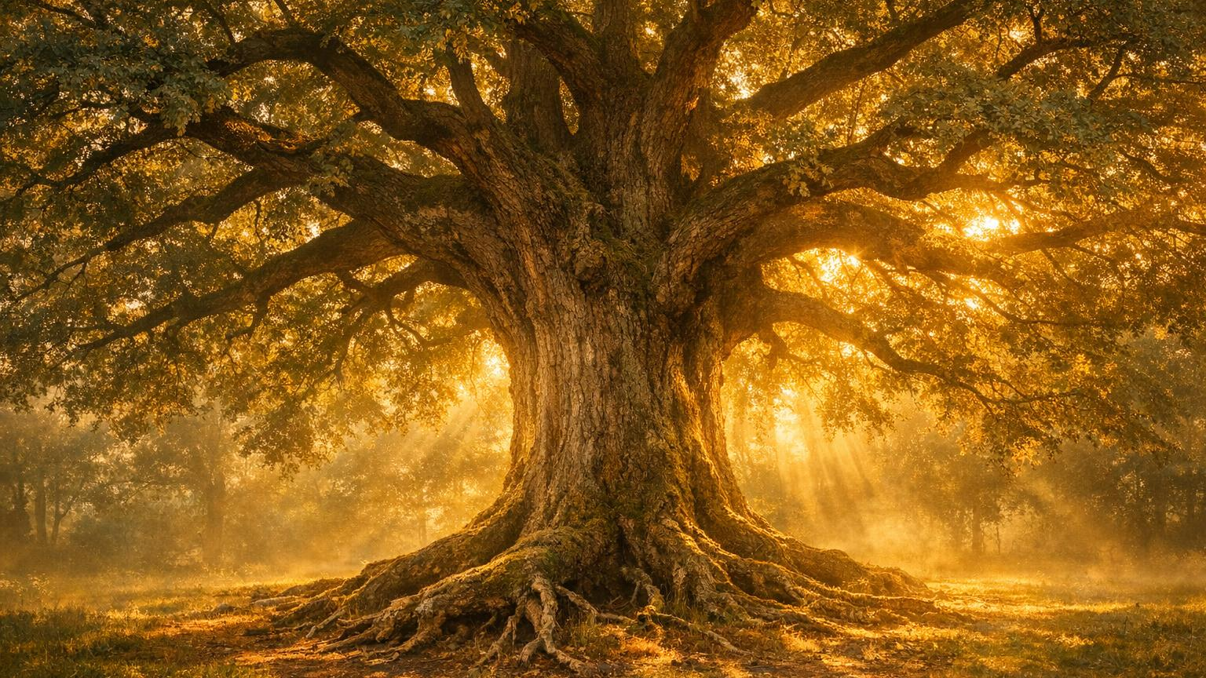
'They shall be called oaks of righteousness, the planting of the Lord.' — Isaiah 61:3
Oaks of Righteousness — Isaiah 61:3
This is God's destination for everyone who makes the exchange.
Not a willow bending in the storm. An OAK. Ancient. Unshakeable. Deeply rooted. Planted intentionally by the Lord Himself. You are not just being healed — you are being established.
YOU ARE THE PLANTING OF THE LORD.

Slide 25
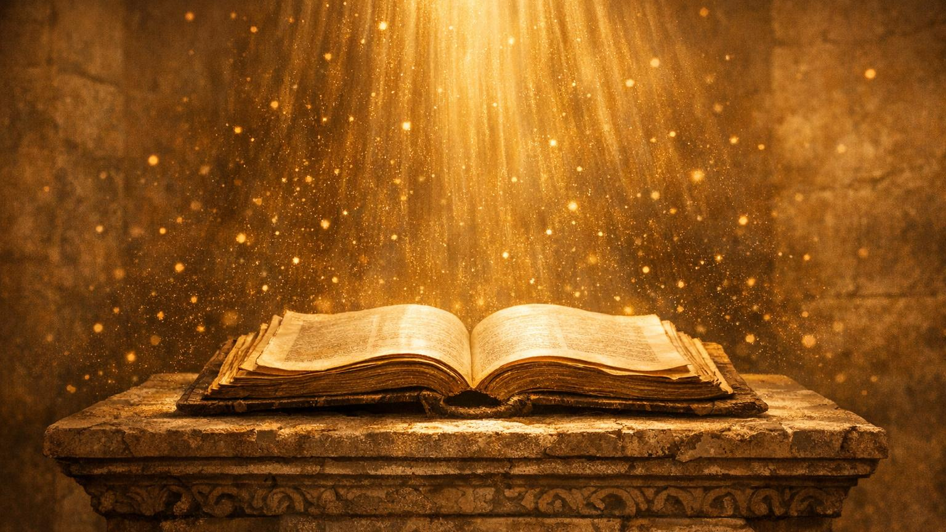
'We are more than conquerors through Him who loved us.' — Romans 8:37
…
Prophetic Declarations
Speak These Over Your Life — Isaiah 61
I am anointed and appointed by the Spirit of God
—
—
—
…My broken heart is being bound up by the Healer
—
—
—
I am released from every captivity that held me
…The Spirit of God glorifies Himself through my life
I am an oak of righteousness, planted by the Lord
…I receive beauty, joy, and praise in exchange for my ashes

Slide 26
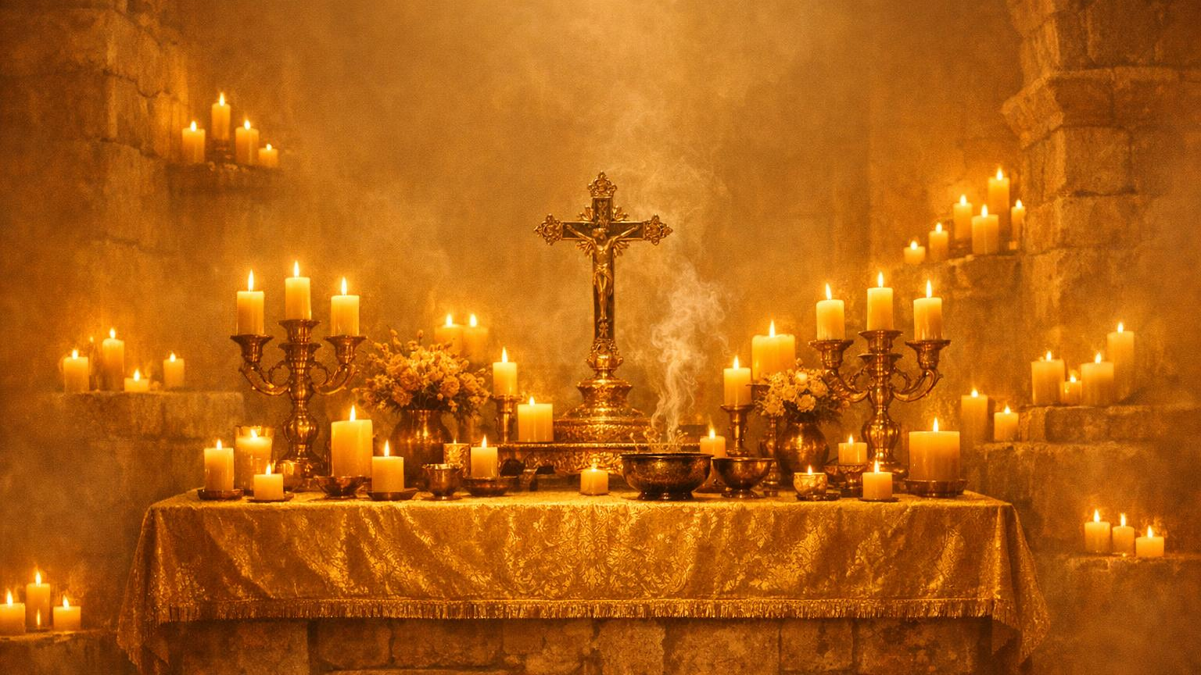
"Come to Me, all who are weary and burdened, and I will give you rest."
— Matthew 11:28
Come to the Exchange
The Altar Is Open
Whatever you carried in here today — the grief, the loss, the burned-down dreams, the years the enemy stole —
God is not finished with your story.
He is ready to make the trade.
Come with your ashes. Leave with His beauty.
If you are hurting or broken — this moment is your exchange.
Do not leave without it.

Slide 27
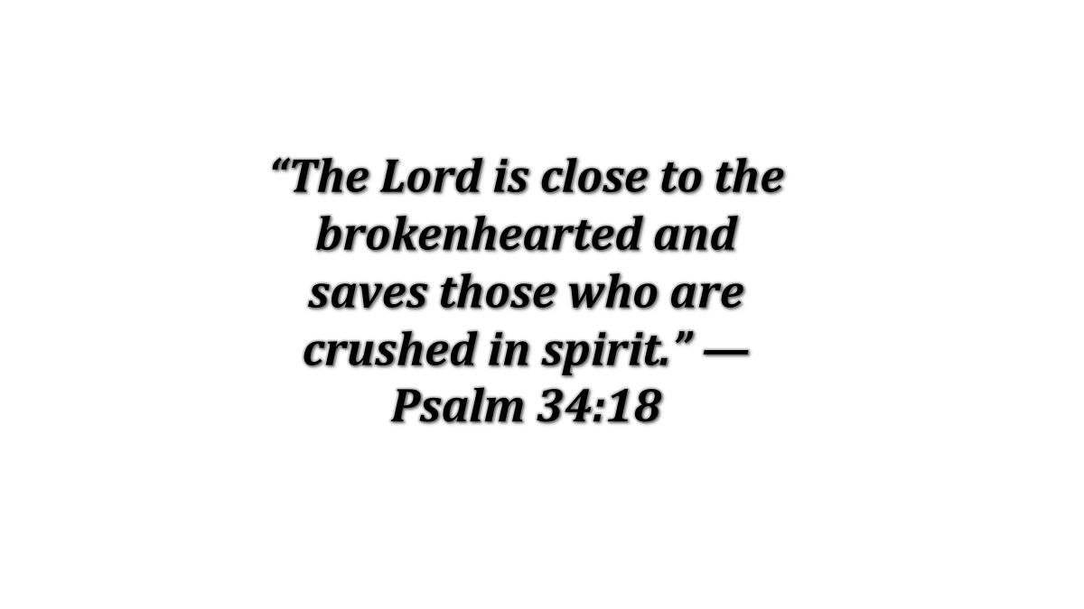
Prayer of Exchange
“Father, we come to You right now at this altar bringing our ashes. Every charred piece of what burned. Every remnant of what we lost.
Every grief we have been carrying, every shame we have been hiding, every wound we have been nursing. We are opening our hands.
We are releasing it. We are done carrying what You already paid for.
We surrender our ASHES. And we receive, by faith,
the CROWN that You purchased for us at Calvary.
We receive the oil of joy — poured out by Your Holy Spirit
into every mourning place in our lives right now.”

Slide 28

"The Lord bless you and keep you; the Lord make His face shine upon you." — Numbers 6:24–25
Go Forth Crowned
The Benediction — Numbers 6:24–26
"The Lord bless you and keep you; the Lord make His face shine upon you and be gracious to you;
the Lord lift up His countenance upon you and give you peace."
You came in with Ashes. You leave wearing a Crown.
Go — and display the Glory of the Lord.

Slide 29
“The Lord is close to the brokenhearted and saves those who are crushed in spirit.” — Psalm 34:18

Slide 30
“He has not despised or scorned the suffering of the afflicted one.” — Psalm 22:24
Why Does God Allow the Fire?
The Question Every Broken Heart Asks
The hardest part of suffering is not the pain itself — it is the silence. When God seems absent in the very moment you need Him most. But the fire is not proof that God has abandoned you. Sometimes the furnace is where He does His deepest work. He does not stand outside the flames — He walks into them with you. What you lost in the fire is not what defines you. What survives it does.
God never wastes suffering. He redeems it — and the ashes become raw material for something new.

Slide 31
“I will give them a new name that no one knows except the one who receives it.” — Revelation 2:17
When Shame Writes Your Name
The Lie That You Are Your Worst Moment
Shame whispers that you are defined by what was done to you — or by what you did. It tells you that your worst moment is your truest self. But God does not name you by your ruins. He does not see damaged goods — He sees a child He purchased at the highest price. Your failures do not disqualify you. Your wounds do not define you. The cross already settled what your name is.
You are not your worst chapter. You are not your ashes. You are His.

Slide 32
“Unless a grain of wheat falls to the ground and dies, it remains only a single seed.” — John 12:24
The Cost of Holding On
When Surrender Feels Like Defeat
Surrender is the most counterintuitive thing God asks of us. Everything in us screams to hold on tighter — to the plan, the relationship, the outcome we prayed for. But God does not ask you to let go so you can be left empty. He asks you to let go because your hands must be open to receive. The death of what you held is not the end — it is the planting. And what God plants, He grows.
What you refuse to release, God cannot redeem. Open hands receive more than clenched fists.

