Slide 1

Edward Christian Church
5/24/2026

Slide 2

Spiritual Warfare
10% Satan’s Tactics
90% How We Respond
Remember…
With God We Are Not
Helpless
Hopeless
We Are Powerful!!

Slide 3

Repeat
These are the 2 Most Important Hours of My Week – Help Me to Cherish Them
I Am Here Today to Worship
Not to Be Entertained
I Am Singing to An Audience of One
Accept My Worship Oh Lord!

Slide 4

Repeat
I Lift My Offering to You
Let It Please You Oh Lord
This is My Seed
Although It Leaves My Hand
It will Never Leave My Life
You Will Multiply It!
Accept My Seed Oh Lord!

Slide 6

WHEN SACRIFICE SPEAKS
John 15:12–13

Slide 7
SACRIFICE
HAS A VOICE
Sacrifice Preaches
Sacrifice Testifies
Sacrifice Reveals Love

Slide 8
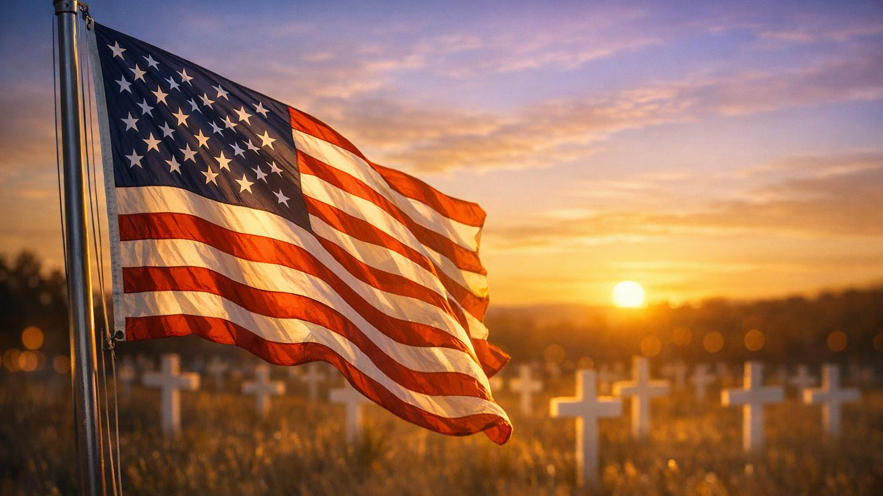
TODAY WE REMEMBER
Freedom is Never Free
Sacrifice is the Price Of Liberty
We Honor Those Who Gave All

Slide 9
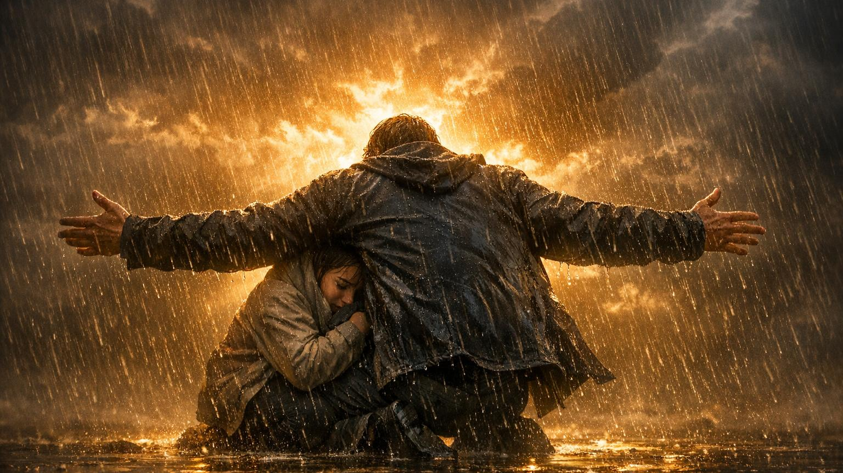
JOHN 15:12–13
“My command is this: Love each other as I have loved you.
Greater love has no one than this: to lay down one’s life for one’s friends.”

Slide 10
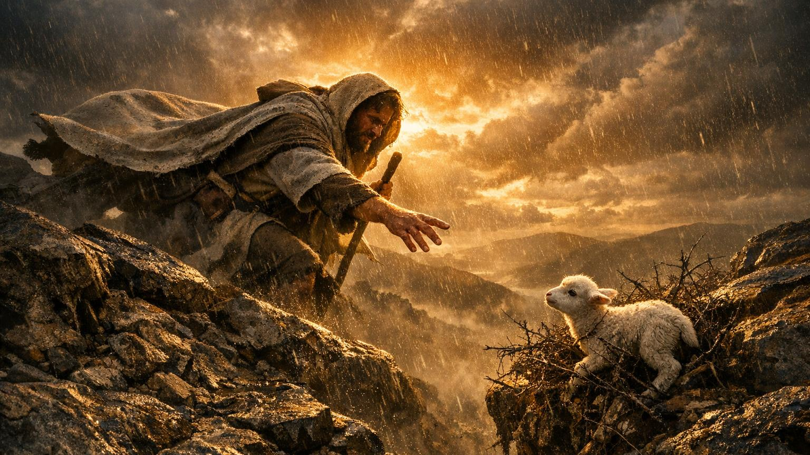
“AS I HAVE LOVED YOU”
Love that Initiates
Love that Pursues
Love that Sacrifices

Slide 11
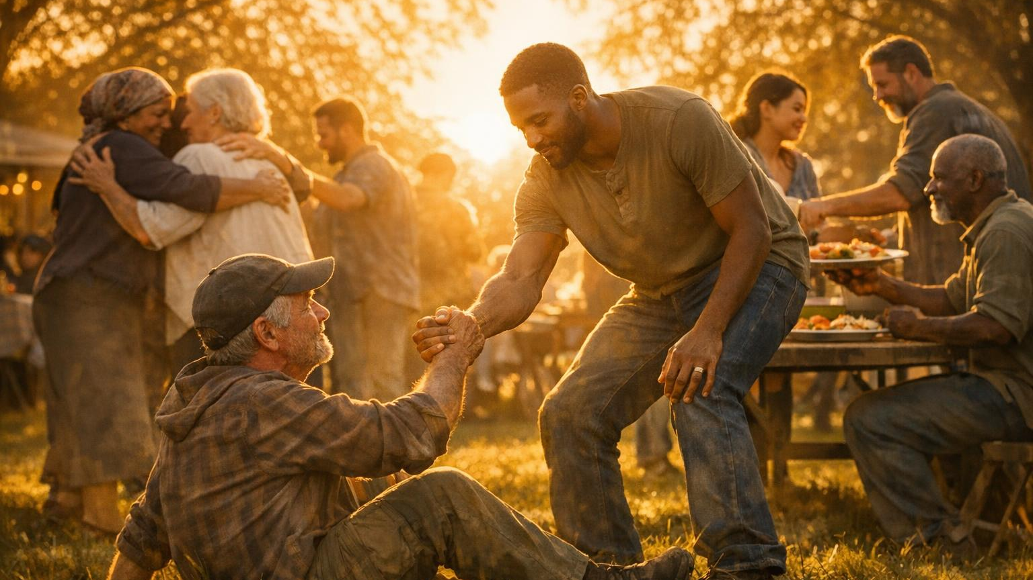
LIFE APPLICATION
LOVE FIRST
Jesus Loved First
Who Must You Love First?

Slide 12
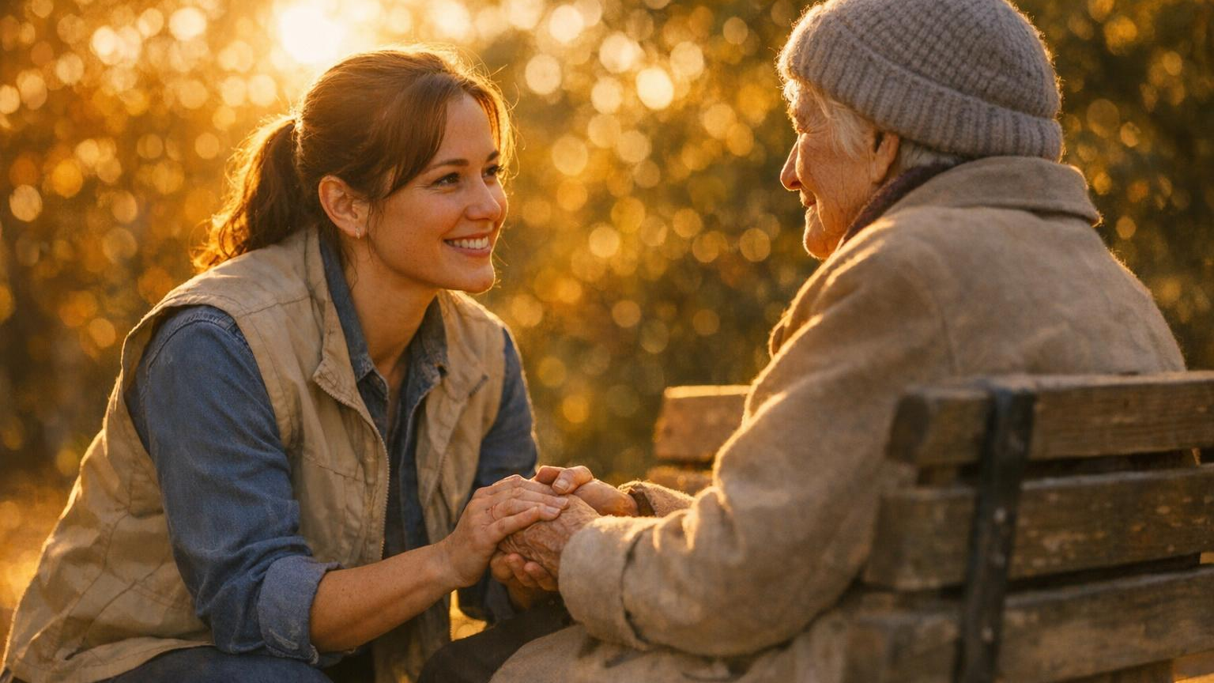
CHALLENGE #1
WHO MUST YOU INITIATE WITH?
Stop waiting
Start obeying

Slide 13
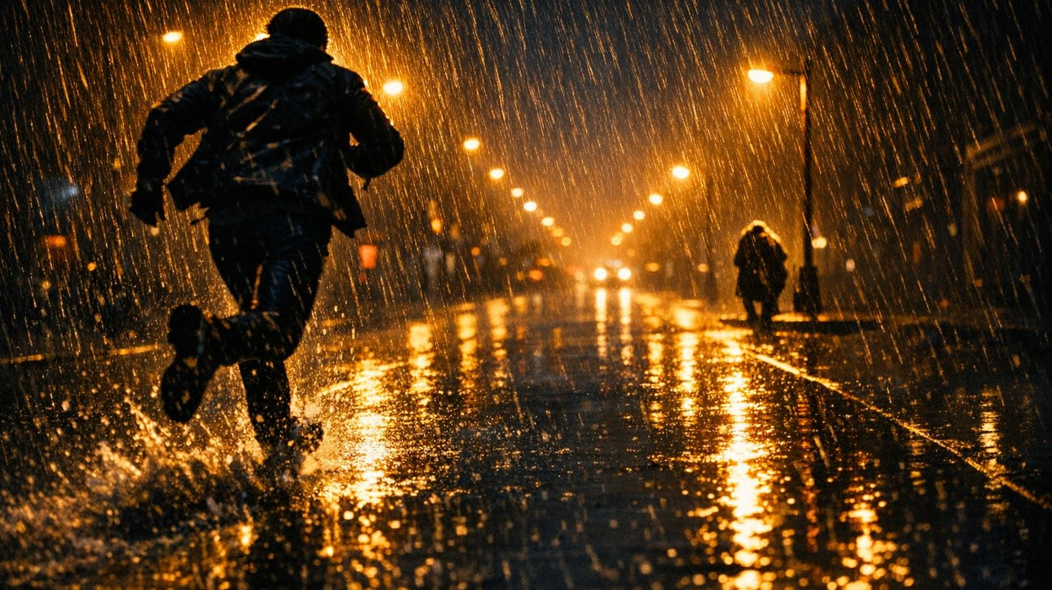
Life Application #2
Love Pursues
Step Toward People
Step Into the Mess

Slide 14
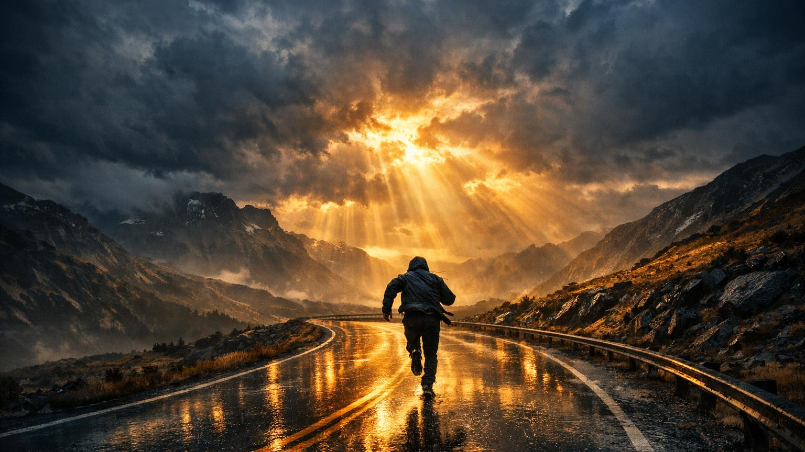
Challenge #2
Who Is God Calling You To Pursue Again?
A Child
A Spouse
A Prodigal

Slide 15
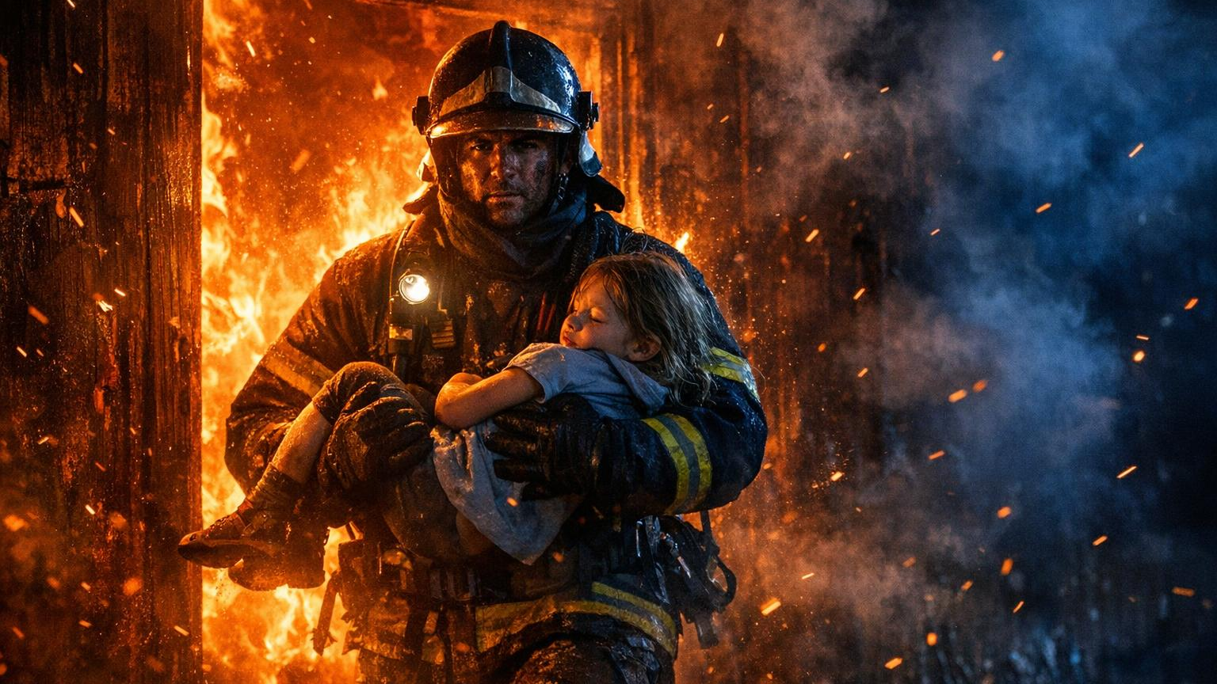
“LAY DOWN HIS LIFE”
Tithēmi = to place down willingly
Love proven by sacrifice

Slide 16
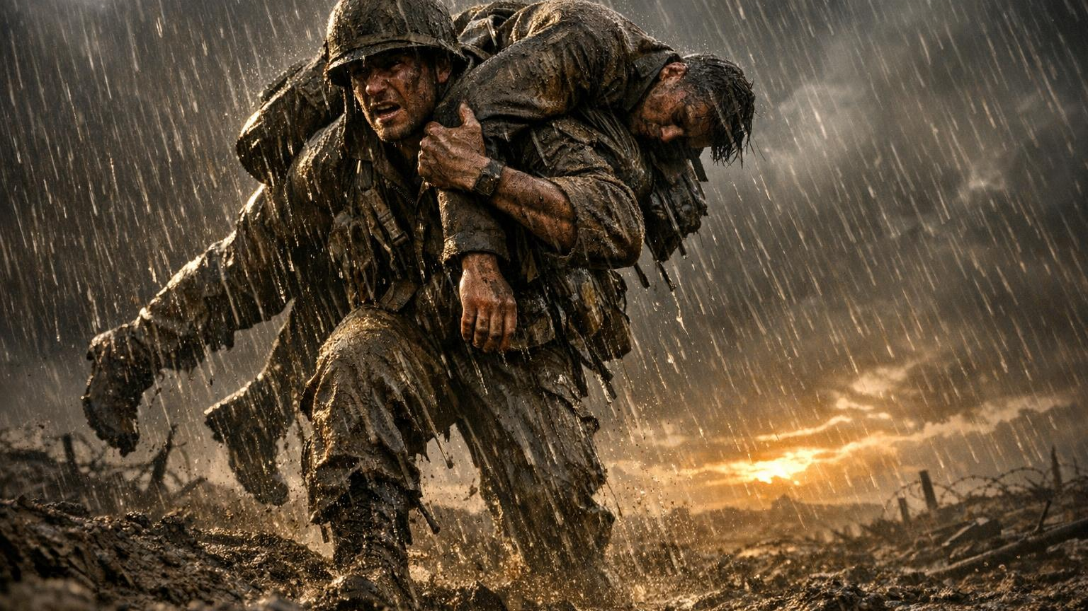
Life Application #3
Love Lays Something Down
Not Feelings
Sacrifice

Slide 17

DEEP CHALLENGE #3
WHAT MUST YOU LAY DOWN?
Pride
Control
Fear

Slide 18
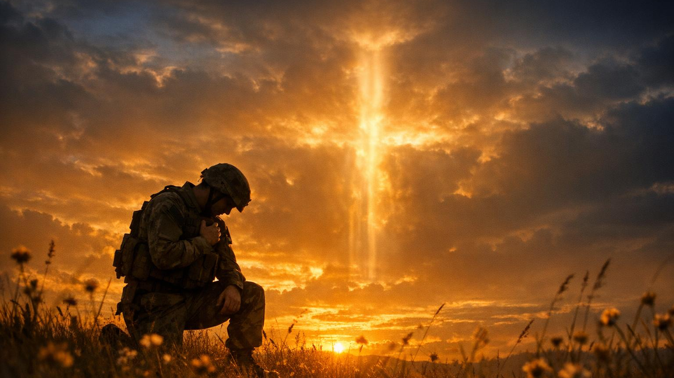
SACRIFICE SPEAKS
Jesus’ sacrifice speaks salvation
Soldiers’ sacrifice speaks freedom
Everyday sacrifice speaks love

Slide 19

EXAMPLE #1: JESUS
THE LOVE THAT REDEEMS
Loved us at our worst
Died for us in sin
Rose for us in power

Slide 20
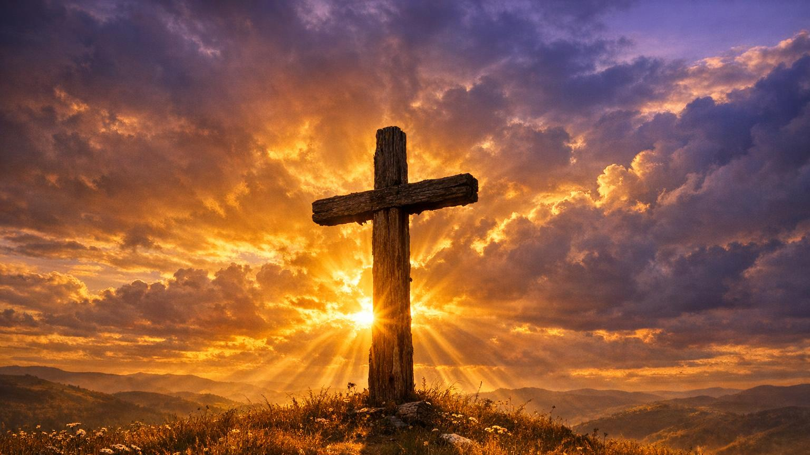
LIFE APPLICATION #4
STOP TRYING TO EARN WHAT JESUS PAID FOR

Slide 21
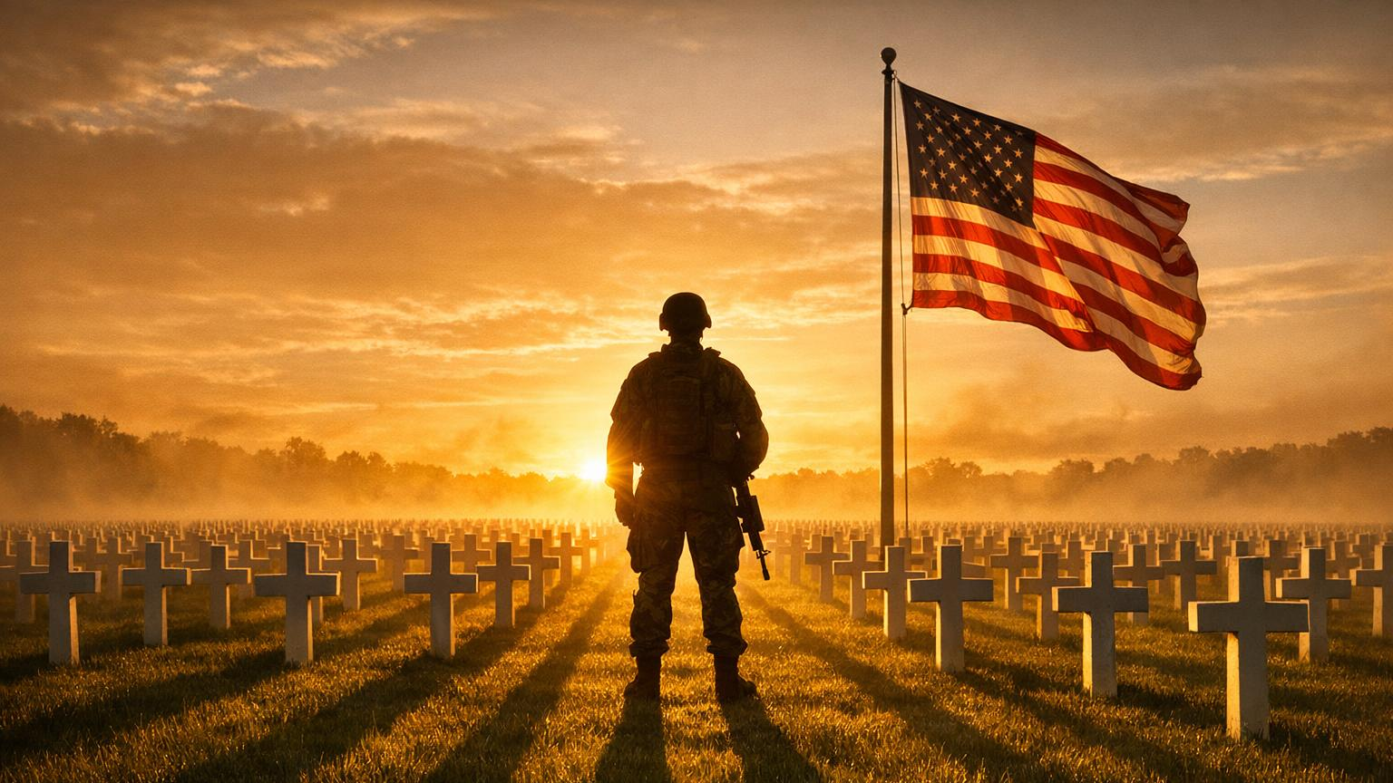
EXAMPLE #2: SOLDIERS
THE LOVE THAT PROTECTS
Sacrifice comfort
Sacrifice safety
Sacrifice self

Slide 22
LIFE APPLICATION #5
LIVE WORTHY OF THEIR SACRIFICE

Slide 23
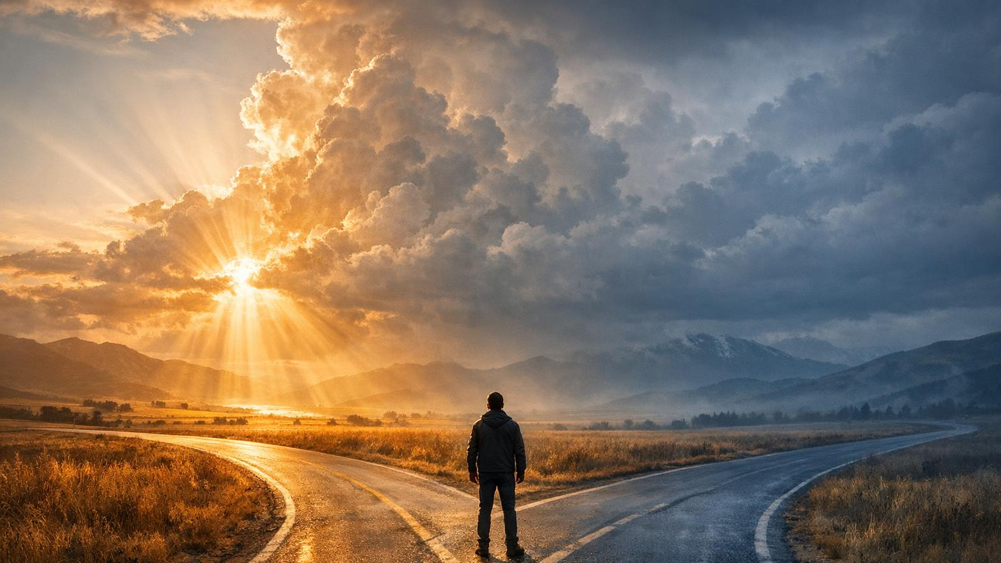
DEEP CHALLENGE #5
ARE YOU USING FREEDOM FOR GOD OR SELF?

Slide 24
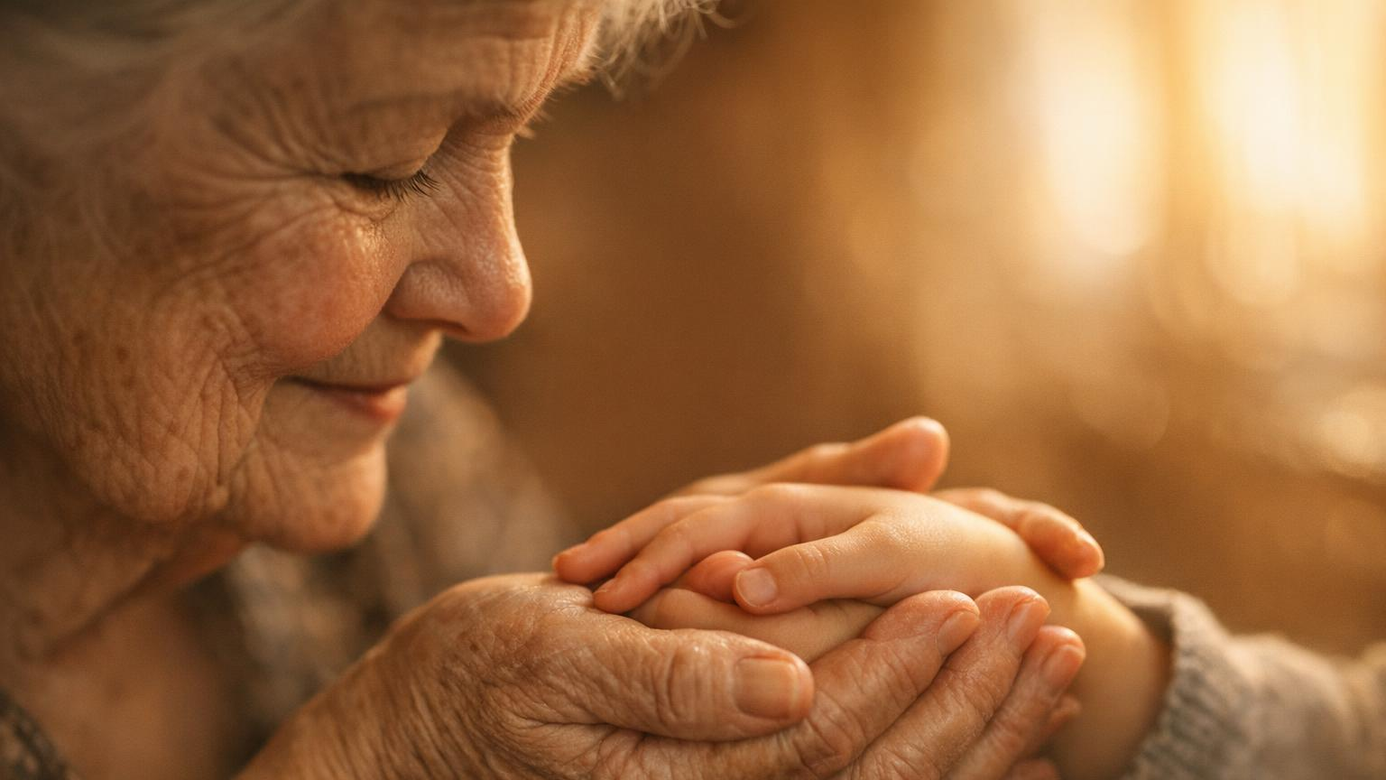
EXAMPLE #3: EVERYDAY PEOPLE
THE LOVE THAT SUSTAINS
Parents
Caregivers
Servants
Quiet heroes

Slide 25
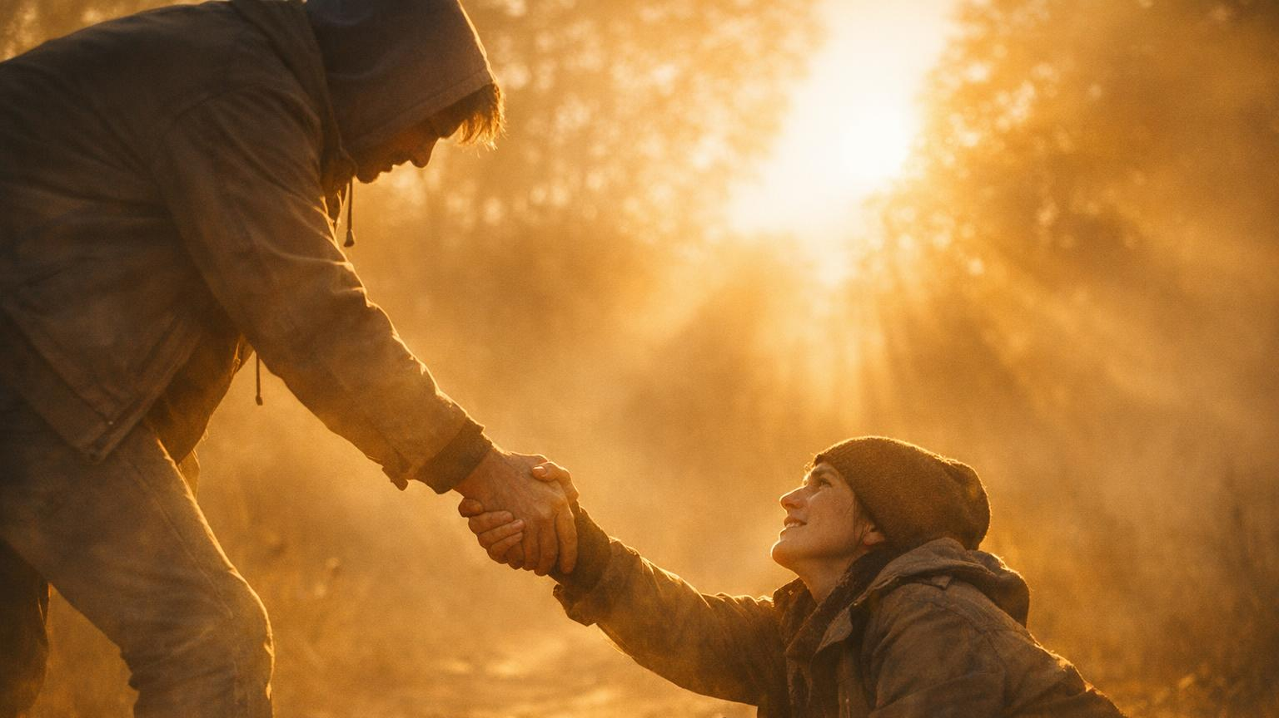
LIFE APPLICATION #6
BE A QUIET HERO FOR SOMEONE

Slide 26
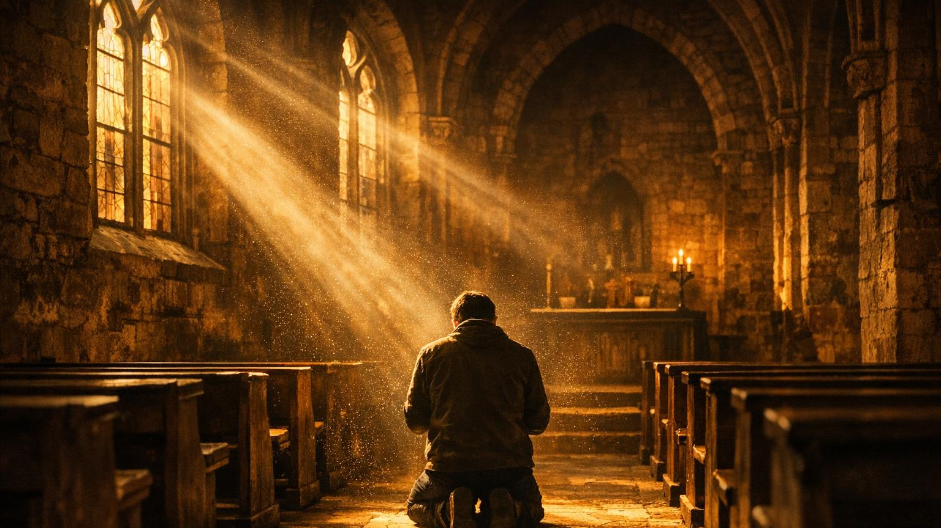
DEEP CHALLENGE #6
WHERE IS GOD CALLING YOU TO BE FAITHFUL?

Slide 27

SACRIFICE IS SEED
What you lay down, God lifts up
What you surrender, God strengthens
What you release, God redeems

Slide 28
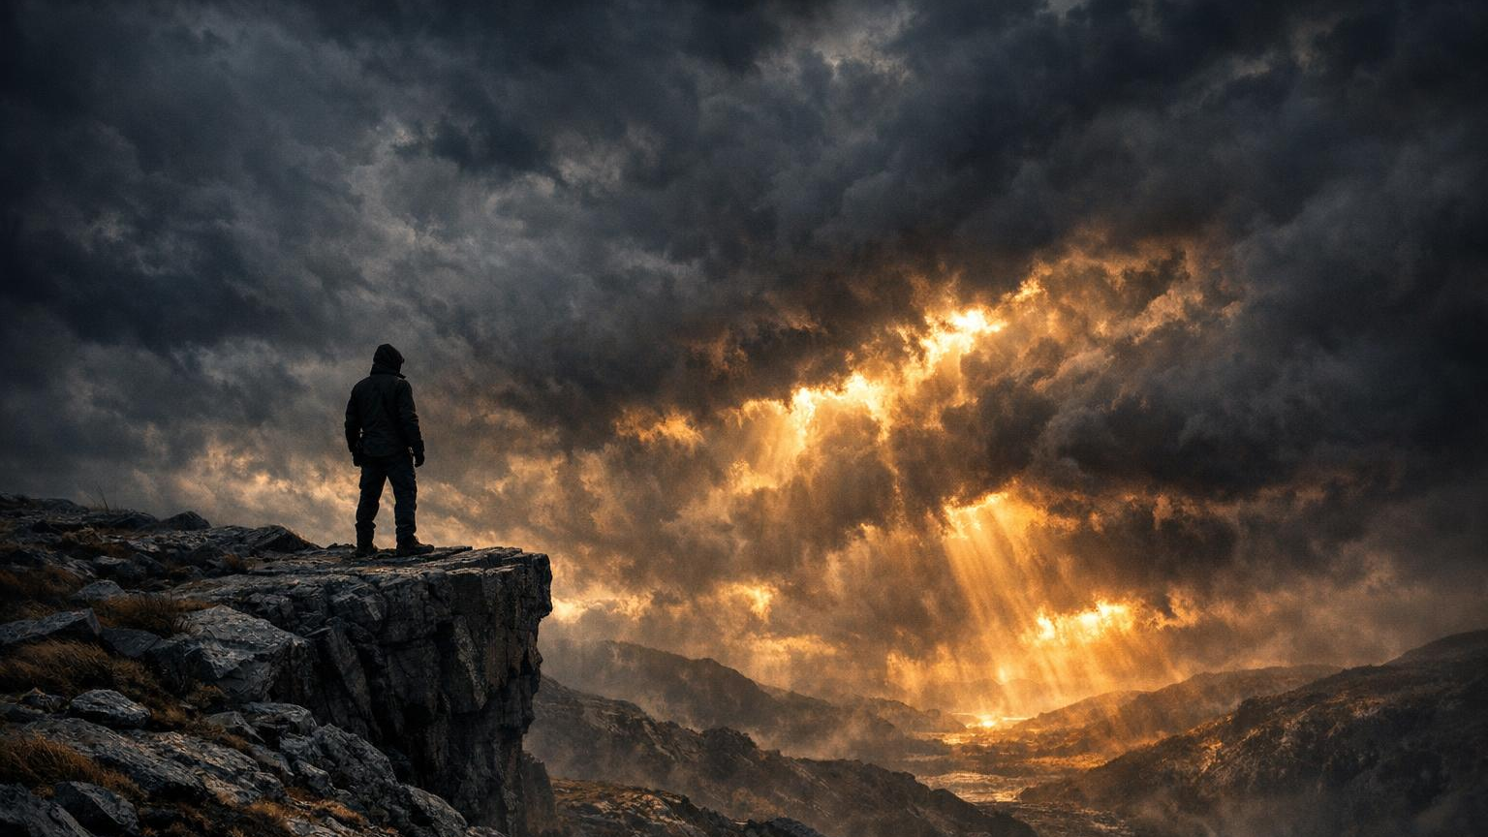
LIFE APPLICATION #7
YOUR SACRIFICE TODAY IS TOMORROW’S BREAKTHROUGH

Slide 29
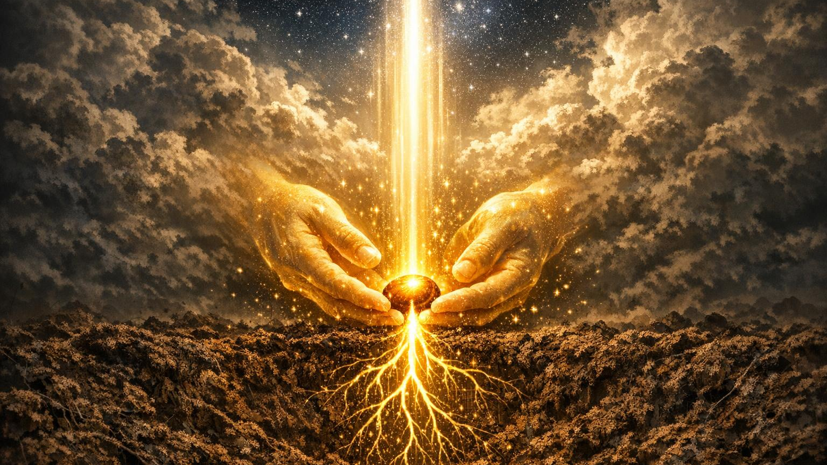
DEEP CHALLENGE #7
WHAT SEED IS GOD ASKING YOU TO PLANT?

Slide 30

DECLARATIONS
SPEAK THIS OVER YOUR LIFE
I Choose Love That Costs Something
I Choose Courage Over Comfort
I Choose Faith Over Fear
I Choose Surrender Over Self‑will

Slide 31
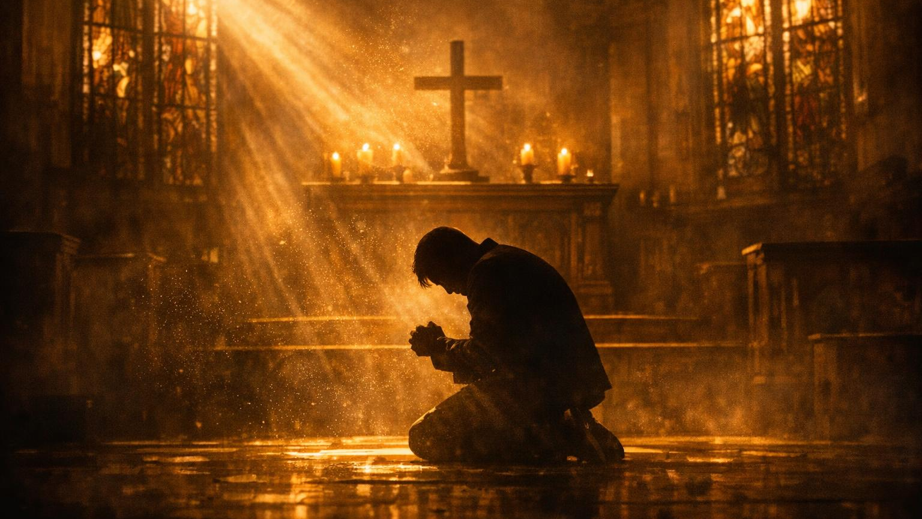
ALTAR CALL — THE ALTAR OF SACRIFICE
If you’re weary — come.
If you’re tangled — come.
If you’re wounded — come.
If you’re fighting alone — come.
If you’re ready to lay something down — come.
And if you need salvation —
The greatest sacrifice was made for you

Slide 32
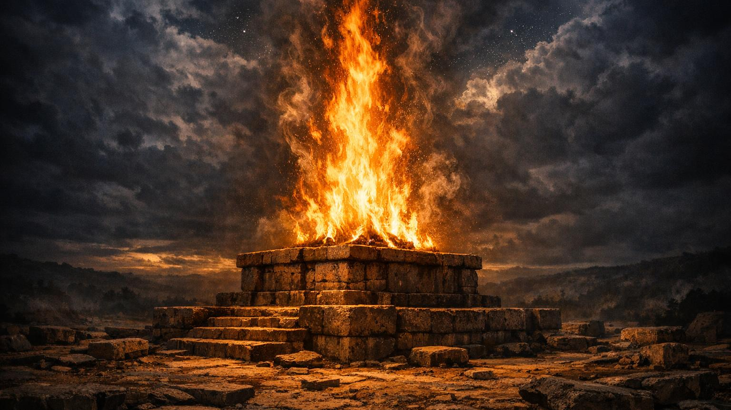
ALTAR CALL
THE ALTAR OF SACRIFICE
Lay it down
Let God lift you up
Receive His love

Slide 33
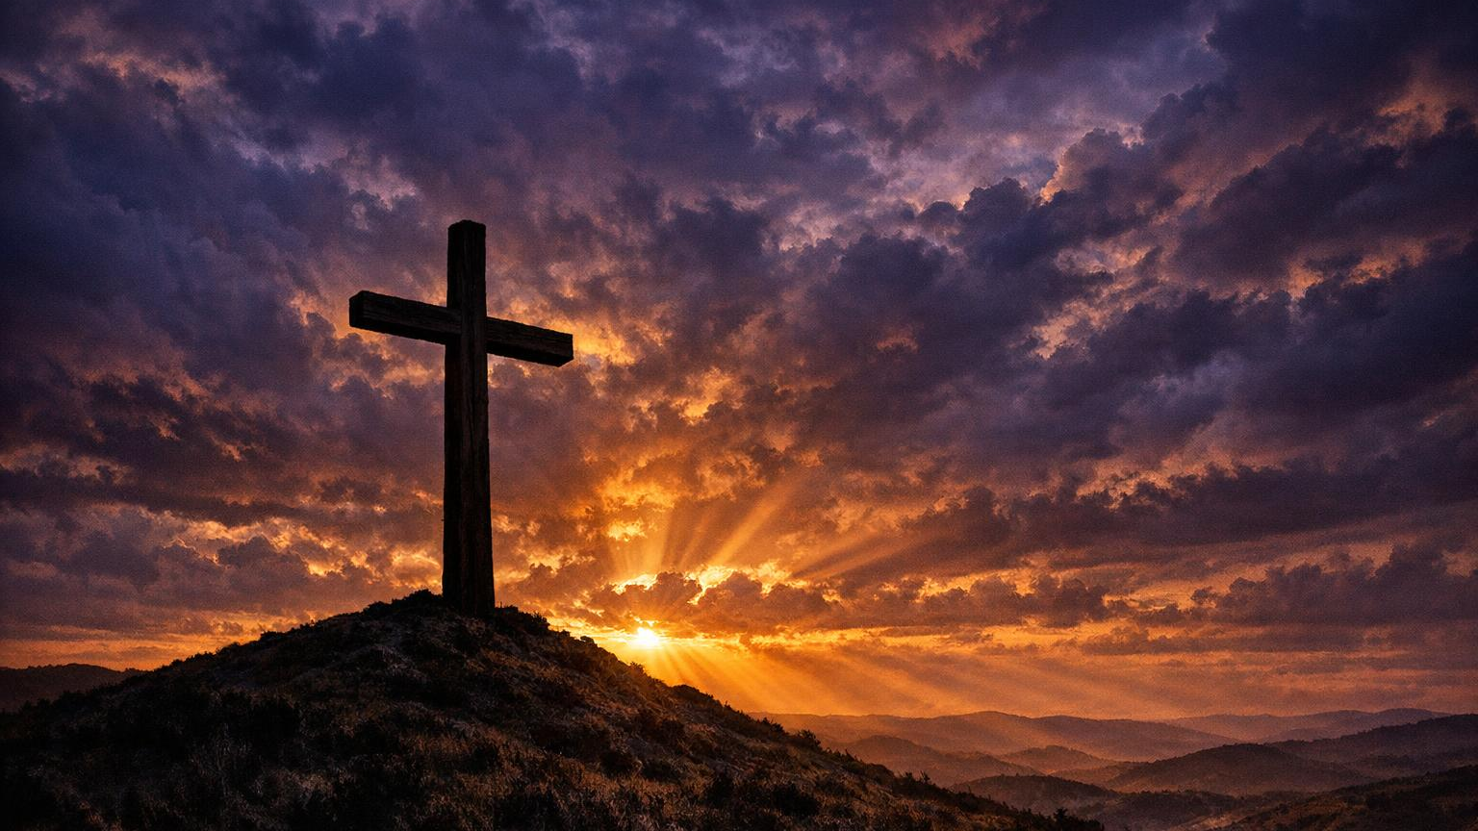
CLOSING DECLARATION
“NO GREATER LOVE —
AND THAT LOVE IS YOURS TODAY.”

Slide 36
"Yes, Brandon, what is it?" asked the teacher.
"I don't want to alarm you, Miss Davis, but my dad said if I don't get better grades, someone was going to be in big trouble."

