Slide 1
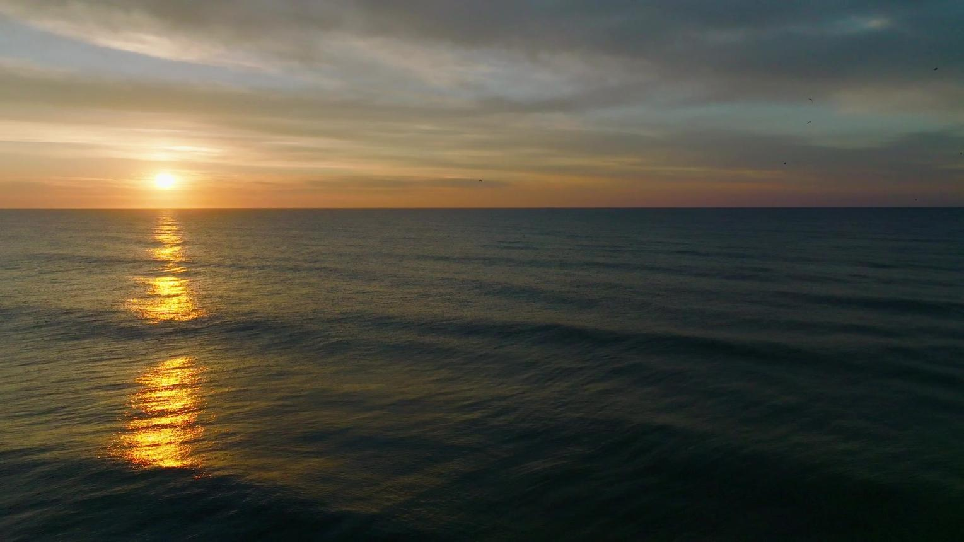
Edward Christian Church
5/31/2026

Slide 2
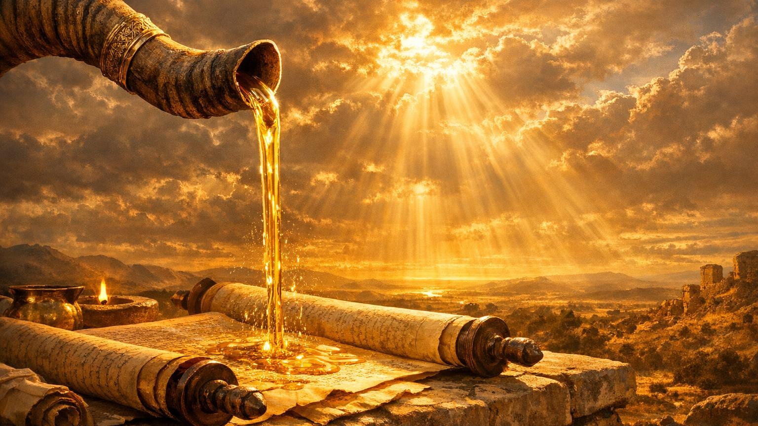
THE TURNAROUND ANOINTING
A Message of Joy, Hope & Divine Reversal
Psalm 126

Slide 3
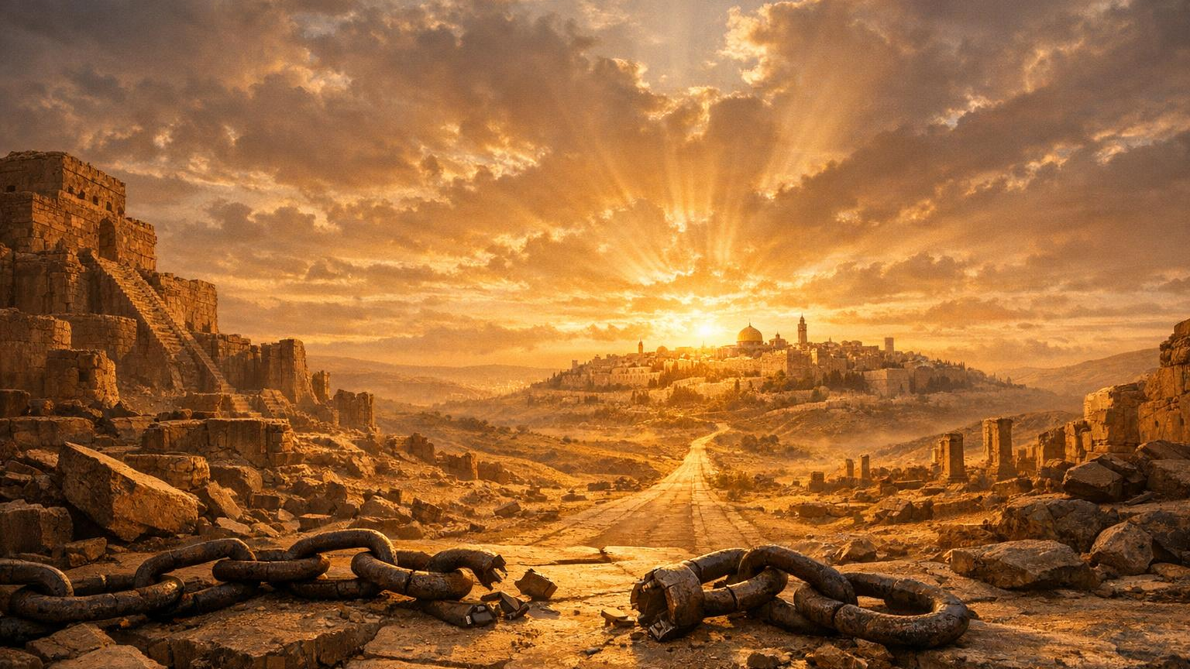
WHY THIS PSALM MATTERS
Written after 70 years of Babylonian captivity
Israel returning home
A nation experiencing divine reversal
A song of restoration, joy, and freedom

Slide 4
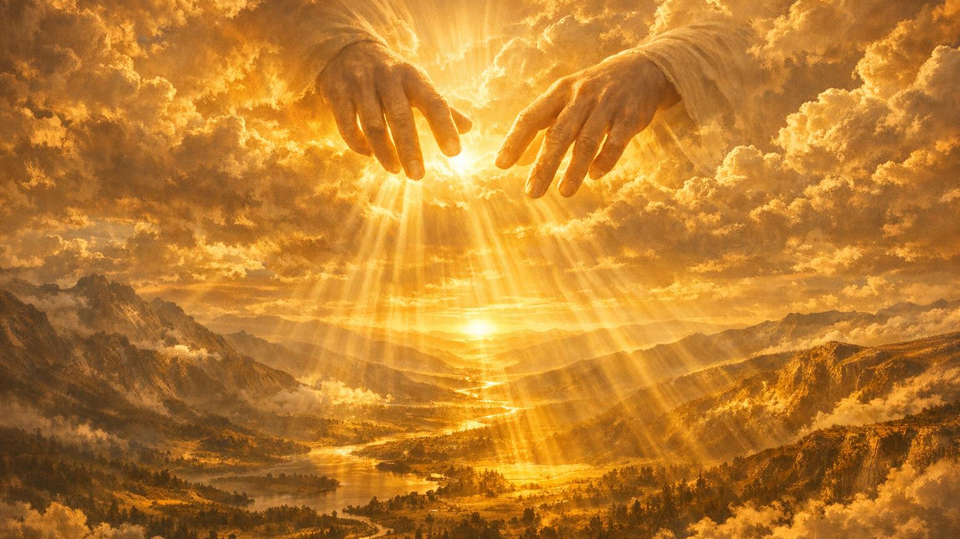
The Turnaround Anointing Begins with God
WHEN GOD RESTORES
Psalm 126:1
God Initiates the Turnaround
God Orchestrates the Turnaround
God Completes the Turnaround

Slide 5
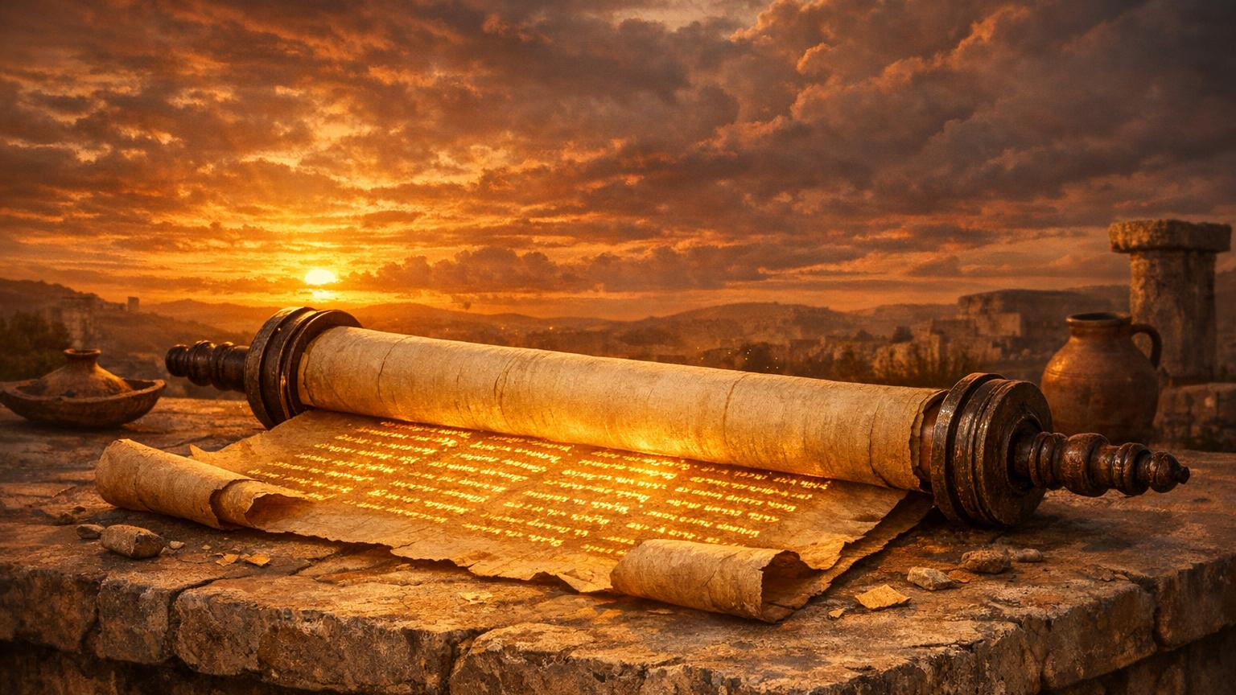
EXEGESIS: “RESTORED”
Hebrew Means:
To Reverse
To Bring Back
To Revive
To Return to Rightful Place

Slide 6
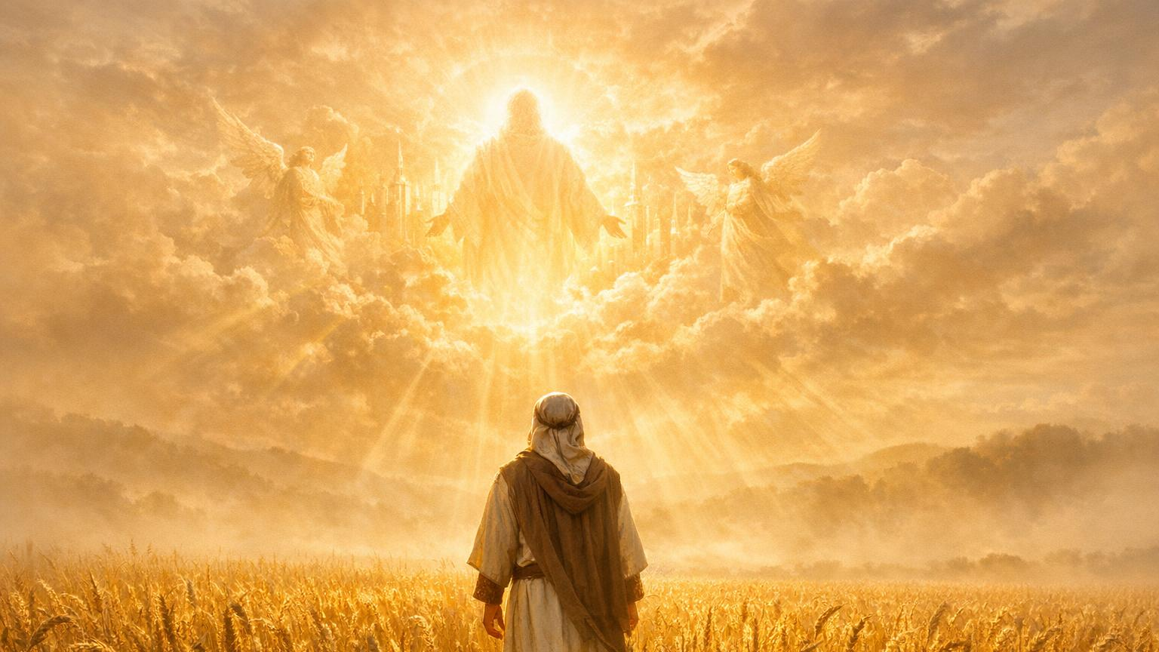
LIKE THOSE WHO DREAMED
Psalm 126:1b — “When the LORD restored the fortunes of Zion, we were like those who dreamed.”
Joy‑Shocked
Overwhelmed
Living in Answered Prayer

Slide 7
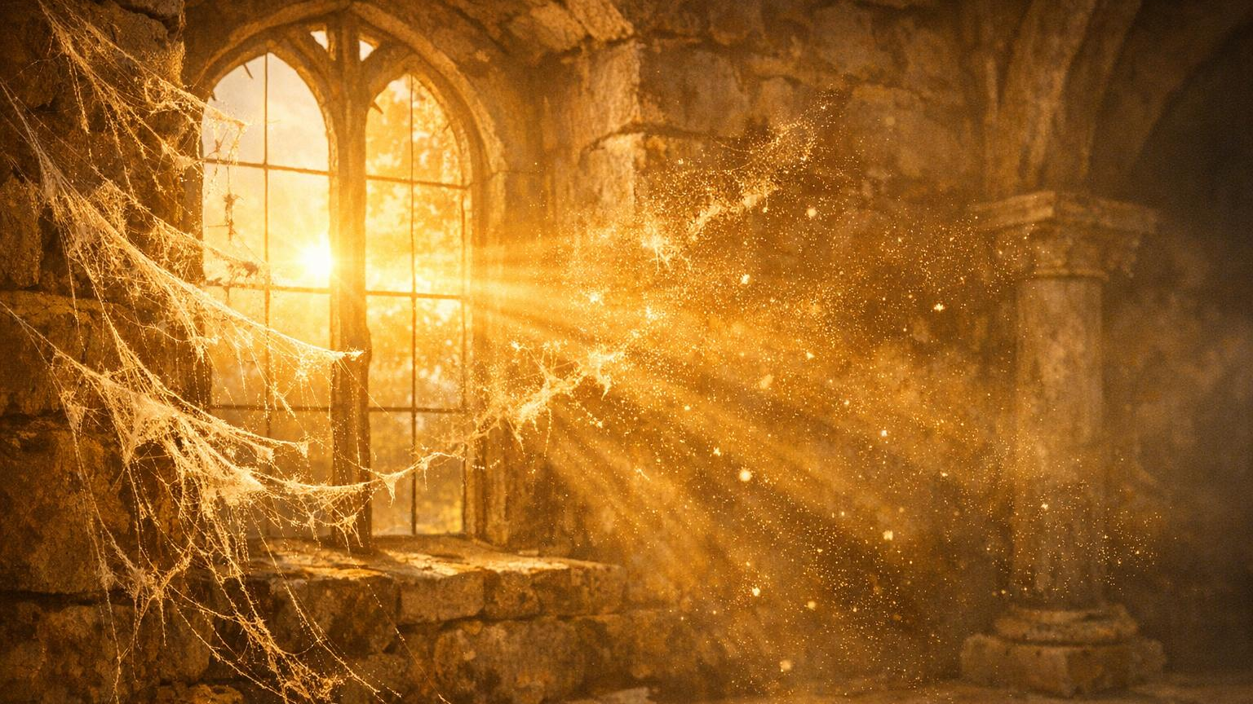
LIGHT‑HEARTED TRUTH
Some of us haven’t dreamed in so long
our imagination has cobwebs on it.

Slide 8
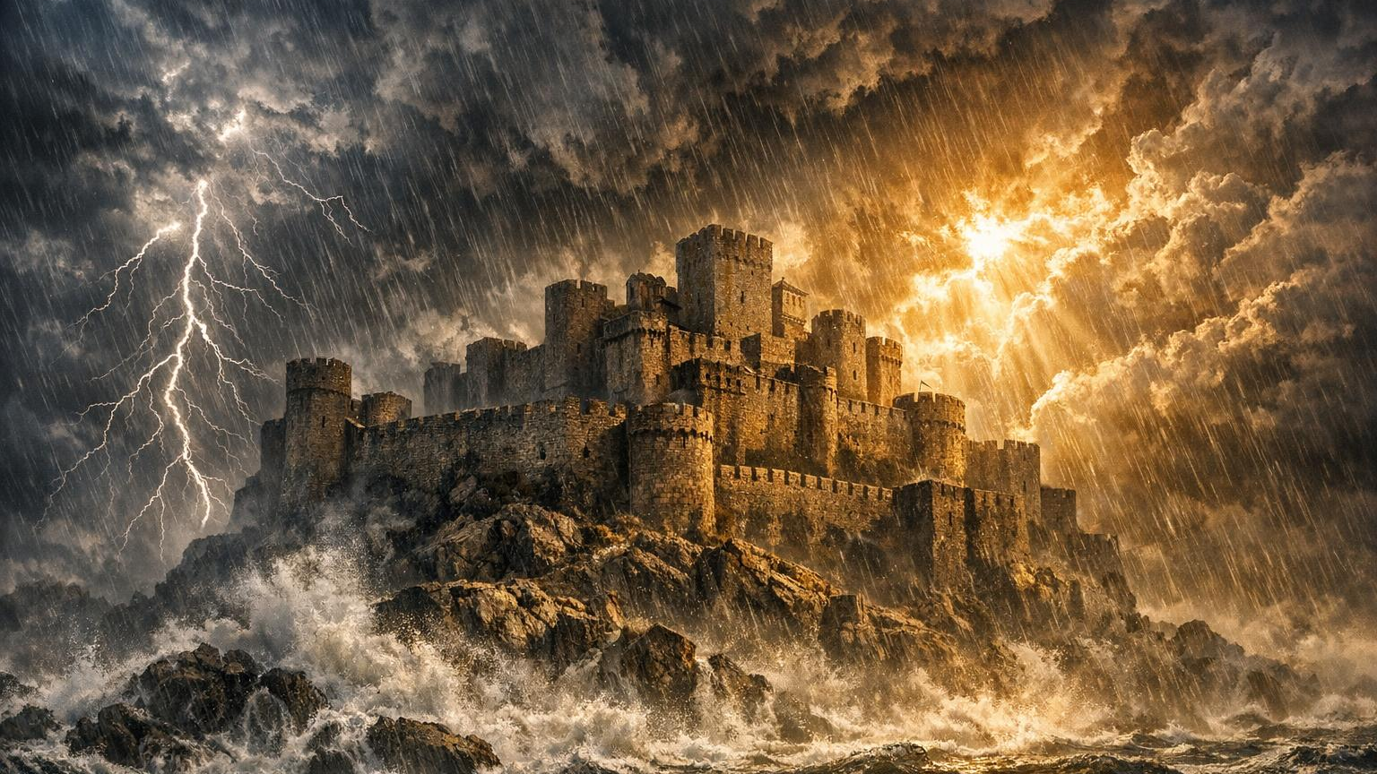
DECLARATION
If God Started It…
…Nothing Can Stop It.

Slide 9
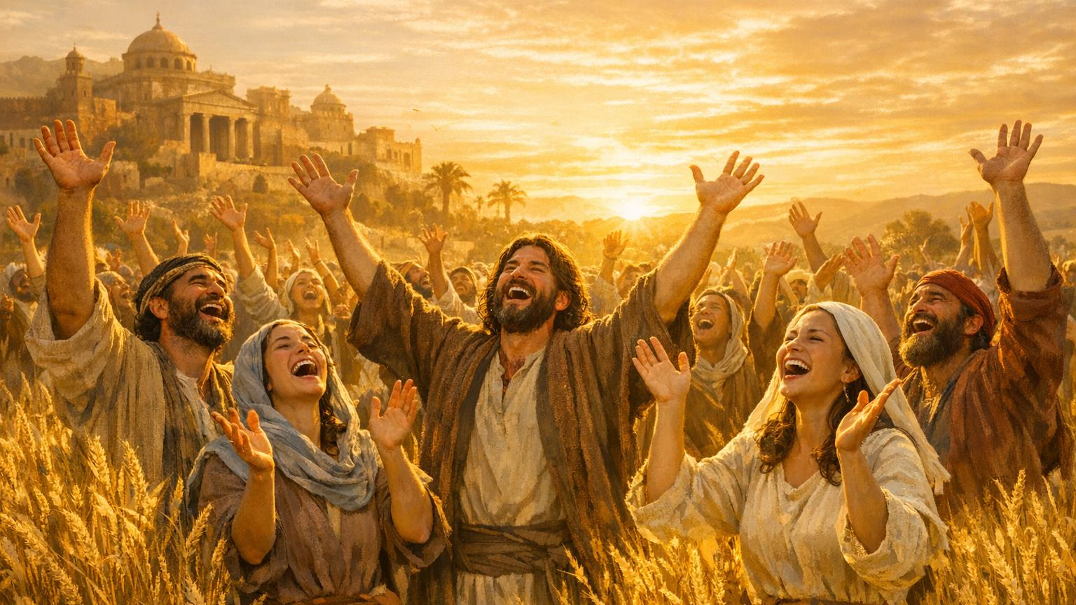
“Our mouths were filled with laughter…” Psalm 126:2
JOY IS THE EVIDENCE OF A TURNAROUND

Slide 10
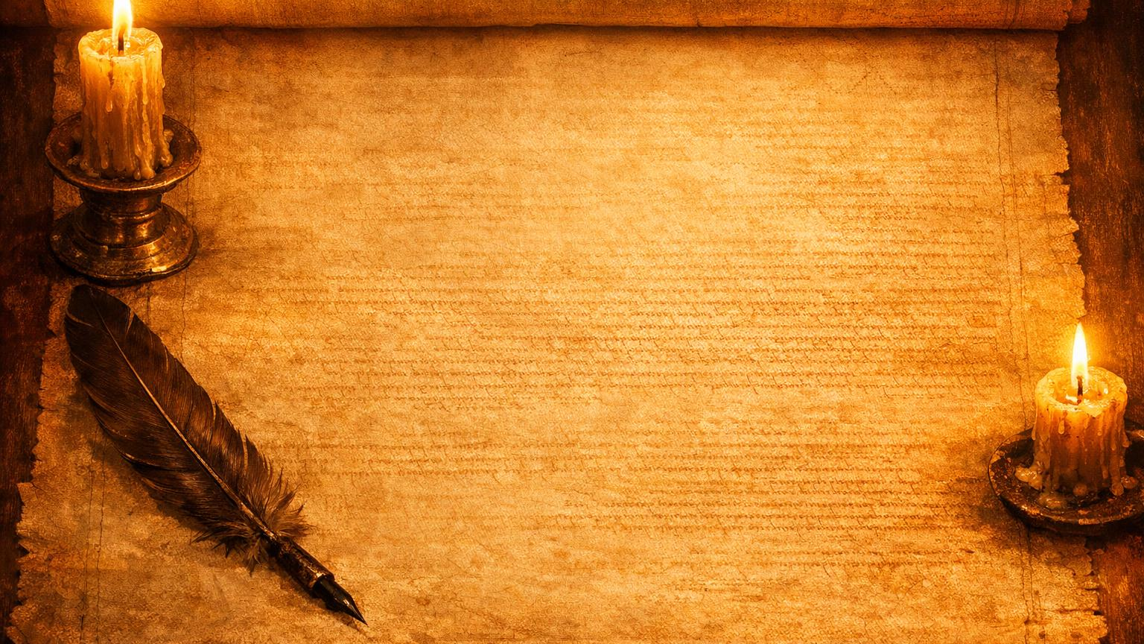
HEBREW WORD: Laughter
Loud Laughter
Free Laughter
Turnaround Laughter

Slide 11

JOY IS A MOVE OF GOD
Joy is Not a Mood —
Joy is a Move of God.

Slide 12
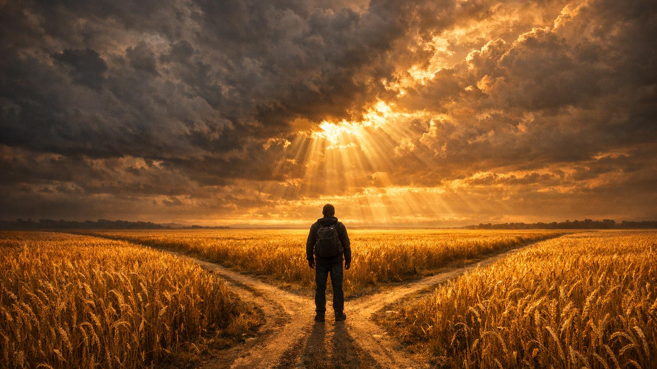
CHALLENGE
Where Has Heaviness Blocked Your Turnaround?
Stress
Schedules
Struggles
Situations

Slide 13
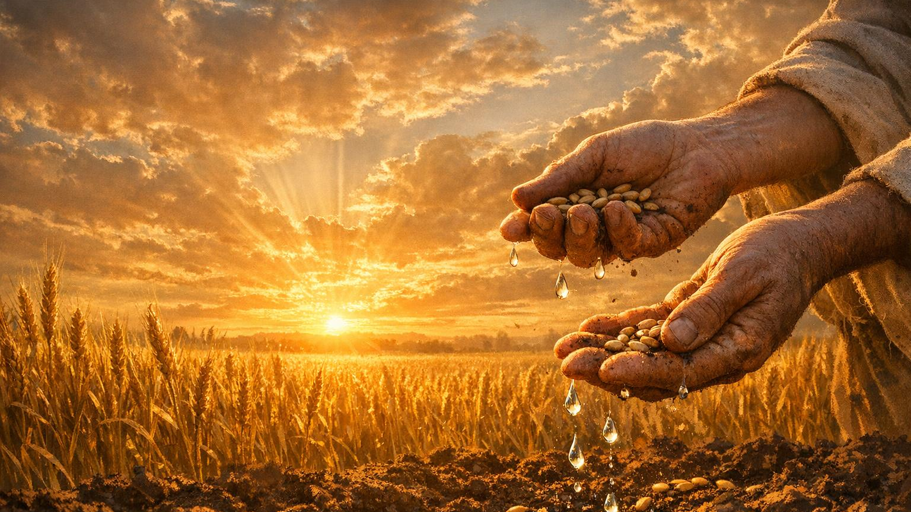
PSALM 126:5
“Those who sow in tears
will reap with shouts of joy.”
TEARS ARE THE SEEDS OF TURNAROUND

Slide 14
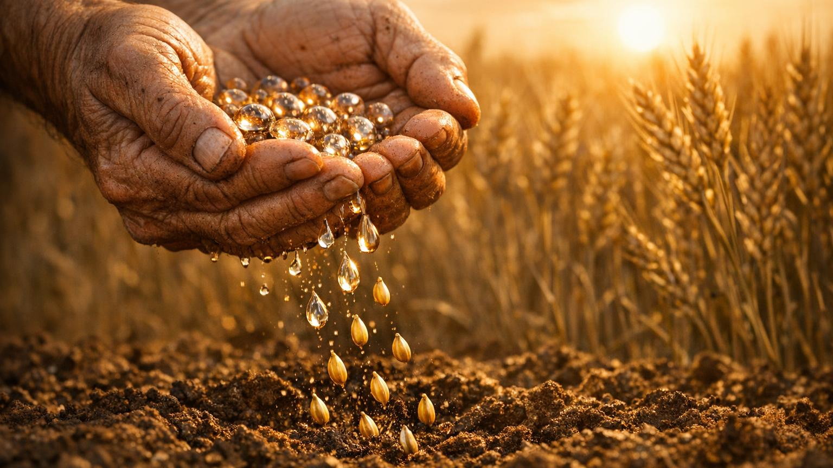
WHAT TEARS MEAN
Tears =
Sowing
Trusting
Believing
Birthing a Turnaround

Slide 15
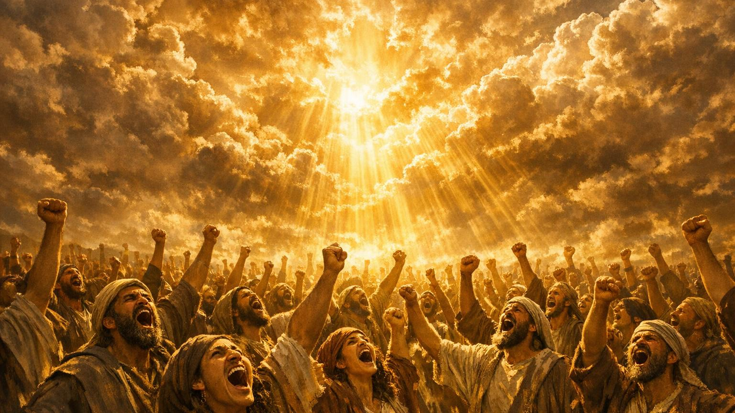
HEBREW WORD: Joy
Means:
Triumphant Shout
Victory Cry
Turnaround Praise

Slide 16
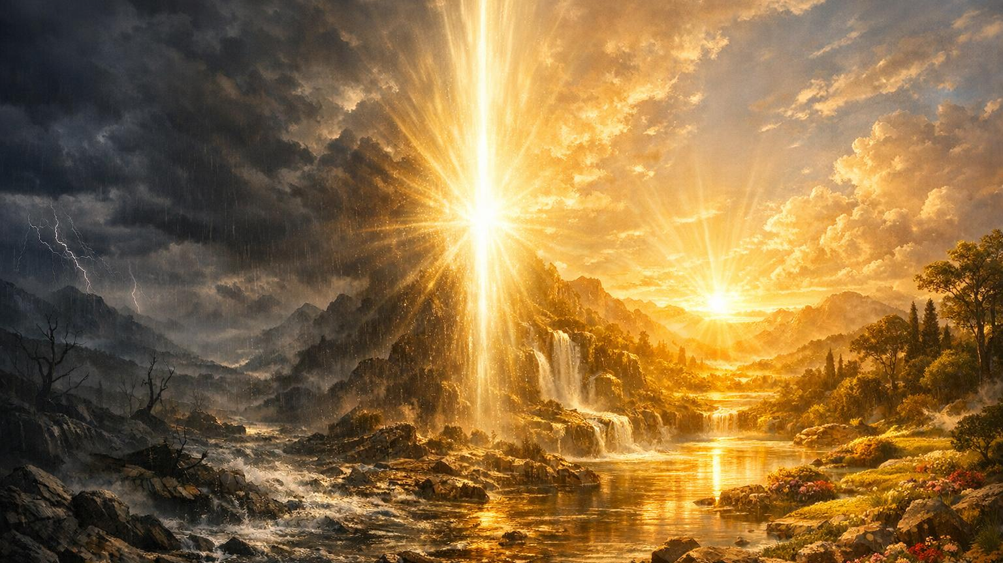
DECLARATION
God is Turning:
Tears → Triumph
Pain → Praise
Worry → Worship

Slide 17
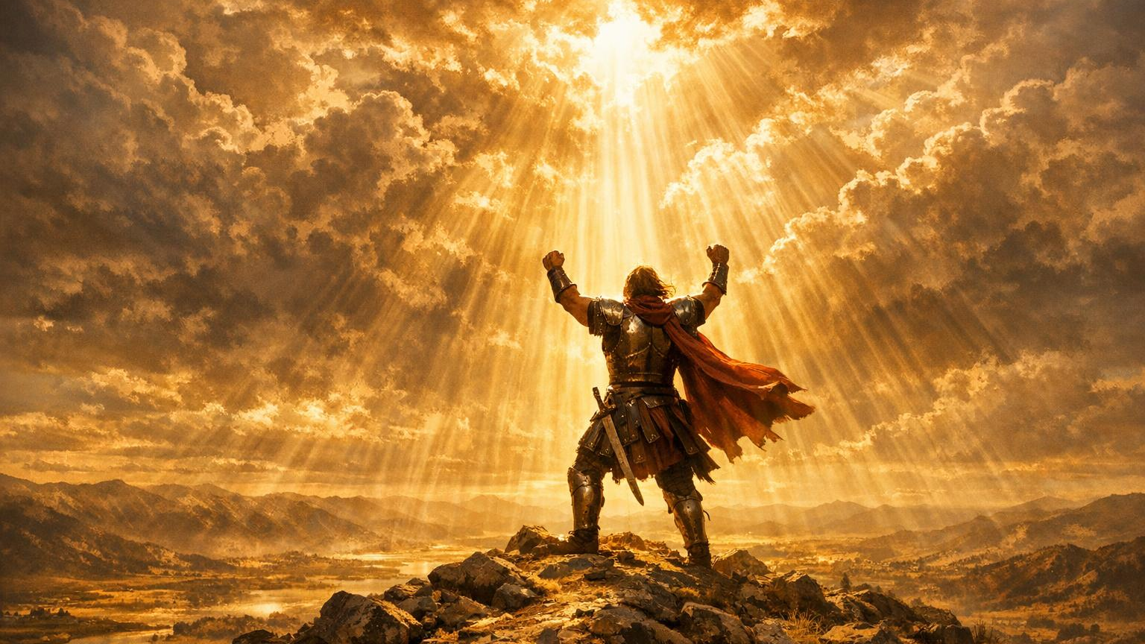
JOY IS THE POWER OF THE TURNAROUND ANOINTING
NEHEMIAH 8:10
“The joy of the Lord is your strength.”

Slide 18
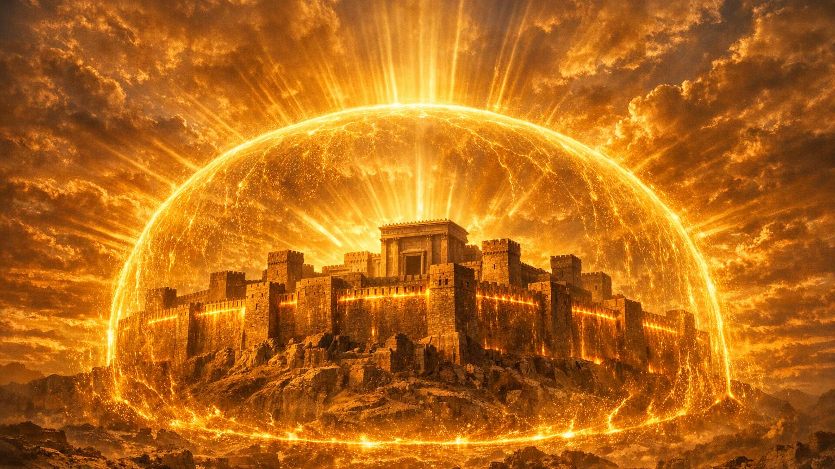
JOY = TURNAROUND STRENGTH
Joy is:
Fortress
Defense
Protection
Turnaround Fuel

Slide 19
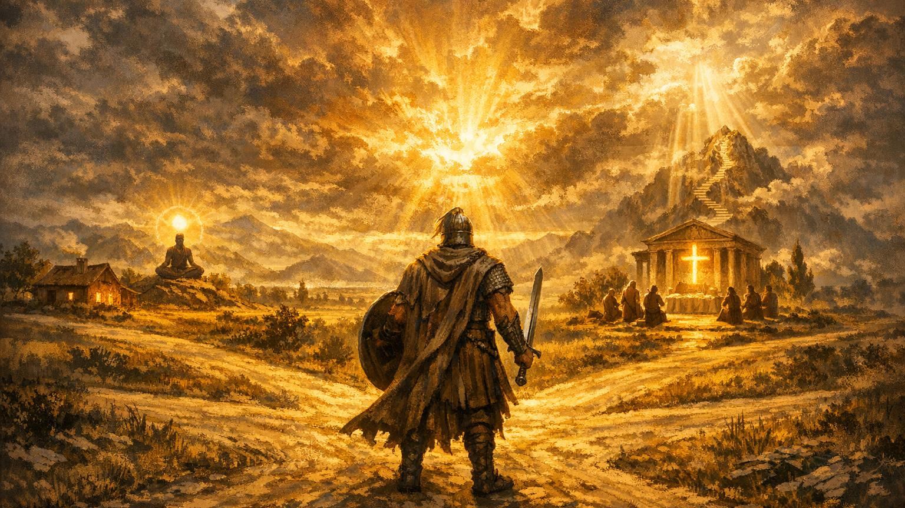
CHALLENGE
Where Do You Need To Fight For Your Turnaround?
Home
Mind
Worship
Expectations

Slide 20
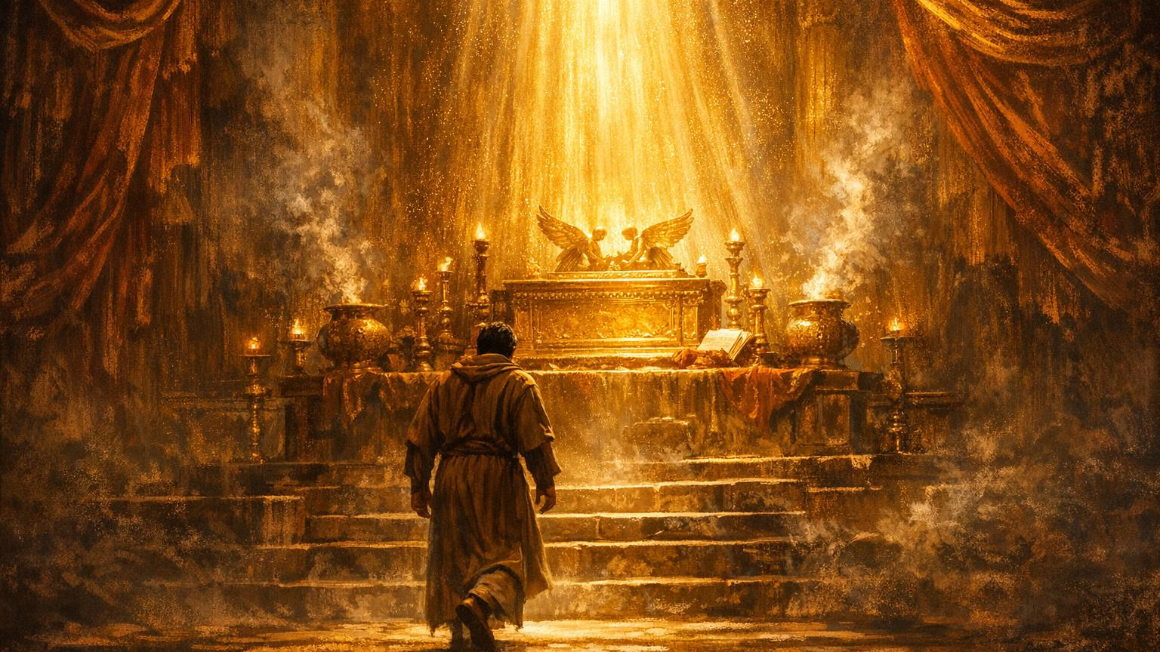
STEP INTO THE TURNAROUND ANOINTING
If you need a turnaround:
Joy
Hope
Strength
Restoration
Come — This is a Turnaround Altar

Slide 21
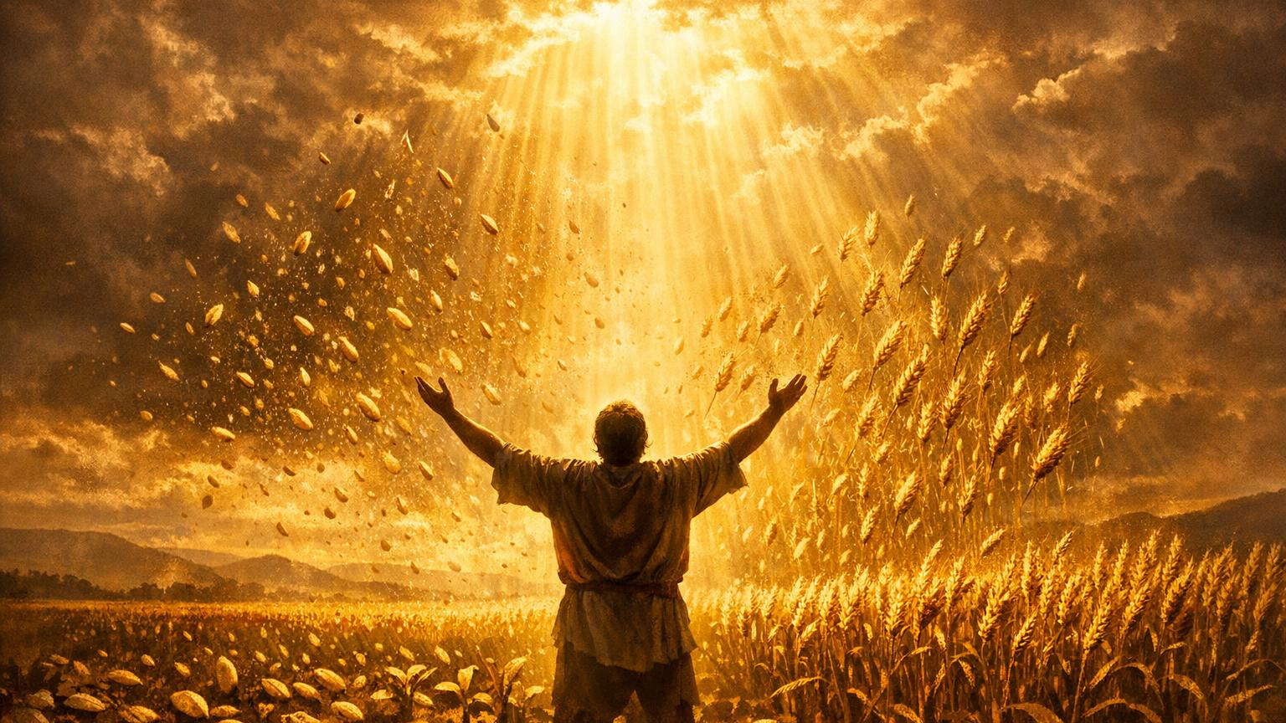
TURNAROUND DECLARATION
“The Lord is restoring me!
My dreams are waking up!
My joy is returning!
My tears are seeds!
This is my turnaround season!
This is my Psalm 126 season!”

Slide 22
Edward Community Church
5/31/2026

